Slide 1
AirSim
Bhawana Chhaglani

Slide 2
Requirements ...
Developing and testing algorithms for autonomous vehicles is expensive and time consuming process.
Large amount of annotated training data is needed for Deep Learning Applications.

Slide 3
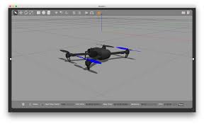
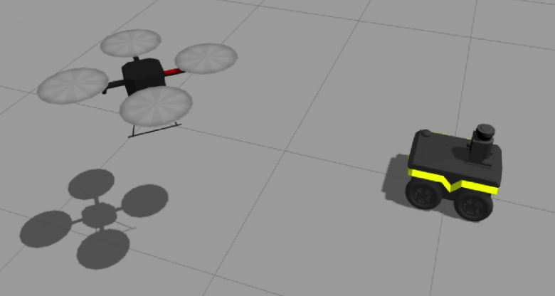
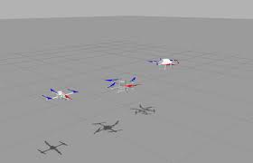
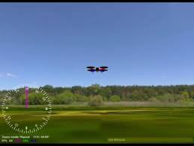
Current State of UAV Simulation
Gazebo
Hector
jMavSim
RotorS

Slide 4
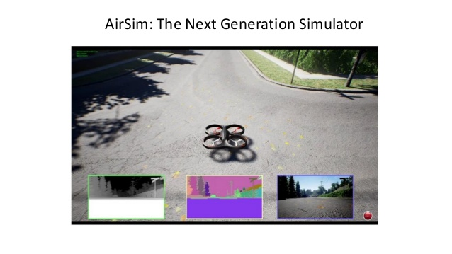

Slide 5
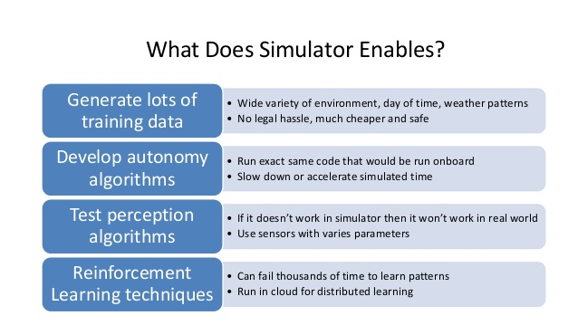

Slide 6
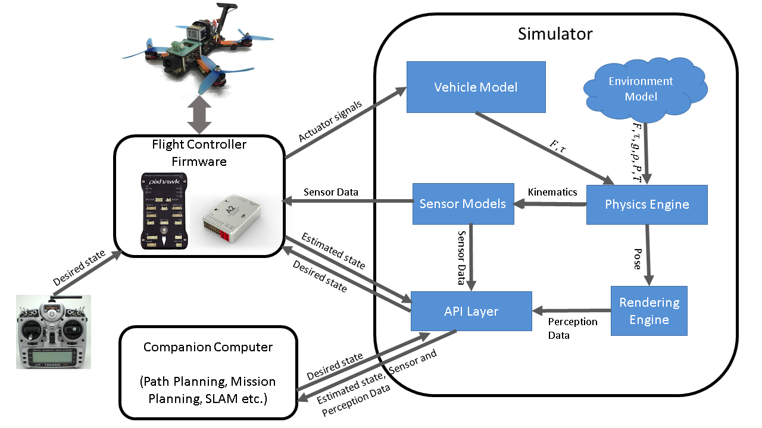
Architecture

Slide 7
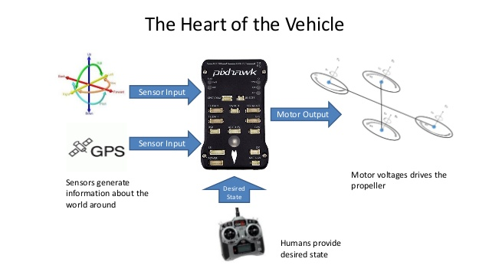
Flight Controller Firmware

Slide 8
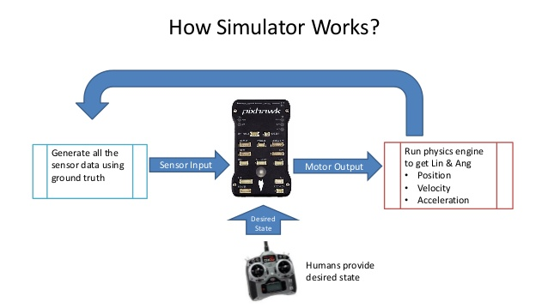

Slide 9
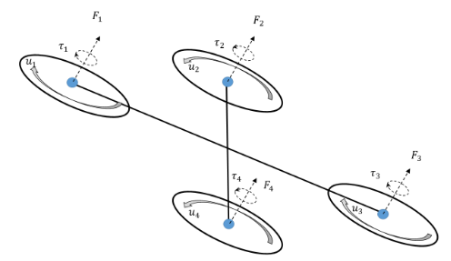
The Vehicle Model

Slide 10

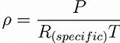
The Environment Model
Gravity
Magnetic Field
Air Pressure & Density

Slide 11
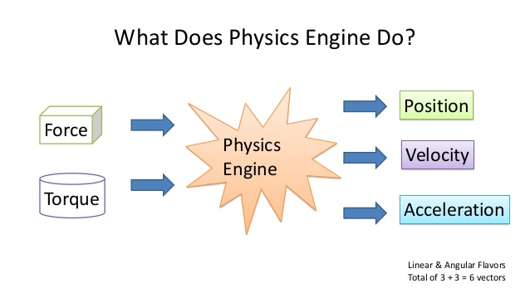

Slide 12
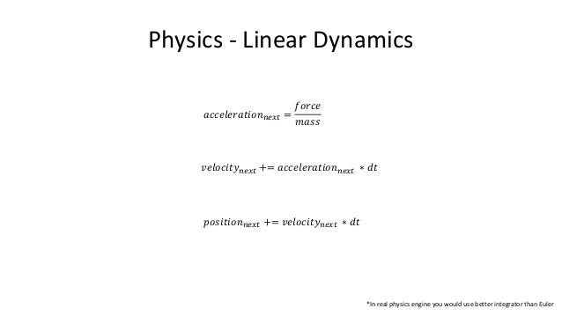

Slide 13
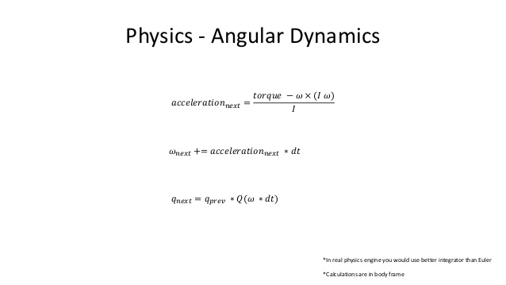

Slide 14
The Sensor Model
Barometer
IMU - Gyroscope + Accelerometer
Magnetometer

Slide 15
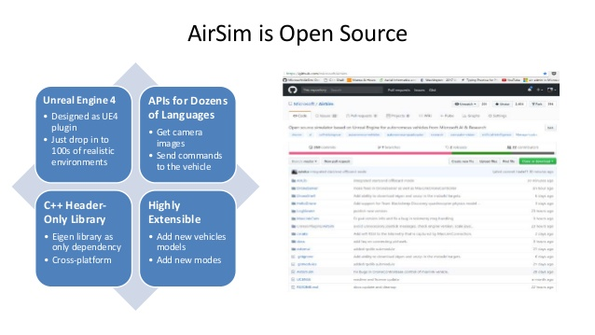
Capabilities
APIs
Get Camera Images
Send Commands to the vehicle
Highly Extensible
Add new vehicle models
Add new modes
Add new Sensors

Slide 16
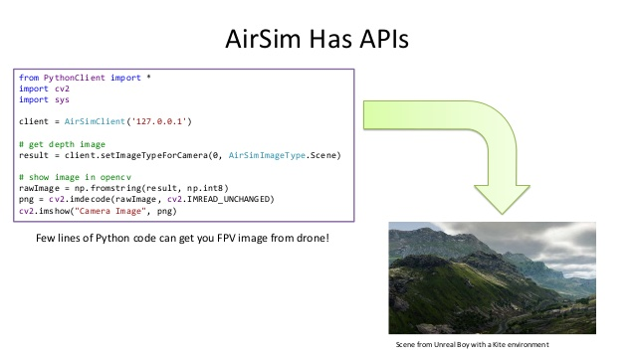
Getting Camera Images

Slide 17
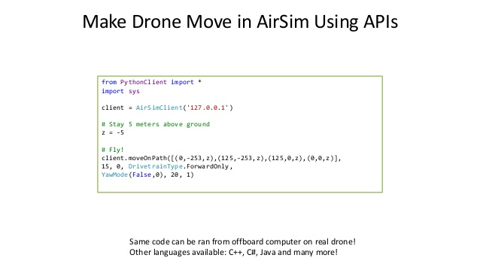
Sending Commands to the Drone

Slide 18
Architecture

Slide 19
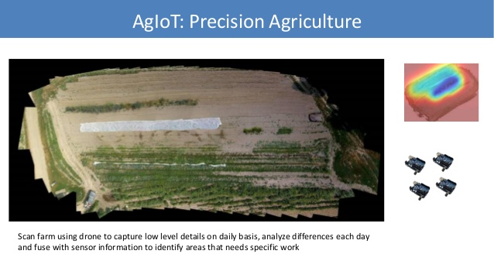
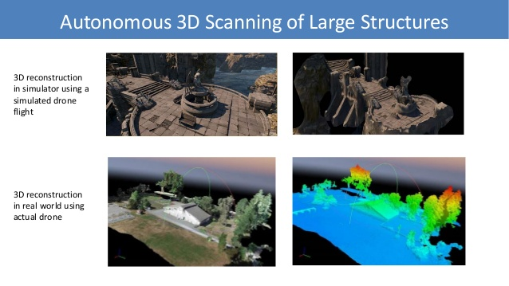
Applications

Slide 20
THANK YOU

