Slide 1

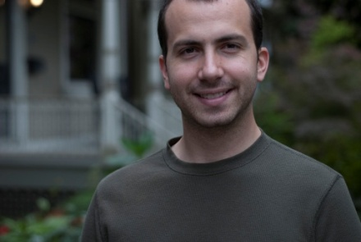



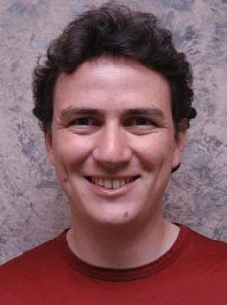
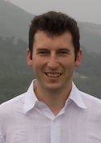
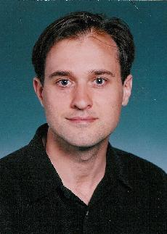


A New Parallel Framework for Machine Learning
Joseph Gonzalez
Joint work with
Yucheng
Low
Aapo
Kyrola
Danny
Bickson
Carlos
Guestrin
Alex
Smola
Guy
Blelloch
Joe
Hellerstein
David
O’Hallaron

Slide 2
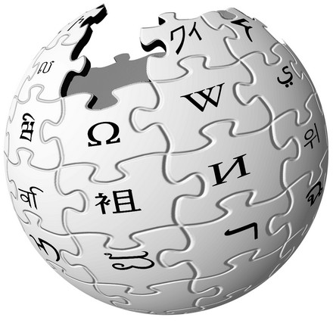



In ML we face BIG problems
750 Million
Facebook Users
24 Million
Wikipedia Pages
6 Billion
Flickr Photos
48 Hours a Minute
YouTube

Slide 3
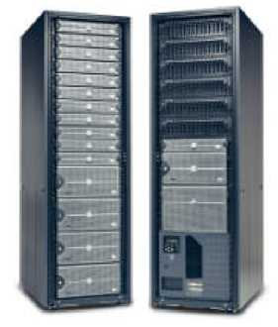
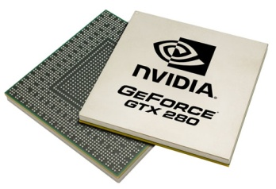
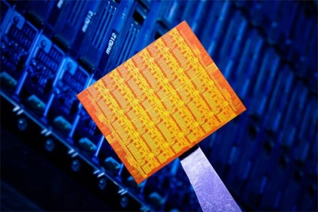
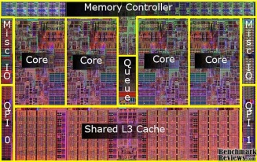

Parallelism: Hope for the Future
Wide array of different parallel architectures:
New Challenges for Designing Machine Learning Algorithms:
Race conditions and deadlocks
Managing distributed model state
New Challenges for Implementing Machine Learning Algorithms:
Parallel debugging and profiling
Hardware specific APIs
GPUs
Multicore
Clusters
Mini Clouds
Clouds

Slide 4
How will we design and implement parallel learning systems?

Slide 5
Threads, Locks, & Messages
We could use ….
“low level parallel primitives”

Slide 6
Threads, Locks, and Messages
ML experts repeatedly solve the same parallel design challenges:
Implement and debug complex parallel system
Tune for a specific parallel platform
Two months later the conference paper contains:
“We implemented ______ in parallel.”
The resulting code:
is difficult to maintain
is difficult to extend
couples learning model to parallel implementation
Graduatestudents

Slide 7
Map-Reduce / Hadoop
... a better answer:
Build learning algorithms on-top of high-level parallel abstractions

Slide 8










MapReduce – Map Phase
CPU 1
4
2
.
3
2
1
.
3
2
5
.
8
1
2
.
9
CPU 2
CPU 3
CPU 4
Embarrassingly Parallel independent computation
No Communication needed

Slide 9
MapReduce – Map Phase
CPU 1
8
4
.
3
1
8
.
4
8
4
.
4
2
4
.
1
CPU 2
CPU 3
CPU 4
1
2
.
9
4
2
.
3
2
1
.
3
2
5
.
8
Image Features

Slide 10
MapReduce – Map Phase
CPU 1
6
7
.
5
1
4
.
9
3
4
.
3
1
7
.
5
CPU 2
CPU 3
CPU 4
1
2
.
9
2
4
.
1
4
2
.
3
8
4
.
3
2
1
.
3
1
8
.
4
2
5
.
8
8
4
.
4
Embarrassingly Parallel independent computation
No Communication needed

Slide 11
MapReduce – Reduce Phase
Attractive Face
Statistics
Ugly Face
Statistics
22
26
.
26
17
26
.
31
CPU 1
CPU 2
1
2
.
9
2
4
.
1
1
7
.
5
4
2
.
3
8
4
.
3
6
7
.
5
2
1
.
3
1
8
.
4
1
4
.
9
2
5
.
8
8
4
.
4
3
4
.
3
Image Features

Slide 12
Map-Reduce for Data-Parallel ML
Excellent for large data-parallel tasks!
Data-ParallelGraph-Parallel
Is there more to
Machine Learning
?
Map Reduce
Feature
Extraction
Cross
Validation
Label Propagation
Lasso
Belief
Propagation
Kernel
Methods
Computing Sufficient
Statistics
Tensor
Factorization
PageRank
Deep Belief
Networks
Neural
Networks

Slide 13
Concrete Example
Label Propagation

Slide 14

Label Propagation Algorithm
Social Arithmetic:
Recurrence Algorithm:
iterate until convergence
Parallelism:
Compute all Likes[i] in parallel
Sue Ann
50% What I list on my profile
40% Sue Ann Likes
10% Carlos Like
80% Cameras
20% Biking
+
40%
I Like:
60% Cameras, 40% Biking
Profile
50%
50% Cameras
50% Biking
Me
Carlos
10%
30% Cameras
70% Biking

Slide 15







Properties of Graph Parallel Algorithms
Dependency
Graph
Factored
Computation
Iterative
Computation
What I Like
What My Friends Like

Slide 16
Map-Reduce for Data-Parallel ML
Excellent for large data-parallel tasks!
Data-ParallelGraph-Parallel
Map Reduce
Map Reduce?
?
Feature
Extraction
Cross
Validation
Label Propagation
Lasso
Belief
Propagation
Kernel
Methods
Computing Sufficient
Statistics
Tensor
Factorization
PageRank
Deep Belief
Networks
Neural
Networks

Slide 17
Why not use Map-Reduce for Graph Parallel Algorithms?

Slide 18







Data Dependencies
Map-Reduce does not efficiently express dependent data
User must code substantial data transformations
Costly data replication
Independent Data Rows

Slide 19
Iterative Algorithms
Map-Reduce not efficiently express iterative algorithms:
Iterations
Data
Data
Data
Data
CPU 1
CPU 1
CPU 1
Data
Data
Data
Data
Data
Data
Data
Data
Slow
Processor
CPU 2
CPU 2
CPU 2
Data
Data
Data
Data
Data
Data
Data
Data
CPU 3
CPU 3
CPU 3
Data
Data
Data
Data
Data
Data
Data
Data
Barrier
Barrier
Barrier

Slide 20
MapAbuse: Iterative MapReduce
Only a subset of data needs computation:
Iterations
Data
Data
Data
Data
CPU 1
CPU 1
CPU 1
Data
Data
Data
Data
Data
Data
Data
Data
CPU 2
CPU 2
CPU 2
Data
Data
Data
Data
Data
Data
Data
Data
CPU 3
CPU 3
CPU 3
Data
Data
Data
Data
Data
Data
Data
Data
Barrier
Barrier
Barrier

Slide 21
MapAbuse: Iterative MapReduce
System is not optimized for iteration:
Iterations
Data
Data
Data
Data
CPU 1
CPU 1
CPU 1
Data
Data
Data
Data
Data
Data
Data
Data
CPU 2
CPU 2
CPU 2
StartupPenalty
Disk Penalty
Startup Penalty
Disk Penalty
Startup Penalty
Data
Data
Disk Penalty
Data
Data
Data
Data
Data
Data
CPU 3
CPU 3
CPU 3
Data
Data
Data
Data
Data
Data
Data
Data

Slide 22
Map-Reduce for Data-Parallel ML
Excellent for large data-parallel tasks!
Data-ParallelGraph-Parallel
Map Reduce
Pregel (Giraph)?
Map Reduce?
Feature
Extraction
Cross
Validation
SVM
Lasso
Belief
Propagation
Kernel
Methods
Computing Sufficient
Statistics
Tensor
Factorization
PageRank
Deep Belief
Networks
Neural
Networks

Slide 23
Pregel (Giraph)
Bulk Synchronous Parallel Model:
Compute
Communicate
Barrier

Slide 24
Problem with Bulk Synchronous
Example Algorithm: If Red neighbor then turn Red
Bulk Synchronous Computation :
Evaluate condition on all vertices for every phase
4 Phases each with 9 computations → 36 Computations
Asynchronous Computation (Wave-front) :
Evaluate condition only when neighbor changes
4 Phases each with 2 computations → 8 Computations
Time 0
Time 1
Time 2
Time 3
Time 4

Slide 25
Bulk synchronous computation can be highly inefficient.
Problem
Example: Loopy Belief Propagation

Slide 26
Loopy Belief Propagation (Loopy BP)
Iteratively estimate the “beliefs” about vertices
Read in messages
Updates marginal estimate (belief)
Send updated out messages
Repeat for all variables until convergence
Notes:
Belief propagation is a message passing algorithm in which messages are sent <click> from variable to factor and then <click> from factor to variable and the processes is repeated. At each phase the new messages are computed using the old message from the previous phase leading to a naturally parallel algorithm known as synchronous Belief Propagation.

Slide 27

Bulk Synchronous Loopy BP
Often considered embarrassingly parallel
Associate processor with each vertex
Receive all messages
Update all beliefs
Send all messages
Proposed by:
Brunton et al. CRV’06
Mendiburu et al. GECC’07
Kang,et al. LDMTA’10
…
Notes:
Belief propagation is a message passing algorithm in which messages are sent <click> from variable to factor and then <click> from factor to variable and the processes is repeated. At each phase the new messages are computed using the old message from the previous phase leading to a naturally parallel algorithm known as synchronous Belief Propagation.

Slide 28
Sequential Computational Structure
Notes:
Consider the following cyclic factor graph. For simplicity lets collapse <click> the factors the edges. Although this model is highly cyclic, hidden in the structure and factors <click> is a sequential path or backbone of strong dependences among the variables. <click>

Slide 29
Hidden Sequential Structure
Notes:
This hidden sequential structure takes the form of the standard chain graphical model. Lets see how the naturally parallel algorithm performs on this chain graphical models <click>.

Slide 30
Hidden Sequential Structure
Evidence
Evidence
Running Time:
Time for a single
parallel iteration
Number of Iterations
Notes:
Suppose we introduce evidence at both ends of the chain. Using 2n processors we can compute one iteration of messages entirely in parallel. However notice that after two iterations of parallel message computations the evidence on opposite ends has only traveled two vertices. It will take n parallel iterations for the evidence to cross the graph.
<click> Therefore, using p processors it will take 2n / p time to complete a single iteration and so it will take 2n^2/p time to compute the exact marginals.
We might now ask “what is the optimal sequential running time on the chain.”

Slide 31
Optimal Sequential Algorithm
Running
Time
Bulk Synchronous
2n²/p
Gap
p ≤ 2n
Forward-Backward
2n
p = 1
Optimal Parallel
n
p = 2
Notes:
Using p processors we obtain a running time of 2n^2/p.
Meanwhile<click> using a single processor the optimal message scheduling is the standard Forward-Backward schedule in which we sequentially pass messages forward and then backward along the chain. The running time of this algorithm is 2n, linear in the number of variables.
Surprisingly, for any constant number of processors the naturally parallel algorithm is actually slower than the single processor sequential algorithm. In fact, we need the number of processors to grow linearly with the number of elements to recover the original sequential running time.
Meanwhile, <click> the optimal parallel scheduling for the chain graphical model is to calculate the forward messages on one processor and the backward messages on a second processor resulting in <click> a factor of two speedup over the optimal sequential algorithm.
Unfortunately, we cannot use additional processors to further improve performance without abandoning the belief propagation framework.
However, by introducing slight approximation, we can increase the available parallelism in chain graphical models. <click>

Slide 32
The Splash Operation
Generalize the optimal chain algorithm: to arbitrary cyclic graphs:
~
Grow a BFS Spanning tree with fixed size
Forward Pass computing all messages at each vertex
Backward Pass computing all messages at each vertex
Notes:
We introduce the Splash operation as a generalization of this parallel forward backward pass.
Given a root <click> we grow <click> a breadth first spanning tree. Then starting at the leaves <click> we pass messages inward to the root in a “forward” pass. Then starting at the root <click> we pass messages outwards in a backwards pass.
It is important to note than when we compute a message from a vertex we also compute all other messages in a procedure we call updating a vertex. This both ensures that we update all edges in the tree and confers several scheduling advantages that we will discuss later.
To make this a parallel algorithm we need a method to select Splash roots in parallel and so provide a parallel scheduling for Splash operations. <click>

Slide 33
Data-Parallel Algorithms can be Inefficient
Optimized in Memory Bulk Synchronous
Asynchronous Splash BP
The limitations of the Map-Reduce abstraction can lead to inefficient parallel algorithms.

Slide 34
The Need for a New Abstraction
Map-Reduce is not well suited for Graph-Parallelism
Data-ParallelGraph-Parallel
Map Reduce
Pregel (Giraph)
Feature
Extraction
Cross
Validation
Belief
Propagation
Kernel
Methods
SVM
Computing Sufficient
Statistics
Tensor
Factorization
PageRank
Neural
Networks
Lasso
Deep Belief
Networks

Slide 35
What is GraphLab?

Slide 36
The GraphLab Framework
Graph Based
Data Representation
Update Functions
User Computation
Scheduler
Consistency Model

Slide 37
Data Graph
A graph with arbitrary data (C++ Objects) associated with each vertex and edge.
Graph:
Social Network
Vertex Data:
User profile text
Current interests estimates
Edge Data:
Similarity weights

Slide 38
Implementing the Data Graph
Multicore Setting
Cluster Setting
In Memory
Relatively Straight Forward
vertex_data(vid) → data
edge_data(vid,vid) → data
neighbors(vid) → vid_list
Challenge:
Fast lookup, low overhead
Solution:
Dense data-structures
Fixed Vdata&Edata types
Immutable graph structure
In Memory
Partition Graph:
ParMETIS or Random Cuts
Cached Ghosting
A
B
C
D
Node 1
Node 2
A
B
A
B
C
D
C
D

Slide 39
The GraphLab Framework
Graph Based
Data Representation
Update Functions
User Computation
Scheduler
Consistency Model

Slide 40
Update Functions
An update function is a user defined program which when applied to a vertex transforms the data in the scopeof the vertex
label_prop(i, scope){
// Get Neighborhood data
(Likes[i], W_{ij}, Likes[j]) ←scope;
// Update the vertex data
// Reschedule Neighbors if needed
if Likes[i] changes then
reschedule_neighbors_of(i);
}

Slide 41
The GraphLab Framework
Graph Based
Data Representation
Update Functions
User Computation
Scheduler
Consistency Model

Slide 42
The Scheduler
The scheduler determines the order that vertices are updated.
CPU 1
b
c
d
a
b
c
Scheduler
e
f
b
e
f
g
a
i
h
i
j
h
i
j
k
CPU 2
The process repeats until the scheduler is empty.

Slide 43
Choosing a Schedule
The choice of schedule affects the correctness and parallel performance of the algorithm
GraphLab provides several different schedulers
Round Robin: vertices are updated in a fixed order
FIFO: Vertices are updated in the order they are added
Priority: Vertices are updated in priority order
Obtain different algorithms by simply changing a flag!
--scheduler=roundrobin
--scheduler=fifo
--scheduler=priority

Slide 44
Implementing the Schedulers
Multicore Setting
Cluster Setting
Challenging!
Fine-grained locking
Atomic operations
Approximate FiFo/Priority
Random placement
Work stealing
Multicore scheduler on each node
Schedules only “local” vertices
Exchange update functions
Node 1
Node 2
f(v₁)
CPU 1
CPU 2
CPU 1
CPU 2
CPU 1
CPU 2
CPU 3
CPU 4
Queue 1
Queue 2
Queue 1
Queue 2
f(v₂)
Queue 1
Queue 2
Queue 3
Queue 4
v₁
v₂

Slide 45
The GraphLab Framework
Graph Based
Data Representation
Update Functions
User Computation
Scheduler
Consistency Model

Slide 46
Ensuring Race-Free Code
How much can computation overlap?

Slide 47
Importance of Consistency
Many algorithms require strict consistency, or performs significantly better under strict consistency.
Alternating Least Squares
Notes:
There are some people who have claimed that ML is resilient to “soft-computation”
-- ask me afterwards I can give a number of examples

Slide 48
Importance of Consistency
Machine learning algorithms require “model debugging”
Build
Test
Debug
Tweak Model
Notes:
There are some people who have claimed that ML is resilient to “soft-computation”
-- ask me afterwards I can give a number of examples

Slide 49
GraphLab Ensures Sequential Consistency
For each parallel execution, there exists a sequential execution of update functions which produces the same result.
CPU 1
time
Parallel
CPU 2
Sequential
Single
CPU

Slide 50
Common Problem: Write-Write Race
Processors running adjacent update functions simultaneously modify shared data:
CPU1 writes:
CPU 1
CPU 2
CPU2 writes:
Final Value

Slide 51
Consistency Rules
Full Consistency
Data
Guaranteed sequential consistency for all update functions

Slide 52
Full Consistency
Full Consistency

Slide 53
Obtaining More Parallelism
Full Consistency
Edge Consistency

Slide 54
Edge Consistency
Edge Consistency
Safe
CPU 1
Read
CPU 2

Slide 55
Consistency Through R/W Locks
Read/Write locks:
Full Consistency
Edge Consistency
Write
Write
Write
Canonical Lock Ordering
Read
Write
Read
Read
Write

Slide 56
Consistency Through R/W Locks
Multicore Setting: Pthread R/W Locks
Distributed Setting: Distributed Locking
Prefetch Locks and Data
Allow computation to proceed while locks/data are requested.
Data Graph
Partition
Node 1
Node 2
Lock Pipeline

Slide 57
Consistency Through Scheduling
Edge Consistency Model:
Two vertices can be Updated simultaneously if they do not share an edge.
Graph Coloring:
Two vertices can be assigned the same color if they do not share an edge.
Phase 1
Phase 2
Phase 3
Barrier
Barrier
Barrier

Slide 58
The GraphLab Framework
Graph Based
Data Representation
Update Functions
User Computation
Scheduler
Consistency Model

Slide 59
Algorithms Implemented
PageRank
Loopy Belief Propagation
Gibbs Sampling
CoEM
Graphical Model Parameter Learning
Probabilistic Matrix/Tensor Factorization
Alternating Least Squares
Lasso with Sparse Features
Support Vector Machines with Sparse Features
Label-Propagation
…

Slide 60
Shared Memory Experiments
Shared Memory Setting
16 Core Workstation

Slide 61
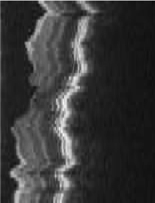

Loopy Belief Propagation
3D retinal image denoising
Vertices: 1 Million
Edges: 3 Million
Data Graph
Update Function:
Loopy BP Update Equation
Scheduler:
Approximate Priority
Consistency Model:
Edge Consistency

Slide 62
Loopy Belief Propagation
Better
Optimal
SplashBP
15.5x speedup

Slide 63
CoEM (Rosie Jones, 2005)
Named Entity Recognition Task
the dog
<X> ran quickly
Is “Dog” an animal?
Is “Catalina” a place?
Australia
travelled to <X>
Vertices: 2 Million
Edges: 200 Million
Catalina Island
<X> is pleasant
Hadoop | 95 Cores | 7.5 hrs
Notes:
Our 3rd experiment CoEM, a named entity recognition task. We test the scalability of our GraphLab implementation. The aim of coEM is to classify noun phrases. For instance…. The CoEM problem can be represented as a bipartite graph with noun phrases on the left, and contexts on the right. An edge between a noun phrase and a context means that the NP was observed with that context in the corpus. For instance, on the top edge, it means that the phrase “the dog ran quickly” was observed.

Slide 64
CoEM (Rosie Jones, 2005)
Better
Optimal
Hadoop | 95 Cores | 7.5 hrs
GraphLab | 16 Cores | 30 min
GraphLabCoEM
6x fewer CPUs!
15x Faster!
64
Notes:
We now show the performance of our implementation.
On the small problem, we achieve a respectable 12x speedup on 16 processors.
On the large problem, we are able to achieve nearly a perfect speedup. This is due to the large amount of work available.
So we used 6x fewer CPUS to get 15x faster performance.

Slide 65
Experiments
Amazon EC2 High-Performance Nodes

Slide 66
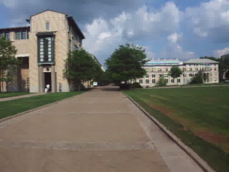
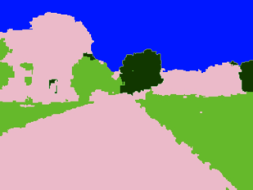
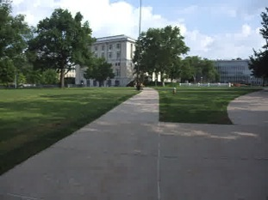
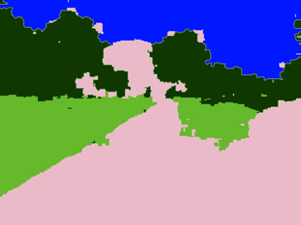
Video Cosegmentation
Segments mean the same
Gaussian EM clustering + BP on 3D grid
Model: 10.5 million nodes, 31 million edges

Slide 67
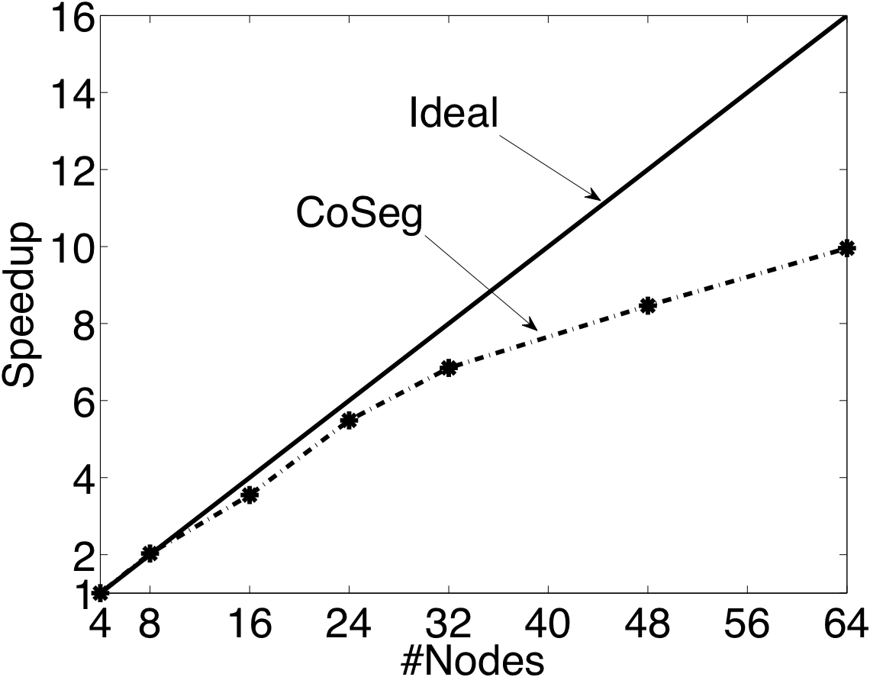
Video Coseg. Speedups

Slide 68
Prefetching Data & Locks

Slide 69
Matrix Factorization
Netflix Collaborative Filtering
Alternating Least Squares Matrix Factorization
Model: 0.5 million nodes, 99 million edges
Users
Netflix
d
Movies

Slide 70
Netflix
Speedup Increasing size of the matrix factorization

Slide 71
The Cost of Hadoop

Slide 72
Summary
An abstraction tailored to Machine Learning
Targets Graph-Parallel Algorithms
Naturally expresses
Data/computational dependencies
Dynamic iterative computation
Simplifies parallel algorithm design
Automatically ensures data consistency
Achieves state-of-the-art parallel performance on a variety of problems

Slide 73




Checkout GraphLab
Documentation… Code… Tutorials…
http://graphlab.org
Questions & Feedback
jegonzal@cs.cmu.edu

Slide 74
Current/Future Work
Out-of-core Storage
Hadoop/HDFS Integration
Graph Construction
Graph Storage
Launching GraphLab from Hadoop
Fault Tolerance through HDFS Checkpoints
Sub-scope parallelism
Address the challenge of very high degree nodes
Improved graph partitioning
Support for dynamic graph structure

