Slide 1
MCA Final Year Project (Review II)
AI-BASED EARLY DETECTION OF DDOS ATTACKS IN IOT NETWORKS
Submitted to the Presidency University, Bengaluru in partial fulfillment for the award of the degree of Master of Computer Applications (MCA)
Project Number : MCA_MP_24
Under the supervision of
Ms. Akshatha G H
Project Guide, School of Information Science
Presidency University, Bengaluru
Name | Roll Number
SONA RAJENDREN | 20252MCA0065
FEBIN SHAHAS K | 20252MCA0001
MANUEL JOSE | 20252MCA0214
ADEEB ANISHAD | 20252MCA0039

Slide 2
Review II Outline
Problem Statement & Refined Objectives
Literature Review
System Architecture & Design Models
Dataset & Feature Engineering
Module-Wise Development Progress
Federated Learning Results & Model Comparison
Database Design & Backend Integration
Review II Deliverables & Validation
Tools and Technologies
Project Repository & Timeline
References

Slide 3
Problem Statement & Refined Objectives
Problem: Resource-constrained IoT devices and MQTT brokers can be vulnerable to high-volume attacks. Cloud-only monitoring may add network delay and move traffic off-device.
Refined objectives
What changed since Review I
1
Build a 10-feature Edge-IIoTset sample with a binary target: Normal vs. DDoS.
Dataset fixed to Edge-IIoTset (100,000 rows, 50% Normal / 50% attack) instead of IoT-23 / BoT-IoT.
Features adapted to the dataset: tcp.flags.syn and mqtt.topic replaced by tcp.connection.syn and protocol-presence flags.
Federated model is a small MLP (10-16-1): FedAvg averages numeric weights, which a tree does not have. Trees stay as centralised baselines.
Fixed scaling, so every client scales identically and no data statistics are shared.
2
Train lightweight edge classifiers (Decision Tree, Naive Bayes) as centralised baselines.
3
Train one shared detector with Federated Learning (FedAvg, Flower) without sharing raw data.
4
Evaluate under IID and non-IID client data using accuracy, F1 and ROC-AUC.
5
Implement live alerts and mitigation in Sprint 3.

Slide 4
Literature Review
Related work, part 1 of 2 (MQTT intrusion detection)
Study / Citation | What They Investigated | Key Finding | Relevance to Our Project
Hindy et al. (2021) MQTT-IoT-IDS2020 | Machine-learning detection of MQTT attacks; released the MQTT-IoT-IDS2020 dataset. | The study compares packet, unidirectional-flow and bidirectional-flow features; flow features help distinguish MQTT attacks. | Our current features are packet-level. Flow-level features remain a planned extension.
Khan et al. (2021) Deep Learning for MQTT | Deep neural network for MQTT intrusion detection, compared with Naive Bayes, Random Forest, kNN, Decision Tree, LSTM and GRU on two public datasets. | A deep neural network is evaluated against conventional and recurrent models on MQTT datasets. | Motivates a compact federated neural model; Decision Tree and Naive Bayes remain centralised baselines.

Slide 5
Literature Review
Related work, part 2 of 2 (datasets and federated learning)
Study / Citation | What They Investigated | Key Finding | Relevance to Our Project
Ferrag et al. (2022) Edge-IIoTset | Testbed-generated IoT and IIoT dataset with 14 attack types in 5 threat categories, built for centralised and federated learning. | A realistic dataset suited to both centralised and federated training. | Our data source: a balanced 100,000-row sample of Normal and 4 DDoS types.
Mothukuri et al. (2022); Rahman et al. (2020) Federated IoT Security | Federated approaches to IoT security, compared with centralised and on-device training. | Federated learning trains across local datasets by exchanging model updates instead of raw traffic. | Motivates FedAvg; our measured results are compared with centralised baselines.

Slide 6
System Architecture & Module Design
Offline dataset, baselines and FL complete | Sprint 3: live alerts and mitigation planned
1
IoT Devices
ESP32 + sensors publish live telemetry over MQTT.
2
MQTT Broker
Eclipse Mosquitto receives and routes all pub/sub traffic.
attack traffic
Done
3
Maps Edge-IIoTset fields to 10 scaled packet and protocol features.
Done
4
Edge Classification
Decision Tree / Naive Bayes flags Normal vs. DDoS traffic.
ATTACKER
MQTT CONNECT Flood
PUBLISH Storm
TCP SYN Flood
Done
5
Federated Learning
Flower / FedAvg aggregates model updates, no raw data shared.
Sprint 3
6
FastAPI service for real-time alerts and response rules (planned).
blocked
Sprint 3
7
Applies approved DDoS blocks at the broker or firewall (planned).

Slide 7
Data Pipeline and Federated Learning Workflow
A. Data pipeline (Sprint 1)
Edge-IIoTset CSV
DNN-EdgeIIoT-dataset
Filter 5 classes
Normal + DDoS TCP / UDP / ICMP / HTTP
Balanced sample
100,000 rows, 50% Normal / 50% attack
10 features
extracted, then fixed scaling
Stratified split
80,000 train / 20,000 test
B. Federated workflow (Sprint 2)
Simulated client 0: local partition, local training
FedAvg server
weights averaged, weighted by client data size
Global model
MLP 10-16-1, saved as global_model.pkl
Simulated client 1: local partition, local training
Simulated client 2: local partition, local training
Each round, simulated clients train locally and FedAvg combines model weights by client size. Raw examples are not sent to the server. The project also includes a five-round Flower run with three clients.

Slide 8
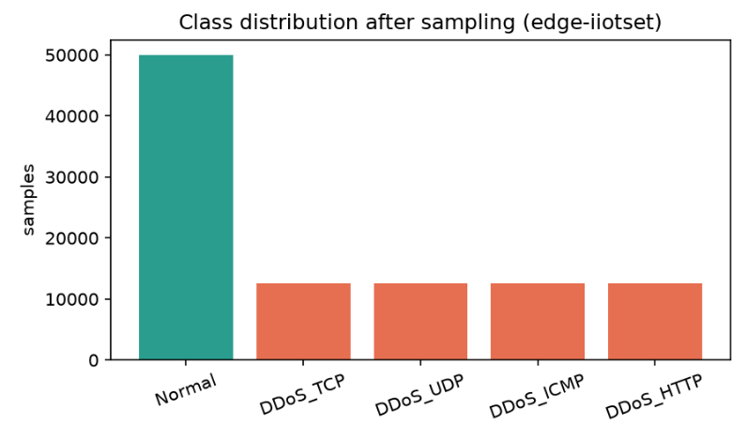
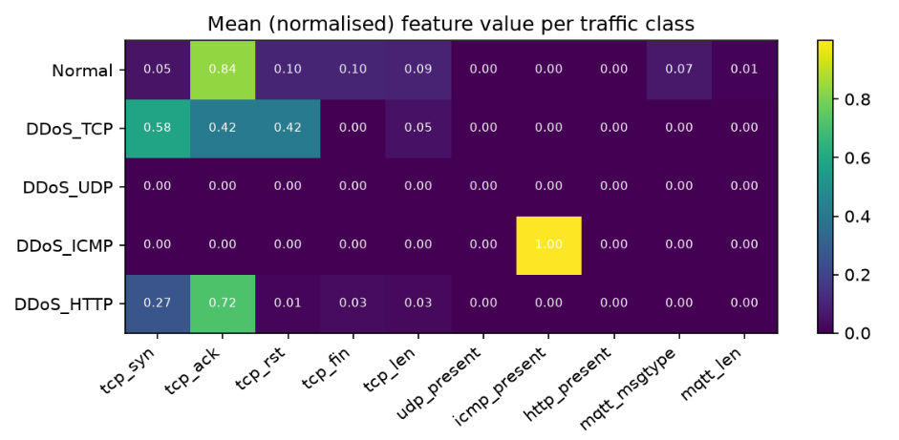
Dataset and Feature Engineering
100,000 rows
Edge-IIoTset sample: 80,000 train, 20,000 test
5 traffic categories
Model target: Normal vs. DDoS
10 features
tcp_syn, tcp_ack, tcp_rst, tcp_fin, tcp_len, udp_present, icmp_present, http_present, mqtt_msgtype, mqtt_len
Observations
TCP and ICMP attacks show clear signals; HTTP traffic shows TCP-flag patterns. All 12,500 sampled DDoS_UDP rows map to zero across all 10 features.
The model target is binary, not attack type. Add a UDP-specific feature (such as UDP port) and re-evaluate before claiming UDP coverage.

Slide 9
Development Status and Evidence
Module | What was built | Status | Evidence
Dataset & EDA | Load, filter 5 classes, balanced sample, 10 features, split; class and feature plots | Completed | 100,000 rows; reports/*.png, dataset_summary.md
Baseline classifiers | Decision Tree and Naive Bayes (centralised) | Completed | Accuracy 0.9127 and 0.6738
FedAvg simulation | 3 clients, IID and non-IID, 10 rounds | Completed | Accuracy 0.9076, ROC-AUC 0.9605
Flower deployment | Real Flower server and 3 clients | Completed | 5 rounds; accuracy 0.9012, F1 0.8991
Testing | Automated tests for core modules | Completed | 5 passed (pytest)
Sprint 3 | Real-time alerts (FastAPI), InfluxDB storage, mitigation | Planned | -
Sprint 4 | Benchmarking and final evaluation | Planned | -
Sprint 5 | Documentation and final demo | Planned | -

Slide 10
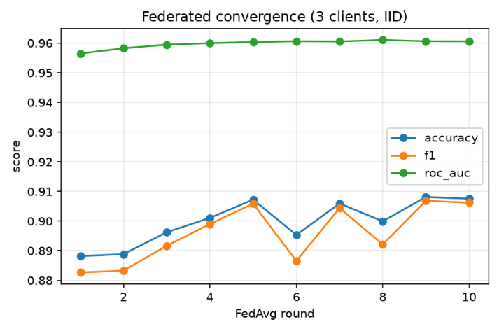
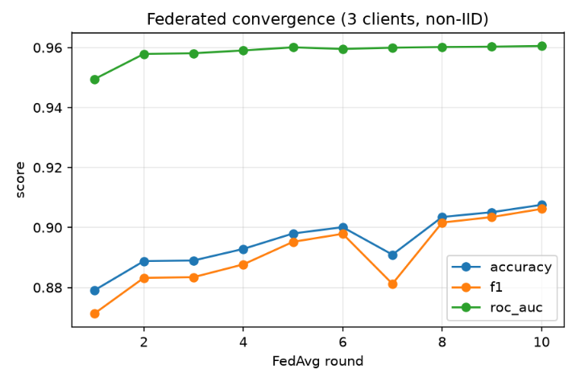
FL Convergence: IID vs Non-IID
At round 10, both runs reach 0.9076 accuracy and 0.9062 F1; ROC-AUC is 0.9606 (IID) and 0.9605 (non-IID). Non-IID starts lower (0.879 vs. 0.888) and catches up.
Recall dips at IID rounds 6 and 8 (0.8178 and 0.8275); missed attacks remain an important metric to monitor.

Slide 11
Model Comparison & Flower Run
Model | Accuracy | F1 | ROC-AUC
Decision Tree (centralised) | 0.9127 | 0.9120 | 0.9616
Naive Bayes (centralised) | 0.6738 | 0.7520 | 0.8698
FedAvg MLP, IID (10 rounds) | 0.9076 | 0.9062 | 0.9606
FedAvg MLP, non-IID (10 rounds) | 0.9076 | 0.9062 | 0.9605
Flower run (5 rounds) | 0.9012 | 0.8991 | -
Interpretation
FedAvg reaches 0.9076 accuracy, 0.51 percentage points below the Decision Tree, while sharing model weights instead of raw examples.
Evaluation limit: the model predicts Normal vs. DDoS. All sampled UDP-DDoS rows map to zero with the current features, so UDP detection is not established.
Next: add a UDP-specific feature and report performance by attack type.
Test split: 20,000 examples from a balanced, stratified sample. The reported task is binary classification: Normal vs. DDoS.

Slide 12
Database Design & Backend Integration
Implemented (Sprints 1-2): file-based storage
Planned design (Sprint 3)
Input: dataset/DNN-EdgeIIoT-dataset.csv, read by src/data_pipeline.py.
Models: decision_tree.pkl, naive_bayes.pkl and global_model.pkl in models/, written and reloaded by src/model_io.py.
Results: fl_history*.json, fl_flower_history.json and the report plots in reports/.
Flower backend: src/fl/server.py and client.py run FedAvg over gRPC and save the global model.
Settings kept in one place: src/config.py.
InfluxDB measurement traffic: tag device_id; fields tcp_syn, tcp_ack, tcp_rst, tcp_fin, tcp_len, mqtt_msgtype, mqtt_len.
InfluxDB measurement detections: tags device_id, model; fields label, score.
FastAPI service: /predict to score a feature vector, /alerts to list detections, /mitigate to trigger drop or block rules.
Live path: ESP32 publishes over MQTT, features are computed from live packets, the global model classifies, alerts are written to InfluxDB.

Slide 13
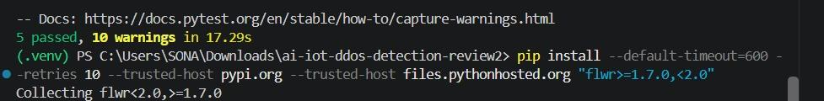
Review II Deliverables and Validation
Review II package
src/ : config, features, data_pipeline, eda, train_baselines, model_io, metrics and the fl/ package (client, server, simulate, common).
tests/ : 5 automated tests, all passing.
models/ : 3 saved models.
reports/ : dataset summary, class and feature plots, IID, non-IID and Flower histories, convergence charts.
Automated tests
Baseline training log
The reported results use the supplied Edge-IIoTset sample and project scripts; the repository contains the code, models, plots and test suite.

Slide 14
Tools and Technologies Used
HW
IoT
PY
ML
FL
Hardware
IoT Protocol
Programming
ML & Numerical Libraries
Federated Learning
ESP32 DevKit V1, mini breadboard, micro-USB
MQTT — Eclipse Mosquitto broker
Python 3.11; C++ / Arduino IDE
Pandas, NumPy, Scikit-learn
Flower (flwr) — FedAvg aggregation
API
EVAL
DATA
DB
VCS
Backend API
Evaluation Tools
Datasets
Database
Dev & VCS
Planned: FastAPI for prediction and alerts
Matplotlib; accuracy, F1 and ROC-AUC
Edge-IIoTset (100,000-row balanced sample)
Planned: InfluxDB for live telemetry
VS Code, Jupyter, Git, GitHub

Slide 15
Project Repository
Project repository
https://github.com/sona-rajendren/AI-Based-DDoS-Detection-IoT
Review II includes
• Dataset pipeline and EDA
• Decision Tree and Naive Bayes baselines
• FedAvg simulation and Flower client/server
• Automated tests, saved models and reports
Next: Sprint 3 alerts and mitigation, followed by evaluation and final demo.

Slide 16
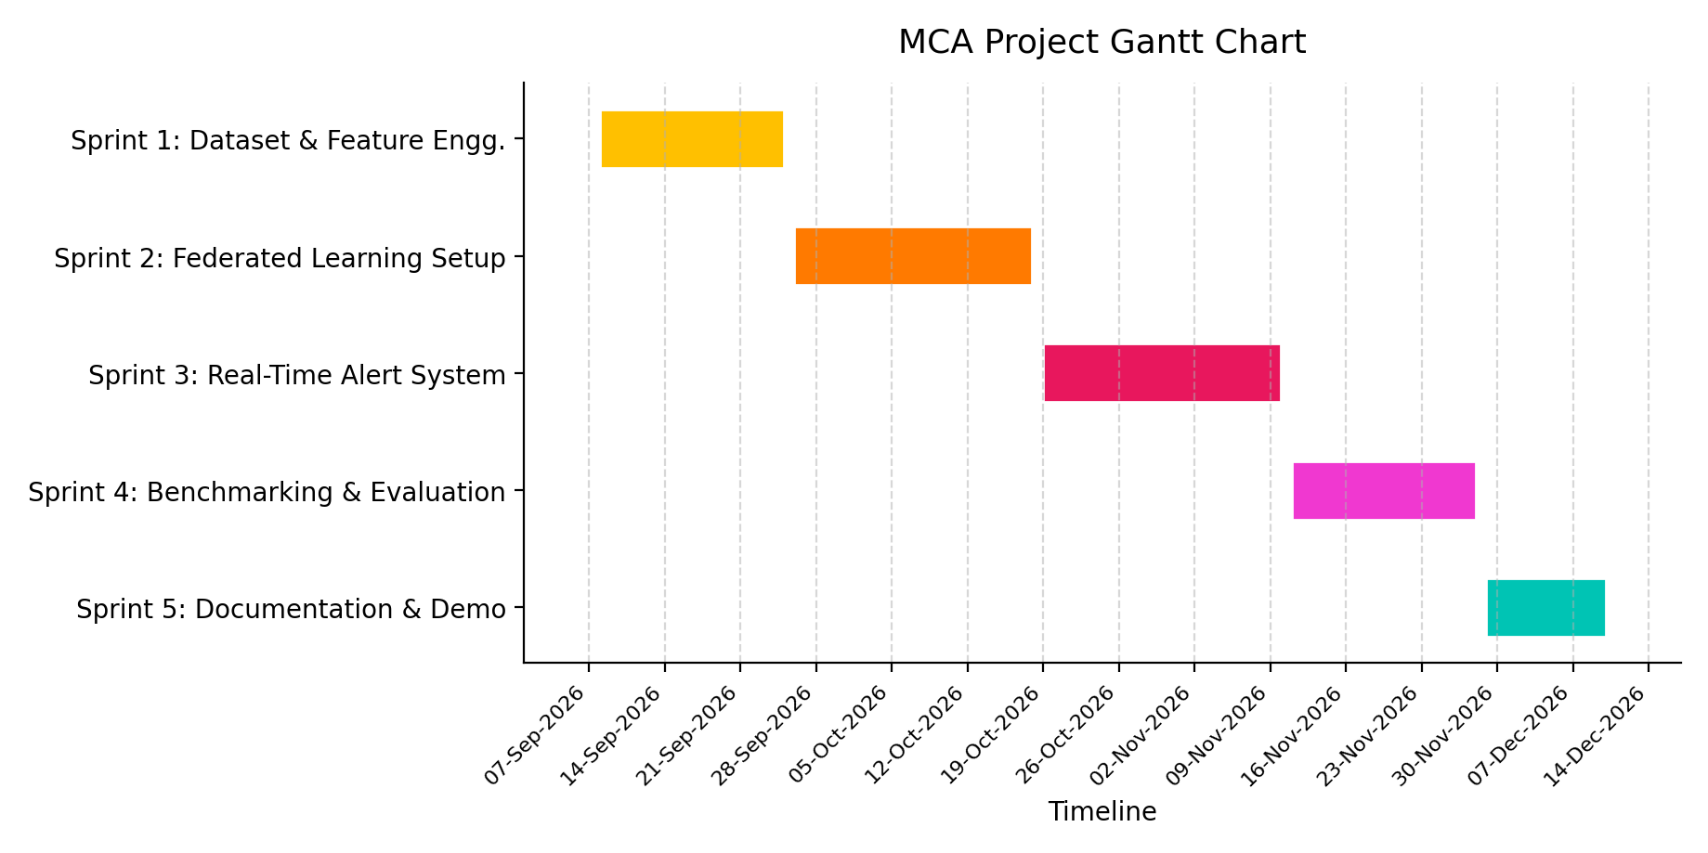
Project Timeline
Review 1 : 7 Sept 2026
Review 2 : 22-27 Oct 2026
Final Demo & Report Submission : 10 Dec 2026
Sprints 1-2 complete; Sprint 3 (alerts, mitigation) is next

Slide 17
References
[1] M. A. Ferrag et al. “Edge-IIoTset: A new comprehensive realistic cyber security dataset of IoT and IIoT applications for centralized and federated learning,” IEEE Access, vol. 10, pp. 40281–40306, 2022.
[2] B. McMahan et al. “Communication-efficient learning of deep networks from decentralized data,” in Proc. AISTATS, PMLR vol. 54, 2017, pp. 1273–1282.
[3] D. J. Beutel et al. “Flower: A friendly federated learning research framework,” arXiv:2007.14390, 2020.
[4] H. Hindy et al. “Machine learning based IoT intrusion detection system: An MQTT case study (MQTT-IoT-IDS2020 dataset),” in Proc. INC 2020, LNNS, Springer, 2021.
[5] M. A. Khan et al. “A deep learning-based intrusion detection system for MQTT enabled IoT,” Sensors, vol. 21, no. 21, art. 7016, 2021.
[6] C. Kolias et al. “DDoS in the IoT: Mirai and other botnets,” Computer, vol. 50, no. 7, pp. 80–84, 2017.
[7] V. Mothukuri et al. “Federated-learning-based anomaly detection for IoT security attacks,” IEEE Internet Things J., vol. 9, no. 4, pp. 2545–2554, 2022.
[8] S. A. Rahman et al. “Internet of Things intrusion detection: Centralized, on-device, or federated learning?,” IEEE Netw., vol. 34, no. 6, pp. 310–317, 2020.

Slide 18
Thank you
Questions and discussion

