Slide 1
Overview
Introduction to Memory Management
Logical vs Physical Address Spaces
Swapping
Contiguous Allocation
Virtual Memory
Paging
Segmentation
Segmentation with Paging
Demand Paging
Page Replacement Algorithms

Slide 2
Introduction to Memory Management
Through CPU scheduling and multiprogramming, we are able to improve the CPU utilization and the response time.
To achieve this, we have several active processes simultaneously resident in memory, i.e., the memory is shared among the processes.
Memory management is required to decide on allocation of memory among various processes.
Selection of appropriate memory management techniques plays an important role in better performance from the computer system.
In order to execute a program, it must be brought into main memory from disk and placed within a process. This activity is called Process Loading. Swapping is the opposite of Loading.

Slide 3
Logical vs Physical Address Spaces
Physical addresses are provided directly by the machine.
– one physical address space per machine
– addresses typically range from 0 to some maximum, though some portions
of this range are usually used by the OS and/or devices, and are not available
for user processes
Virtual addresses (or logical addresses) are addresses provided by the OS to
processes.
– one virtual address space per process
– addresses typically start at zero, but not necessarily
– space may consist of several segments
Address translation (or address binding) means mapping virtual addresses to
physical addresses.

Slide 4
The Background
1. What does this component do ?
  The memory management component of an operating system is responsible for allocating main memory to user processes. This requires choosing a basic approach, selecting memory management algorithms, and maintaining memory management data structures.
  Memory management is heavily dependent on the computer hardware.
  2. How does it affect system performance ?
  Memory management schemes affect overall system performance: CPU utilization and response to users. CPU utilization is improved by having a good selection of processes in memory so there are always runnable processes available when the CPU becomes idle. At the same time, efficiency is an issue. Memory management algorithms should not add unnecessarily to context switch time, or overall system overhead.
  3. What is stored in memory ?
  Program instructions and data are stored in memory: Each must be fetched to be used. Executing one instruction may require several memory accesses: one to get the instruction, one or more to get the necessary operands or to store results. The memory controller sees only a series of physical addresses;

Slide 5
The Background.. Contd..
  references to actual locations in memory. There is no distinction between data and instructions.
  One of the inefficiencies of modern computers is the discrepancy between CPU time (the time it takes to operate on data or instructions that are loaded into registers) and memory access time (the time it takes to get the information into registers). It is important to reduce the number of memory accesses, if possible. Caching of currently used instructions and data in special high-speed memory caches is one way to reduce the amount of time spent in memory accesses.
  Memory is a linear array of locations (bytes or words), each with its own address. The amount of physical memory determines the physical address space. The logical (or virtual) address space of a computer may be larger than the physical address space. Computers today support at least 32-bit and often 64-bit address spaces. The physical address space doesn’t always match this.
  Primary memory is called random-access memory because each location can be accessed (read or written) in the same amount of time.

Slide 6
Concepts in Memory Management
Relocation
  When a translator (compiler, interpreter, or assembler) translates a source code program into object code, it has no idea where the code will be loaded when the program is run. In fact, each time it is run it will likely occupy a different area of memory
  Furthermore, programs will possibly be swapped in and out of memory, so they may occupy different physical address locations at different times.
  Therefore, the translator cannot assign absolute physical addresses to the instructions and data values in the program.
  Relocation is the process of converting a logical address to a physical address.

Slide 7
Concepts in Memory Management.. Contd..
Protection
Program address space includes process control information (PCB), program code, data segment (global data), and stack/heap space. This information may or may not be stored in contiguous locations; but it can be visualized as a linear sequence of addresses.
OS must protect the address space of one process from unauthorized access by other processes. No process should be allowed to access kernel code or space.
Protection must be provided by the hardware, not the operating system. There is no way to tell in advance which addresses a program might reference as it runs. Dynamic calculation of array subscripts, pointers, etc. is only done at execution time.

Slide 8
Concepts in Memory Management.. Contd..
Sharing
  If several processes are executing the same program (for example, an editor), then memory is used more efficiently if each process uses the same copy of the program code. This kind of sharing is almost always done automatically by the system software.
  Processes that cooperate to solve a problem (for example, the producer-consumer problem) may want to access shared data structures. The processes that will participate in the sharing must declare shared memory segments explicitly. In UNIX, for example, the system calls shmget(), shmat() allow one process to declare a shared memory area and another to attach it to its address space. The operating system is responsible for protecting the shared memory from unauthorized access by other processes. It must also make sure that the sharing processes are restricted to the shared portion of each other’s address space.

Slide 9
Concepts in Memory Management.. Contd..
Program Translation and Address Spaces
A process has a logical address space, which is a linear set of locations that encompass the program code, variables, stack, libraries, etc. As the program executes, all or part of the logical address space is mapped to a physical address space, which is a subset of primary memory. The address space is a product of the translation-linking-loading process.
Translators generate relocatable object code modules from source code. The various modules are then joined together (linked) to form a single module, the load module, which is then loaded (copied to memory).
At some point in time, the addresses produced by the translator must be converted to physical addresses. This process is called binding. Addresses can be bound at compile time (rarely), load time, or run time. The most common binding time in modern systems is run time.

Slide 10

Multistep Processing of a User Program

Slide 11
Concepts in Memory Management.. Contd..
Distinguish the following kinds of addresses:
Symbolic addresses (variable names and occasionally named instructions) are used in the source code. The translator converts them to logical addresses.
Logical addresses are assigned independent of the physical locations. They may still require additional mapping operations to be bound to absolute/physical addresses.
Relative addresses are a kind of logical address. The address is expressed as an offset from the start address of the module, which by convention is usually established as zero. The translator assigns relative addresses.
Physical addresses (absolute addresses) refer to the actual location at which a particular instruction or variable is loaded.

Slide 12
Concepts in Memory Management.. Contd..
Loading
Absolute Loading
An absolute loader copies a load module into memory, making no adjustments to the logical addresses assigned by the translator. It assumes that the translator (or the programmer) assigned the correct absolute addresses.
With this approach, a load module must always occupy the same set of memory locations. This approach is virtually never used.
Addresses are bound at compile time.

Slide 13
Concepts in Memory Management.. Contd..
Relocatable Loading
As it copies a load module into memory, the relocatable loader adds an offset to each logical address in the program.
This type of loader requires the translator to generate relative addresses. It is also necessary for the program to be loaded into consecutive memory locations.
The physical addresses are found by adding M to each relative address, where M is the start address of the load module.
In this case, addresses are bound at load time. It is a more flexible approach than compile time binding, since the program can be loaded into a separate set of locations each time it runs.

Slide 14
Concepts in Memory Management.. Contd..
Dynamic Loading (more accurately, dynamic relocation)
Relocatable loading does not support swapping. Once a process has been loaded and relocated, its addresses are absolute. A swapped-out process could only be swapped back to the memory locations it started in. This is too restrictive.
Dynamic loading or dynamic relocation defers the process of determining absolute addresses until the address is used. The loader places the load module into memory without adjusting relative addresses. A special register is loaded with the start address of the load module. Hardware automatically adds the register contents to a relative address each time the address is used.
In this case, address binding is at run-time.

Slide 15

Dynamic relocation using a relocation register

Slide 16
Concepts in Memory Management.. Contd..
Linking
A linker joins several object modules into a single load module.
Input to the linker is a set of object modules.
Each module has been translated with relative addresses, relative to 0 as the start address of the module. References from one module to another (function calls, data references, etc.) are still symbolic.
The loader must generate a single contiguous module in which all the external references have been resolved. Linkage editor is the term often applied to this type of linker.

Slide 17
Concepts in Memory Management.. Contd..
A dynamic linker postpones some of the linkage functions until run time. Dynamic linking can be done either at load-time or at run time.
Load-time dynamic linking prepares a relocatable load module in the normal way, but leaves unresolved some external references, usually to system utilities or language libraries. At load time, system copies of the target modules can be linked in. Utilities can be changed without forcing programmers to re-link existing load modules and a shared code can be linked in to more than one program.
Run-time dynamic linking goes a step farther; some modules will not be linked in until they are actually called.

Slide 18
Multistep Processing of a User Program

Slide 19
Swapping
A process can be swapped temporarily out of memory to a backing store, and then brought back into memory for continued execution.
Backing store – fast disk large enough to accommodate copies of all memory images for all users; must provide direct access to these memory images.
Swapping a process out means removing all of its pages from memory, or
marking them so that they will be removed by the normal page
replacement process. Suspending a process ensures that it is not
runnable while it is swapped out.
Which process(es) to suspend?
– low priority processes
– blocked processes
– large processes (lots of space freed) or small processes (easier to reload)

Slide 20

Schematic View of Swapping

Slide 21
Contiguous Allocation
Main memory is usually divided into two partitions:
  Resident operating system, usually held in low memory with interrupt vector.
  User processes then held in high memory.
Single-partition allocation
  Relocation-register scheme used to protect user processes from each other, and from changing operating-system code and data.
  Relocation register contains value of smallest physical address; limit register contains range of logical addresses – each logical address must be less than the limit register.

Slide 22
Contiguous Allocation .. Monoprogramming
User Program
OS ( in RAM )
OS (in ROM)
User Program
DDs (in ROM)
User Program
OS (in RAM)
Adv : Simple
Disadv : ‘Mono’
Obvious Solution : Multi.

Slide 23
Contiguous Allocation .. Multiprogramming with Fixed-sized Partitions
Partition1
Partition2
Partition3
OS ( in RAM )
Partition1
Partition2
Partition3
OS ( in RAM )
Multiple I/P Queues Single I/P Queue
Adv : Multi Disadv : Fixed.

Slide 24
Contiguous Allocation .. Multiprogramming with Variable-sized Partitions
  Hole – block of available memory; holes of various size are scattered throughout memory.
  When a process arrives, it is allocated memory from a hole large enough to accommodate it.
  Operating system maintains information about:
  a) allocated partitions b) free partitions (hole)
OS
OS
OS
OS
process 5
process 5
process 5
process 5
process 9
process 9
process 8
process 10
process 2
process 2
process 2
process 2

Slide 25
Dynamic Storage Allocation Problem
How to satisfy a request of size n from a list of free holes.
First-fit: Allocate the first hole that is big enough.
Best-fit: Allocate the smallest hole that is big enough; must search entire list, unless ordered by size. Produces the smallest leftover hole.
Worst-fit: Allocate the largest hole; must also search entire list. Produces the largest leftover hole.
Which scheme is better in terms of speed and storage utilization?

Slide 26
Fragmentation
External Fragmentation
Fragmentation that is external to the partition allocated.
Internal Fragmentation
Fragmentation that is internal to the partition alloacted.
Reduce external fragmentation by compaction

Slide 27
Virtual Memory
Virtual Memory is a technique that allows the execution of processes not completely in memory. The main visible advantage is that programs can be larger than physical memory.
Goals:
Allow virtual address spaces that are larger than the physical address
space.
Method:
Allow pages (or segments) from the virtual address space to be
stored in secondary memory, as well as primary memory.
Move pages (or segments) between secondary and primary memory to
that they are in primary memory when they are needed.

Slide 28
Paging
Divide physical memory into fixed-sized blocks called frames (size is power of 2, between 512 bytes and 8192 bytes).
Divide logical memory into blocks of same size called pages.
Keep track of all free frames.
To run a program of size n pages, need to find n free frames and load program.
Set up a page table to translate logical to physical addresses.
May result in Internal fragmentation.

Slide 29
Address Translation Scheme
Address generated by CPU is divided into:
  Page number (p) – used as an index into a page table which contains base address of each page in physical memory.
  Page offset (d) – combined with base address to obtain the physical memory address.

Slide 30

Address Translation Architecture

Slide 31

Paging Example

Slide 32
Implementation of Page Table
Page table is kept in main memory.
Page-table base register (PTBR) points to the page table.
Page-table length register (PTLR) indicates size of the page table.
In this scheme every data/instruction access requires two memory accesses. One for the page table and one for the data/instruction.
The two memory access problem can be solved by the use of a special fast-lookup hardware cache called associative memory or translation look-aside buffers (TLBs)

Slide 33

Paging Hardware With TLB

Slide 34
Effective Access Time
Associative Lookup = ε time unit
Assume memory cycle time is 1 microsecond
Hit ratio – percentage of times that a page number is found in the associative registers; ration related to number of associative registers.
Hit ratio = α
Effective Access Time (EAT)
EAT = (1 + ε) α + (2 + ε)(1 – α)
= 2 + ε – α

Slide 35
Memory Protection
Memory protection implemented by associating protection bit with each frame.
Valid-invalid bit attached to each entry in the page table:
  “valid” indicates that the associated page is in the process’ logical address space ( is thus a legal page) and is also in memory.
  “invalid” indicates that the page is not currently in memory.

Slide 36
Two level Paging Example
A logical address (on 32-bit machine with 4K page size) is divided into:
  a page number consisting of 20 bits.
  a page offset consisting of 12 bits.
Since the page table is paged, the page number is further divided into:
  a 10-bit page number.
  a 10-bit page offset.
Thus, a logical address is as follows:
where p_{i} is an index into the outer page table, and p₂ is the displacement within the page of the outer page table.
page number
page offset
p_{i}
p₂
d
10
10
12

Slide 37

Address Translation Scheme
Address-translation scheme for a two-level 32-bit paging architecture
Main memory

Slide 38
Shared Pages
Shared code
  One copy of read-only (reentrant) code shared among processes (i.e., text editors, compilers, window systems).
Private code and data
  Each process keeps a separate copy of the code and data.
  The pages for the private code and data can appear anywhere in the logical address space.

Slide 39

Shared Pages Example

Slide 40
Segmentation
Memory-management scheme that supports user view of memory.
A program is a collection of segments. A segment is a logical unit such as:
main program,
procedure,
function,
method,
object,
local variables, global variables,
common block,
stack,
symbol table, arrays

Slide 41

User’s View of a Program

Slide 42
Logical View of Segmentation
1
1
4
2
3
4
2
3
user space
physical memory space

Slide 43
Segmentation Architecture
Logical address consists of a two tuple:
<segment-number, offset>,
Segment table – maps two-dimensional physical addresses; each table entry has:
  base – contains the starting physical address where the segments reside in memory.
  limit – specifies the length of the segment.
Segment-table base register (STBR) points to the segment table’s location in memory.
Segment-table length register (STLR) indicates number of segments used by a program;
segment number s is legal if s < STLR.

Slide 44

Segmentation Hardware

Slide 45

Segmentation Example

Slide 46
Segmentation Architecture .. Contd..
Relocation
  dynamic
  by segment table
Sharing
  shared segments
  same segment number
Allocation
  first fit/best fit
  external fragmentation
Protection. With each entry in segment table associate:
  validation bit = 0 ⇒ illegal segment
  read/write/execute privileges
  Protection bits associated with segments; code sharing occurs at segment level.

Slide 47

Segmentation With Paging

Slide 48
Comparing Memory Management Strategies
• Hardware support
• Performance
• Fragmentation
• Sharing
• Protection
Programmer Awareness

Slide 49
Demand Paging
When to Page?
Demand paging brings pages into memory when they are used. Alternatively,
the OS can attempt to guess which pages will be used, and pre-fetch them.
What to Replace?
Unless there are unused frames, one page must be replaced for each page that
is loaded into memory. A replacement policy specifies how to determine
which page to replace.

Slide 50
Paging Mechanism
When virtual memory is used, a valid bit (V ) in each page table entry is used
track which pages are in (primary) memory, and which are not.
V = 1: valid entry which can be used for translation
V = 0: invalid entry. If the MMU encounters an invalid page table entry, it
raises a page fault exception.
To handle a page fault exception, the operating system must:
– Determine which page table entry caused the exception.
– Ensure that that page is brought into memory.
On return from the exception handler, the instruction that resulted in the page
fault will be retried.
If (pure) segmentation is being used, there will be a valid bit in each segment
table entry to indicate whether the segment is in memory.

Slide 51
Page Replacement Policies
FIFO ( First In First Out )
LRU ( Least Recently Used )
OPR ( Optimal Page Replacement )
Enhanced Second Chance

Slide 52
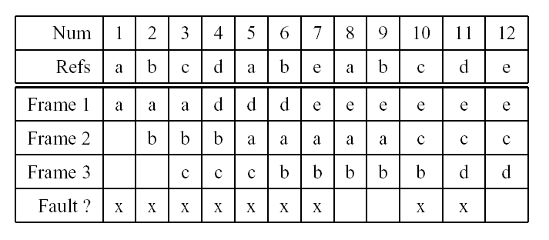
Page Replacement Policy - FIFO
The FIFO policy: replace the page that has been in memory the longest
A three-frame example:

Slide 53
Other Page Replacement Policies
FIFO is simple, but it does not consider:
Recency of Use: when was a page last used?
Frequency of Use: how often as a page been used?
Cleanliness: has the page been changed while it is in memory?
The principle of locality suggests that usage ought to be considered in a replacement decision.
Cleanliness may be worth considering for performance reasons.

Slide 54
Locality
Locality is a property of the page reference string. In other words, it is a property of programs themselves.
Temporal locality says that pages that have been used recently are likely to be used again.
Spatial locality says that pages “close” to those that have been used are likely to be used next.

Slide 55
Page Replacement Policy - LRU
LRU is based on the principle of temporal locality: replace the page that has not been used for the longest time
To implement LRU, it is necessary to track the each page’s recency of use. For example: maintain a list of in-memory pages, and move a page to the front of the list when it is used.

Slide 56
The “Use” Bit
A use bit (or reference bit) is a bit found in each page table entry that:
– is set by the MMU each time the page is used, i.e., each time
the MMU translates a virtual address on that page
The use bit provides a small amount of efficiently-maintainable
usage information that can be exploited by a page replacement
algorithm.

Slide 57
Page Cleanliness The “Dirty” Bit
A page is dirty if it has been changed since it was loaded into memory.
A dirty page is more costly to replace than a clean page. (Why?)
The MMU identifies dirty pages by setting a dirty bit in the page table entry when the contents of the page change. Operating system clears the dirty bit when it cleans the page.
The dirty bit potentially has two roles:
– Indicates which pages need to be cleaned.
– Can be used to influence the replacement policy.

Slide 58
Enhanced Second Chance Replacement Algorithm
Classify pages according to their use and dirty bits:
(0,0): not recently used, clean.
(0,1): not recently used, dirty.
(1,0): recently used, clean
(1,1): recently used, dirty
Algorithm:
1. Sweep once looking for (0,0) page. Don’t clear use bits while looking.
2. If none found, look for (0,0) or (0,1) page, this time clearing “use” bits
while looking.

Slide 59
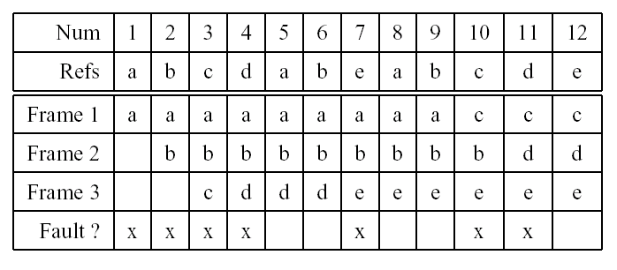
Page Replacement Policy - OPR
There is an optimal page replacement policy for demand paging.
The OPR policy: replace the page that will not be used referenced for the
longest time.

Slide 60
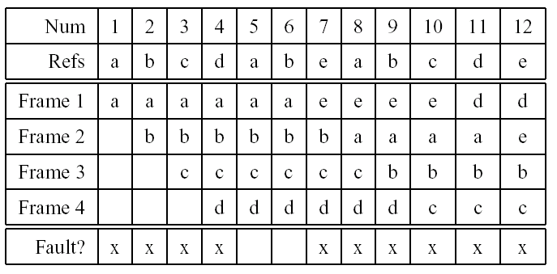
Belady’s Anomaly
FIFO replacement, 4 frames
FIFO example on slide 46 with same reference string had 3 frames and only 9 faults.
More memory does not necessarily mean fewer page faults.

Slide 61
How Much Memory Does a Process need ?
Principle of locality suggests that some portions of the process’s virtual address space are more likely to be referenced than others.
A refinement of this principle is the working set model of process reference behaviour.
According to the working set model, at any given time some portion of a program’s address space will be heavily used and the remainder will not be.
The heavily used portion of the address space is called the working set of the process.
The working set of a process may change over time.
The resident set of is the set of process pages that are located in memory.
According to the working set model, if a process’s resident set includes its working set, it will rarely page fault.

Slide 62
Thrashing And Load Control
what is a good multiprogramming level?
– if too low: resources are idle
– if too high: too few resources per process
A system that is spending too much time paging is said to be thrashing.
Thrashing occurs when there are too many processes competing for the available memory.
Thrashing can be cured by load shedding, e.g.,
– killing processes (not nice)
– suspending and swapping out processes (nicer)

Slide 63
Terms introduced today
Please look through the list and verify that you understand the meaning
of every term :
Process Loading 11. Dynamic Storage Allocation
Physical Addresses - first fit, best fit, worst fit
Logical Addresses 12. External and Internal Fragmentation
Address Binding 13. Compaction
Binding at Compile time, 14. Virtual Memory
  - load time, 15. Paging
  - link time - pages, frames,
Relocation - page table, PTBR, PTLR, TLB
MMU 16. Segmentation
Swapping - segments, segment table, STBR, STLR
Backing Store 17. Demand Paging
Contiguous Allocation 18. Page Replacement Policies
  - fixed and variable partitions - FIFO, LRU, OPR, Enhanced 2nd Chance

