Slide 1

National Engineering College, K.R. Nagar, Kovilpatti – 628 503 (An Autonomous Institution, Affiliated to Anna University, Chennai)
Department of Artificial Intelligence and Data Science
DigitalT3 Hackathon
DocuMentor
An AI-Driven Document Assistant
Student Name : Sonali Mitra A
Starter Kit Title : Data Extraction
Mentor Name : Mr. Sonubabu Tamilvanan

Slide 2
Problem Statement of starter kit
OVERLOADED WITH DOCS?
Time to Rethink efficiency
As businesses grow, so does the overwhelming flood of documents. This causes delays, missed insights, and cost inefficiencies. How can we manage documents smarter, faster, and without manual hassle?

Slide 3
Need of Problem/Use cases/Applications
Need of Problem:
Inefficient Document Management
Information Overload
Missed Opportunities and Errors
Use Cases:
Legal Firms
Financial Institutions
Healthcare Providers
Applications:
Contract Review Automation
Financial Reporting
Research Paper Summarization

Slide 4
DOCUMENT CHAOS IS HOLDING US BACK
Say goodbye to manual sorting. With AI at its core, DocuMentor transforms how you handle, categorize, and retrieve documents. Seamlessly access critical data in seconds, letting your business focus on what truly matters.

Slide 5
Innovation of model developed
From Chaos to Clarity
Reducing Errors and Boosting Productivity
DocuMentor not only reduces the time spent on document processing but also minimizes human error. With AI integration, companies can focus on growth while ensuring compliance, security, and smarter decision-making.

Slide 6
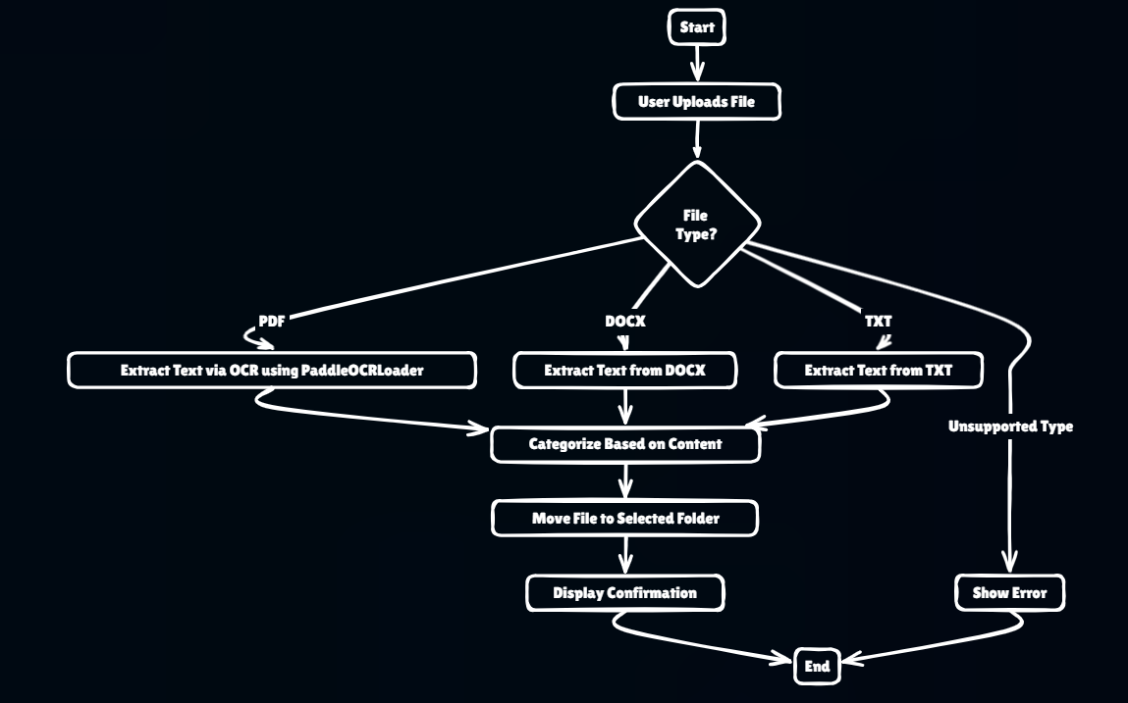
Prototype Developed

Slide 7
Prototype Developed
Text Extraction: Uses PyPDF2 for PDFs, `docx` library for DOCX files, and standard file I/O for TXT files to read and extract text.
File Categorization: Determines file type by extension and categorizes based on predefined keywords found in the extracted text.
File Management: Allows file upload via a dialog, categorizes and moves files to appropriate folders, and lists files with options to view or download them.
User Interface: Built with tkinter, featuring a full-screen layout with a background image and dynamic buttons for file management actions.
Error Handling: Uses message boxes to notify users of errors or confirm successful actions like file movement and downloads.

Slide 8
Prototype Developed
Github link : DocuMentor
Video link : Demo video

Slide 9
Future Work
What's Next:
Improve document categorization using advanced algorithms.
Add cloud storage integration for remote access and backup.
Enhance search features for better document retrieval.
Implement user authentication and access control.
Collect user feedback for continuous improvement.
How to Get Involved:
Provide feedback on the app’s features and usability.
Participate in beta testing to identify bugs and suggest improvements.
Contribute to the codebase or documentation.
Share the project to increase visibility and adoption.
Collaborate on new integrations or features.

Slide 10
Thank You

