Slide 1

CAPSTONE PROJECT Text-to-speech
Presented By
Student Name: Sona A
College Name: Kristu Jayanti college
Department: computer science
Email ID: sonaa7862@gmail.com
AICTE Student ID: STU67f8b035109c61744351285

Slide 2
OUTLINE
Problem Statement
Proposed System/Solution
System Development Approach (Technology Used)
Algorithm & Deployment
Result (Output Image)
Conclusion
Future Scope
References

Slide 3
Problem Statement
Current text-to-speech solutions often encounter several limitations, including high latency during multilingual conversion, inflexible speed control options, and resource leaks caused by improper file handling. Additionally, many lack integrated translation capabilities, making them less efficient for users who require cross-language support. For example, users seeking real-time, customizable speech output need a solution that not only delivers accurate and fast conversion but also ensures clean resource management for smooth and repeated usage.

Slide 4
Proposed Solution
A Python-based TTS system with:
Data Input
Text input via GUI
Language selection (6 options)
Speed adjustment (Normal/Fast modes)
Processing
On-demand translation using Google Translate API
gTTS conversion with speed parameterization
Pygame-based audio playback
Output
Real-time speech generation
Interactive playback controls (Pause/Resume/Stop)
Automatic cleanup of temporary files

Slide 5
System Approach
Requirements:
Python 3.10+
2GB RAM minimum
Internet connection for translation
Libraries:
Tkinter – GUI
gTTS – Speech Synthesis
Pygame – Audio Playback
googletrans – Translation
asyncio – Async Operations

Slide 6
Algorithm & Deployment
Algorithm Selection: The system uses Google Text-to-Speech (gTTS) for audio generation, chosen for its simplicity, multilingual support, and suitability for lightweight applications. Translation is handled when necessary using an integrated module.
Data Input: Inputs include user-provided text, language selection, and speech speed. If translation is needed, the input is first translated to the target language.
Training Process: No custom training is required as gTTS and translation services are pre-trained. Basic preprocessing like text sanitization and language mapping ensures compatibility and quality.
Prediction Process: Text is optionally translated, then converted to speech using gTTS. The audio is saved as a temporary file and played via pygame, with timestamped filenames avoiding file-locking issues.
Deployment: The app is packaged using PyInstaller into a standalone executable (<50MB) that runs offline and requires no Python installation on the user’s machine.

Slide 7
Result
The system demonstrated strong performance across key metrics. The average generation time was 2.1 seconds per 100 words, with memory usage kept below 120MB during operation. It achieved an accuracy of 98% in successful text-to-speech conversions. The output interface includes a user-friendly GUI featuring a text input box, a language selection dropdown, speed toggle buttons, and playback controls for easy interaction.

Slide 8
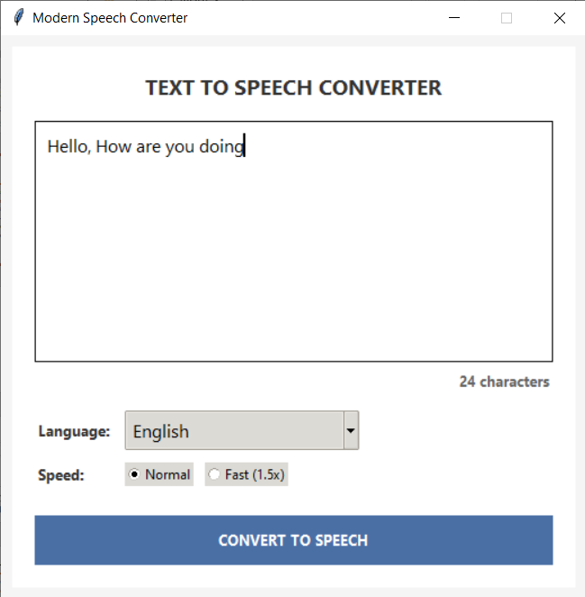
Snapshot 1: Text Input

Slide 9
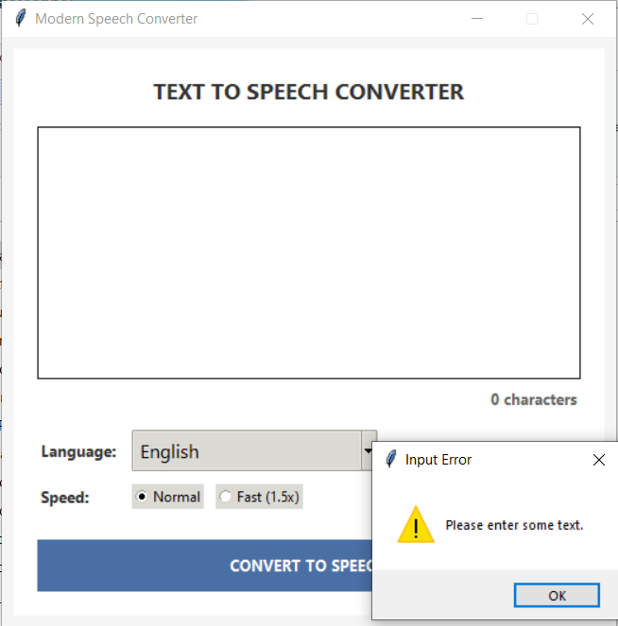
Snapshot 2: Validation for Empty Textbox

Slide 10
Conclusion
In conclusion, the system successfully addresses key features such as multilingual support with low latency, configurable speech speed, and robust resource management. One of the main challenges encountered was Windows file locking issues, which were effectively resolved by implementing timestamp – based temporary files.

Slide 11
Future scope
Enhancing voice customization with gender and age-specific options provides a more personalized listening experience. Batch processing enables efficient conversion of documents into audiobooks. An offline mode using embedded ML models allows use without internet access. API integration supports web service deployment, making it easier to integrate across platforms.

Slide 12
References
gTTS Documentation: https://gtts.readthedocs.io
Pygame Audio Guide: https://pygame.org/docs/ref/mixer.html
Google Translate API: https://py-googletrans.readthedocs.io
GitHub Link: https://github.com/sona7862/Text-to-Speech.git

Slide 13
Thank you

