Slide 1
INVESTMENT ASSIGNMENT SUBMISSION
Name: Sonali Narharshettiwar

Slide 2
Abstract
What is spark funds?
You work for Spark Funds, an asset management company. Spark Funds wants to make investments in a few companies. The CEO of Spark Funds wants to understand the global trends in investments so that she can take the investment decisions effectively. This pattern is often observed among early stage startup investors.
Business objective: The objective is to identify the best sectors, countries, and a suitable investment type for making investments. The overall strategy is to invest where others are investing, implying that the 'best' sectors and countries are the ones 'where most investors are investing’.
Spark Funds has two minor constraints for investments:
It wants to invest between 5 to 15 million USD per round of investment
It wants to invest only in English-speaking countries because of the ease of communication with the companies it would invest in.
Goals of data analysis:
Investment type analysis
Country analysis
Sector analysis

Slide 3
Steps to be proceed with this investment case study
There are four major parts that are needed to be done for this case study:
Data understanding/Exploration
Data cleaning (cleaning missing values, removing redundant columns etc.)
Data Analysis
Recommendations(Checkpoints)

Slide 4
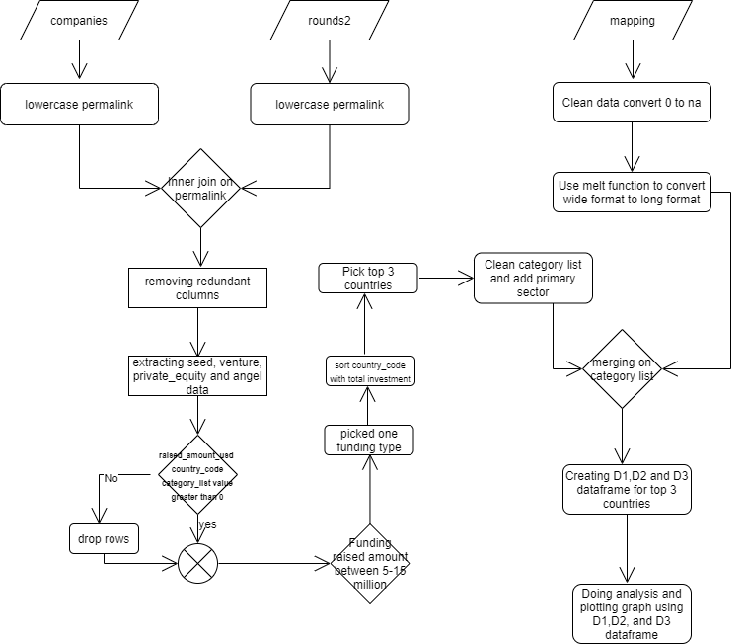
Flowchart

Slide 5
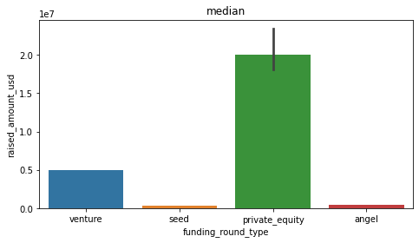
Investment Type Analysis Plot 1: Representing amount of investment in each funding type
A plot showing the representative amount of investment in each funding type. This chart should make it clear that a certain funding type (FT) is best suited for Spark Funds.
There are 14 different types of investments.
As outliers were present (slide 5), I took median and it has been observed that private equity amount invested is more that 15M USD.
Investment amount for seed and angel type are below 5M USD starting limit of Spark Fund.
Venture is the only investment funding type which is in range 5M USD -15M USD.

Slide 6
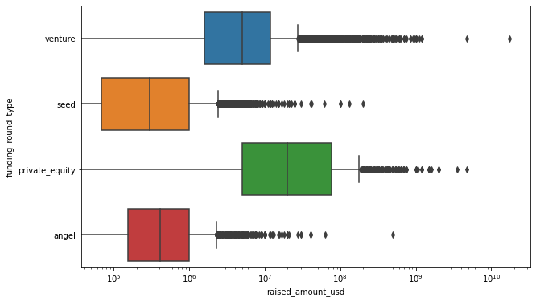
Investment Type Analysis
Boxplot of raised USD amount for 4 targeted funding type

Slide 7
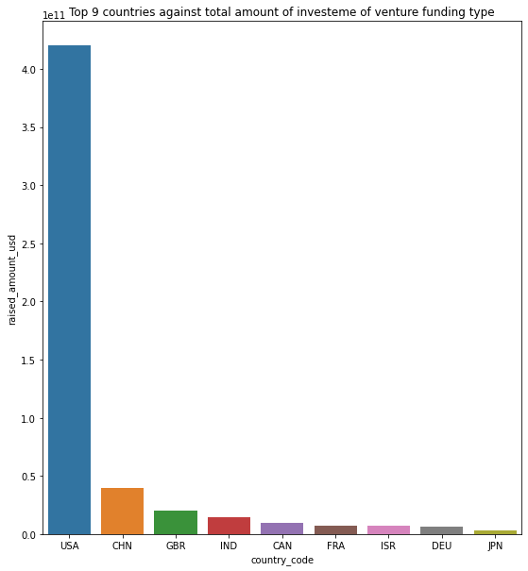
Country Analysis - Plot 2: Plotting top 9 countries against the total amount of investments of funding type
A plot showing the top 9 countries against the total amount of investments of funding type FT. This should make the top 3 countries (Country 1, Country 2, and Country 3) very clear.
USA is the most invested company and also English speaking country.
China follows USA, but NOT a English speaking country.
United Kingdom and India are among the top 3 countries to attract investments.
Canada, France, Germany, Israel and Japan are among top 9 countries

Slide 8
Sector Analysis
Country Name | Top 3 sectors | Counts of Investments
USA (United States) | Others | 2950
 | Social, Finance, Analytics, Advertising | 2714
 | Cleantech / Semiconductors | 2300
GBR(United Kingdom) | Others | 147
 | Social, Finance, Analytics, Advertising | 133
 | Cleantech / Semiconductors | 128
IND (India) | Others | 110
 | Social, Finance, Analytics, Advertising | 60
 | News, Search and Messaging | 52

Slide 9
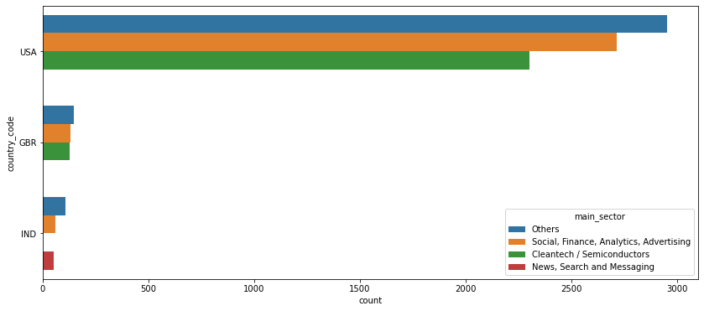
Plot 3: Number of investments in the top 3 sectors of the top 3 countries
A plot showing the number of investments in the top 3 sectors of the top 3 countries on one chart (for the chosen investment type FT). This plot should clearly display the top 3 sectors each in Country 1, Country 2, and Country 3.

Slide 10
Conclusion
Based on the investment strategy of Spark Fund, following is the output:
Funding type is Venture
Top 3 English speaking countries are : USA, GBR and IND.
Top 3 sectors for top 3 countries for Venture are:
USA | GBR | IND
Others | Others | Others
Social, Finance, Analytics, Advertising | Social, Finance, Analytics, Advertising | Social, Finance, Analytics, Advertising
Cleantech / Semiconductors | Cleantech / Semiconductors | News, Search and Messaging

