Slide 1
Agentless Introspection of Bare Metal Using BMI

Slide 2
Project Overview
Create an end to end agentless introspection system for the bare metal environment. Goals of the project are:
● To create a system that would extend the agentless system crawler
● Introspection of the frames (system information) generated by the crawler to check possible vulnerability in a system

Slide 3
What we have done till now ?
Set up BMI and Crawler VM
Put RHEL 7 image in ceph pool
Created iSCSI target of RHEL 7 that is stored in Ceph
Crawled RHEL 7 using Python Script (crawler.py)
Crawled OS Metadata and Packages in output file
Created Script for Comparing packages between crawled file and usn repository for Vulnerability Analysis

Slide 4
Demo- Proof of Concept

Slide 5
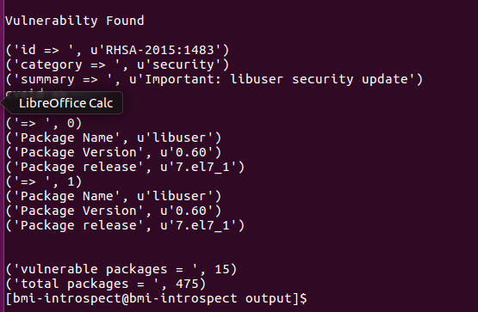
Results

Slide 6
User and Personas
User: For our test case scenario end user(commodity renter) will be our primary user
Our system will generate introspection report which consist of Vulnerable packages with its severity and package version number which will help to analyse Vulnerable packages for security purposes to the commodity renter

Slide 7
Plan for next Sprint
We will mount multiple bare metal images parallely
We will crawl multiple mount points parallely
We will automate vulnerability analysis for every crawled output file within regular time interval(Frequency)
Modify the vulnerability script to modularize the output

