Slide 1
Agentless Introspection of Bare Metal using BMI
Team:
Bhautik Pipaliya
Aditya Mohan Sharma
Sona Varma
Mihir Borker

Slide 2
Project Overview
Create an on-demand end to end agentless introspection system for the bare metal environment. Goals of the project are:
Generate vulnerability Analysis report by analyzing the frame(system information) generated by the crawler

Slide 3
Work we have done till now
Crawled OS Metadata and packages for vulnerability analysis
Created end to end workflow for one image
Created in-memory database to decrease computation time
Created Sample User Interface (User can request vulnerability report)

Slide 4
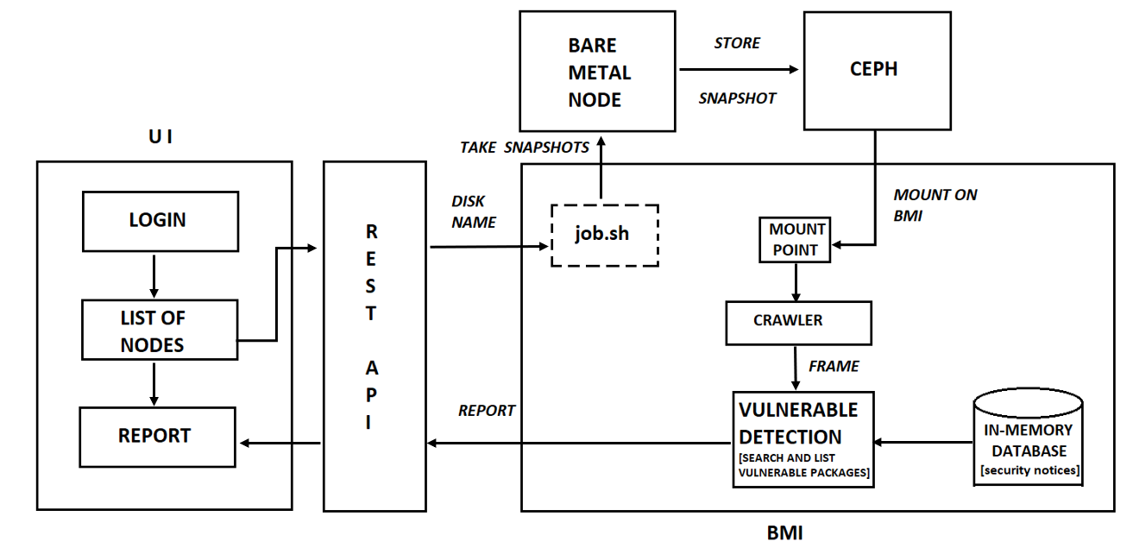
Architecture

Slide 5
Demo

Slide 6
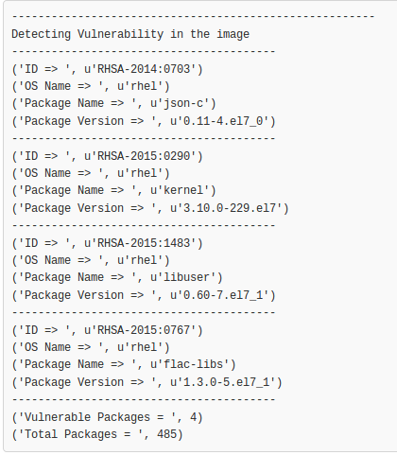
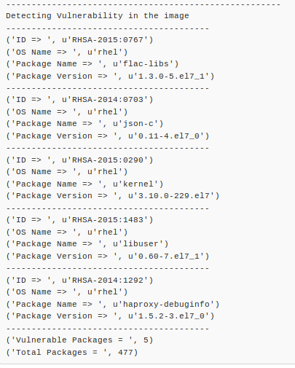
Results
Added
Vulnerable
Package

Slide 7
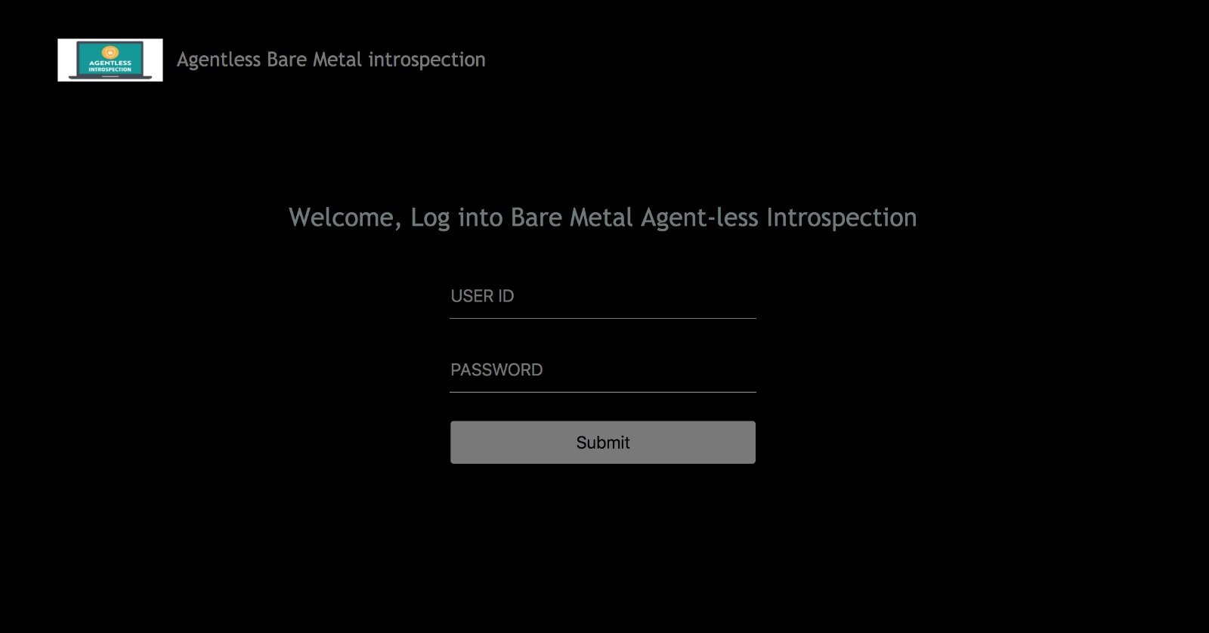
User Interface

Slide 8
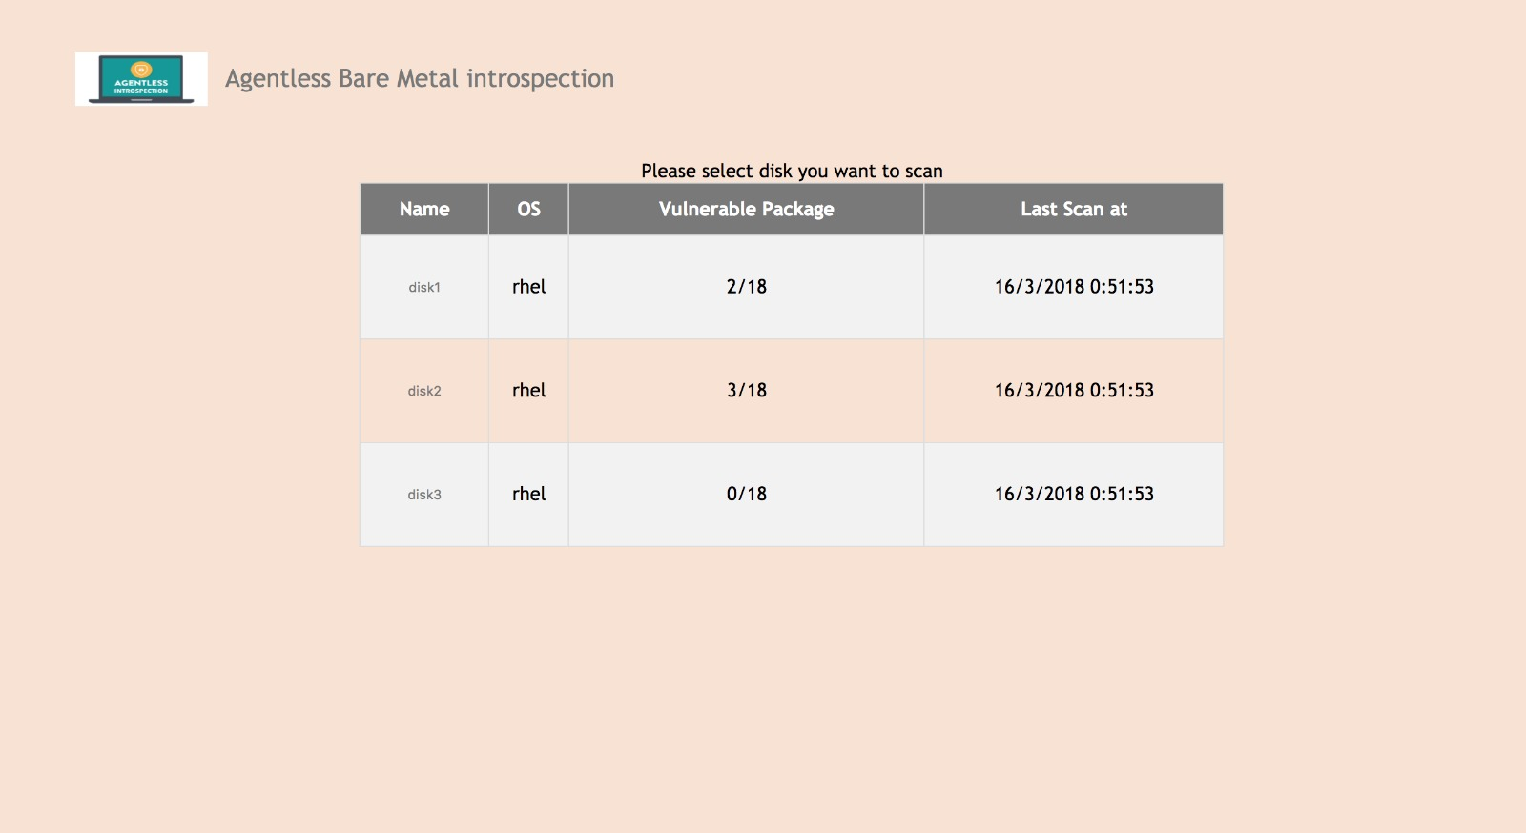
User Interface

Slide 9
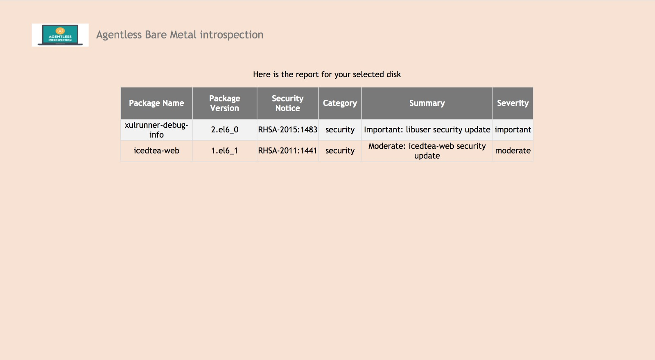
User Interface

Slide 10
In memory database
Earlier backend script was taking a lot of time (~1 min 48 sec) to detect all vulnerability packages in an image
We have created in-memory database that contains the Security Notices repo
By creating in-memory database, we are able to decrease the time for vulnerability detection by ~1 min 12 secs. Now it takes ~33 secs per/image thus improving efficiency.

Slide 11
Plan for next Sprint
Performance analysis of the system (analyze the overhead of taking snapshots of images)
Connect UI with the backend script through which vulnerability reports will be dynamically generated and accessible to the user
Create multiple instances of the script to mount multiple images parallely and make agentless crawler more efficient
We are planning to extend BMI API to add “introspect” command which would introspect the given node and generate a vulnerability report

Slide 12
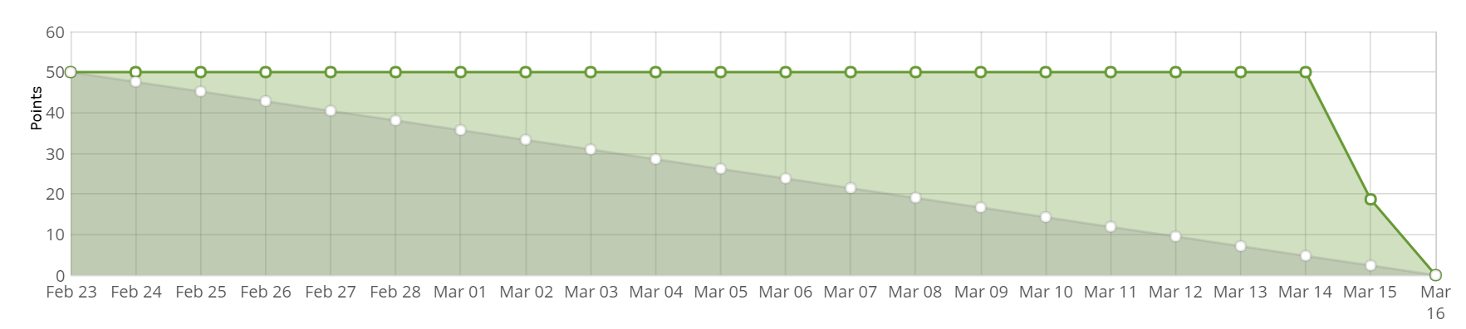
Burndown Chart

