Slide 1
Agentless Bare metal introspection

Slide 2
What is Bare Metal?
It’s a computer system or a network in which a VM is installed directly on the hard disk rather than OS of a host machine.
A lot of companies are preferring bare metal servers over VM due to unpredictability and degradation in performance.
Problems are like:
Slow provisioning
Server release for users
Poor tolerance to failures.

Slide 3
Advantages to M2
Diskless Provisioning:
These systems keep provisioning image resident on a network accessible remote logical disk that appears as a local disk to bare metal systems.
Boot multiple servers from a singe image
M2 can rapidly start running applications by fetching necessary OS and application libraries before start-up and further required are fetched on demand.

Slide 4
Goals and Vision
Extending M2 API calls to allow Bare Metal Introspection.
Providing Agentless Crawler using M2 Infrastructure.

Slide 5
Motivation
We will be extending existing crawler to create an agentless Introspection Crawler for BM machines, that means Crawler will stay out of the main disk image repo, and reasons are:
Data Noise: Since a lot of resources will be reading & writing from a single point so sometimes one resource can read incomplete data or induce data noise
Deadlocks: we have deadlocks on resources and this can cause latency.
Performance can go down since Crawler (will be discussed later) could need more resources and cause loud on that node.
Security vulnerability.

Slide 6
Scope and features
Extending existing crawler to make API calls to M2 to clone and mount existing images/snapshots of system information to a different location.
Extracting information from the location in form of Frames (block of plain text)
Providing obtained information (Frame) to Annotator which will evaluate the frame potential vulnerabilities.

Slide 7
Acceptance Criteria : Minimum acceptance criteria is a script that allows The crawler to operate in a specified network to fetch Frames and send them to annotators for analysis.
User Personas:
Companies like IBM that are using Bare Metal Servers, as they can use agentless crawlers to introspect through the disk images and perform testing for checking vulnerabilities and improve performance and increase fault tolerance.

Slide 8
So what is M2?
M2 is a general architecture for cloud provisioning for remote local storage, and it provides:
Rapidly releasing and acquiring servers to handle fluctuation in demand.
Rapidly recover from failed servers by booting another server with cloned disk and iBFT (since it is iSCSI based).
Snapshot and clone disk images on demand.
With M2 we can get cloned images for provisioning of a disk with desired application and then can do reconfiguration which is faster than provisioning server from scratch.

Slide 9
A bare-metal cloud service has to offer on demand bare-metal servers with minimum startup overhead so that short-lived deployments with lifespans of a few hours can use bare-metal servers efficiently.
We use iBFT, that is a method of communicating parameters about the iSCSI boot device to an operating system.
iBFT makes M2 OS-agnostic, since it eliminates the need for OS-specific parsing and modification of images to configure the identity of the iSCSI server for a given server.
M2 API Server:
It a python based RESTful web service that controls flow between components of M2.
Exposed API enables user to provision servers, clone provision servers, create snapshots and perform images in them.
It also maintains a DB for mapping BM servers to disk images.

Slide 10
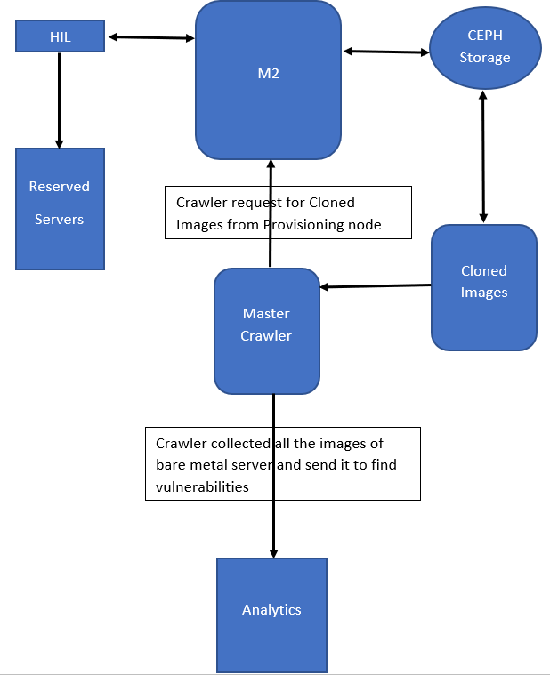
Our architecture

