Slide 1
FINAL PROJECT Statistical and Predictive Modeling for Analytics II (DATA 2204) SONAKSHI Karkera 100720763 Prof: Sam plati
Fraud transaction detection for banking industry

Slide 2
Problem Statement
In banking sector fraud has become one of the leading issues that they are trying to stop for the past 100 years.
The problem selected for this project is to identify the fraudulent behavior based on various transactions performed by the customers.
This problem of fraud detection is framed as classification problems —predicting a discrete class label output given a data observation. Our aim here is to detect 100% of the fraudulent transactions while minimizing the incorrect fraud classifications.
This dataset contains various transactions that occurred, where we have 610 frauds out of 1372 transactions. The dataset is fairly balanced, the positive class (frauds) account for 44% of all transactions
The dataset provided is a valuable training and testing ground for supervised machine learning to try and develop models that can identify patterns of fraud from the features within the data.
We will use detection algorithms and identify transactions with a high probability of being fraudulent.
The ultimate goal of analyzing the dataset is to be able to predict cases of fraud or unsafe practices far in advance, so those responsible can be punished, and those who are innocent are not harmed.

Slide 3
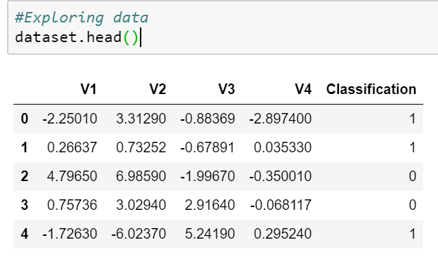
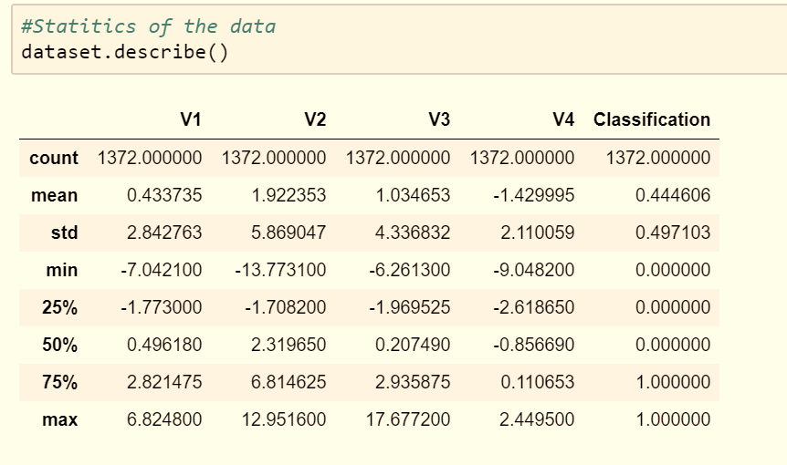
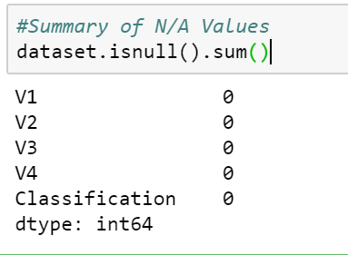
Exploratory data analysis (EDA)
On exploring the data through head function we find that the data has 4 independent variables-V1, V2,V3,V4 and 1 dependent variable-classification (fig 1)
Describe function to get various summary statistics that exclude NaN values. This gives us important information about count, min, max, std, mean and percentile for each feature.(fig 2)
We check if there are any null or missing values in any of the features. However, the dataset has no null values.
Fig 1
Fig 2
Fig 3

Slide 4
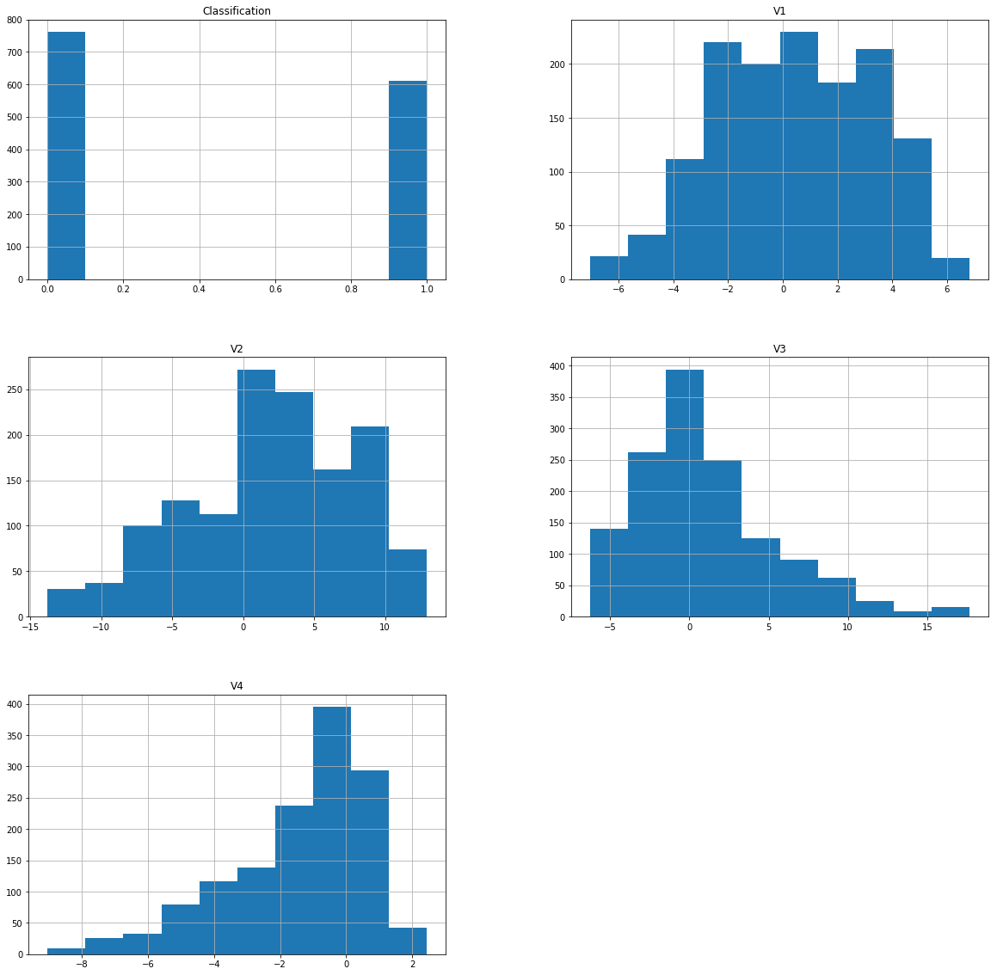
Graphical Representation of Data
Histogram Plot
We look at the behaviors or distribution of columns by plotting Histogram, Boxplot and correlation plot.
The histogram graph on the right, provides us with distribution of data for each feature. For V1, the data is widely spread across the center. We see that majority of the values for V1 ranges between -6 to 6. We can see a Gaussian-like shape to the data, that although is not strongly the familiar bell-shape, is a rough approximation.
V3 is positively skewed while v4 is negatively skewed. Most of the data point for V3 is between -5 to 5 whereas for v4 it is between 1.5 to -2
For V2, the data is widely spread across the center. . We see that majority of the values for V2 ranges between 0 to 20.

Slide 5
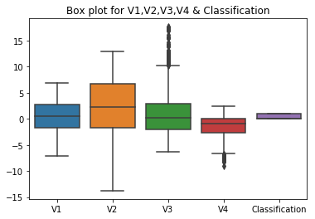
From the above graph first black horizontal line of rectangle shape of box plot is First quartile or 25%
Second black horizontal line of rectangle shape of box plot is second quartile or 50% or median.
Third black horizontal line of rectangle shape of box plot is third quartile or 75%
Top black horizontal line of rectangle shape of box plot is maximum value and bottom is minimum value. Small diamond shape of box plot is outlier data or erroneous data.
We see that max value for V1 is approx. 6 and minimum is -6. Maximum concentration of data lies between -1 and 3. Any value beyond minimum and max value is outliers and we need to eliminate this from our data.
Similarly for V2 max value is approx. 12 and minimum is -13. Maximum concentration of data lies between -1 and 6
For V3, max value is approx. 17 and minimum is -6 Maximum concentration of data lies between -1 and 3.However, we see some outlier values beyond 10.
For V4, max value is approx. 3 and minimum is -9 Maximum concentration of data lies between -2 and 0.However, we see some outlier values beyond -6

Slide 6
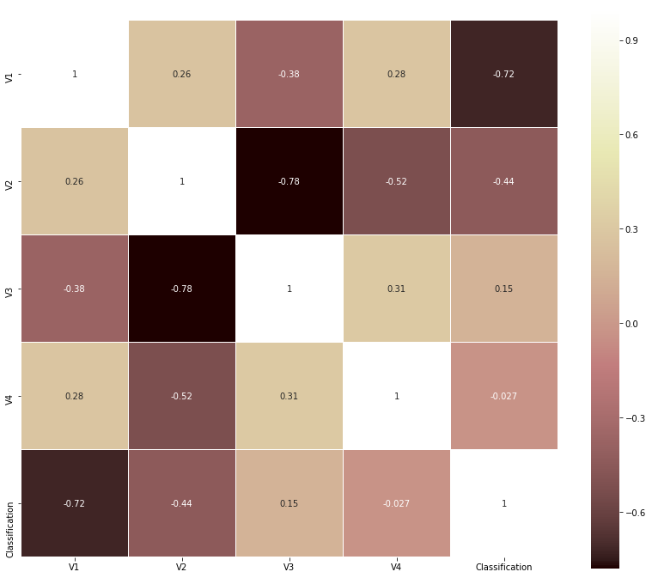
Correlation graph:
From the below correlation matrix graph, we see V1 has strong negative correlation with classification of about 72% whereas with V3 again it is negatively correlated by 38%.In case of V2 and V3 , its positively correlated by 26% and 28%
Similarly, V2 has strong negative correlation with V3 V4 by 78% and 52%.Whereas with classification its again it is negatively correlated by 44%.

Slide 7
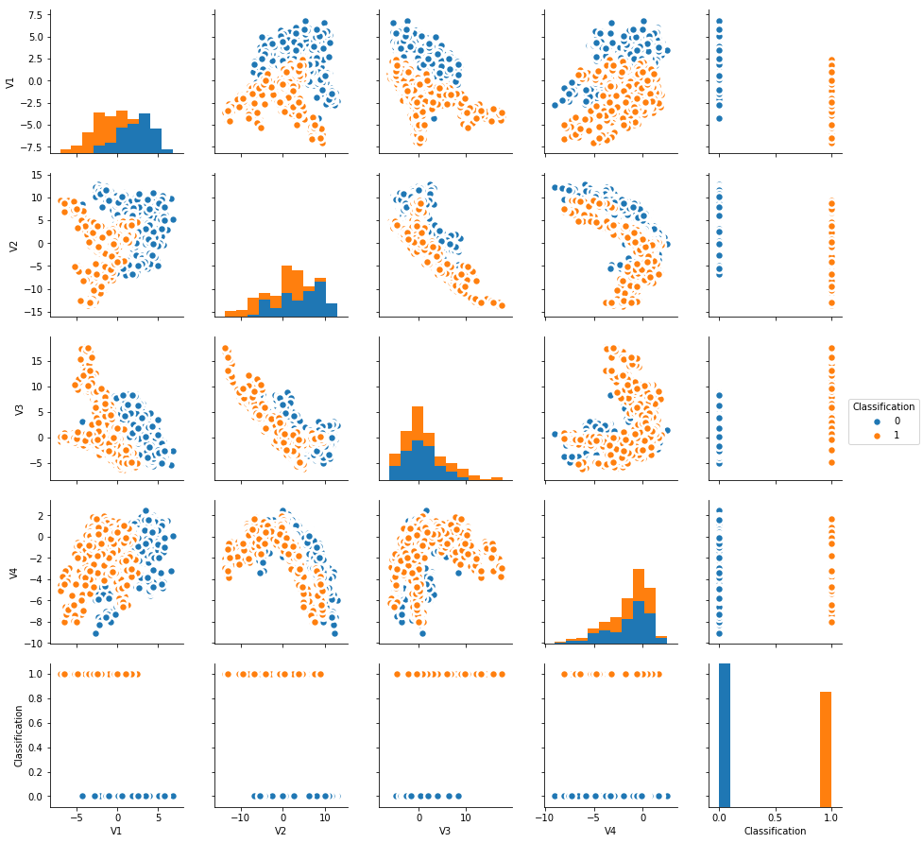
Scatter plot
From the above scatter Plot, we see that V1 has somewhat linear relationship with V2 and V4. Hence, they are correlated.
Similarly, V4 and classification has linear relationship.
Assumption for correlation: If two are correlated and one is removed then it won’t affect the model as each one is same as the other

Slide 8
Models used
The objective of choosing model is to create simple and efficient model like
Decision tree and use ensemble methods to check if the performance of the model
increases.
A decision tree allows partitioning data into much deeper level, not easily achieved with
other decision-making classifiers such as logistic regression or support of vector machines.
When we fit a decision tree to a our train dataset, top few nodes on which the tree is split
are the most important variables in the dataset and feature selection is done automatically.
Additionally since we have non linear data relationship, decision tree handles nonlinear
relationships between parameters and does not let it affect tree performance.
Ensemble methods: The problem with decision tree is that as number of levels in the tree grows
the tree becomes prone to overfitting. It suffers from large bias with simple trees and a large
variance with complex trees. and ensemble method is the viable way to apply
regularization over the model.

Slide 9
Bagging(Random Forest): Creates m new training sets. Each new train data set picks an example of sample with substitution (bootstrap test) from original set. By inspecting with substitution, a few observation might be rehashed in each new training set. The m models are fitted utilizing the above m bootstrap samples and consolidated by averaging the result (for relapse) or casting a ballot (for grouping)
Advantages:
It is useful for improving accuracy and stability of the algorithms
It reduces variance.
Boosting(AdaBoost): gives consecutive learning of the indicators. The main indicator is found out in original dataset, while coming up next are learnt on the training set dependent on the execution of the past one. It begins by characterizing the original dataset and giving equivalent loads to every observation. On the off chance that classes are anticipated inaccurately utilizing the primary learner, at that point it gives higher load to the missed classified observation. Being an iterative procedure, it keeps on including classifier until a point of confinement is come to in the quantity of models or precision.
Advantages:
Each tree complements the previous ones (Avoid redundancy)
Keeps track of errors.

Slide 10
Gradient boosting: Gradient Boosting trains models in a gradual, additive and sequential manner. It identifies the shortcoming of weak decision tree by using gradient in the loss function.
the loss function would be a measure of how good our predictive model is at classifying fraudulent behavior.
Random Forest Classifier: It trains each tree independently, using random sample of the data. This randomness helps to make the model more robust than a single decision tree, and they are less likely to overfit on the train data
Advantages:
RF are much easier to tune
It resolves overfitting problem.

Slide 11
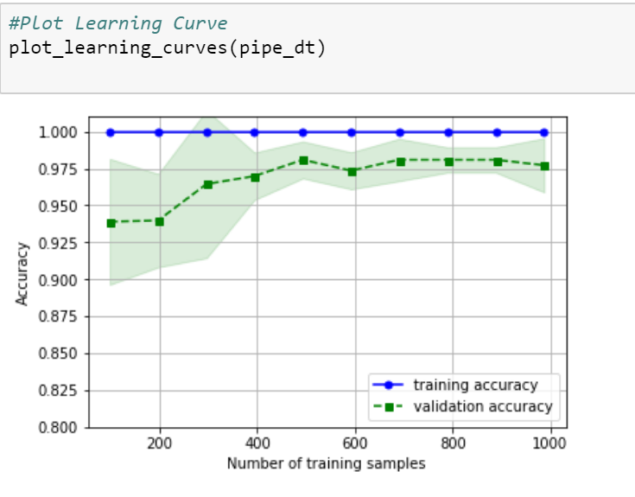
Results
Decision tree with Optimization
We divide the data into train and test (80:20) after scaling
the data so that our features fit in the range of 0 to 1.
We set random state as 100 to get standard result each time
it runs.
We import Decision Tree Classifier through pipeline.
Grid Search is used to find the optimal hyperparameters which is then passed on to our Decision Tree classifier. We then evaluate the testing and training accuracy through learning plot.
Using cross validation, we evaluate recall value-which is a measure of how many truly relevant results are returned.
Above plot tells us how much we benefit from adding more training data and whether the estimator suffers more from a variance error or a bias error.
We see that training score is much greater than the validation score for the maximum number of training samples, adding more training samples will most likely increase generalization. The Model could benefit from more training examples.
We can see clearly from (fig c) that the training score is still around the maximum and the validation score increases with more training samples.
Fig c

Slide 12
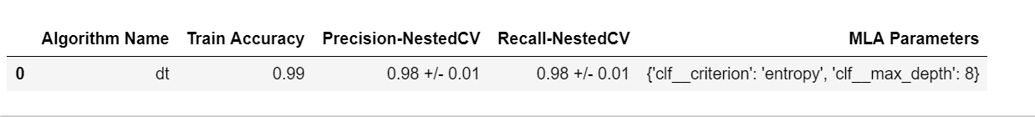
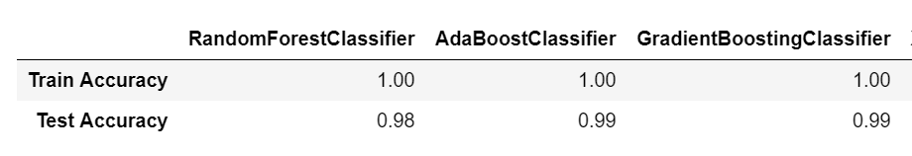
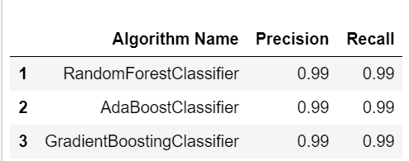
Relying only on classification accuracy when evaluating certain learning method is not enough, you need to consider additional evaluation metrics such as recall value
We get recall value of 98%±0.01 and accuracy of 99% is quite good. It might be possible that the classifier is overfitting the training set. Therefore, to avoid that, you need to perform your classification process using ensemble models and check if there is any chance in model performance.
We have we will try using other models or use ensemble method. We’ll compare the results of ensemble methods

Slide 13
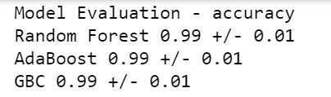
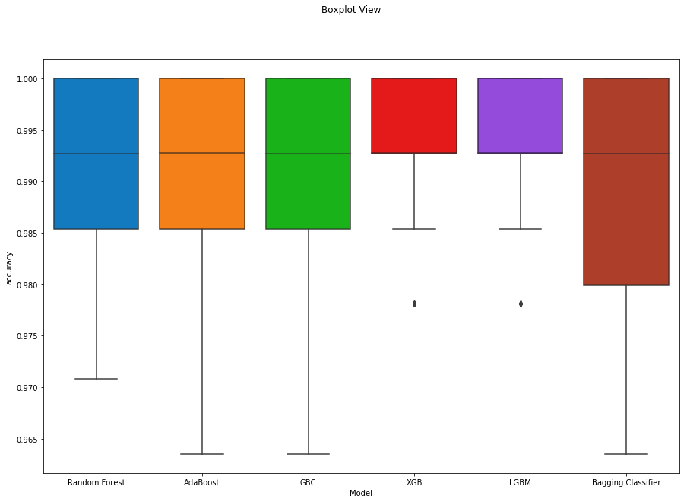
Random Forest Classifier: Random decision forests corrects
decision tree’s issue of overfitting to their training set.
We see that training accuracy is still around the maximum
and the test accuracy is 98%. Though technically the
"accuracy" of the model is >99%.
When the actual transaction is fraud the classifier
is able to identify it 99% of the times.
AdaBoost Classifier: It is less susceptible to overfitting
training set.
We see that training accuracy is still around the maximum
and the test accuracy is 99%. Though technically the
"accuracy" of the model is >99%,when the actual
transaction is fraud the classifier is able to identify it
99% of the times.

Slide 14
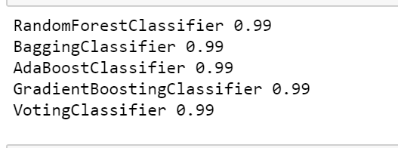
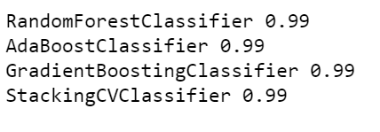
Gradient Boosting Classifier: It generalizes allowing optimization of an arbitrary differentiable loss function. We see that training accuracy is still around the maximum and the test accuracy is 99%. Though technically the "accuracy" of the model is >99%,when the actual transaction is fraud the classifier is able to identify it 99% of the times.
Voting Classifier: It combines different machine learning classifiers, and takes vote on what the predicted class labels are for a record. Looking at the below result, the recall value there is not much increase or decrease in the value after combining all the model into one.
Stacking Classifier: In this a new model is trained from the combined
predictions of previous models. We obtain value of 99% after stacking
all the previous models.
Comparison:
Hence ,we see that ensemble models are working perfectly fine and not
much difference in accuracy and recall value They perform pretty well
the same.

Slide 15
Conclusion
Comparing the two models, decision tree with optimization using ensemble method performs better than the decision tree.
Recall value is the metric we look for rather than accuracy of the model.
It classifies fraudulent transactions 99% of the time.
The training accuracy of the decision tree is 1, which indicates that there is high variance and the model wont perform good with provided with real time data.
Ensemble models mitigates the problem of overfitting. Hence, we choose this as it mitigates the issue of overfitting.

Slide 16
Recommendation
On comparing Decision Tree and ensemble methods, we see that both them perform quite well and there is not much difference in the recall values of the ensemble methods and decision tree. However, decision tree is prone to overfitting and ensemble methods control overfitting hence its wise to choose any one of the ensemble methods for modelling.
Our aim was to achieve recall value of > 95%, which we achieved using the models described. However, credibility of the result comes under question when it performs so well. If we have more features and data for this dataset then probably we would see some difference in the performance.
The main reason for using ensemble classifier is that it combines all results equally weighted from decision tree model. An improvement to this work could be optimizing each of the simple models by finding best parameters and then checking whether the ensemble model can outperform.

Slide 17
KNN can be used to achieve high performance, without a priori assumptions about the distributions from which the training examples.
SVM can be used for credit card fraud recognition, for each test case, it decides whether the test case falls inside the learned area. At that point if a test case falls inside the learned area, it is considered as expected; else it is pronounced as an anomaly. This model can be used to have higher precision and recall value as compared to other models

Slide 18
References:
Boosting, Bagging, and Stacking - Ensemble Methods with Sklearn and Mlens
Robert DeFilippi-Robert DeFilippi - https://medium.com/@rrfd/boosting-bagging-and-stacking-ensemble-methods-with-sklearn-and-mlens-a455c0c982de
Building Decision Tree Algorithm in Python with Scikit Learn
http://dataaspirant.com/2017/02/01/decision-tree-algorithm-python-with-scikit-learn/

