Slide 1
Air Quality Analysis - USA Identify Problems / Propose Solutions Contribute to the Body of Knowledge
Submitted By:
Shreshtha Shukla
Sonakshi Garg

Slide 2
Problem Statement and Data
Rapid industrialization has given rise to land, air and water resources sites being contaminated with toxic waste and pollutants
Analyzing the historical data and trying to find out the various factors affecting the levels of pollution
The proposed solutions may help in determining emission limits and reduce the pollution by taking necessary action
The dataset is of 316 MB having 55 Attributes. https://www.kaggle.com/epa/air-quality/data

Slide 3

DATA QUALITY CHALLENGES
Dimensionality
Complex and Heterogeneous Data
Missing values
Duplicate data
Outliers

Slide 4

Air Quality Analysis – Data Mining Pipeline
Data Exploration
Attribute Categorization
Data Cleaning
Performing Data Mining tasks:
a) Classification
b) Clustering
c) Association
Inferences and next steps

Slide 5
Pre-Processing tasks for Data Quality
Replaced missing values – Imputed with mean/modes
Removed Duplicate values
Identified and removed outliers
Data Transformation
Data Discretization

Slide 6
Attribute Categorization
Location – State_code, county_code, site_num, state_name
Time and Resolution – year, sample_duration, metric_used
Measurement Method – parameter_code, parameter_name, units_of_meausre
Yearly Readings Coverage – observation_count, observation_percent
Readings Statistics – arithmetic_mean, ninety_nine_percentile, ten_percentile
Validation – completeness_indicator, event_type

Slide 7
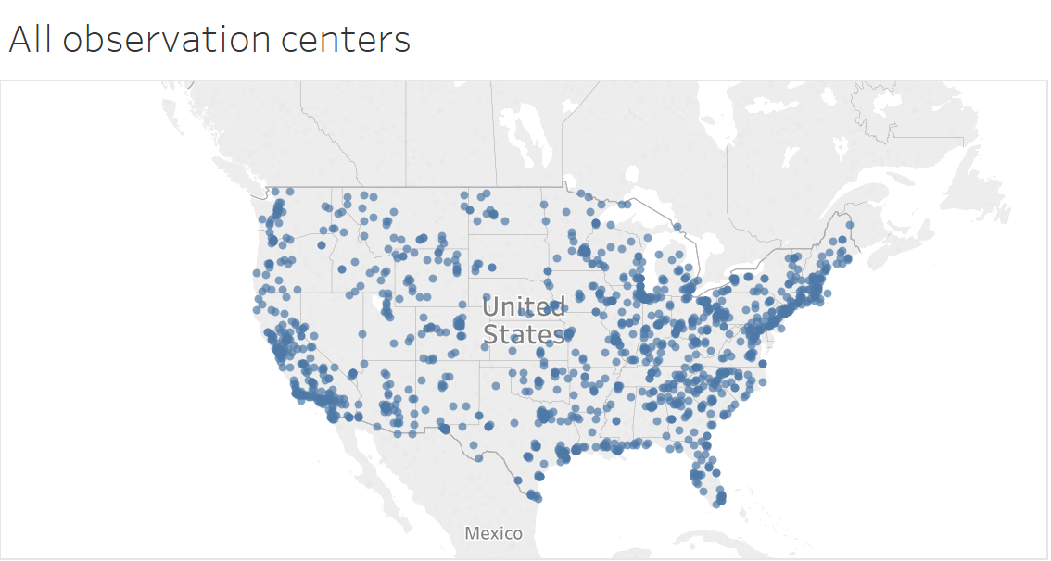
Data Exploration

Slide 8
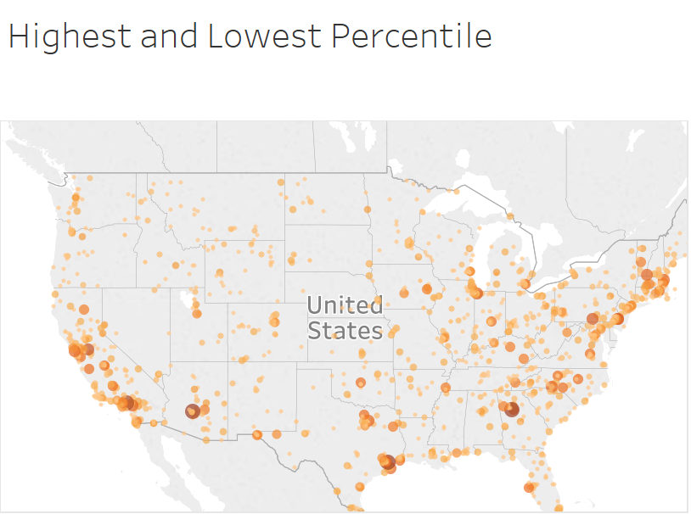
Data Exploration

Slide 9
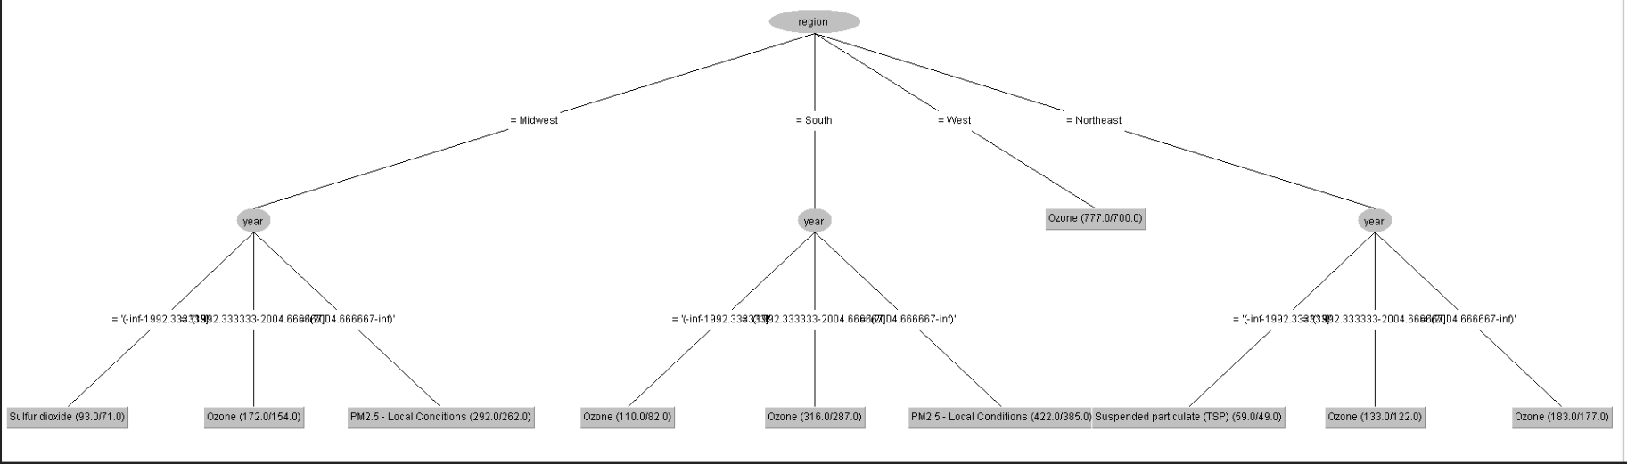
Data Mining task – Classification (DecisionTree)

Slide 10
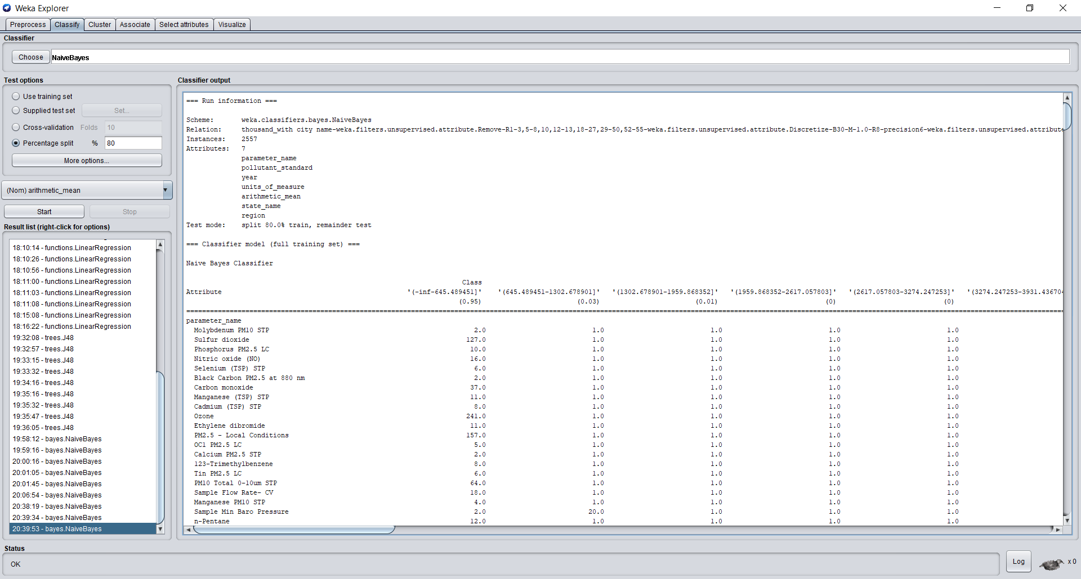
Data Mining task – Classification (NaiveBayes)

Slide 11
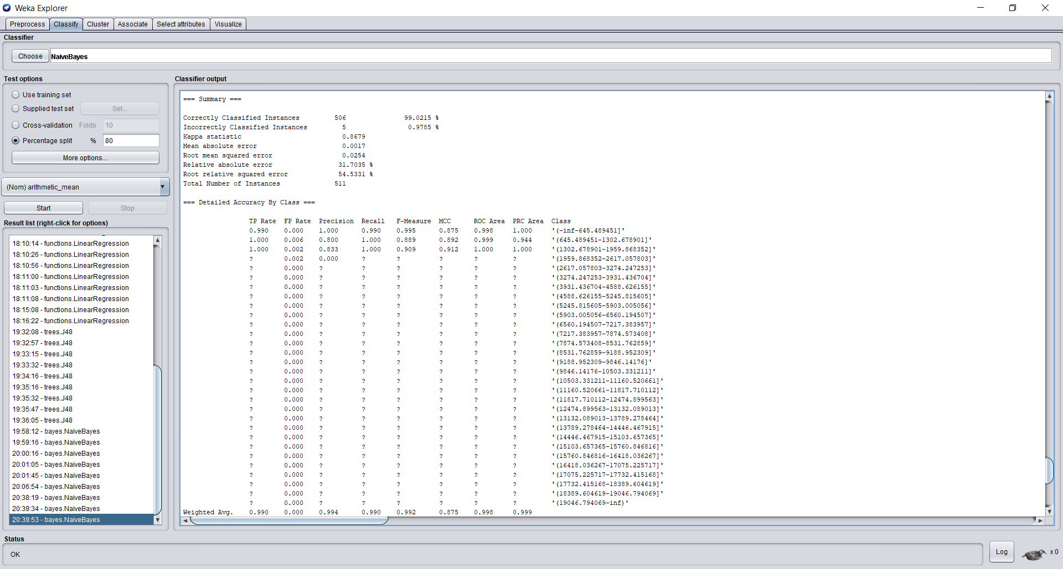
Data Mining task – Classification (NaiveBayes)

Slide 12
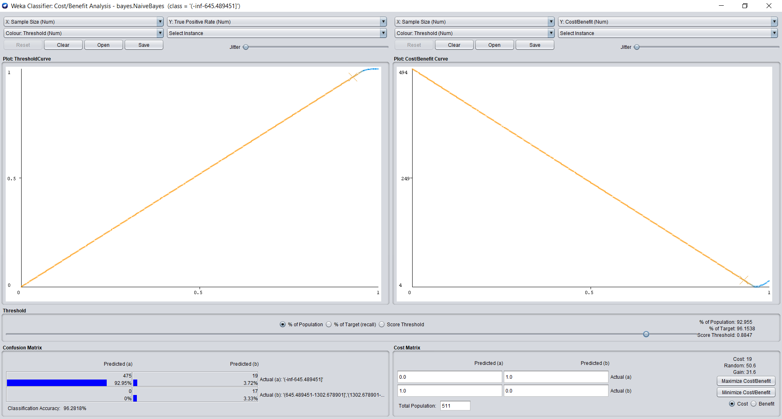
Data Mining task – Classification (NaiveBayes)

Slide 13

Data Mining task – Classification (NaiveBayes)

Slide 14
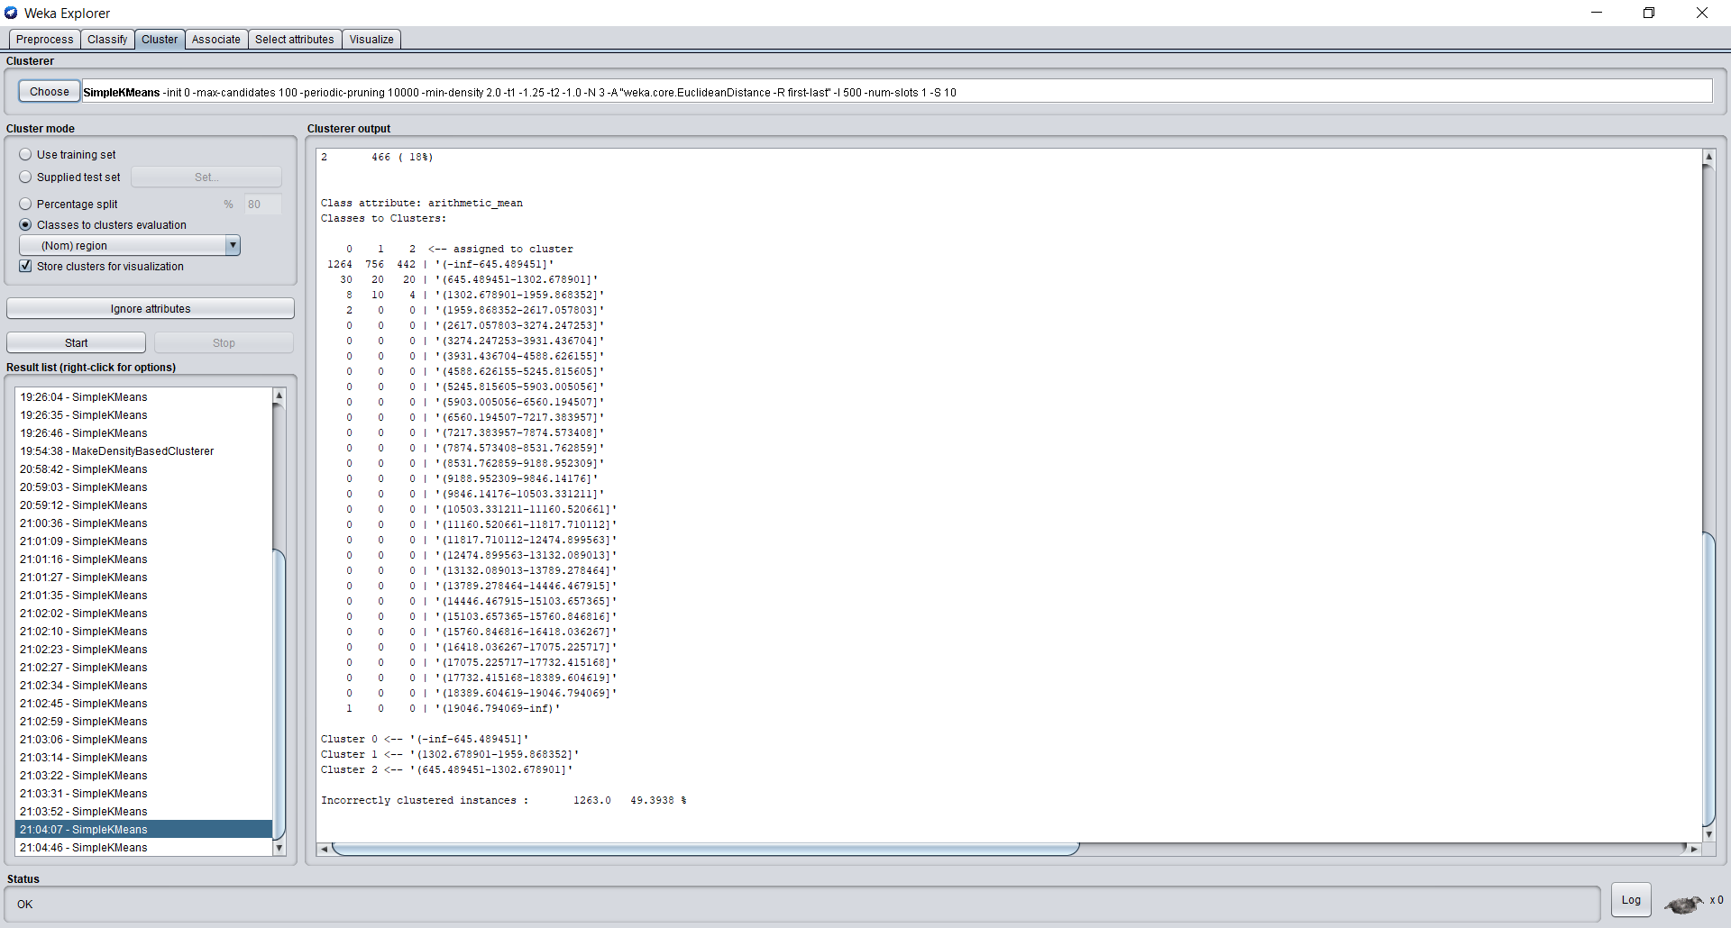
Data Mining task – Clustering (SimpleKMeans)

Slide 15
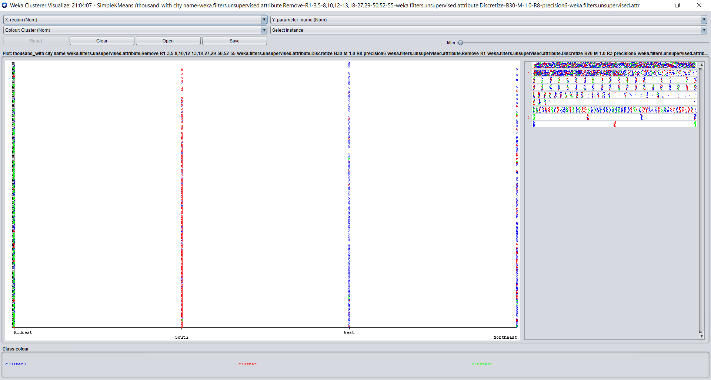
Data Mining task – Clustering (SimpleKMeans)

Slide 16
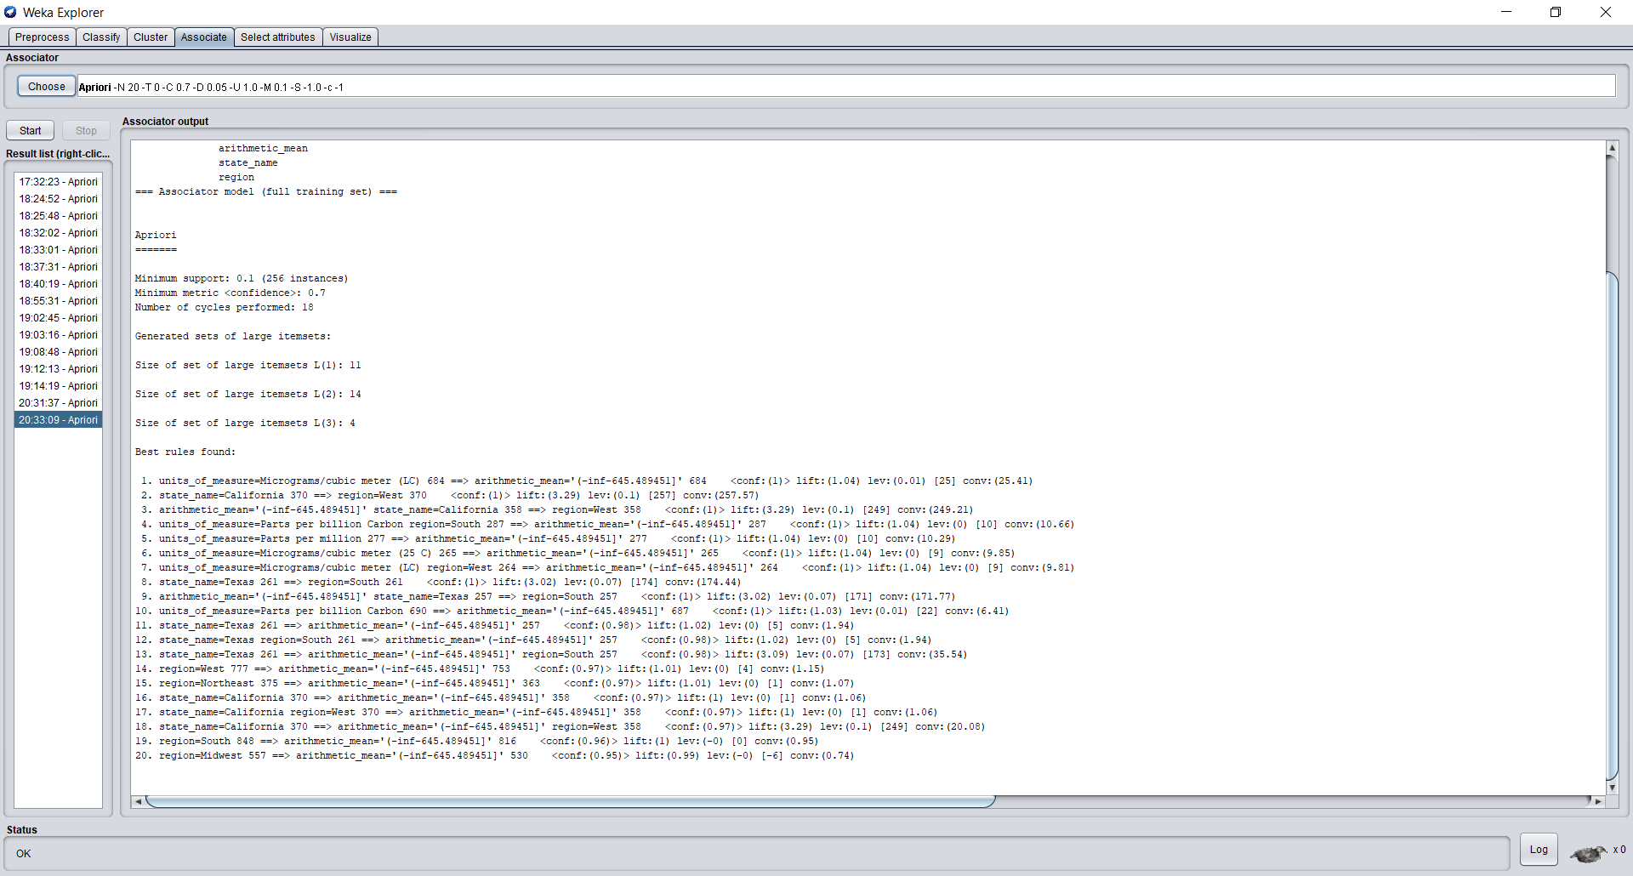
Data Mining task - Association Rules

Slide 17
Next steps
Optimizing our models for more informative insights
Prediction techniques

Slide 18
THANK YOU

