Slide 1
Customer Segmentation & Shopping Behavior Analysis
SQL & Power BI Dashboard
Capstone Project

Slide 2
Project Overview
• Objective: Analyze customer shopping behavior using SQL & Power BI
• Understand gender, age, category, and payment insights
• Build interactive dashboard for better decision-making

Slide 3
Dataset Description
• Source: MySQL Database (customer table)
• Columns include:
- age, gender, category, shopping_mall
- invoice_date, invoice_no
- payment_method, price, quantity
• Total Sales measure created using (price × quantity)

Slide 4
Dashboard Components
• Gender Distribution Chart
• Age Group Distribution
• Category Distribution
• Payment Method Breakdown
• Sales Trend & Category Sales

Slide 5
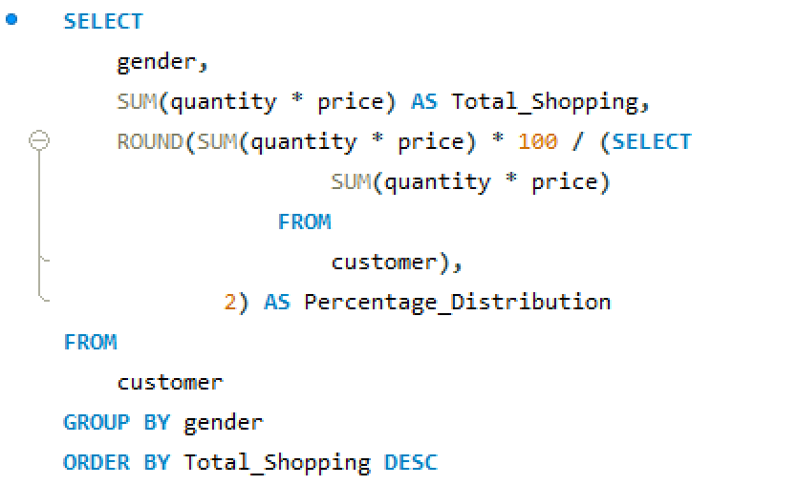
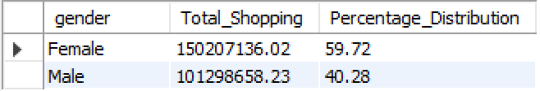
1. How is the shopping distribution according to gender?
Female customers contribute 59.72% of total shopping — so they shop slightly more overall.

Slide 6
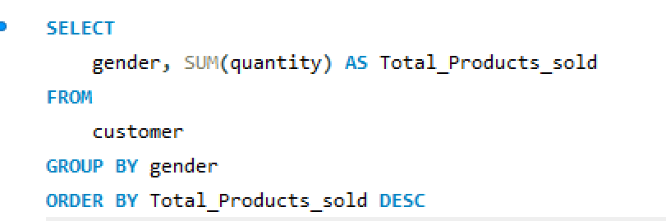
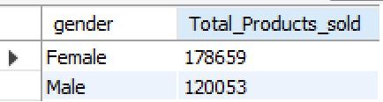
2. Which gender did we sell more products to?
Female customers purchased more products overall than male customers.

Slide 7
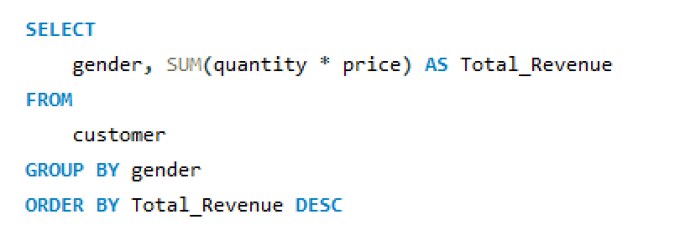
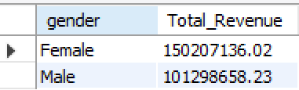
3. Which gender generated more revenue?
Females customers generates more Revenue than Male customers.

Slide 8
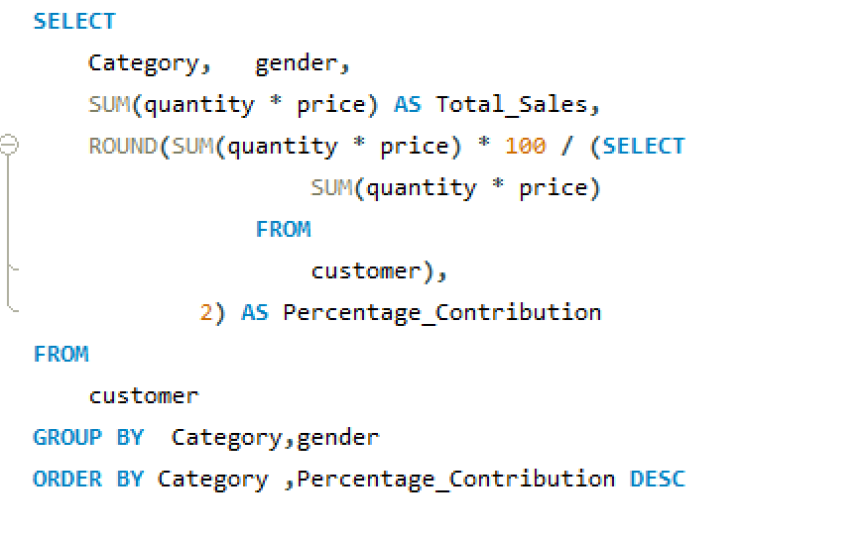
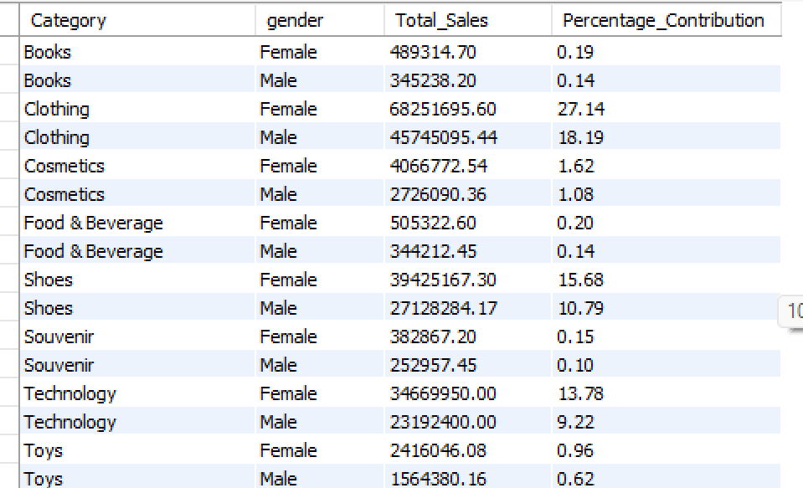
4. Distribution of purchase categories relative to other columns
Females buy more Products from every category overall than Males.

Slide 9
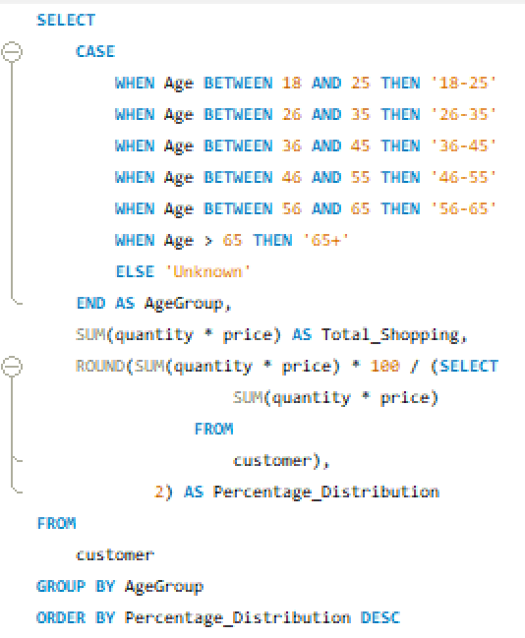
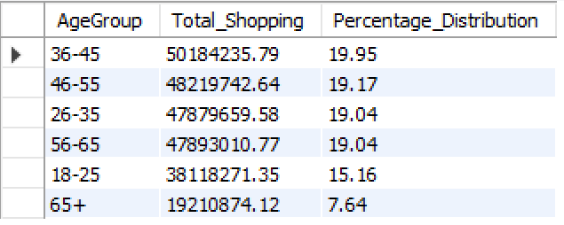
5. How is the shopping distribution according to age?
36-45 years group contributes 19.95% of total shopping - so they shop slightly more overall.

Slide 10
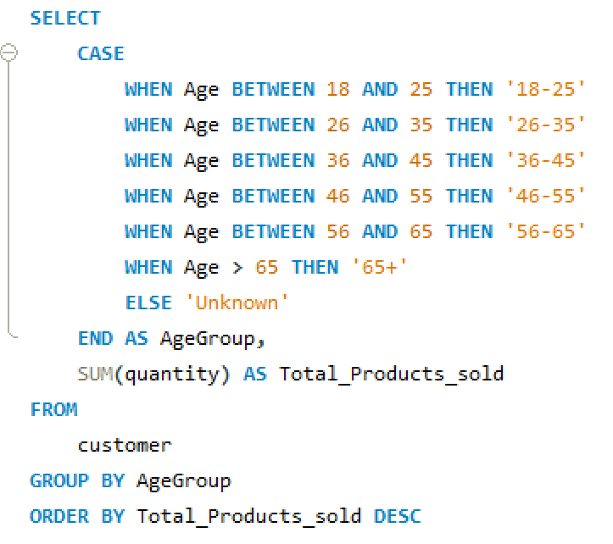
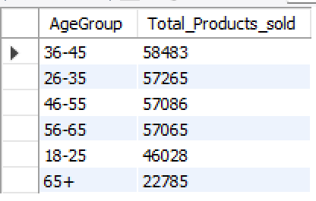
6. Which age cat did we sell more products to?
The 36–45 years group bought the most products — your top customer segment.

Slide 11
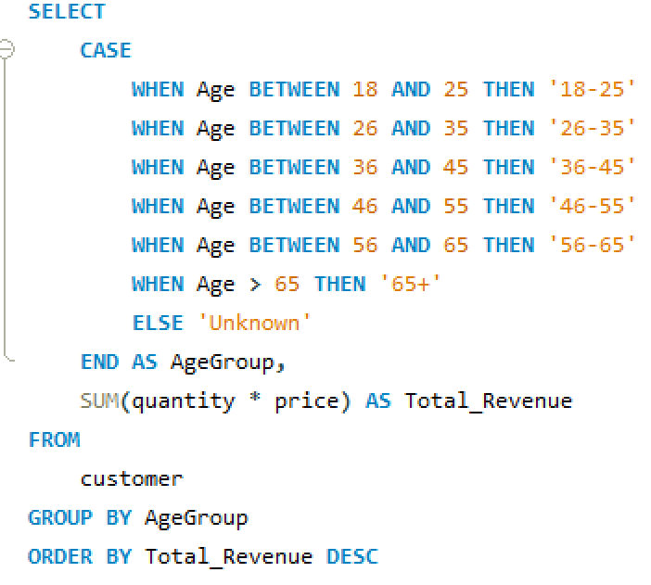
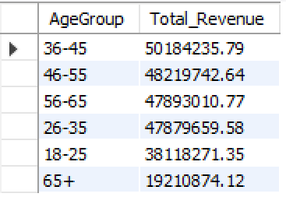
7. Which age cat generated more revenue?
36-45 years Group customers generates more Revenue.

Slide 12
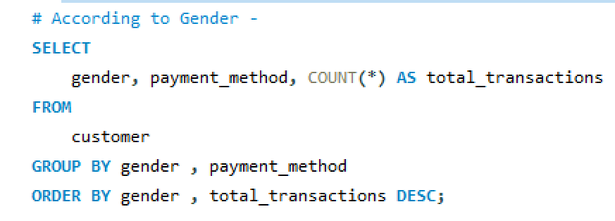
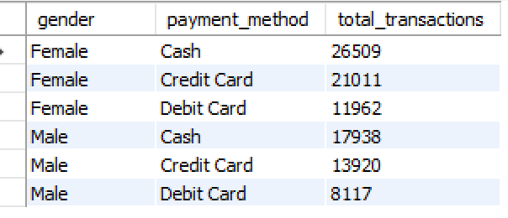
8. Does the payment method have a relation with other columns?
Males & Females both prefers a Cash payment mode.

Slide 13
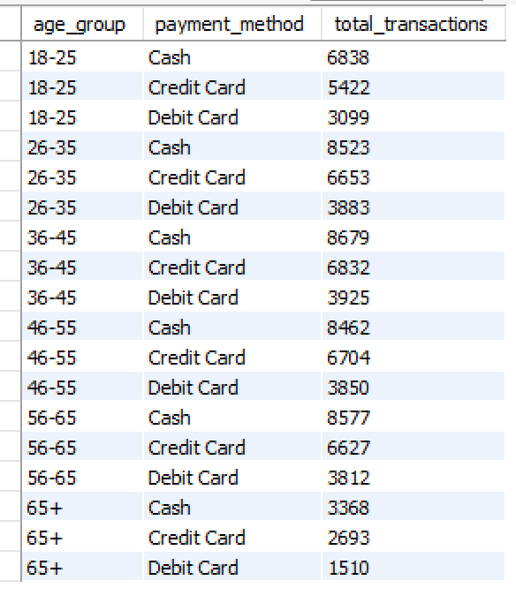
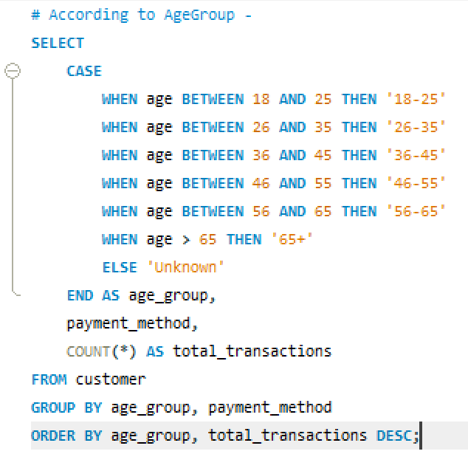
8. Does the payment method have a relation with other columns?
It Shows how age influences payment preference (you might find that younger people use cards, while older ones use cash).

Slide 14
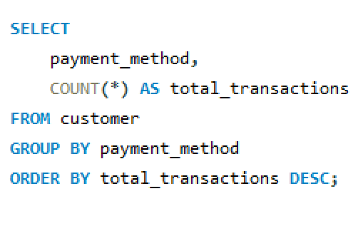
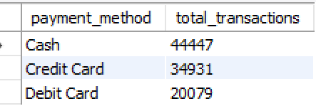
9. How is the distribution of the payment method?
Most customers used Cash, followed by Credit Card, then Debit Card.

Slide 15
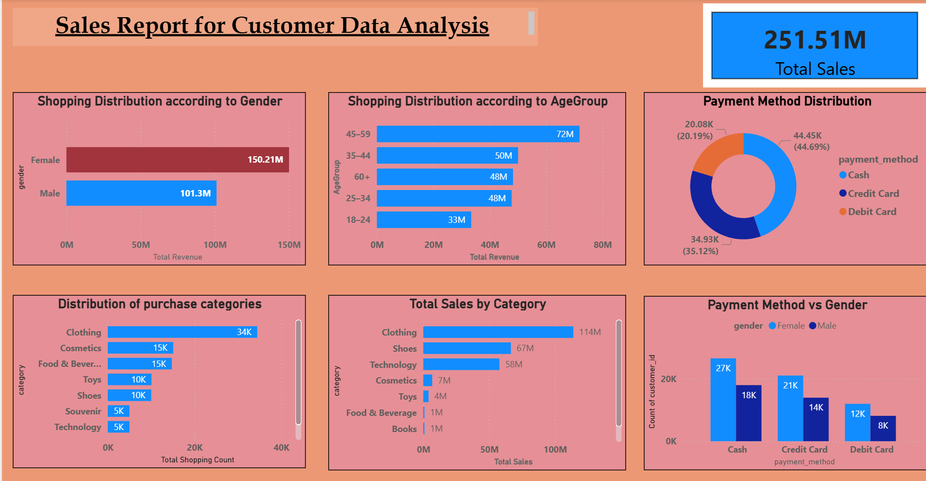

Slide 16
Key Insights
Women and middle-aged customers are the strongest contributors to business revenue.
Clothing and Shoes are the dominant product drivers.
Cash remains the primary payment choice, indicating possible digital adoption barriers.
Some categories show low revenue despite moderate purchase counts.

Slide 17
Final Recommendations
The company should prioritize female shoppers, focus on middle-aged customers, promote high-value categories, and speed up digital payment adoption.
These steps will increase sales, improve customer loyalty, and strengthen business performance.

Slide 18

Thank You!

