Slide 1
IMDB Movies Analysis

Slide 2
Key Insights
A handful of directors produce the majority of films.
Blockbuster titles dominate overall revenue.
Popularity and revenue do not always correlate.

Slide 3
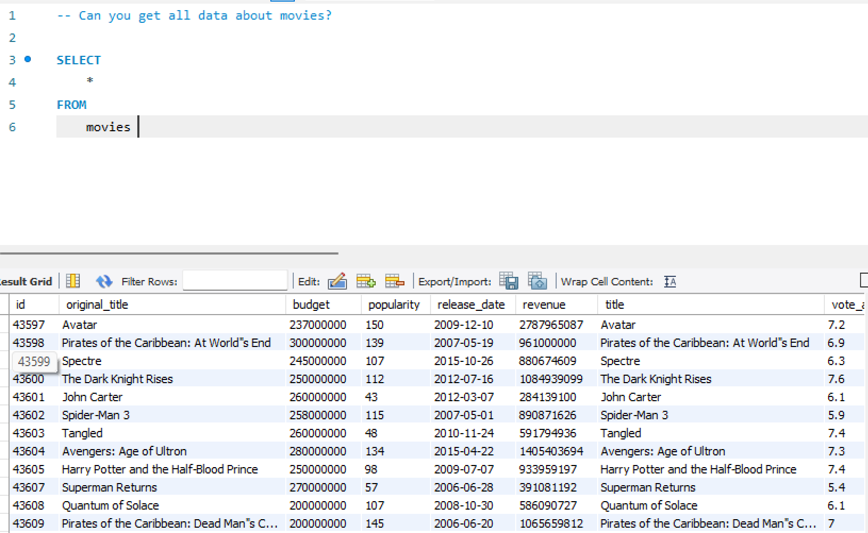
1. Can you get all data about movies?

Slide 4
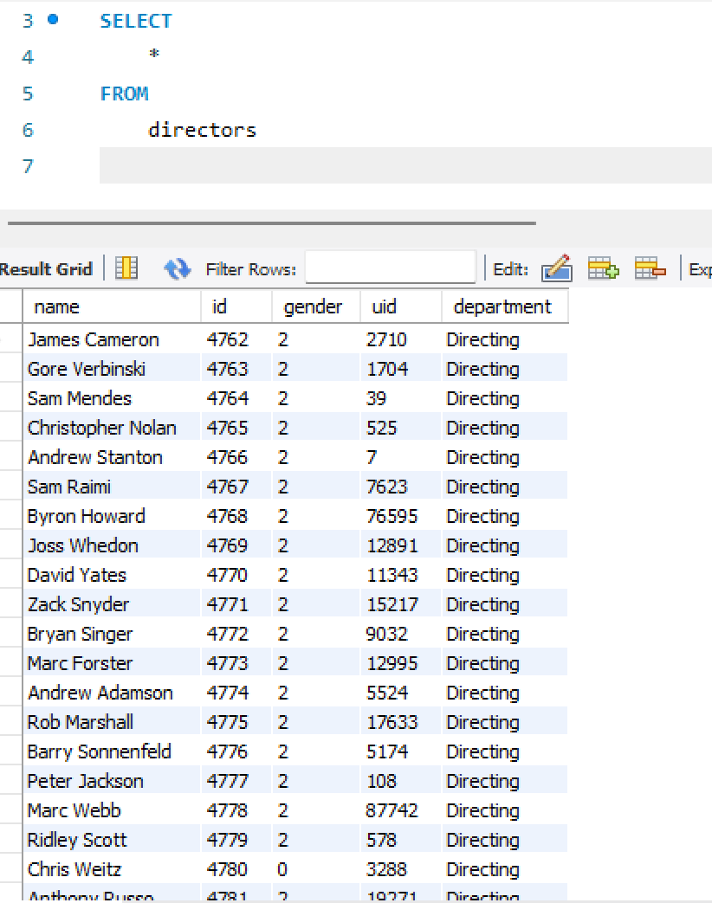
2. How do you get all data about directors?

Slide 5
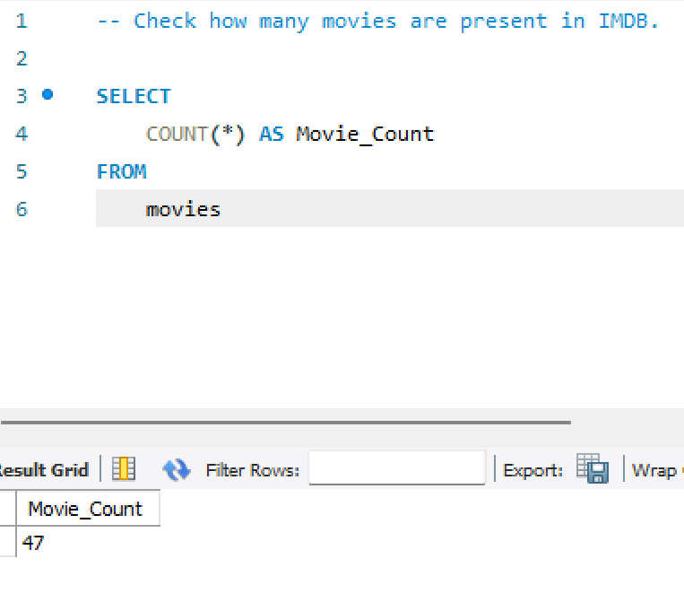
3. Check how many movies are present in IMDB.

Slide 6
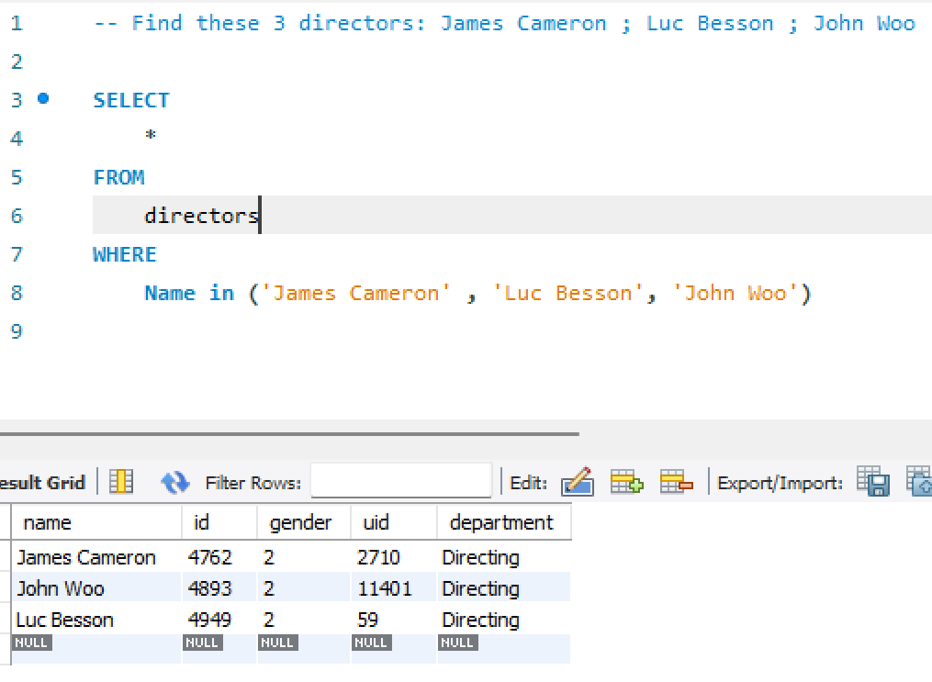
4. Find these 3 directors: James Cameron ; Luc Besson ; John Woo

Slide 7
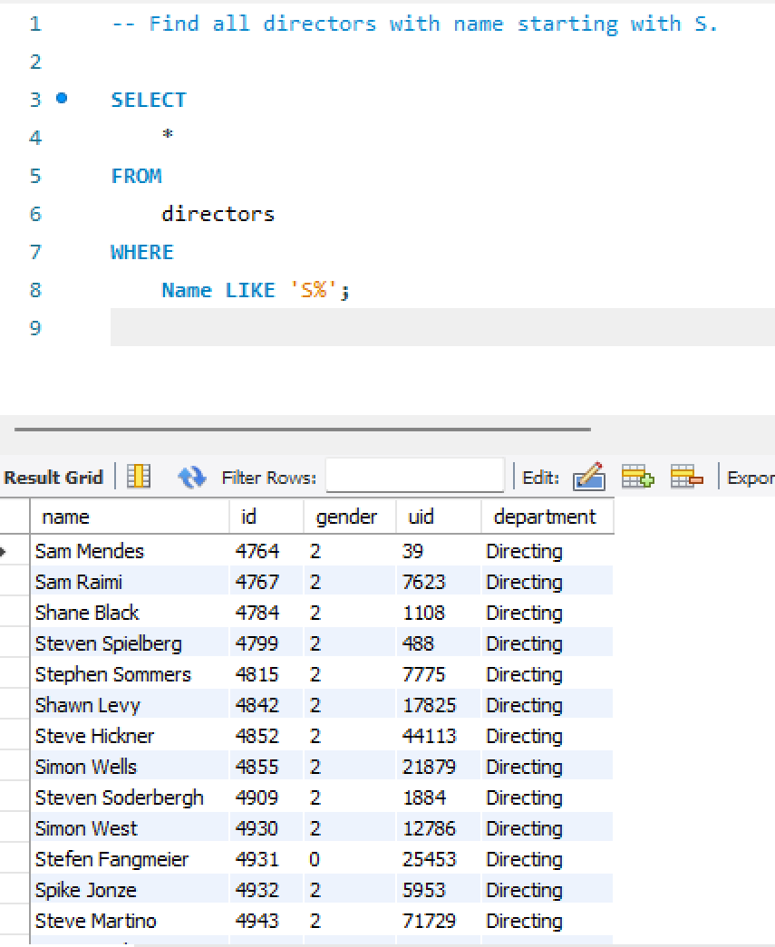
5. Find all directors with name starting with S.

Slide 8
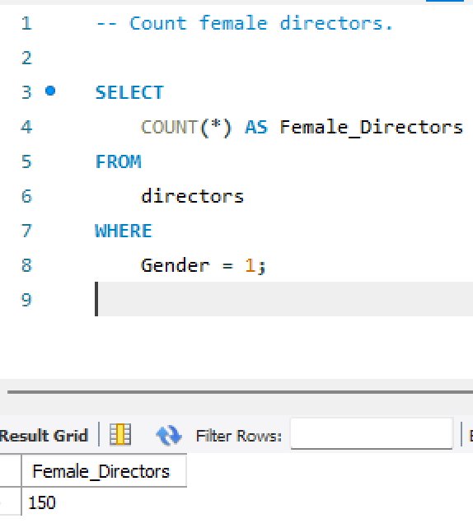
6. Count female directors.

Slide 9
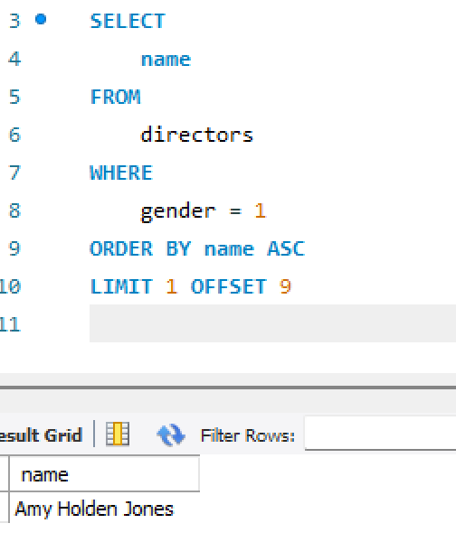
7. Find the name of the 10th first women directors?

Slide 10
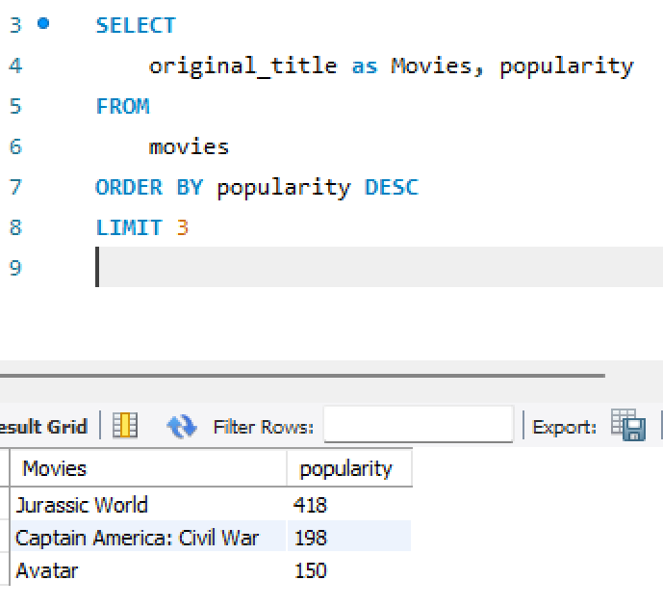
8. What are the 3 most popular movies?

Slide 11
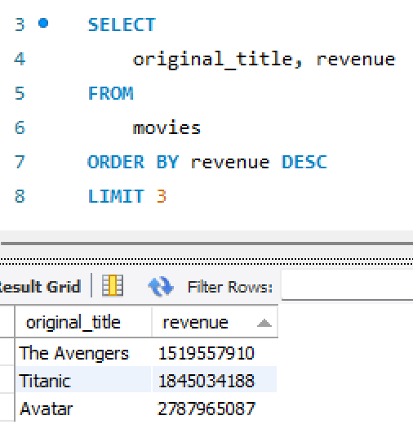
9. What are the 3 most bankable movies?

Slide 12
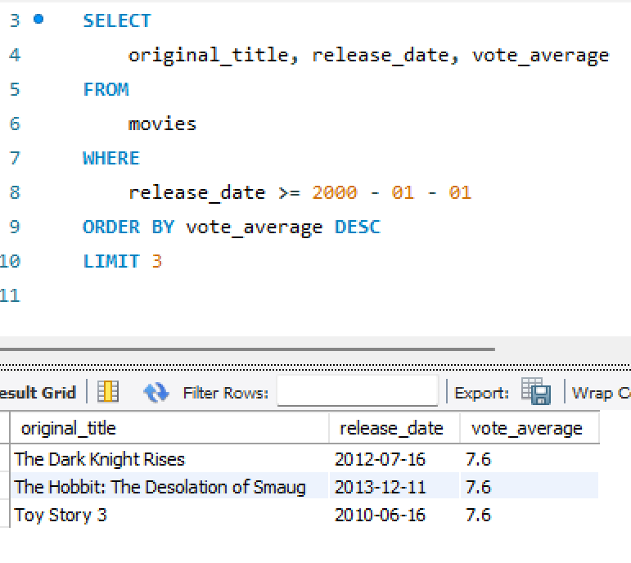
10. What is the most awarded average vote since the January 1st, 2000?

Slide 13
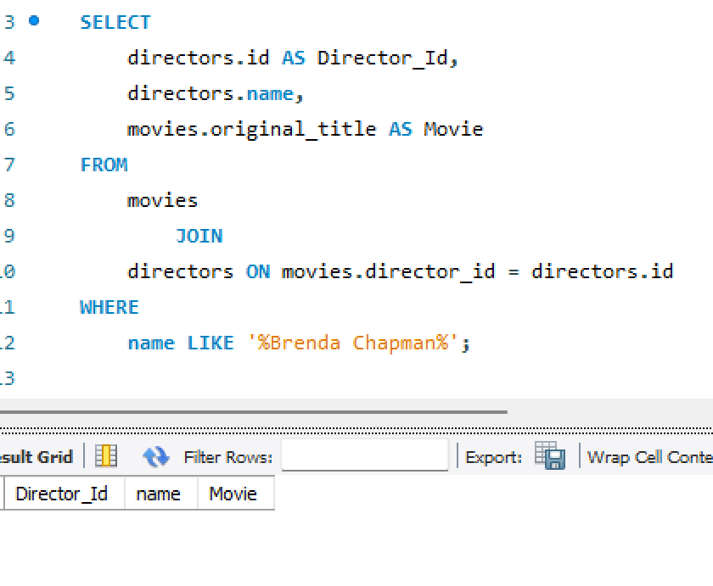
11. Which movie(s) were directed by Brenda Chapman?
The Result shows 0 rows because there are no movies directed by Brenda Chapman.

Slide 14
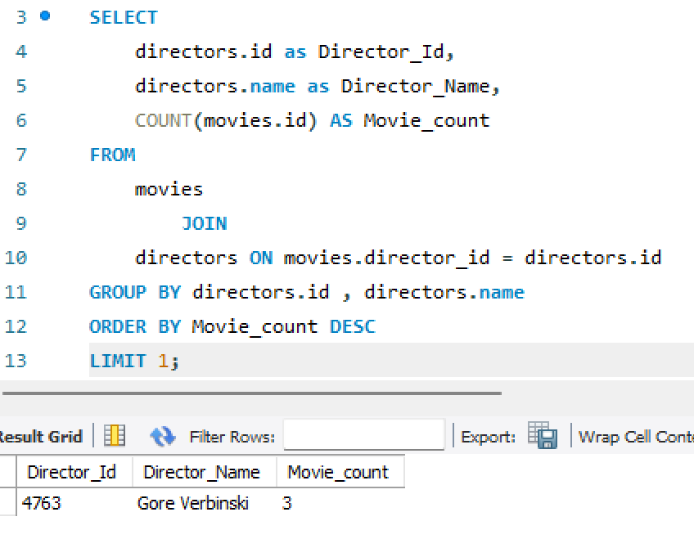
12. Which director made the most movies?

Slide 15
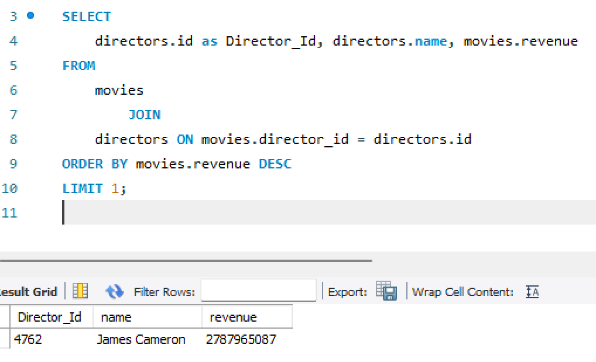
13. Which director is the most bankable?

Slide 16
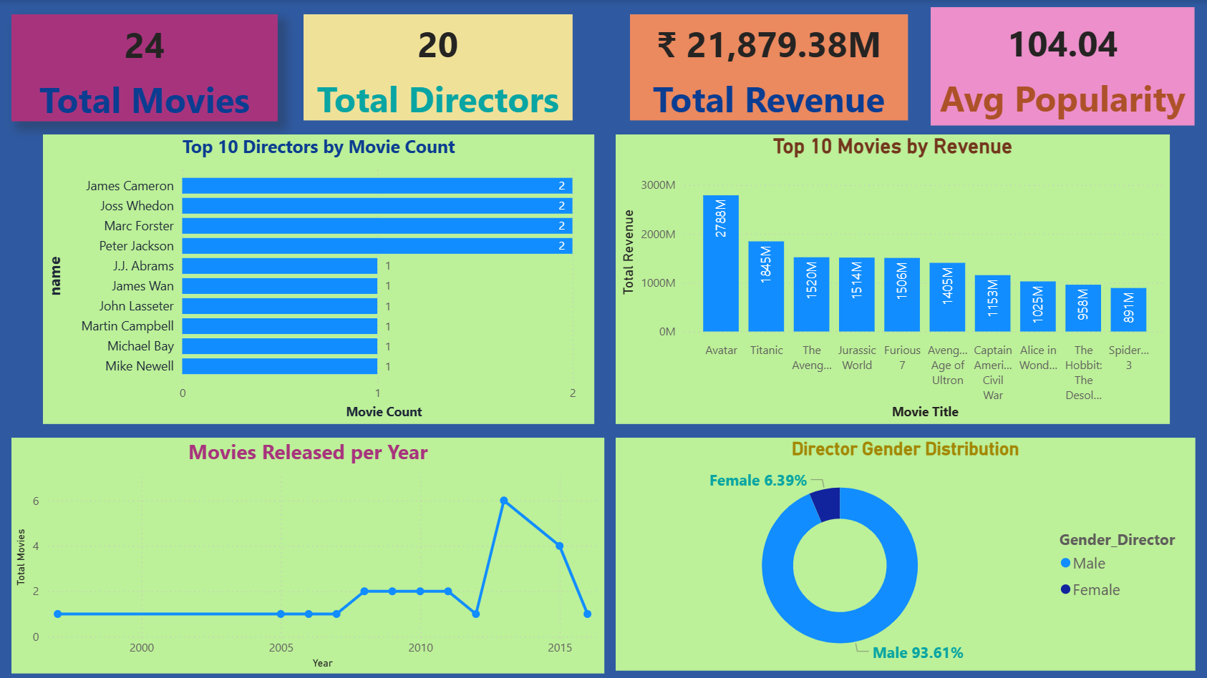
IMDB_Movies Summary Report

Slide 17
Recommendations
Invest in high-performing directors.
Allocate budget strategically to mid-budget movies.
Use data insights to plan marketing campaigns efficiently.

Slide 18
Thank you!!

