Slide 1
Advanced Data and Network Mining – CA2

Slide 2
Project Proposal
The project is based on Lead scoring predictive analysis for an e-tutorial company X Education that sells online educational courses to Industry professionals.
The dataset has been obtained from Kaggle[1].
The objective of the analysis is to predict potential leads that could get converted to future customers.
The project adopts the CRISP-DM process of implementation.

Slide 3
CRISP – DM Process
Data Understanding
Business Understanding
Data Preparation
Data
Deployment
Modelling
Evaluation

Slide 4
Business Understanding
To improve the efficiency of the process of identifying the ‘Hot Leads’ – most potential leads that could get converted into future customers.
The company requires a model that can assign a lead score to customers in order to achieve a higher conversion rate.
In a data analysis perspective, to achieve a better lead scoring model with a targeted conversion rate of 80%.

Slide 5
Data Understanding
The dataset had 37 attributes with 9240 instances.
It had mostly object type attributes (30) with a few numeric attributes(7) as well.
The statistical summary suggested the leads attribute had a uniform distribution while the TotalVisits ,TotalTimeSpent and PageViews attributes were positively skewed.
The Asymmetrique Activity Score and Asymmetrique Profile Score had a higher concentration around the mean.
There were no duplicates in the data.
6 columns had more than 35% missing values.

Slide 6
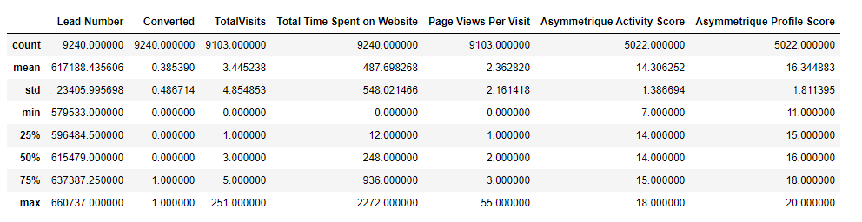
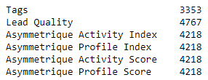
Statistical Summary of the Numerical attributes
Attributes with more than 35% missing values

Slide 7
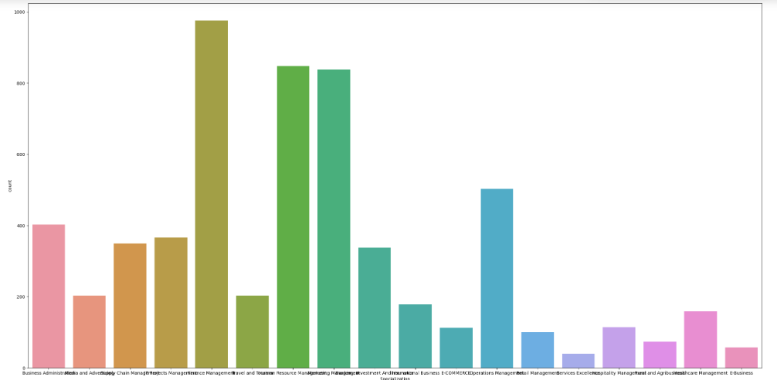
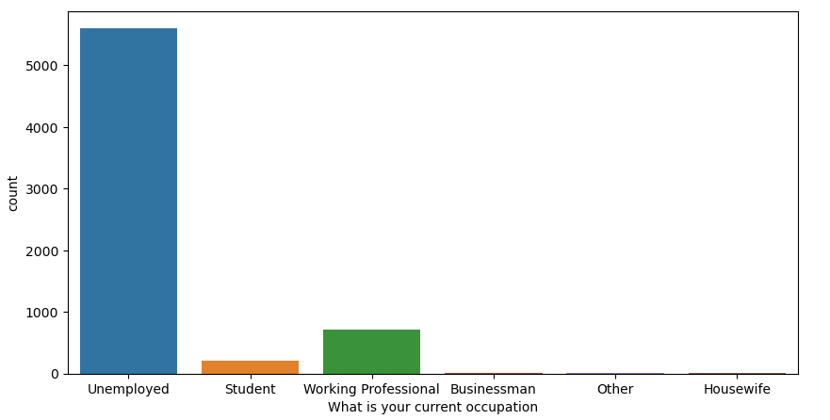
Visual understanding of data patterns

Slide 8
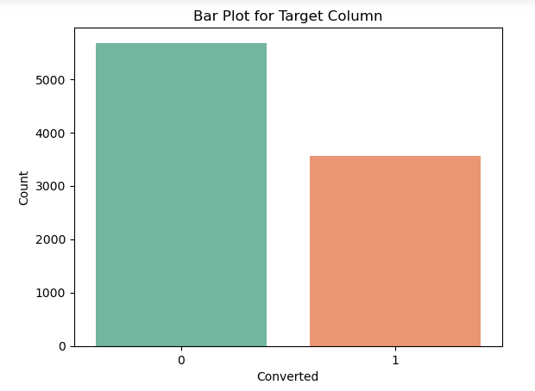
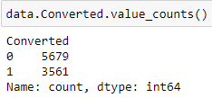
Distribution of Target Variable
The Target Column “Converted” is a binary class variable with 0 and 1 as classes.
The distribution of target variable showed class imbalance.

Slide 9
Data Preparation
The columns with missing values more than 45% were dropped.
Columns with irrelevant and redundant data were dropped.
The imbalanced columns were dropped as imputation could result in skewed data.
The missing values on columns which had class object data were handled by populating with most frequent values.
The categorical columns were handled for case-sensitive data to avoid redundant categories.
The correlation heatmap was plotted to identify any correlated variables.

Slide 10
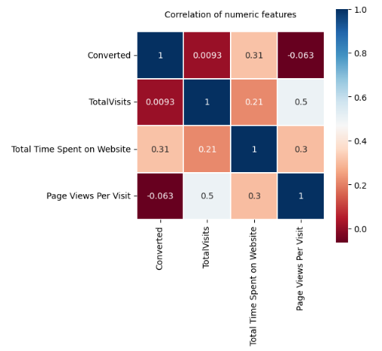
Correlation Matrix

Slide 11
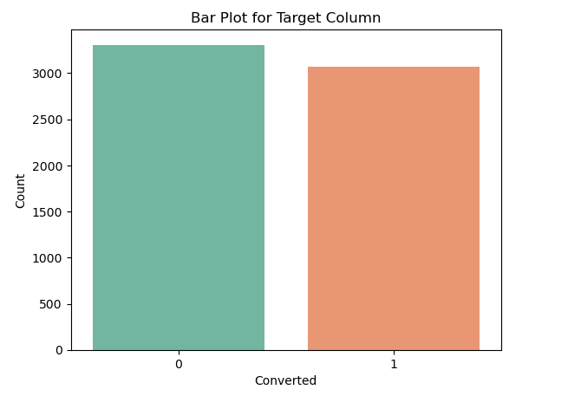
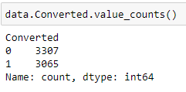
Class imbalance
The class imbalance observed initially in the target variable was reduced after the data preprocessing. So, there were no further measures taken to address it.

Slide 12
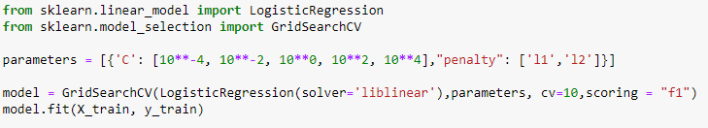
Modelling
The data was split into training and testing datasets based on 80:20 rule.
The following models were used to train and predict the lead scoring
Logistic Regression (10-Fold CV)
Decision Tree Classifier
Random Forest Classifier
Logistic Regression Model:

Slide 13

Decision Tree Classifier
Random Forest Classifier

Slide 14
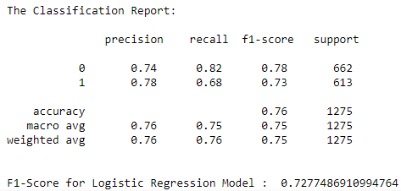
Evaluation
All the three models were evaluated for the performance metrics F1, Recall and accuracy
The Random Forest Model outperformed the other two followed by Decision Tree and at lowest is the Logistic Regression model .
Logistic Regression Model:

Slide 15
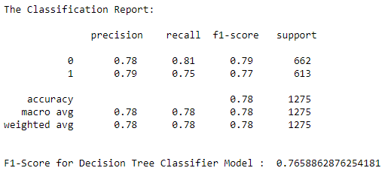
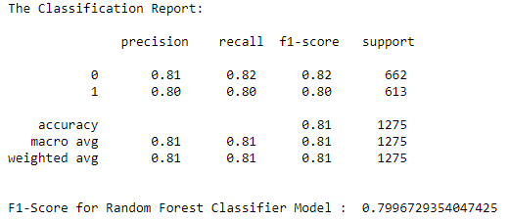
Decision Tree Classifier:
Random Forest Classifier:

Slide 16
Auto Modelling – Rapid Miner
The automodeling from Rapidminer studio was used to model and compare results with Scikit-learn’s Models.
The following models were used for modelling and evaluation.
Naive Bayes
Generalized Linear Model
Logistic Regression
Fast Large Margin
Deep Learning
Decision Tree
Random Forest
Gradient Boosted Trees
Support Vector Machine

Slide 17
Auto Modelling Evaluation
Model | Accuracy | Precision | Recall | F Measure | Classification Error
Naive Bayes | 91.89% | 92.05% | 95.09% | 93.54% | 8.11%
Generalized Linear Model | 92.88% | 92.02% | 96.88% | 94.38% | 7.12%
Logistic Regression | 93.86% | 93.28% | 97.05% | 95.12% | 6.14%
Fast Large Margin | 91.93% | 92.49% | 94.60% | 93.52% | 8.07%
Deep Learning | 93.64% | 93.40% | 96.50% | 94.92% | 6.36%
Decision Tree | 85.04% | 82.54% | 95.93% | 88.72% | 14.96%
Random Forest | 92.50% | 92.43% | 95.71% | 94.03% | 7.50%
Gradient Boosted Trees | 93.37% | 91.88% | 97.91% | 94.80% | 6.63%
Support Vector Machine | 91.33% | 90.59% | 95.96% | 93.19% | 8.67%

Slide 18
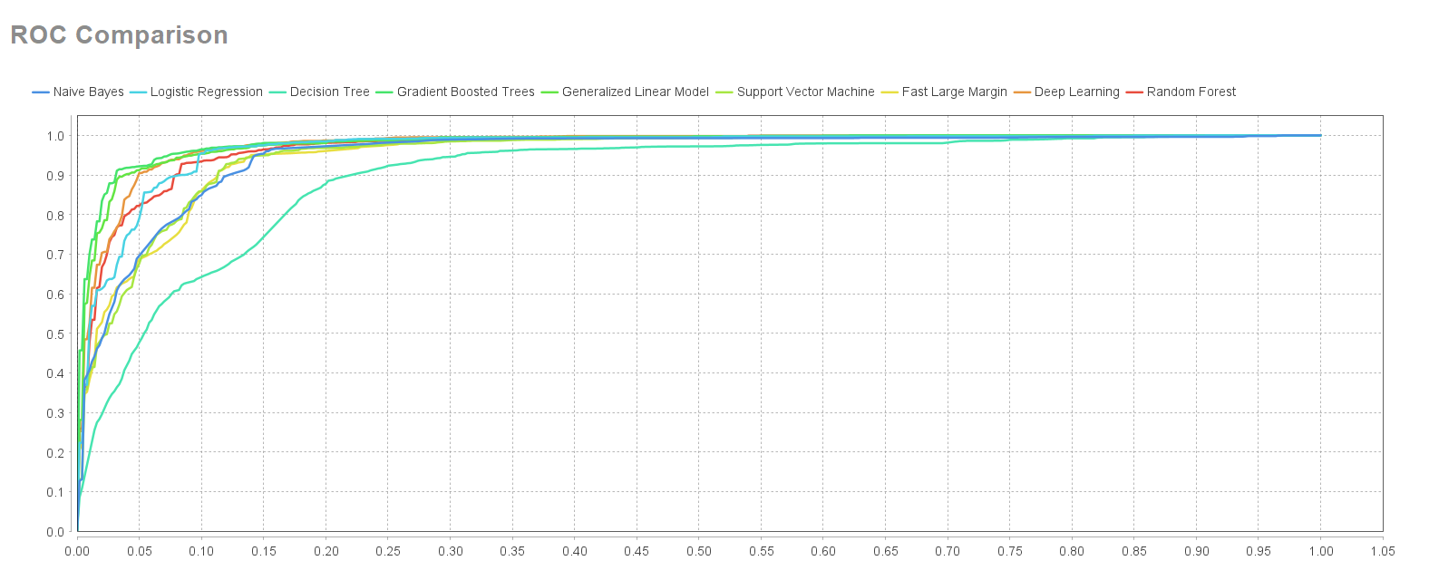
ROC Comparison of the Models

Slide 19

Deployment Plan
The deployment plan is mostly specific to the company’s business needs and requirements.
On a higher level, the deployment plan includes setting up the environment with necessary resources and hardware or cloud infrastructure.
The trained model to be used with tools like Dockers or Kubernetes for easy deployment and scalability.
To develop an API( Application Programming Interface) and integrate into real-time systems.
The deployed model would take input data and predict if the lead is a potential customer or not.

Slide 20

References
[1] Dataset - https://www.kaggle.com/datasets/amritachatterjee09/lead-scoring-dataset
Scikit-learn Libraries https://scikit-learn.org/stable/tutorial/index.html
Rapid Miner https://docs.rapidminer.com/

