Slide 1
Data Storage solutions for data analytics

Slide 2
Dataset and Business Understanding
Global Terrorism Database – an open-source dataset
135 variables and 200k+ records
Dates, location, weapons, casualties and nature of target information of Terrorist events
Understanding of patterns and evolution of Terror attacks globally and assist in developing counter-terrorist strategies

Slide 3
KEY STAKEHOLDERS
Government Agencies
International Organizations
Research Institutions
Policy Makers

Slide 4

SCHEMA and ETL

Slide 5
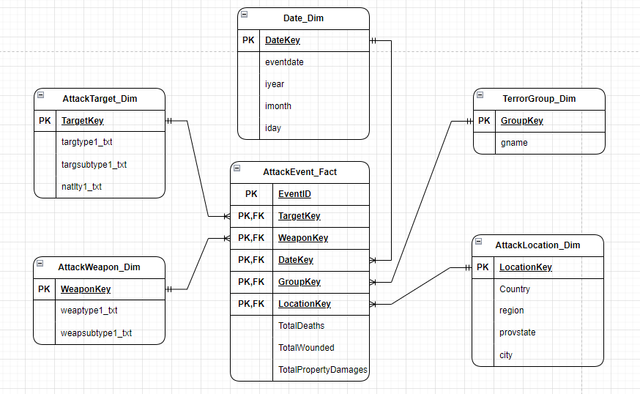
STAR SCHEMA
DIMENSION TABLES:
Date_Dim
AttackTarget_Dim
AttackWeapon_Dim
AttackLocation_Dim
TerrorGroup_Dim
FACT TABLE:
AttackEvent_Fact

Slide 6
ETL – extract, transform and load
Extract – Two CSV files that contain the data are loaded to SQL server database as a raw dataset.
Transform – Data was cleaned by addressing null values and unrecognized data records.
Load – The data was loaded into the dimension and fact tables using SSIS packages from visual studio.

Slide 7
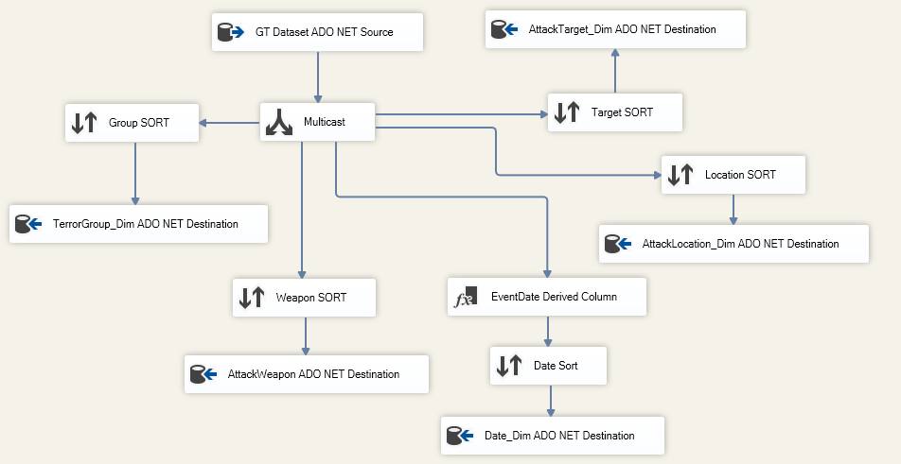

SSIS DATA FLOW TASK
Dimension Tables
Fact Table

Slide 8
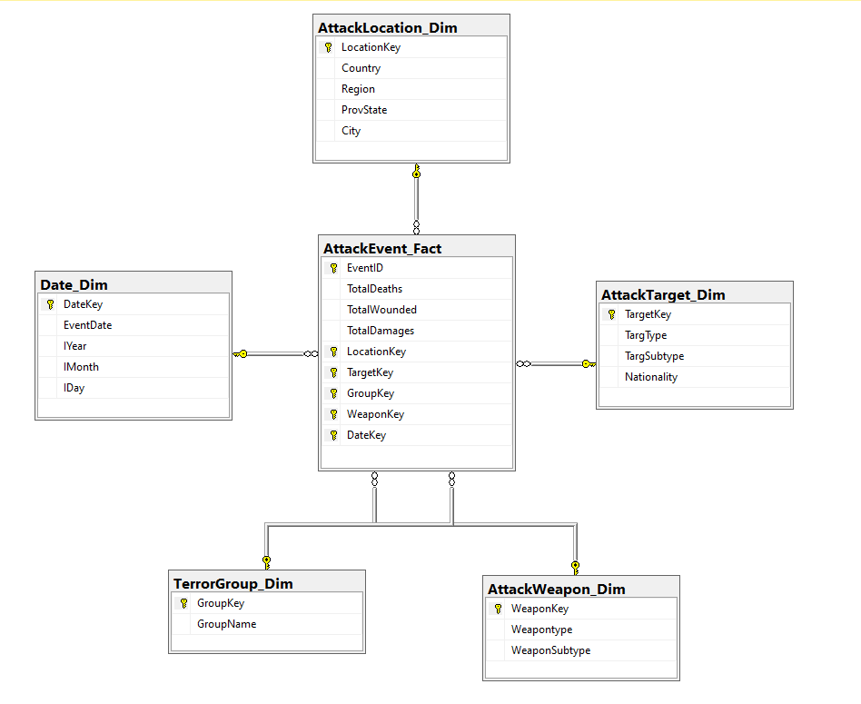
Database DIAGRAM of Global_terrorism DB

Slide 9


Visualizations and reports

Slide 10
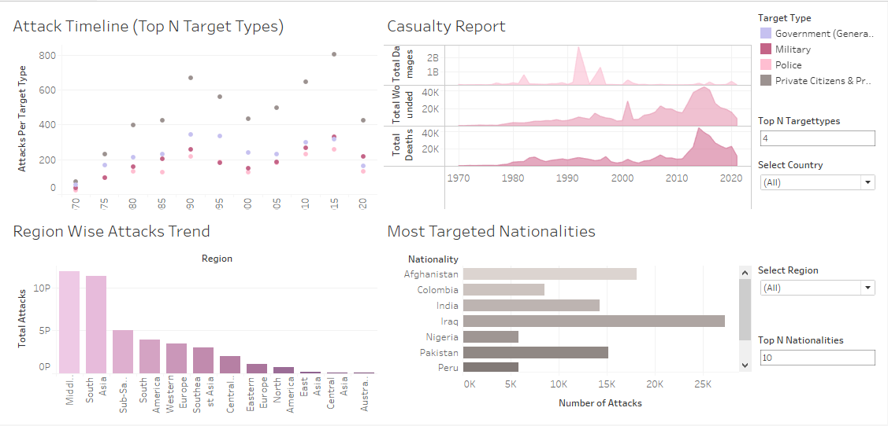
TABLEAU DASHBOARD

Slide 11
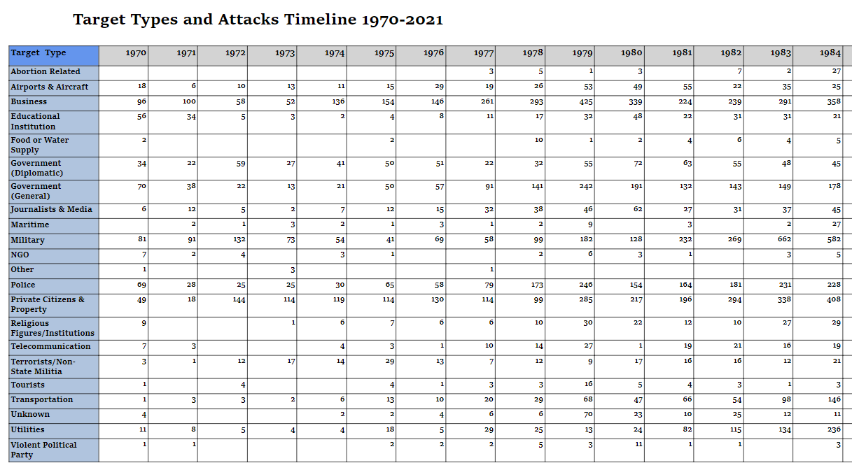
SSRS REPORTS - MATRIX
SELECT TerrorGroup_Dim.GroupName, AWD.WeaponType, ATD.TargType, DD.IYear, COUNT(*) AS total_attacks FROM AttackEvent_Fact AS AEF INNER JOIN AttackTarget_Dim ATD ON AEF.TargetKey = ATD.TargetKey INNER JOIN AttackWeapon_Dim AWD ON AEF.WeaponKey = AWD.WeaponKey INNER JOIN TerrorGroup_Dim ON AEF.GroupKey = TerrorGroup_Dim.GroupKey INNER JOIN Date_Dim DD on AEF.DateKey=DD.DateKey WHERE TerrorGroup_Dim.GroupName!='Unknown’ GROUP BY TerrorGroup_Dim.GroupName,AWD.WeaponType, ATD.TargType, DD.IYear

Slide 12
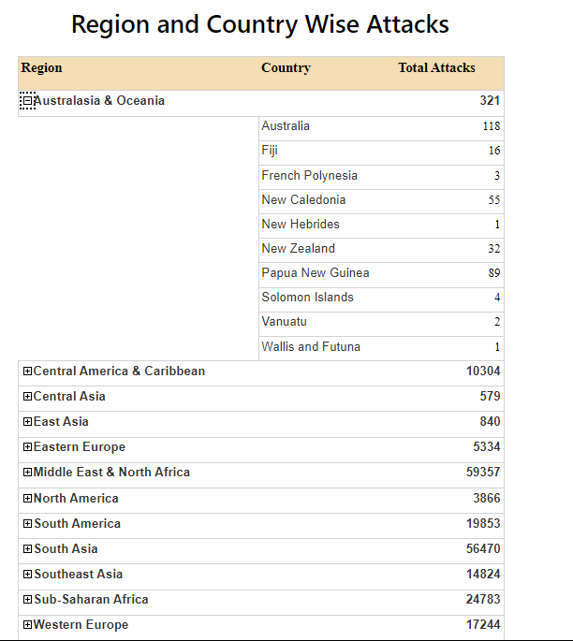
SSRS REPORTS – DRILL DOWN
SELECT ALD.Region,ALD.Country,COUNT(AEF.EVENTID) AS TOTAL_ATTACKS
FROM AttackEvent_Fact AEF
INNER JOIN AttackLocation_Dim ALD ON ALD.LocationKey=AEF.LocationKey
GROUP BY ALD.Region,ALD.Country
ORDER BY 3 DESC

Slide 13
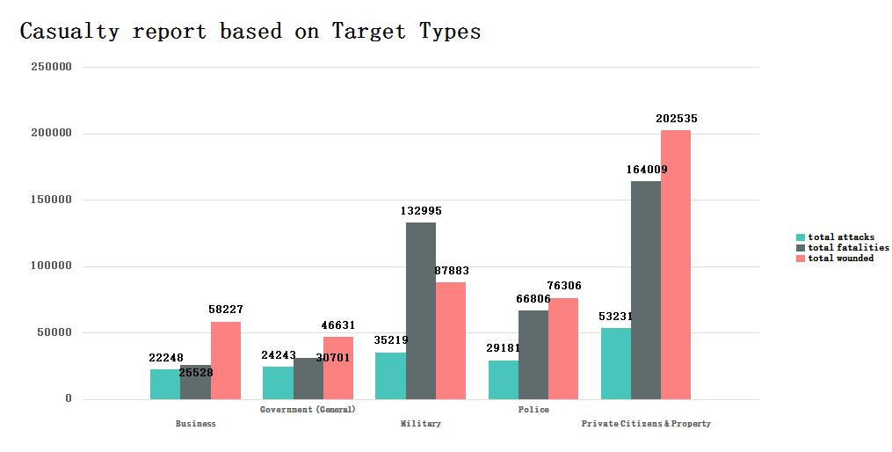
SSRS REPORTS – CHART
SELECT ATD.TargType, COUNT(*) AS total_attacks, SUM(AEF.TotalDeaths) AS total_fatalities, SUM(AEF.TotalWounded) AS total_wounded
FROM AttackEvent_Fact AS AEF
INNER JOIN AttackTarget_Dim ATD ON AEF.TargetKey = ATD.TargetKey
WHERE ATD.TargType != 'Unknown'
GROUP BY ATD.TargType

Slide 14
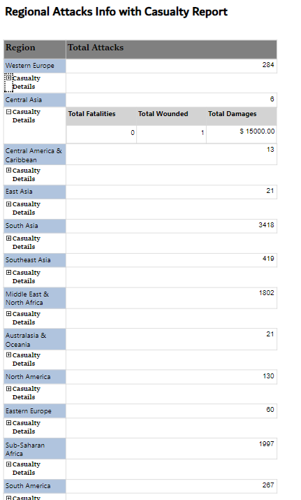
SSRS REPORTS –SUBREPORT
SELECT AL.Region, DD.IYear AS AttackYear, COUNT(AEF.eventid) as Total_Attacks, SUM(AEF.TotalDeaths) AS Total_Fatalities, SUM(AEF.TotalWounded) AS Total_Wounded, SUM(AEF.TotalDamages) AS Total_Damages FROM AttackEvent_Fact AS AEF INNER JOIN AttackLocation_Dim AL ON AEF.LocationKey = AL.LocationKey INNER JOIN Date_Dim DD ON AEF.DateKey = DD.DateKey WHERE DD.IYear = @attackYear and AL.Region = @Region GROUP BY AL.Region, DD.IYear

Slide 15

GRAPH DATABASES – NEO4J

Slide 16
Bikestore sample database
A sample database with sales and product details of a bikestore
Contains two schemas – sales and production
Contains 9 tables – 5 in sales schema and 4 in production
Every table is connected to atleast one other by a foreign key reference.

Slide 17
Node LABELS and NODES:
The tables from the relational database are created as nodes with labels on NEO4J and loaded from CSV files exported from the SQL server database.
The primary keys of SQL server tables are created as unique constraints on the node labels.
The foreign key references are created as relationships on the nodes.

Slide 18
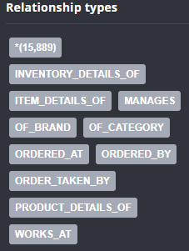
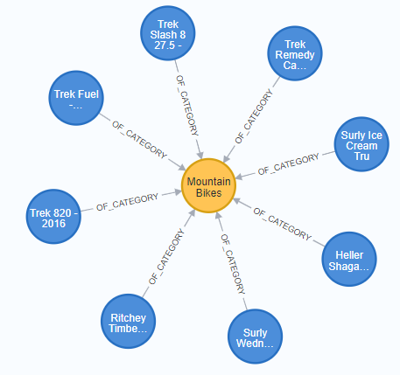
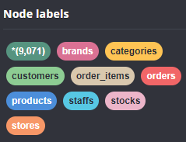
Samples of NEO4j OBJECTS
The pictures on the right show the list of node labels, count of nodes, relationship types and count of relationships and a sample of a relationship connecting its nodes.

Slide 19
Comparative study between rdbms and graph Database
The following observations were made during the NEO4J graph database implementation.
Neo4j does not natively support referential cascade rules
Node properties with any null values are not stored on the node
Named relationships providing a meaningful reference
Composite unique keys cannot be created in NEO4J. Alternatively Node key can be used.

Slide 20
SQL and CQL query comparison
1. Retrieve details of products with their categories and brands:
SQL:
SELECT p.product_id, p.product_name, c.category_name, b.brand_name
FROM production.products p
INNER JOIN production.categories c ON p.category_id = c.category_id
INNER JOIN production.brands b ON p.brand_id = b.brand_id;
CQL:
MATCH (p:products)-[:OF_CATEGORY]->(c:categories),(p)-[:OF_BRAND]->(b:brands)
RETURN p.ProductID, p.ProductName, c.CategoryName, b.BrandName;

Slide 21
2. List 10 recent orders with customer information:
SQL:
SELECT TOP 10 o.order_id, o.order_status, o.order_date, c.first_name, c.last_name FROM sales.orders o
INNER JOIN sales.customers c ON o.customer_id = c.customer_id ORDER BY (order_date) DESC
CQL:
MATCH (o:orders)-[:ORDERED_BY]->(c:customers)
RETURN o.OrderID, o.OrderStatus, date({year:toInteger(substring(o.OrderDate,6,4)),
month:toInteger(substring(o.OrderDate,3,2)),day:toInteger(substring(o.OrderDate,0,2))}) as date, c.FirstName, c.LastName
ORDER BY date DESC LIMIT 10;

Slide 22
3. Count the number of orders for each customer:
SQL:
SELECT c.customer_id, c.first_name, c.last_name, COUNT(o.order_id) AS order_count
FROM sales.customers c
LEFT JOIN sales.orders o ON c.customer_id = o.customer_id
GROUP BY c.customer_id, c.first_name, c.last_name;
CQL:
MATCH (o:orders)-[:ORDERED_BY]->(c:customers)
RETURN c.CustomerID, c.FirstName, c.LastName, COUNT(o) AS order_count;

Slide 23
4. Calculate the average order quantity and total order amount for each product:
SQL: SELECT p.product_id, p.product_name, AVG(oi.quantity) AS avg_quantity, SUM(oi.list_price * oi.quantity) AS total_amount
FROM production.products p
INNER JOIN sales.order_items oi ON p.product_id = oi.product_id
GROUP BY p.product_id, p.product_name;
CQL:
MATCH (p:products)<-[:PRODUCT_DETAILS_OF]-(oi:order_items)-[:ITEM_DETAILS_OF]->(o:orders)
WITH p, AVG(toInteger(oi.Quantity)) AS avg_quantity, SUM(toFloat(oi.ListPrice) *toInteger( oi.Quantity)) AS total_amount
RETURN p.ProductID, p.ProductName, avg_quantity, total_amount;

Slide 24

5. Find the total revenue for each order:
SQL:
SELECT o.order_id, SUM(oi.list_price * oi.quantity) AS total_revenue
FROM sales.orders o
INNER JOIN sales.order_items oi ON o.order_id = oi.order_id
GROUP BY o.order_id;
CQL:
MATCH (oi:order_items)-[:ITEM_DETAILS_OF]->(o:orders)
RETURN o.OrderID, SUM(toFloat(oi.ListPrice) * toInteger(oi.Quantity)) AS total_revenue;

Slide 25
6. List the staff members and their total sales amount:
SQL:
SELECT s.staff_id, s.first_name, s.last_name, SUM(oi.list_price * oi.quantity) AS total_sales_amount
FROM sales.staffs s
INNER JOIN sales.orders o ON s.staff_id = o.staff_id
INNER JOIN sales.order_items oi ON o.order_id = oi.order_id
GROUP BY s.staff_id, s.first_name, s.last_name;
CQL:
MATCH (oi:order_items)-[:ITEM_DETAILS_OF]->(o:orders)-[:ORDER_TAKEN_BY]->(s:staffs)
RETURN s.StaffID, s.FirstName, s.LastName, SUM(toFloat(oi.ListPrice) * toInteger(oi.Quantity)) AS total_sales_amount;

Slide 26
7. List the top 5 customers with the highest total order amounts:
SQL:
SELECT TOP 5 c.customer_id, c.first_name, c.last_name, SUM(oi.list_price * oi.quantity) AS total_order_amount
FROM sales.customers c
INNER JOIN sales.orders o ON c.customer_id = o.customer_id
INNER JOIN sales.order_items oi ON o.order_id = oi.order_id
GROUP BY c.customer_id, c.first_name, c.last_name
ORDER BY total_order_amount DESC
CQL:
MATCH (c:customers)<-[:ORDERED_BY]-(o:orders)<-[:ITEM_DETAILS_OF]-(oi:order_items)
RETURN c.CustomerID, c.FirstName, c.LastName, SUM(toFloat(oi.ListPrice) * toInteger(oi.Quantity))
AS total_order_amount ORDER BY total_order_amount DESC LIMIT 5;

Slide 27
8. Find the average quantity of each product sold:
SQL:
SELECT p.product_id, p.product_name, AVG(oi.quantity) AS avg_quantity_sold
FROM production.products p
INNER JOIN sales.order_items oi ON p.product_id = oi.product_id
GROUP BY p.product_id, p.product_name;
CQL:
MATCH (oi:order_items)-[:PRODUCT_DETAILS_OF]->(p:products)
RETURN p.ProductID, p.ProductName, AVG(toInteger(oi.Quantity)) AS avg_quantity_sold

Slide 28
conclusion
This project helped us in understanding the following aspects:
Importance of Data Warehouse in:
Storing and managing structural and historical data for analytical purposes
Integrating data from various sources
Scalability and optimal performance
Security and access control
Use of Reports and Visualisations:
In addressing business and analytical requirements.
To recognise patterns and trends in data visually
To convey complex information in more accessible and engaging way like charts and graphs.
Help in decision making using relevant and structured presentation of data
Graph databases:
Understanding storing and retrieving data using relationships
Identifying the flexibility in using schema-less structure
Comparative study of relational to graph databases in terms of storage and retrieval of data.

