Slide 1


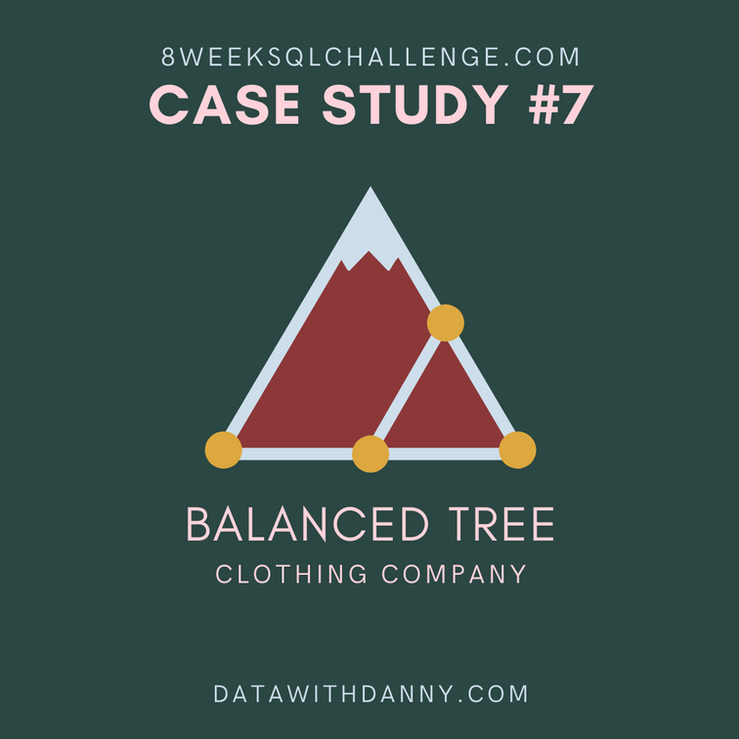

BALANCED TREE
Clothing Company
SQL Case
Study
8WEEKSQLCHALLENGE.COM
  By Sonal Kumari

Slide 2
Overview
  Introduction
  Objective
  Data Overview
  Approach & Methodology
  SQL Queries & Analysis
  Challenges & Issues Faced
  Business Insights & Impact
  How to Increase Business & Profit
  Conclusion & Future Plans
01
02
03
04
05
06
07
08
09

Slide 3



Introduction
Balanced Tree Clothing Company specializes in providing a curated selection of clothing and lifestyle wear for modern adventurers. To maintain a competitive edge, the company seeks to analyze its sales performance, understand customer behaviors, and generate financial reports to inform business decisions. Danny, the CEO, emphasizes the need for actionable insights to enhance overall business operations.

Slide 4






Objective
The primary objective of this report is to analyze sales data to uncover trends and insights that can inform merchandising strategies and financial planning. Specific goals include:
01
02
03
04
Objective 01
Objective 02
Objective 03
Objective 04
Assessing overall sales performance and revenue generation.
Understanding customer transaction behaviors.
Identifying top-selling products and categories.
Evaluating the impact of discounts on sales and revenue.

Slide 5



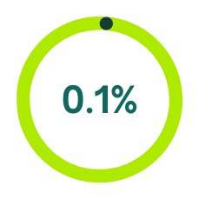
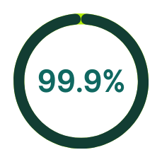
Data Overview
The analysis utilizes two primary datasets:
Product Details (balanced_tree.product_details):
Contains product-specific information including product IDs, names, categories, and segments.
Product Sales (balanced_tree.sales):
Includes transaction-level data, capturing quantity sold, transaction prices, discounts, member status, and timestamps of sales.

Slide 6
Approach & Methodology
Data Extraction
Data Transformation
Data Analysis
Reporting
Retrieve relevant data from the product details and sales tables.
Execute SQL queries to derive insights based on predefined business questions.
Summarize findings and insights in a structured format to facilitate decision-making.
Prepare and clean the data as needed for analysis, ensuring data types align and missing values are addressed.

Slide 7





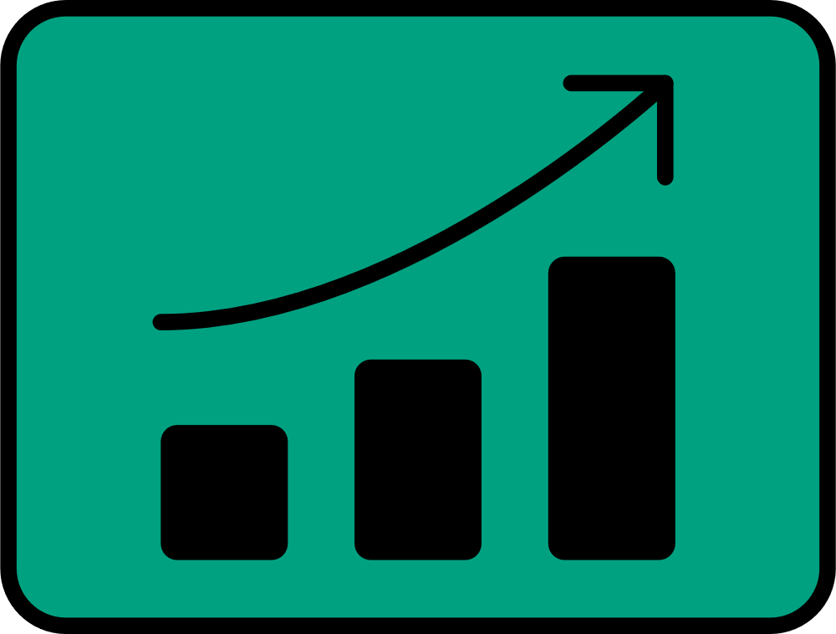



















High Level Sales Analysis
This section summarizes overall sales performance, focusing on total quantity sold, revenue before discounts, and total discount amounts. It provides insights into product performance and pricing strategies.

Slide 8
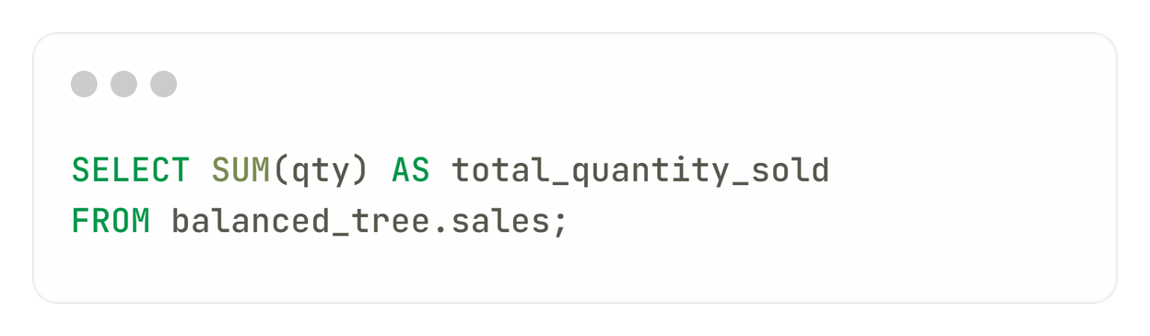
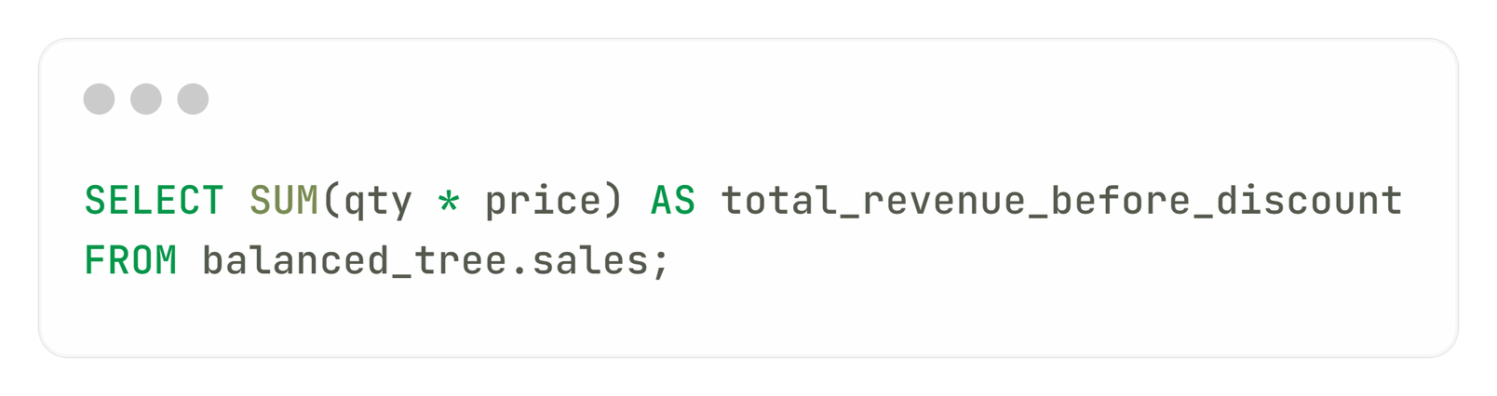
What was the total quantity sold for all products?
total_quantity_sold
45216
What is the total generated revenue for all products before discounts?
total_revenue_before_discount
1289453

Slide 9
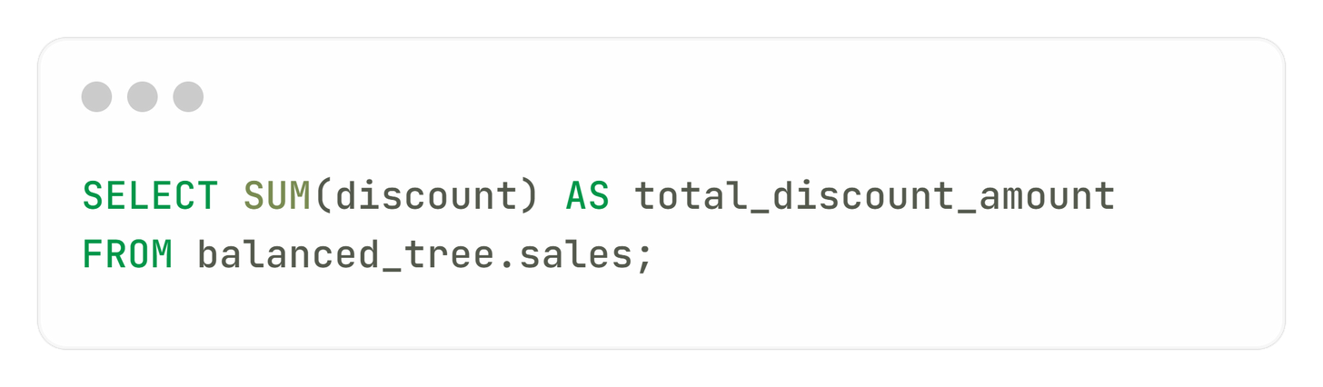
What was the total discount amount for all products?
total_discount_amount
182700

Slide 10
Transaction Analysis
This analysis examines customer transactions, including unique transaction counts, average products per transaction, revenue distribution, and member versus non-member purchases, highlighting customer engagement.

Slide 11
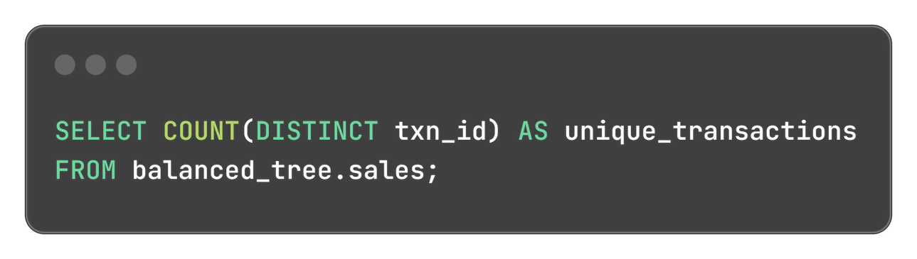
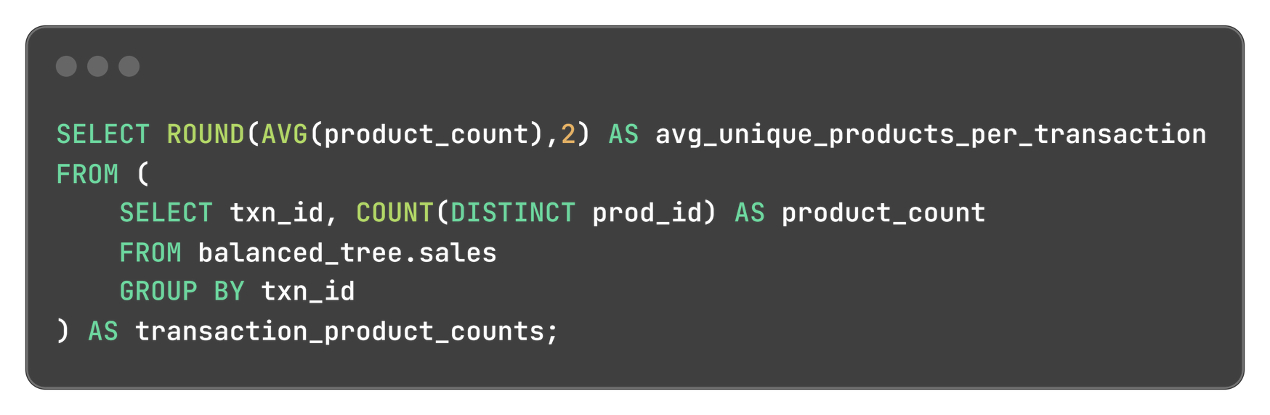
How many unique transactions were there?
Counting the number of distinct transactions that occurred. It provides a measure of customer engagement and transaction frequency.
unique_transactions
2500
What is the average unique products purchased in each transaction?
Calculating the average number of different products bought per transaction. It helps understand customer buying behavior and product diversity in sales.
avg_unique_products_per_transaction
6.04

Slide 12
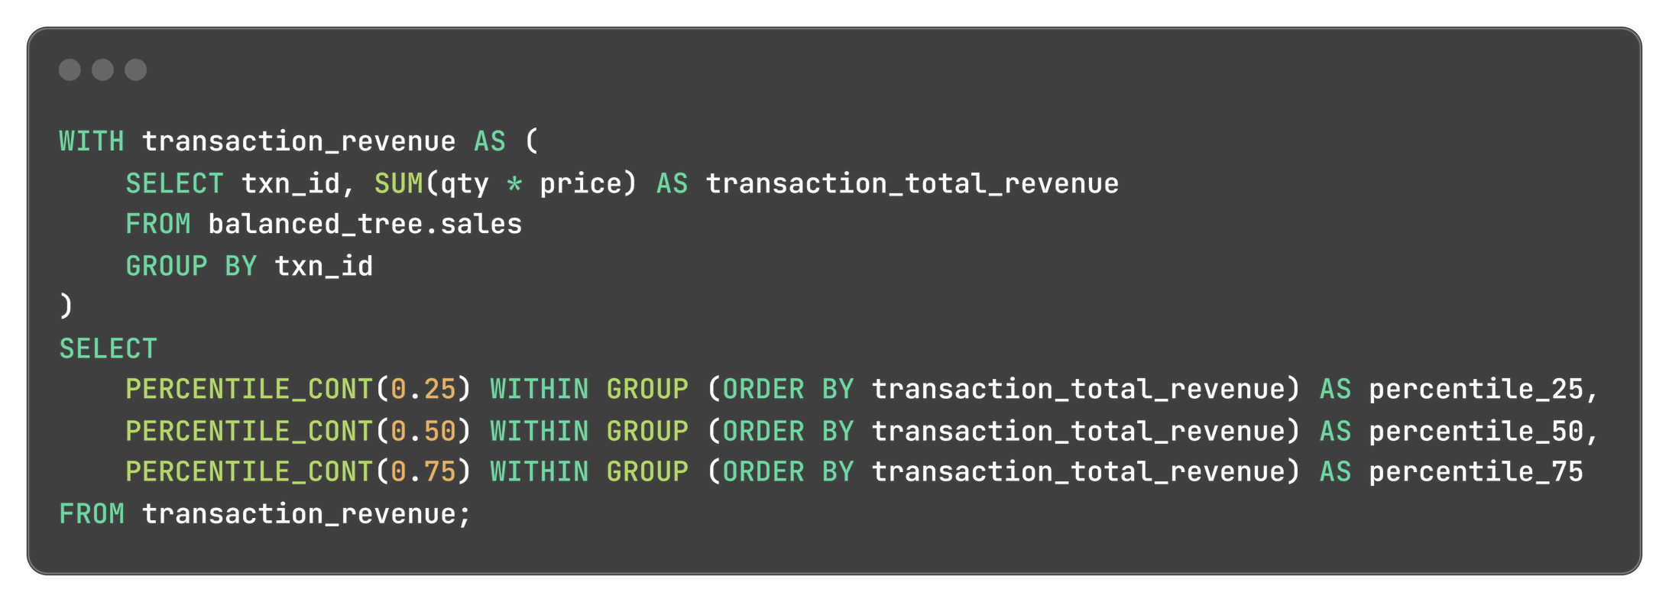
What are the 25th, 50th and 75th percentile values for the revenue per transaction?
This identifies the 25th, 50th (median), and 75th percentile values for revenue generated from each transaction. It helps analyze revenue distribution and identify outliers.
percentile_25 | percentile_50 | percentile_75
375.75 | 509.5 | 647

Slide 13
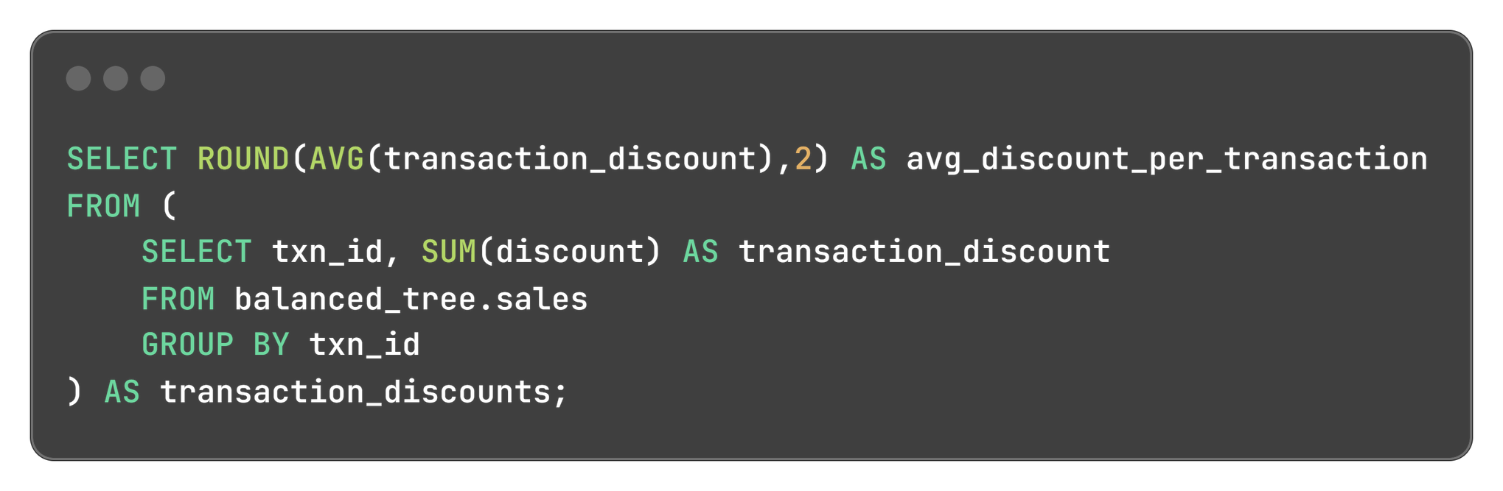
What is the average discount value per transaction?
Computing the average discount applied to each transaction. It provides insights into discounting practices and their impact on sales.
avg_discount_per_transaction
73.08

Slide 14
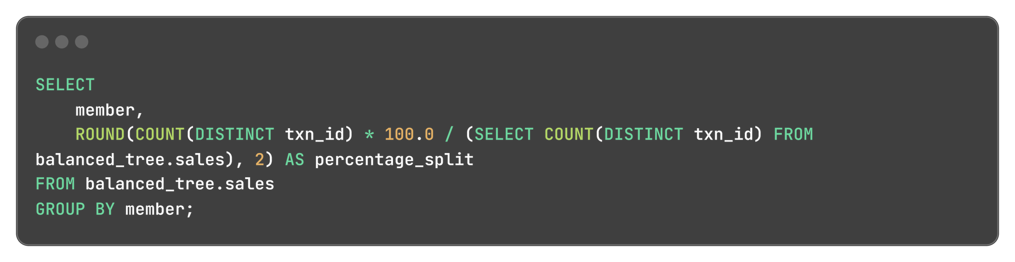
What is the percentage split of all transactions for members vs non-members?
This assesses the proportion of transactions made by members compared to non-members. It helps understand customer loyalty and membership benefits.
member | percentage_split
false | 39.80
true | 60.20

Slide 15
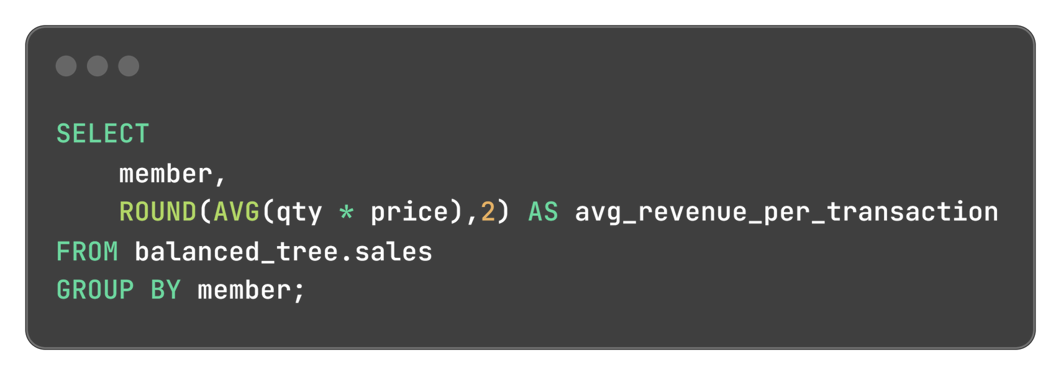
What is the average revenue for member transactions and non-member transactions?
This compares the average revenue generated from transactions by members versus non-members. It helps evaluate the effectiveness of membership programs.
member | avg_revenue_per_transaction
false | 84.93
true | 85.75

Slide 16
Product Analysis
This section evaluates individual product performance, identifying top sellers, calculating total sales metrics by segment and category, and analyzing product penetration and common combinations for cross-selling opportunities.

Slide 17
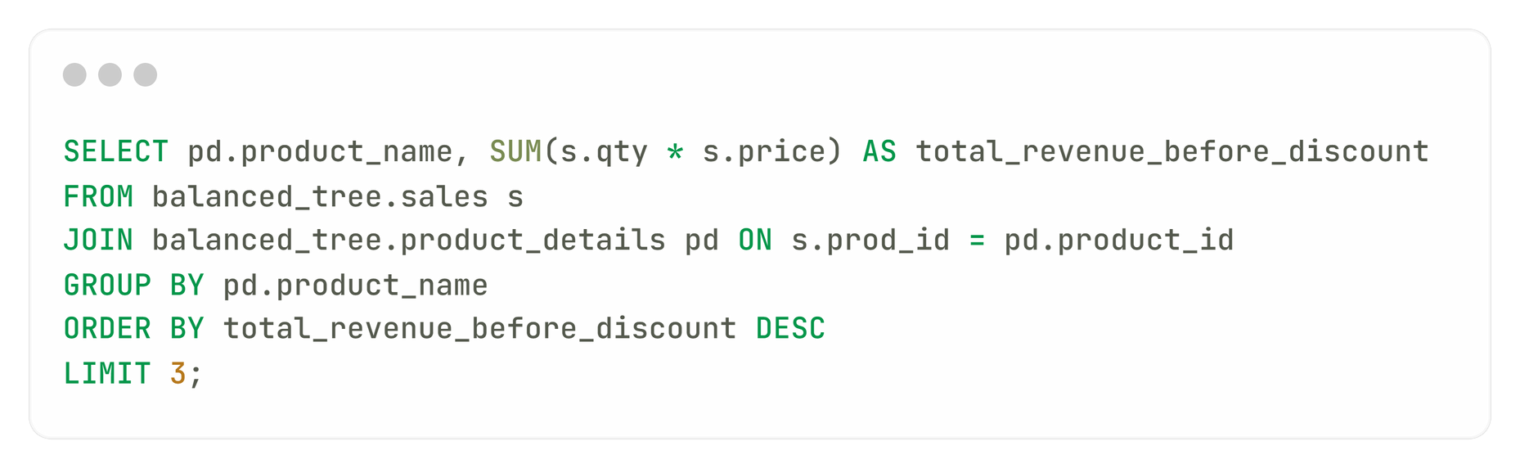
What are the top 3 products by total revenue before discount?
This compares the average revenue generated from transactions by members versus non-members. It helps evaluate the effectiveness of membership programs.
product_name | total_revenue_before_discount
Blue Polo Shirt - Mens | 217683
Grey Fashion Jacket - Womens | 209304
White Tee Shirt - Mens | 152000

Slide 18
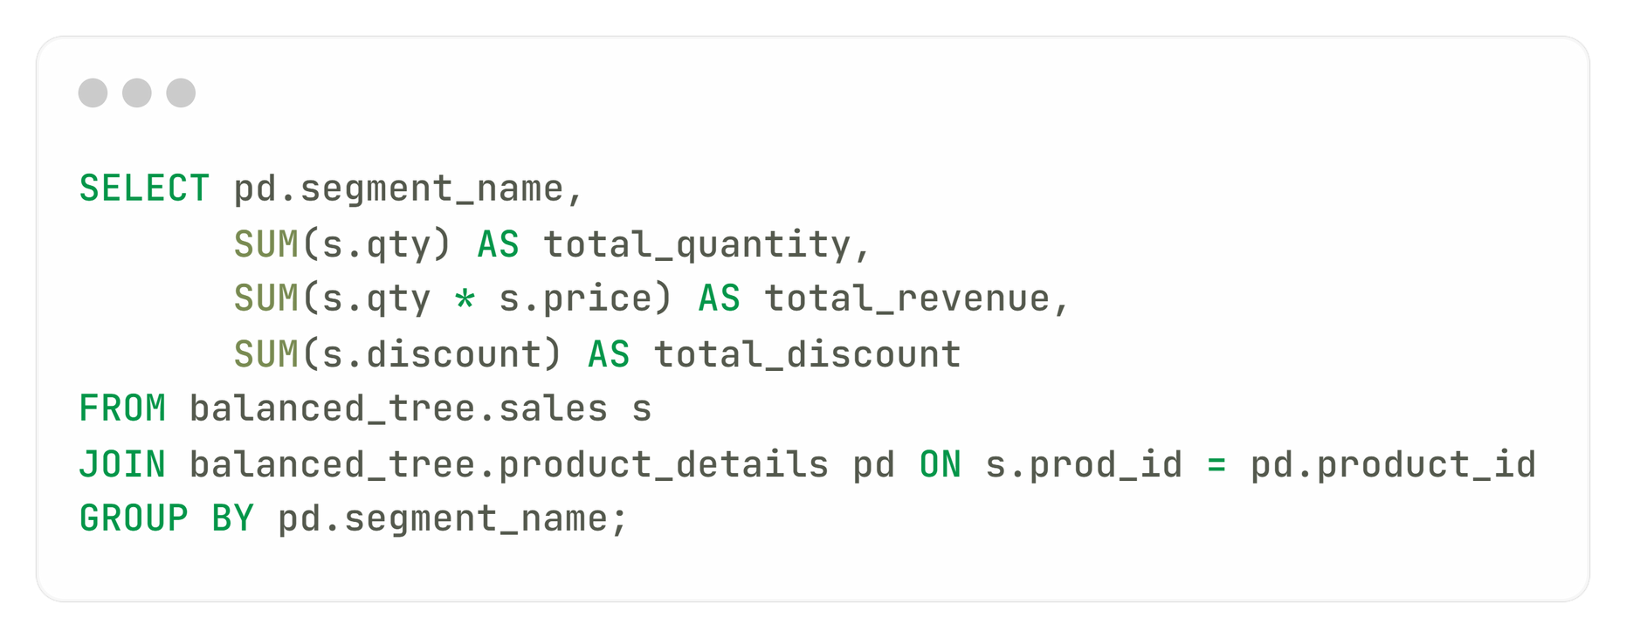
What is the total quantity, revenue, and discount for each segment?
Summarizing the sales performance (quantity sold, revenue, and discounts) for different market segments, aiding in segment analysis.

Slide 19
What is the total quantity, revenue, and discount for each segment?
OUTPUT:
segment_name | total_quantity | total_revenue | total_discount
Shirt | 11265 | 406143 | 46043
Jeans | 11349 | 208350 | 45740
Jacket | 11385 | 366983 | 45452
Socks | 11217 | 307977 | 45465

Slide 20
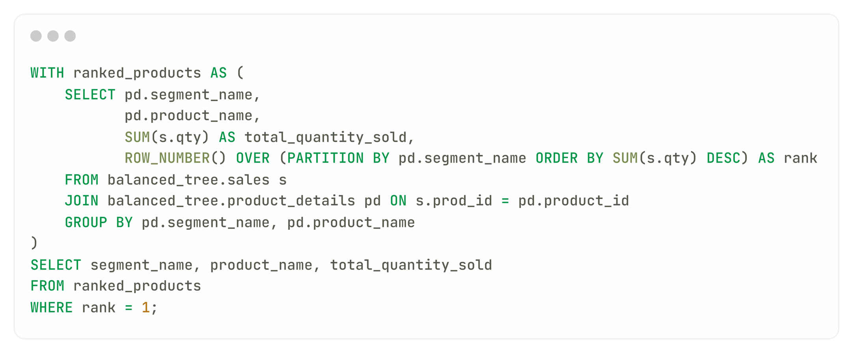
What is the top selling product for each segment?
This identifies the highest-selling product within each market segment, providing insights into targeted sales strategies.

Slide 21
What is the top selling product for each segment?
OUTPUT:
segment_name | product_name | total_quantity_sold
Jacket | Grey Fashion Jacket - Womens | 3876
Jeans | Navy Oversized Jeans - Womens | 3856
Shirt | Blue Polo Shirt - Mens | 3819
Socks | Navy Solid Socks - Mens | 3792

Slide 22

What is the total quantity, revenue, and discount for each category?
Similar to the segment analysis, this summarizes performance metrics for different product categories.
category_name | total_quantity | total_revenue | total_discount
Mens | 22482 | 714120 | 91508
Womens | 22734 | 575333 | 91192

Slide 23
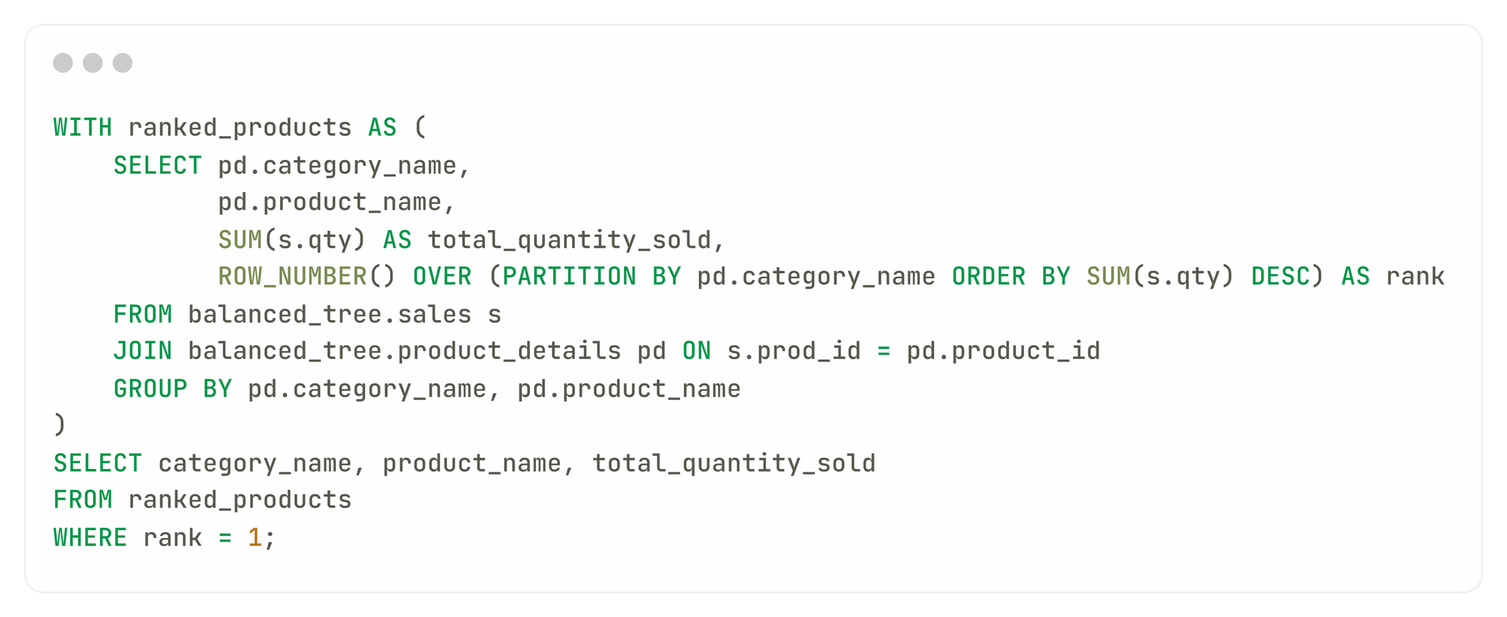
What is the top selling product for each category?
This identifies the leading product in each category based on sales, helping with inventory and marketing focus.

Slide 24
What is the top selling product for each category?
OUTPUT:
category_name | product_name | total_quantity_sold
Mens | Blue Polo Shirt - Mens | 3819
Womens | Grey Fashion Jacket - Womens | 3876

Slide 25
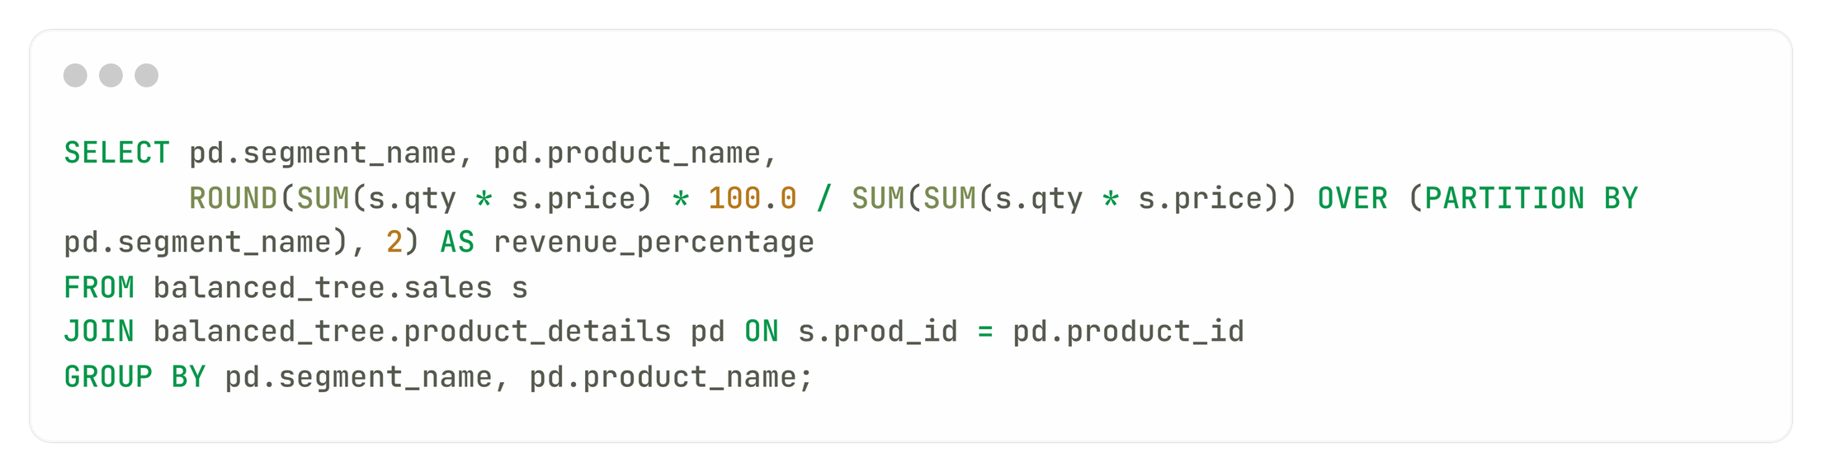
What is the percentage split of revenue by product for each segment?
This shows the revenue contribution of each product within different segments, aiding in product performance assessment.

Slide 26
segment_name | product_name | revenue_percentage
Jacket | Indigo Rain Jacket - Womens | 19.45
Jacket | Khaki Suit Jacket - Womens | 23.51
Jacket | Grey Fashion Jacket - Womens | 57.03
Jeans | Navy Oversized Jeans - Womens | 24.06
Jeans | Black Straight Jeans - Womens | 58.15
Jeans | Cream Relaxed Jeans - Womens | 17.79
Shirt | White Tee Shirt - Mens | 37.43
Shirt | Blue Polo Shirt - Mens | 53.60
Shirt | Teal Button Up Shirt - Mens | 8.98
Socks | Navy Solid Socks - Mens | 44.33
Socks | White Striped Socks - Mens | 20.18
Socks | Pink Fluro Polkadot Socks - Mens | 35.50

Slide 27
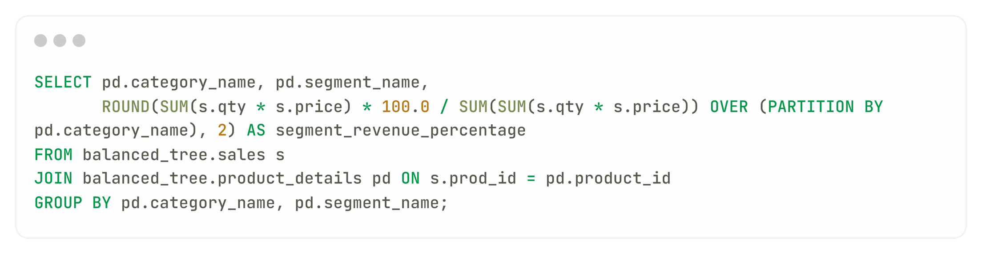
What is the percentage split of revenue by segment for each category?
This analyzes how much revenue each segment contributes within specific product categories.

Slide 28
What is the percentage split of revenue by segment for each category?
OUTPUT:
category_name | segment_name | segment_revenue_percentage
Mens | Socks | 43.13
Mens | Shirt | 56.87
Womens | Jeans | 36.21
Womens | Jacket | 63.79

Slide 29
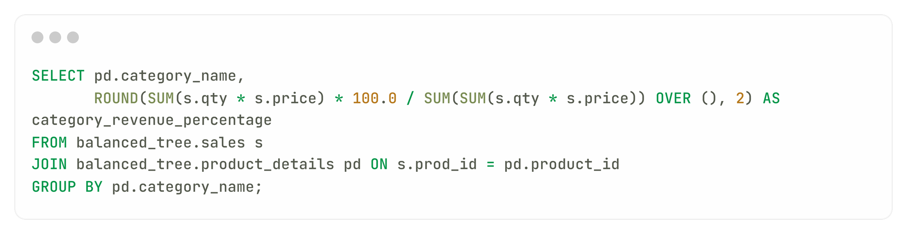
What is the percentage split of total revenue by category?
This shows the overall revenue distribution across different product categories, helping identify which categories drive sales.
category_name | category_revenue_percentage
Mens | 55.38
Womens | 44.62

Slide 30
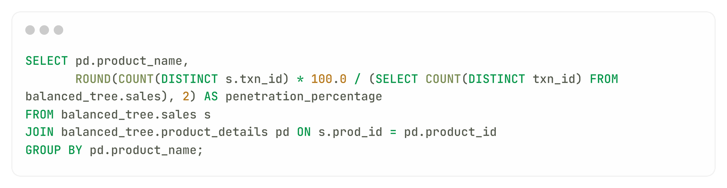
What is the total transaction “penetration” for each product?
This calculates the penetration rate of each product by dividing the number of transactions where the product was sold by the total number of transactions. It helps assess product popularity and market presence.

Slide 31
product_name | penetration_percentage
Black Straight Jeans - Womens | 49.84
Blue Polo Shirt - Mens | 50.72
Cream Relaxed Jeans - Womens | 49.72
Grey Fashion Jacket - Womens | 51.00
Indigo Rain Jacket - Womens | 50.00
Khaki Suit Jacket - Womens | 49.88
Navy Oversized Jeans - Womens | 50.96
Navy Solid Socks - Mens | 51.24
Pink Fluro Polkadot Socks - Mens | 50.32
Teal Button Up Shirt - Mens | 49.68
White Striped Socks - Mens | 49.72
White Tee Shirt - Mens | 50.72

Slide 32
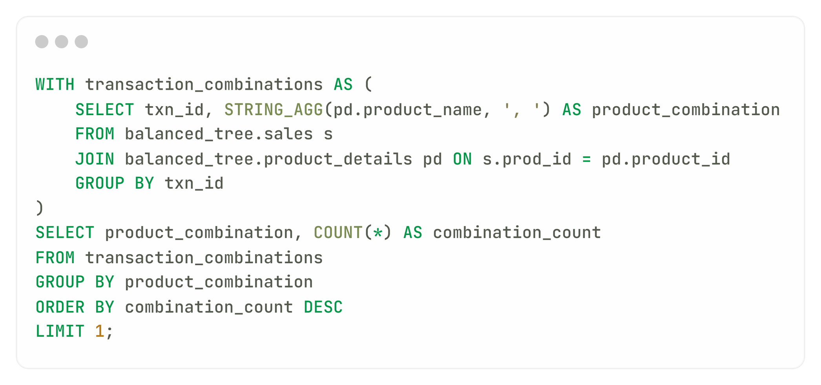
What is the most common combination of at least 1 quantity of any 3 products in a single transaction?
This identifies the most frequently purchased combination of three products in one transaction, providing insights into customer preferences and potential bundling opportunities.

Slide 33
What is the most common combination of at least 1 quantity of any 3 products in a single transaction?
OUTPUT:
product_combination | combination_count
Navy Oversized Jeans - Womens, Black Straight Jeans - Womens, Cream Relaxed Jeans - Womens, Grey Fashion Jacket - Womens, White Tee Shirt - Mens, Teal Button Up Shirt - Mens, Navy Solid Socks - Mens, Pink Fluro Polkadot Socks - Mens | 5

Slide 34
Challenges & Issues Faced
Data Quality and Consistency:
Inconsistent data types across tables complicated joins and aggregations, requiring additional data cleansing steps, such as casting columns and standardizing formats, to ensure reliable results.
Return on Investment
Large datasets led to slow query execution times for complex aggregations. To enhance performance, I implemented optimization strategies, including indexing key columns and simplifying queries where possible.
Customer Satisfaction
Some analyses required intricate SQL queries that were challenging to understand. I simplified these queries by breaking them into smaller components and adding comments for clarity, making them easier for future users.
Customer Satisfaction
Analyzing member versus non-member transactions highlighted the need for deeper insights into customer behavior. I addressed this by segmenting the data more effectively and performing further exploratory analysis to identify distinct patterns.

Slide 35





Sales Trends and Seasonality
Sales peaks during specific months indicated effective promotional strategies, guiding better inventory and marketing planning.
Customer Engagement
Business Insights & Impact
The ratio of member transactions suggested strong engagement with loyalty programs, pointing to potential benefits from enhancing member incentives.
Product Performance
Identifying top-selling products clarified consumer preferences, allowing for focused marketing and improved inventory management.
Discount Impact
Analysis of discount usage showed that while discounts drive volume, they significantly affect overall revenue, requiring a balanced approach to discount strategies.

Slide 36




Recommendations to Increase Business & Profit
Enhanced Marketing Strategies
Inventory Optimization
Regular Data Analysis
Segmentation and Personalization
Develop targeted campaigns for members, utilizing personalized offers to drive engagement and repeat purchases.
Ensure top-selling products are consistently available, using a dynamic inventory system that adjusts based on real-time data.
Establish a routine for monthly analysis to continuously track sales performance and customer behavior, enabling proactive strategy adjustments.
Utilize customer segmentation to create tailored marketing strategies that resonate with various demographics.

Slide 37

  Conclusion & Future Plans
The sales performance analysis for Balanced Tree Clothing Company has revealed key insights into customer behavior, product trends, and the impact of discounts. Members drive over 60% of sales, with top products like the Grey Fashion Jacket and Blue Polo Shirt significantly contributing to revenue. While discounts boost volume, careful planning is needed to protect revenue margins.
  01.
Data-Driven Inventory: Implement a dynamic inventory system to optimize stock levels based on real-time sales.
  02.
Loyalty Program Enhancement: Strengthen the loyalty program by offering personalized promotions to boost member engagement and repeat sales.

Slide 38
BALANCED TREE
Clothing Company
Thank You
FromSonal Kumari

