Slide 1
Idea/Approach Details
Organization name : Bajaj Fin Serv
Problem Statement : Voice Prescription
Team Name :
Team Leader Name : Akash Gudadde
College Code : 40768

Slide 2
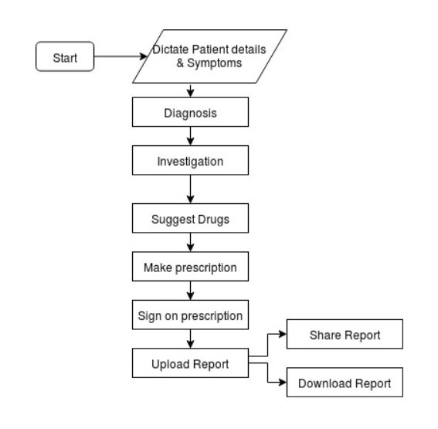
Prototype
Technology stack

Slide 3
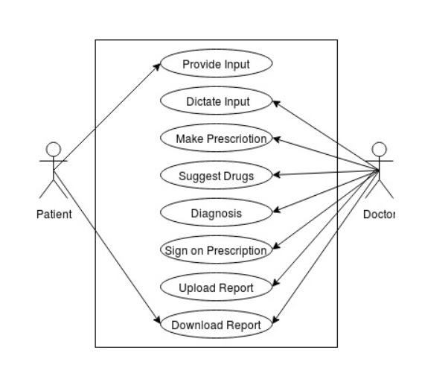
Usecase
Show Stopper

