Slide 1

EDA: ELECTRIC VEHICLE POPULATION ANALYSIS
NAME :- Sonal Kumari
ROLL NO. :- RK21URA14
REG NO. :-12107709
SECTION :-K21UR
COURSE NAME :- INT 353 (EDA PROJECT)

Slide 2
INTRODUCTION
I have chosen a dataset from Kaggle. It is about Electric Vehicle Population and this data collected in the year from 1997 to 2023.
The dataset under consideration contains information related to various aspects of electric vehicles, primarily in the states of Washington (WA) and California (CA).
This dataset contains over 124716 EVs from the USA, along with information on their regional origin, where the EVs are mostly used, and which model year it was made.
It's focused on Electrical Vehicle Type with an aim of appreciating zero emission vehicles, and which state in the USA is using it more, and Clean Alternative Fuel Vehicle (CAFV) Eligibility.
Each entry has 17 columns.
There are 988 missing values in the dataset.

Slide 3
About the project
Electric vehicles emerge as the possible strategy for decarbonization and green transportation due to social demand. Researchers have made multiple efforts and initiatives as the demand surge for sustainable development in the electric vehicle industry. This study analyzes the relevant research of the industry, thereby explores electric vehicle industry development trends with a scientometrics-based data evaluation system, where three key topics are detected: “Vehicle Exhaust Emissions”, “Climate Change”, and “Integration”. The results are visualized in the view of clusters, timeline, and time zone to explore the dynamic direction and future trends of the industry. Further trend detection and forward-looking analysis suggest the significance of stakeholders and their interconnection. In response to the significant challenges in sustainable development, this study proposes the stakeholder engagement system in a comprehensive perspective. The system firstly reveals the driving forces behind the industry development, that is how different motivation and strategies orientate the industry towards sustainability. Then, it furtherly analyzes the commitments and efforts needed from multiple stakeholders, through policy implications, leading factors on demand side, and technology innovation requirements on supply side. The stakeholder engagement system may contribute to stakeholder synergy and resource optimization hence for electric vehicle industry sustainable development and novel ideas to other relevant research fields.

Slide 4
DATA DESCRIPTION
Vehicle Identification Number (VIN): The first 10 characters of the VIN serve as a unique identifier for each vehicle. VINs are critical for tracking and managing vehicle data, including manufacturing details, recalls, and ownership history.
County, City, State, and Postal Code: These fields provide geographical information about the location of electric vehicles. Analyzing the distribution of EVs across counties and cities can help identify regions with higher adoption rates and potential areas for infrastructure development.
Model Year, Make, and Model: These attributes specify details about the electric vehicle, including its year of manufacture and the manufacturer's brand and model name. This information is essential for categorizing and comparing different EVs.
Electric Vehicle Type: This field distinguishes between Battery Electric Vehicles (BEVs) and Plug-in Hybrid Electric Vehicles (PHEVs). BEVs rely solely on electric power, while PHEVs have both electric and gasoline power sources.
Clean Alternative Fuel Vehicle (CAFV) Eligibility: CAFV eligibility indicates whether a vehicle qualifies for incentives and benefits associated with clean alternative fuels. Some vehicles may not be eligible due to factors like low battery range.
Electric Range: The electric range represents the maximum distance an EV can travel on a single electric charge. It is a critical factor for consumers, as it determines the practicality and usability of the vehicle for their needs.
Base MSRP: The Manufacturer's Suggested Retail Price (MSRP) reflects the vehicle's cost before additional fees and taxes. Analyzing the MSRP helps in understanding the affordability of electric vehicles.
Legislative District: This field provides information about the legislative district associated with the vehicle's location. Legislative districts play a role in policymaking and infrastructure development.
DOL Vehicle ID: This is a unique identifier for each vehicle in the dataset, facilitating data management and retrieval.

Slide 5
Vehicle Location: The geographical coordinates (latitude and longitude) pinpoint the precise location of each electric vehicle. This information can be used for mapping and spatial analysis.
Electric Utility: This field identifies the electric utility company serving the vehicle's location. It is important for understanding the sources of electricity powering EVs.
2020 Census Tract: Census tracts are geographic areas used for demographic analysis. This information can be valuable for studying EV adoption patterns in different demographic contexts.

Slide 6
Steps Of EDA
Read the dataframe
Inspect the dataframe
Data Cleaning
Data handling (Outliers)
Data Visualization
Data Analysis
Distributions
Hypothesis Testing

Slide 7
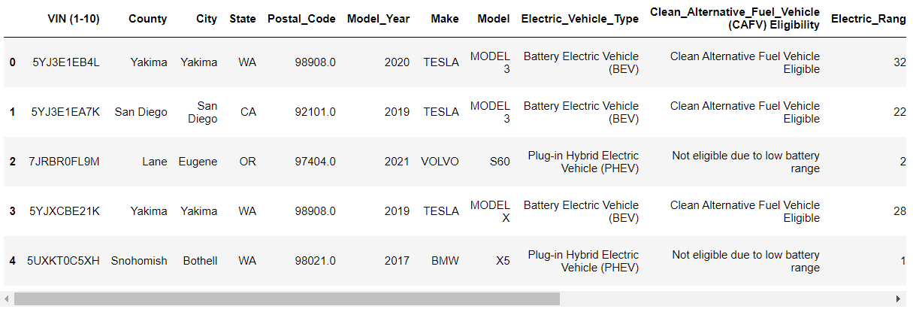
DataSet https://drive.google.com/file/d/1MY0KSzcIQAAyrrkjvdl9vlltUMpBA36R/view?usp=sharing

Slide 8
Data Cleaning
Handling Missing Values: -This includes handling missing values in specific columns such as 'Model', ‘Electric_Utility’,‘Legislative_District’ and 'Vehicle_Location'.
The missing values are handled in a way that is Missing values are either filled with appropriate values (e.g., mode) or, in the case of 'Electric_Utility', rows with missing values are dropped from the dataset.
Exploring Unique Value: - The code explores unique values in specific columns using nunique() and value_counts() functions. For example, it checks the number of unique values in the 'Electric_Utility' column and counts the occurrences of each 'Electric_Vehicle_Type'.
Handling Duplicates: - The code handles duplicates in the dataset by duplicating the first row and appending it to the data, creating a dataset with duplicated rows.
Outlier Detection and Handling: -
Boxplot Visualization: The code creates boxplots to visualize the distribution of the "Model_Year" feature and identify potential outliers using quartiles and the Interquartile Range (IQR).
Outlier Removal: It filters out outliers by defining upper and lower bounds based on the IQR and removes data points outside these bounds.

Slide 9
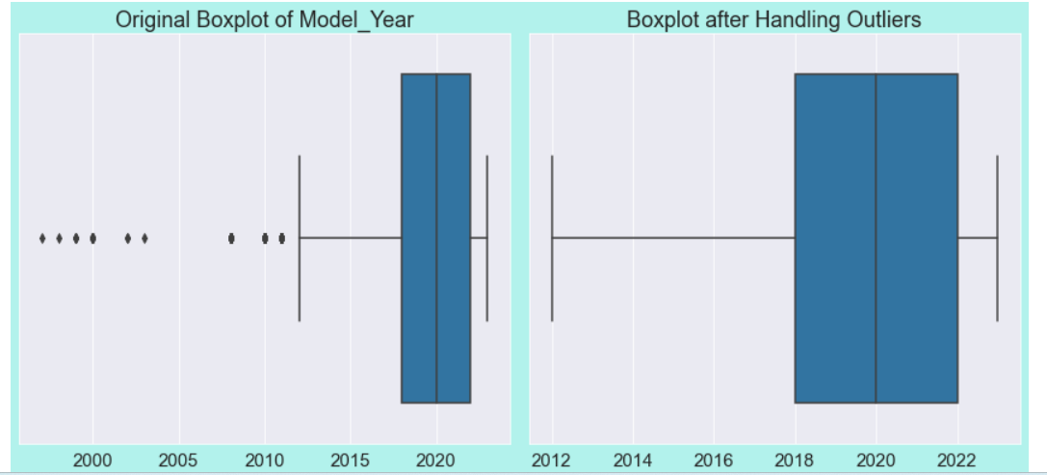
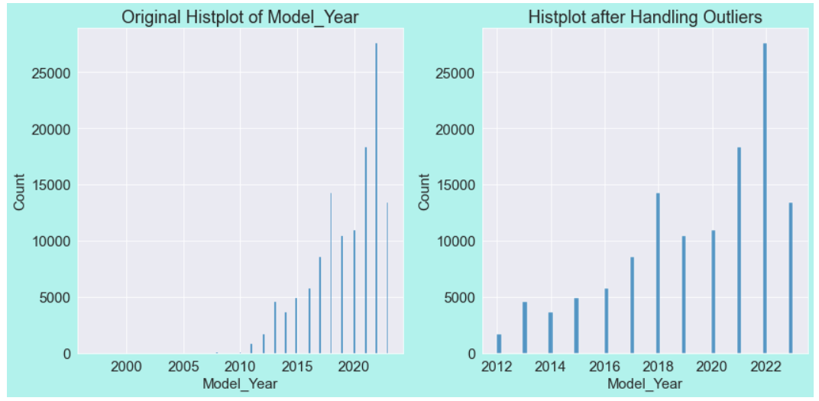
Outliers

Slide 10
Data Exploration
Electric_Range:
Minimum = 0.000000
Maximum = 337.000000
Std = 100.331969
Mean = 79.471936
25% Percentile = 0.000000
50% Percentile = 25.000000
75% Percentile = 200.000000
Base _ MSRP:
Minimum = 0.000000
Std = 10053.289929
Mean = 1556.068906
25% Percentile = 0.000000
50% Percentile = 0.000000
75% Percentile = 0.000000
Maximum = 845000.000000

Slide 11
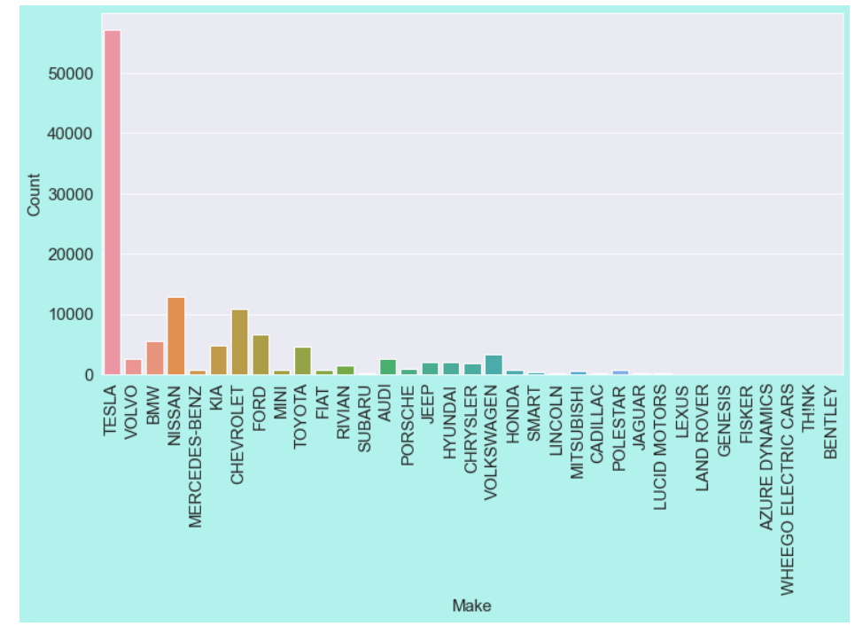
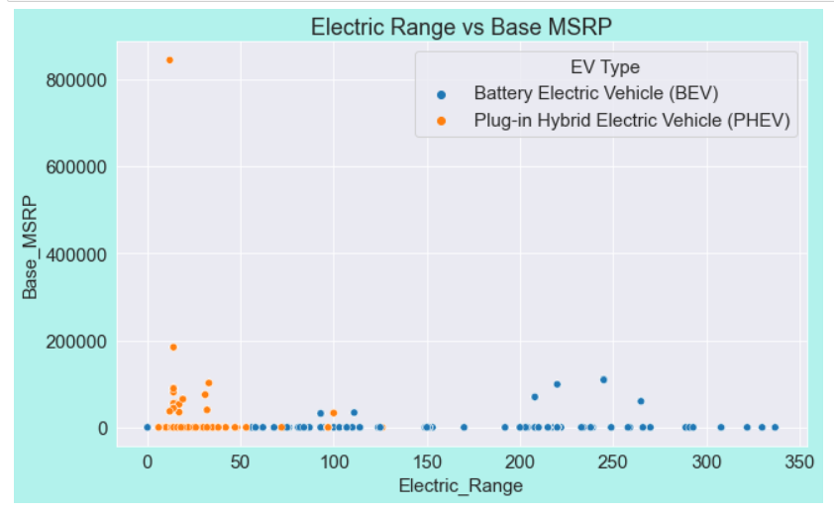
Data Visualization
Count of Vehicles by Make
Scatter Plot of Electric Range vs. Base MSRP

Slide 12
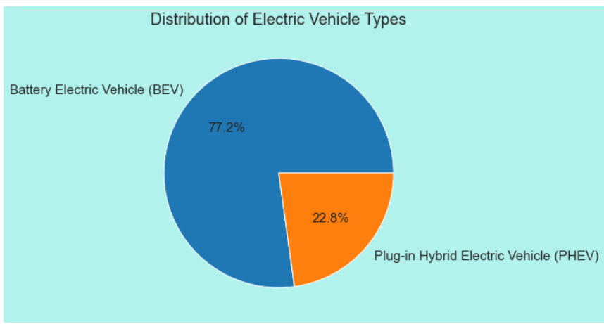
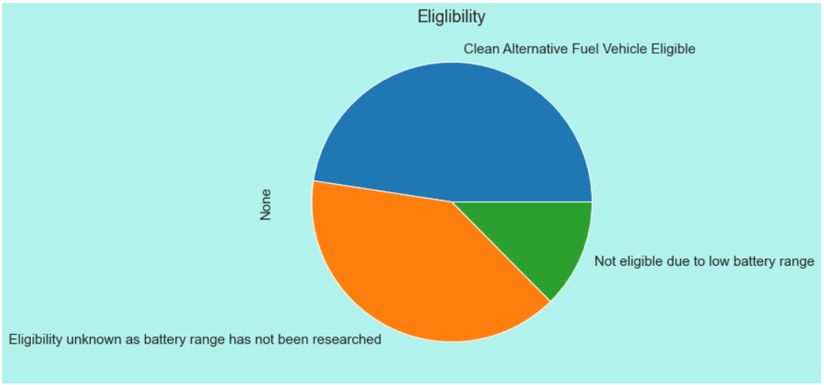
Pie Chart of Electric Vehicle Type Distribution
Pie Chart of Clean Alternative Fuel Vehicle (CAFV) Eligibility

Slide 13
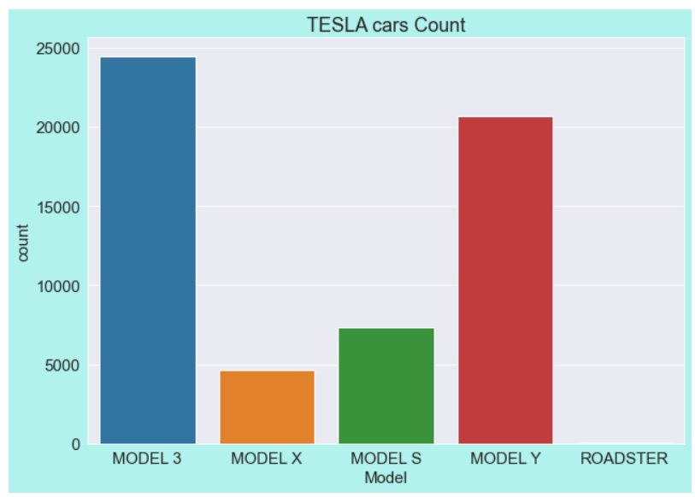
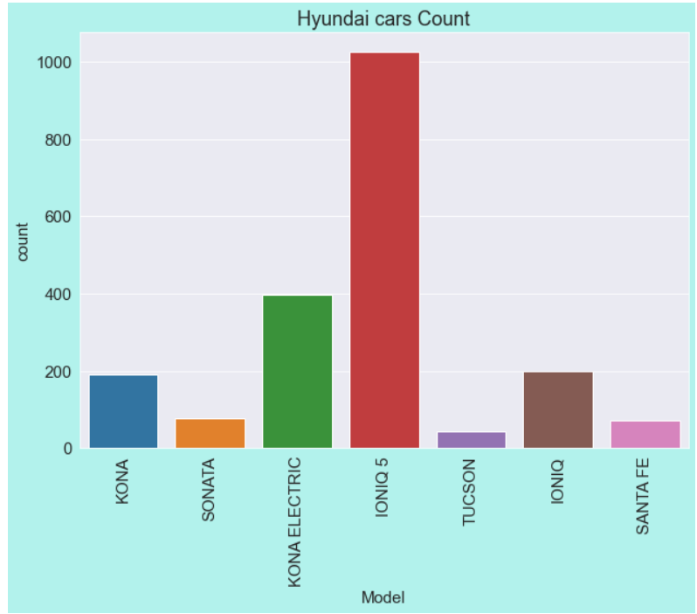
Count Plot of TESLA Cars by Model
Count Plot of HYUNDAI Cars by Model

Slide 14
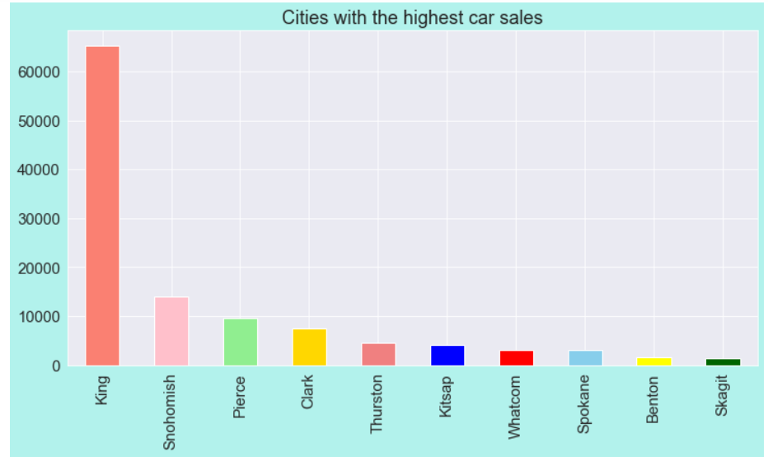
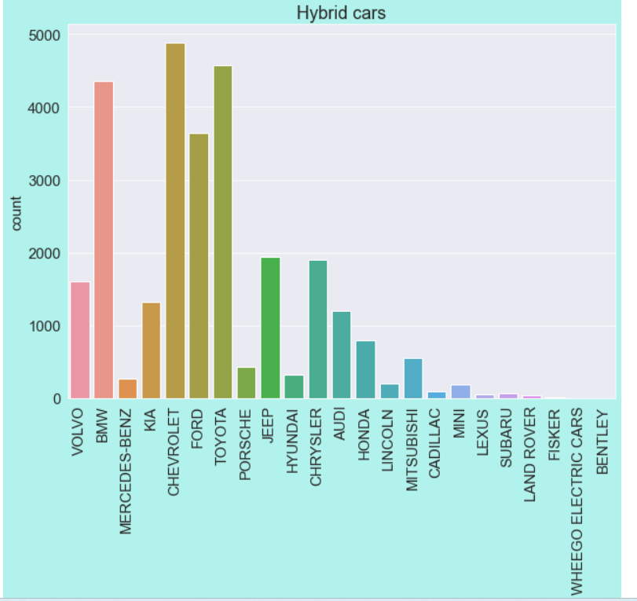
Top 10 Counties by Car Sales
Count Plot of Hybrid Cars by Make

Slide 15
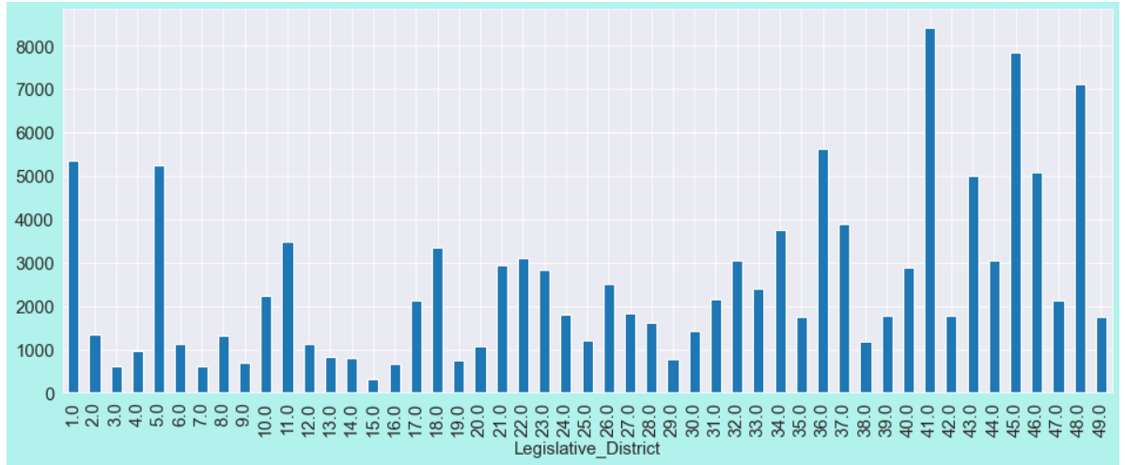
Bar graph of Legislative District Distribution

Slide 16
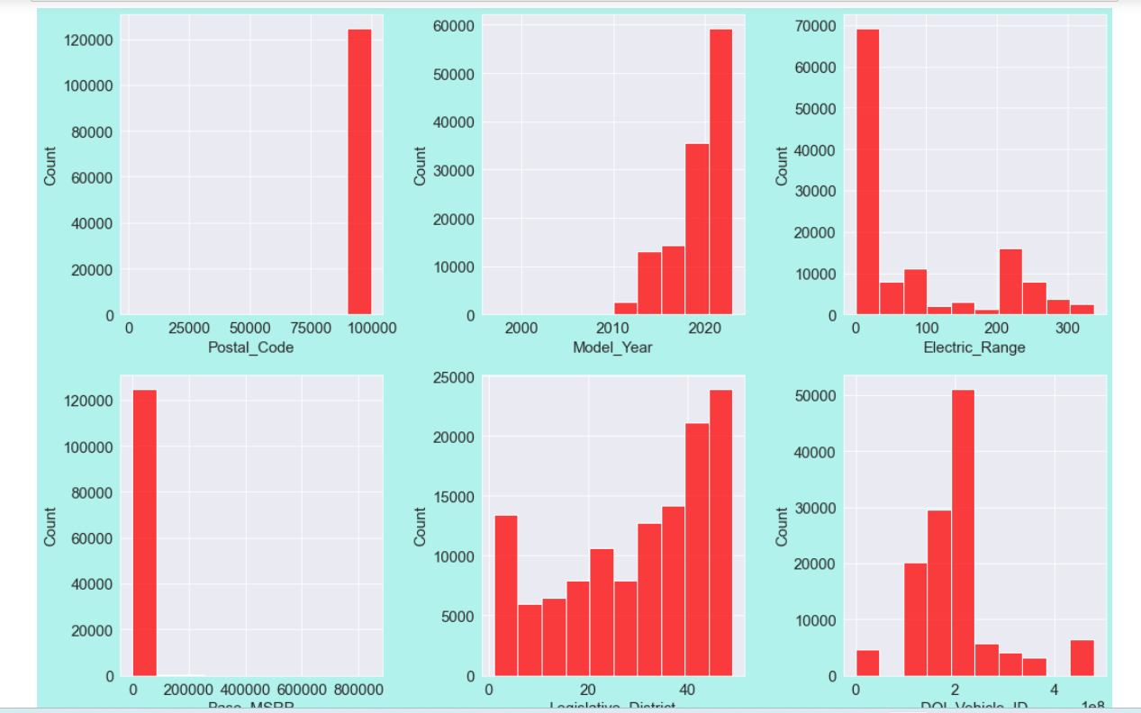
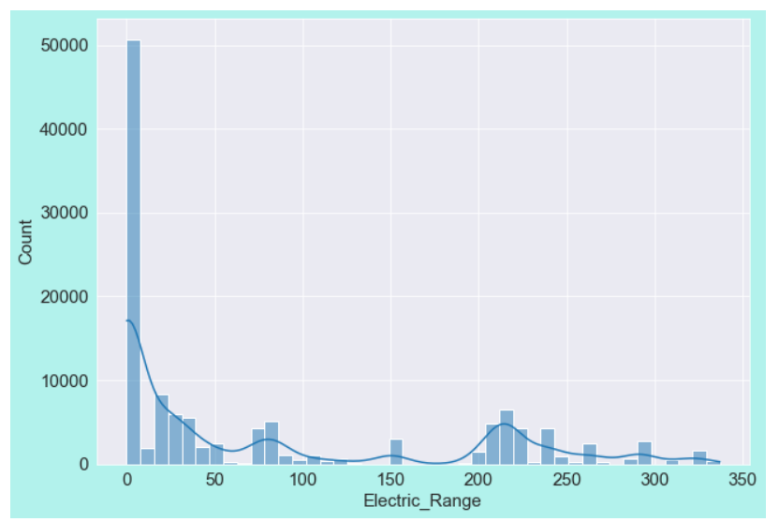
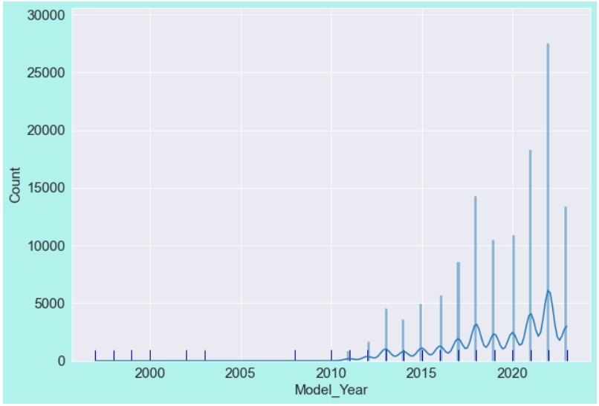
Data Analysis
Univariate Analysis :
Histplot
KDE PLOT
Rug Plot

Slide 17
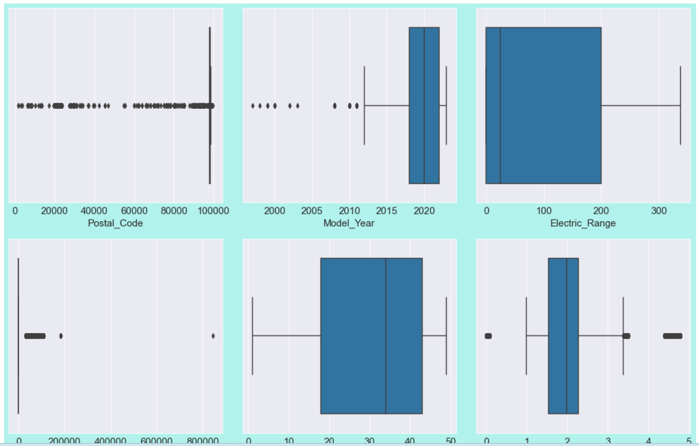
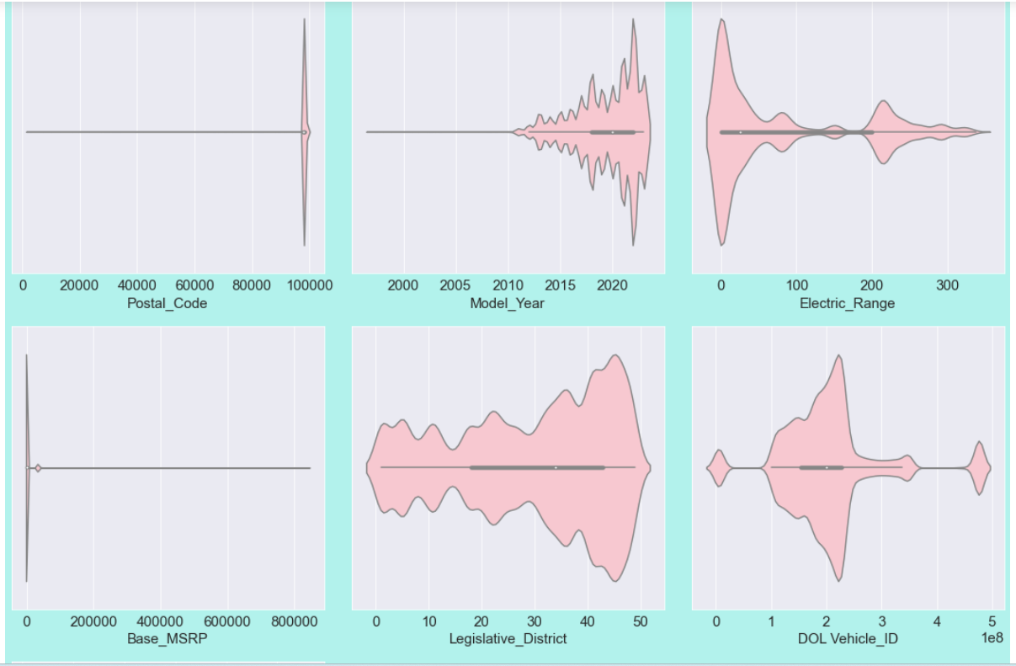
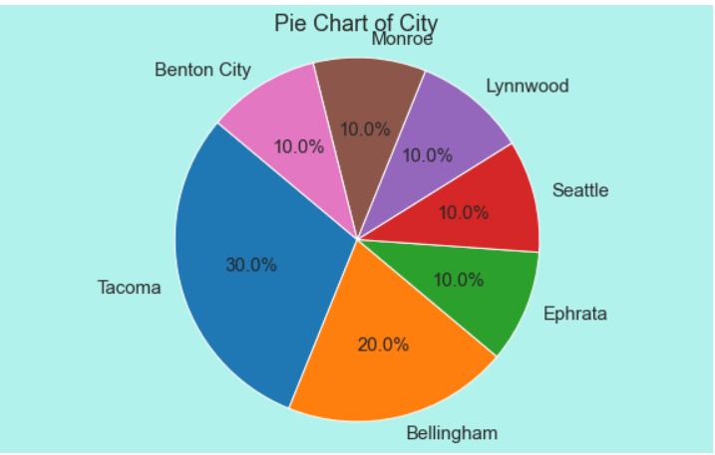
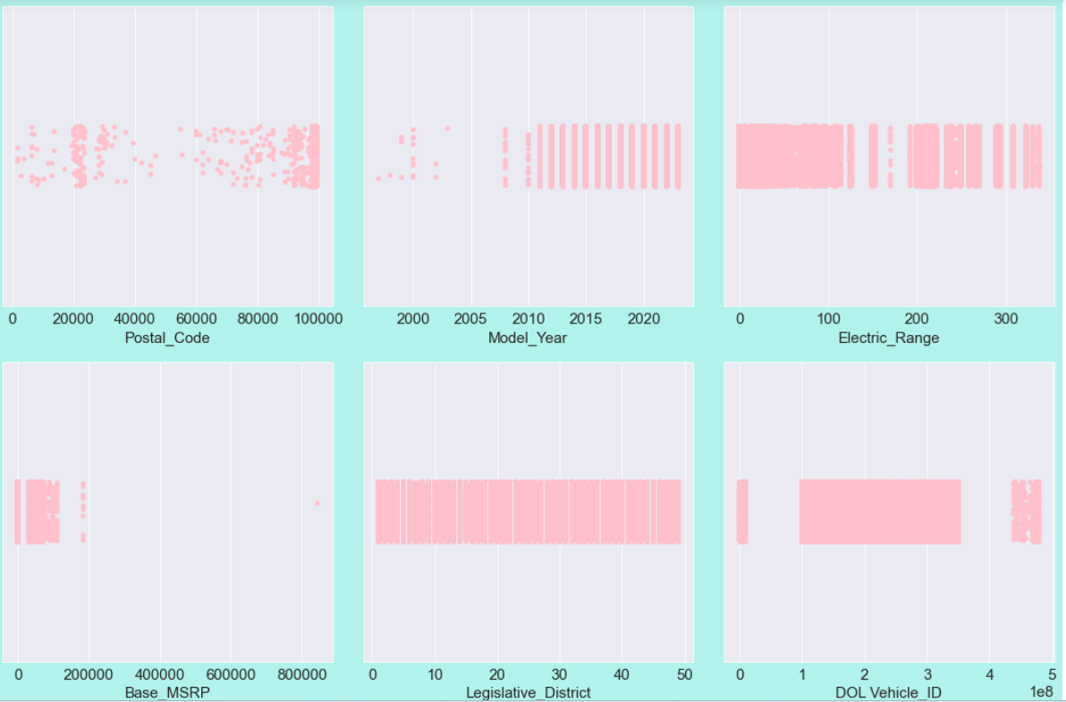
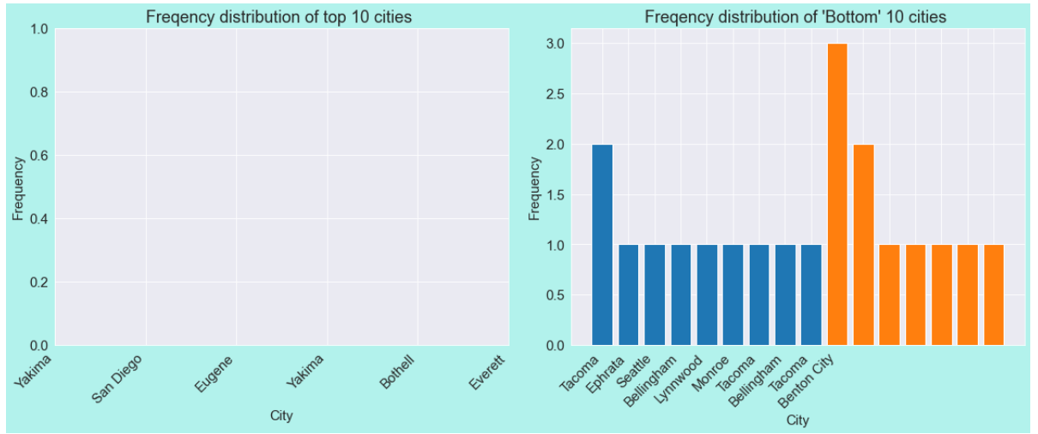
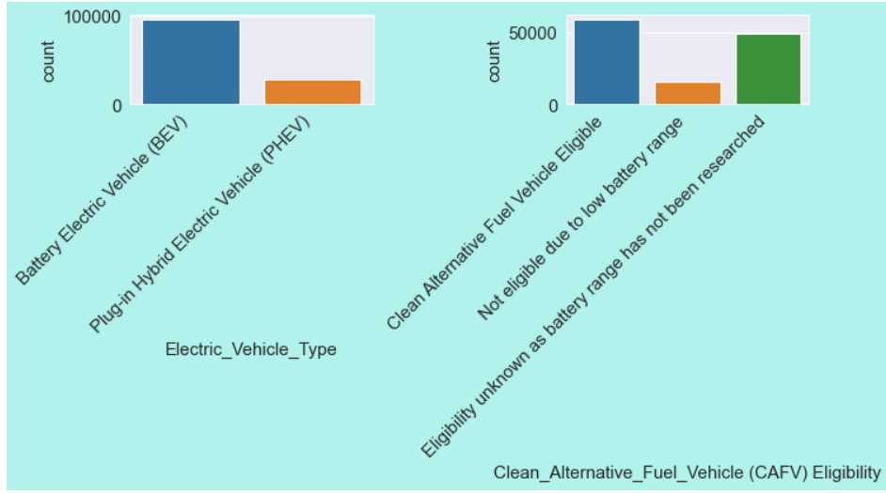
Box Plot
Violin Plot
Pie chart
Strip Plot
Frequency Distribution
Count Plot

Slide 18
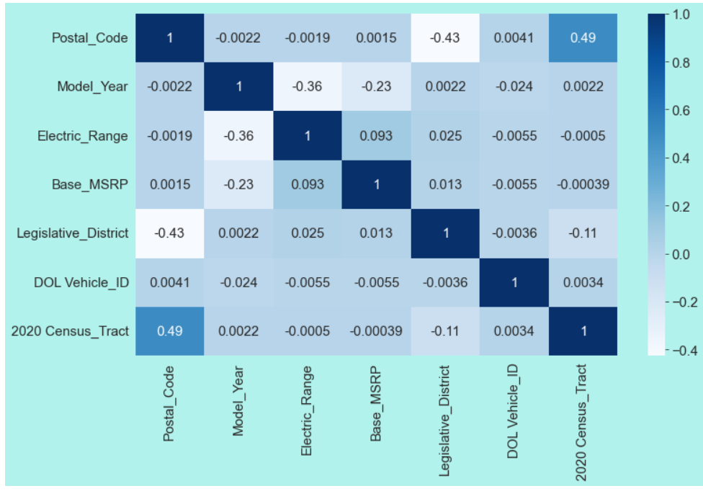
Bivariate Analysis
Bivariate analysis involves exploring the relationship between two variables.
Approaches:-
Scatter Plots (plot.scatter()): Used to visualize the relationship between two numeric variables. It helps identify correlations or patterns between "Postal_Code" and "Model_Year," as well as "Electric_Range" and "Postal_Code."
Line Chart (plt.plot()): Shows how one numeric variable ("Electric_Range") changes concerning another ("Postal_Code").
Heatmap (sns.heatmap()): Visualizes the correlation matrix of all numeric variables, indicating the degree of correlation between pairs of variables.
Hexbin Plot: Used to visualize the density of data points with "Electric_Range" less than 100 against "Postal_Code."
Box Plot (sns.boxplot()): Visualizes the distribution of "Model_Year" across categories of "Clean_Alternative_Fuel_Vehicle (CAFV) Eligibility."
Violin Plot (sns.violinplot()): Shows the distribution of "Model_Year" across different "Legislative_Districts."

Slide 19
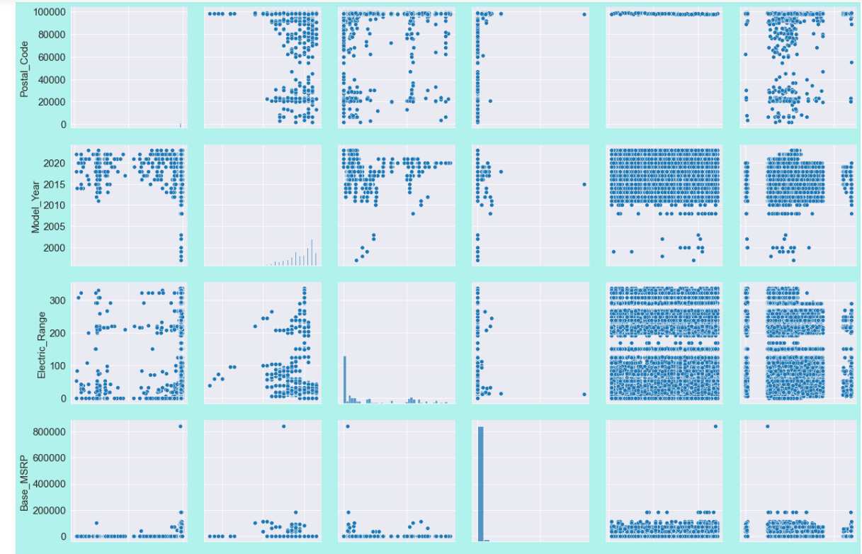
Multivariate Analysis
Multivariate analysis involves the simultaneous analysis of two or more variables to understand their relationships and interactions.
Pairplot (sns.pairplot()): Visualizes pairwise relationships between multiple numeric variables ("Postal_Code," "Model_Year," "Electric_Range," "Base_MSRP," "Legislative_District," and "DOL Vehicle_ID"). It helps identify correlations and patterns among these variables.

Slide 20
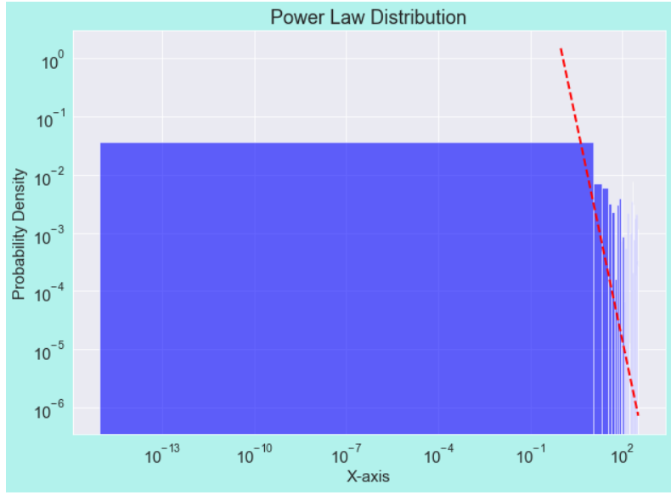
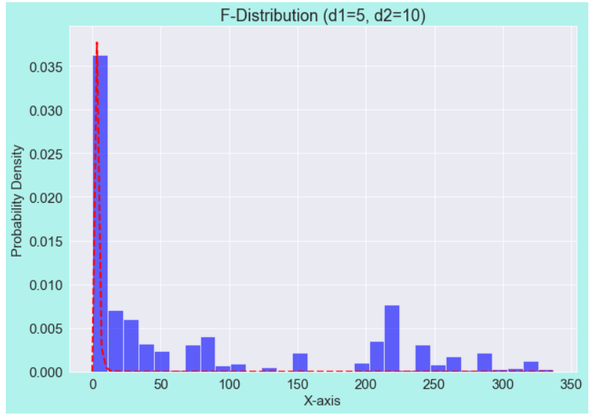
Distributions

Slide 21
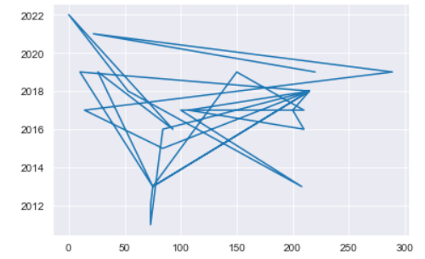
Hypothesis Testing
Normality Testing using Shapiro-Wilk Test
Correlation Tests - Pearson and Spearman’s Rank Correlation
Chi-square Test
T- Test
ANOVA
Mann-Whitney U Test
Freidman Test
Test of Stationarity
Correlation test

Slide 22
Insights
Model 3 of Tesla has almost 30% of EV vehicles followed by Tesla's Model Y. In total almost 50% of the market is captured by Tesla in Washington, USA. Nissan's Leaf is the 3rd vehicle that has captured almost 16% of the market. Tesla captures almost 52% of the market whereas 9 companies together capture 50%. King has the most no. of EV Cars followed by Snohomish then Pierce. The reason could be there might be more no. of charging stations in these areas. Most EV vehicles were manufactured in 2022 followed by 2021, year 2023 is low because almost half of the year is still left. There is not any electric vehicle which is eligible for CAFV incentives in Washington, US. It is noted that for electric ranges greater than 50 are eligible vehicles with clean fuel. The uncertainty lies in those ranges below 50 as they are either not eligible or there is no clear information on them.

Slide 23
Limitations
Missing Data: The dataset has missing values in certain columns, which can affect the completeness of the analysis.
Sample Bias: The dataset is not fully representative of the entire population of electric vehicles. It focusses on specific regions, manufacturers, or time periods, leading to a biased view.
Limited Variables: The available variables do not cover all aspects relevant to the analysis. Some important features or factors influencing electric vehicles' performance or adoption are missing.
Temporal Limitations: The dataset is limited to a specific time, and trends or patterns over time could be missed.
Scope of CAFV Eligibility: The criteria for Clean Alternative Fuel Vehicle (CAFV) eligibility may not be explicitly defined in the dataset, leading to ambiguity in understanding the eligibility status.
Limited Context: The dataset may lack contextual information about external factors influencing electric vehicle ownership or usage, such as government policies, charging infrastructure, or public perception.

Slide 24
Conclusions
After all the analysis of the dataset, we can conclude that Model 3 has been dominating till now and Tesla is the company which is making most of the electrical vehicles. There should be a greater number of charging stations, so that the number of electric vehicles can be used more.

Slide 25
Thank You
Sonal Kumari

