Slide 1
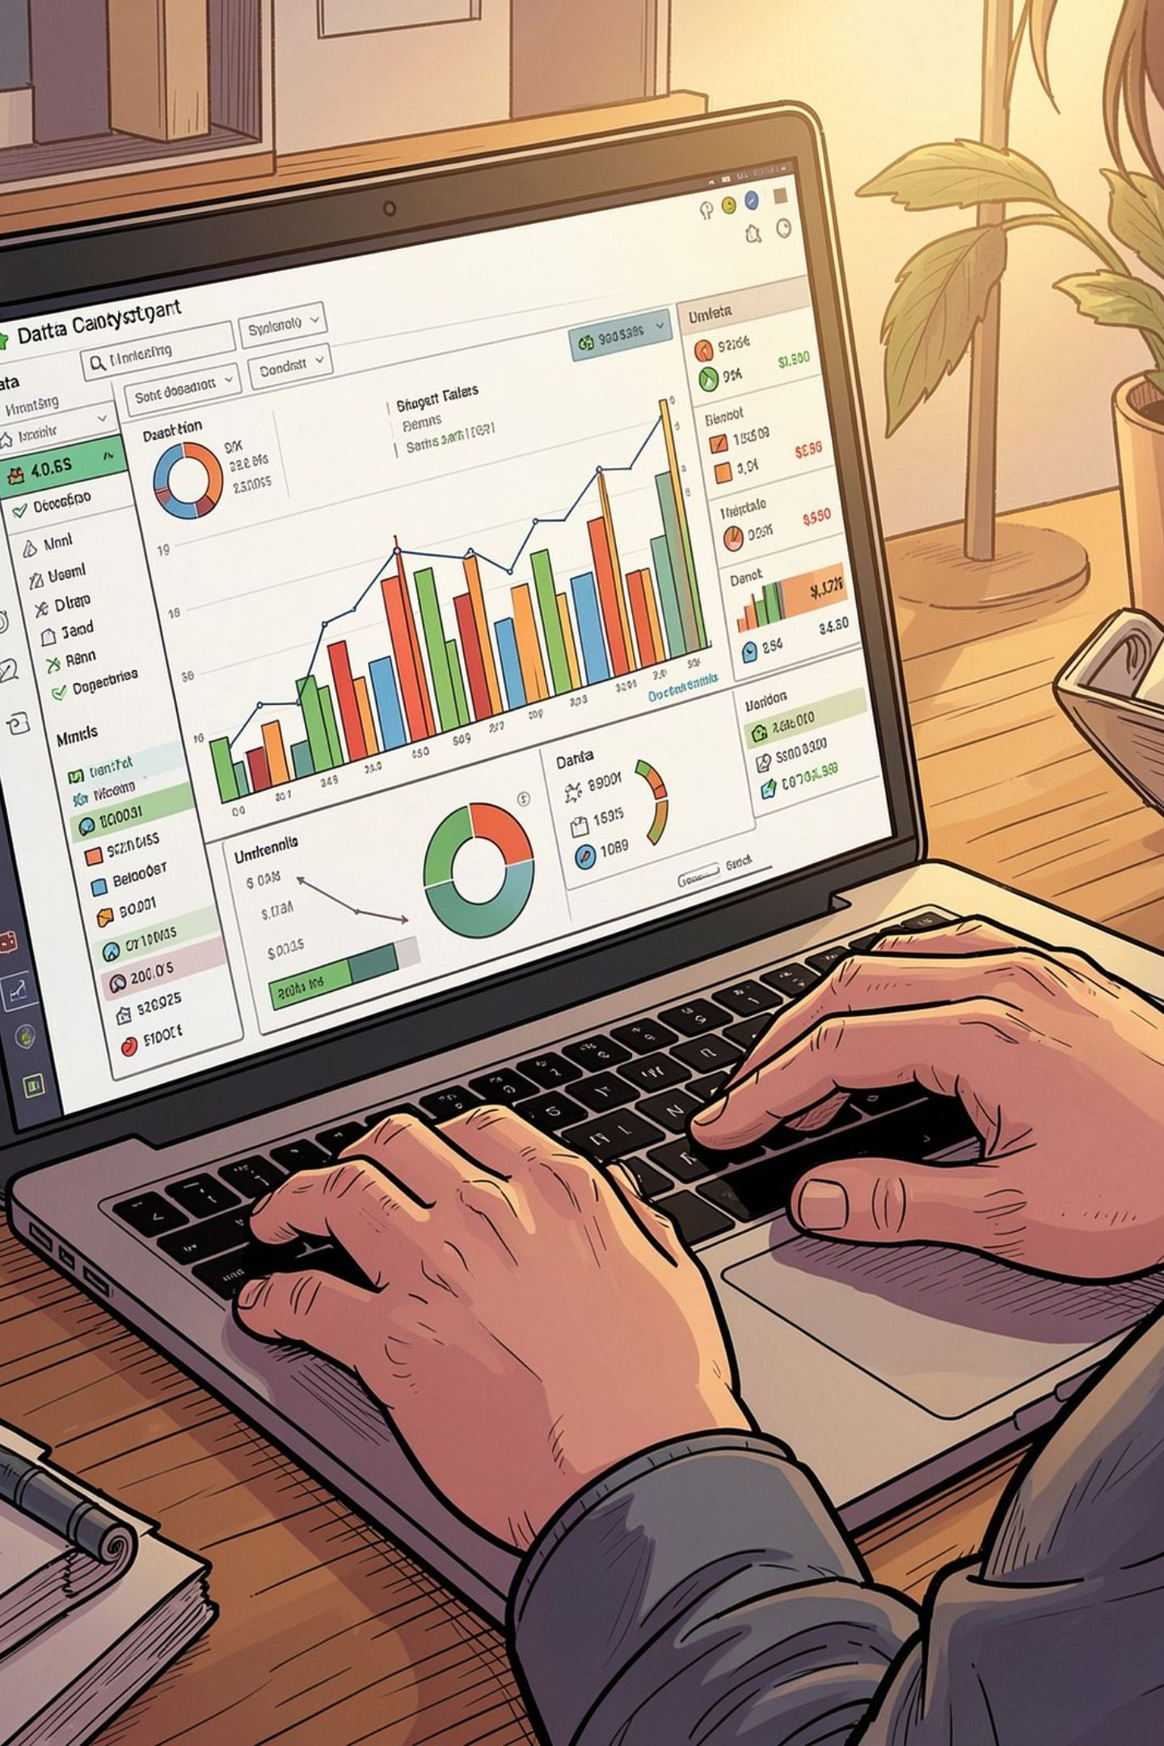
Customer Shopping Behavior Analysis
3,900 purchases • 18 features • Goal: uncover spending, segments, preferences, subscriptions

Slide 2
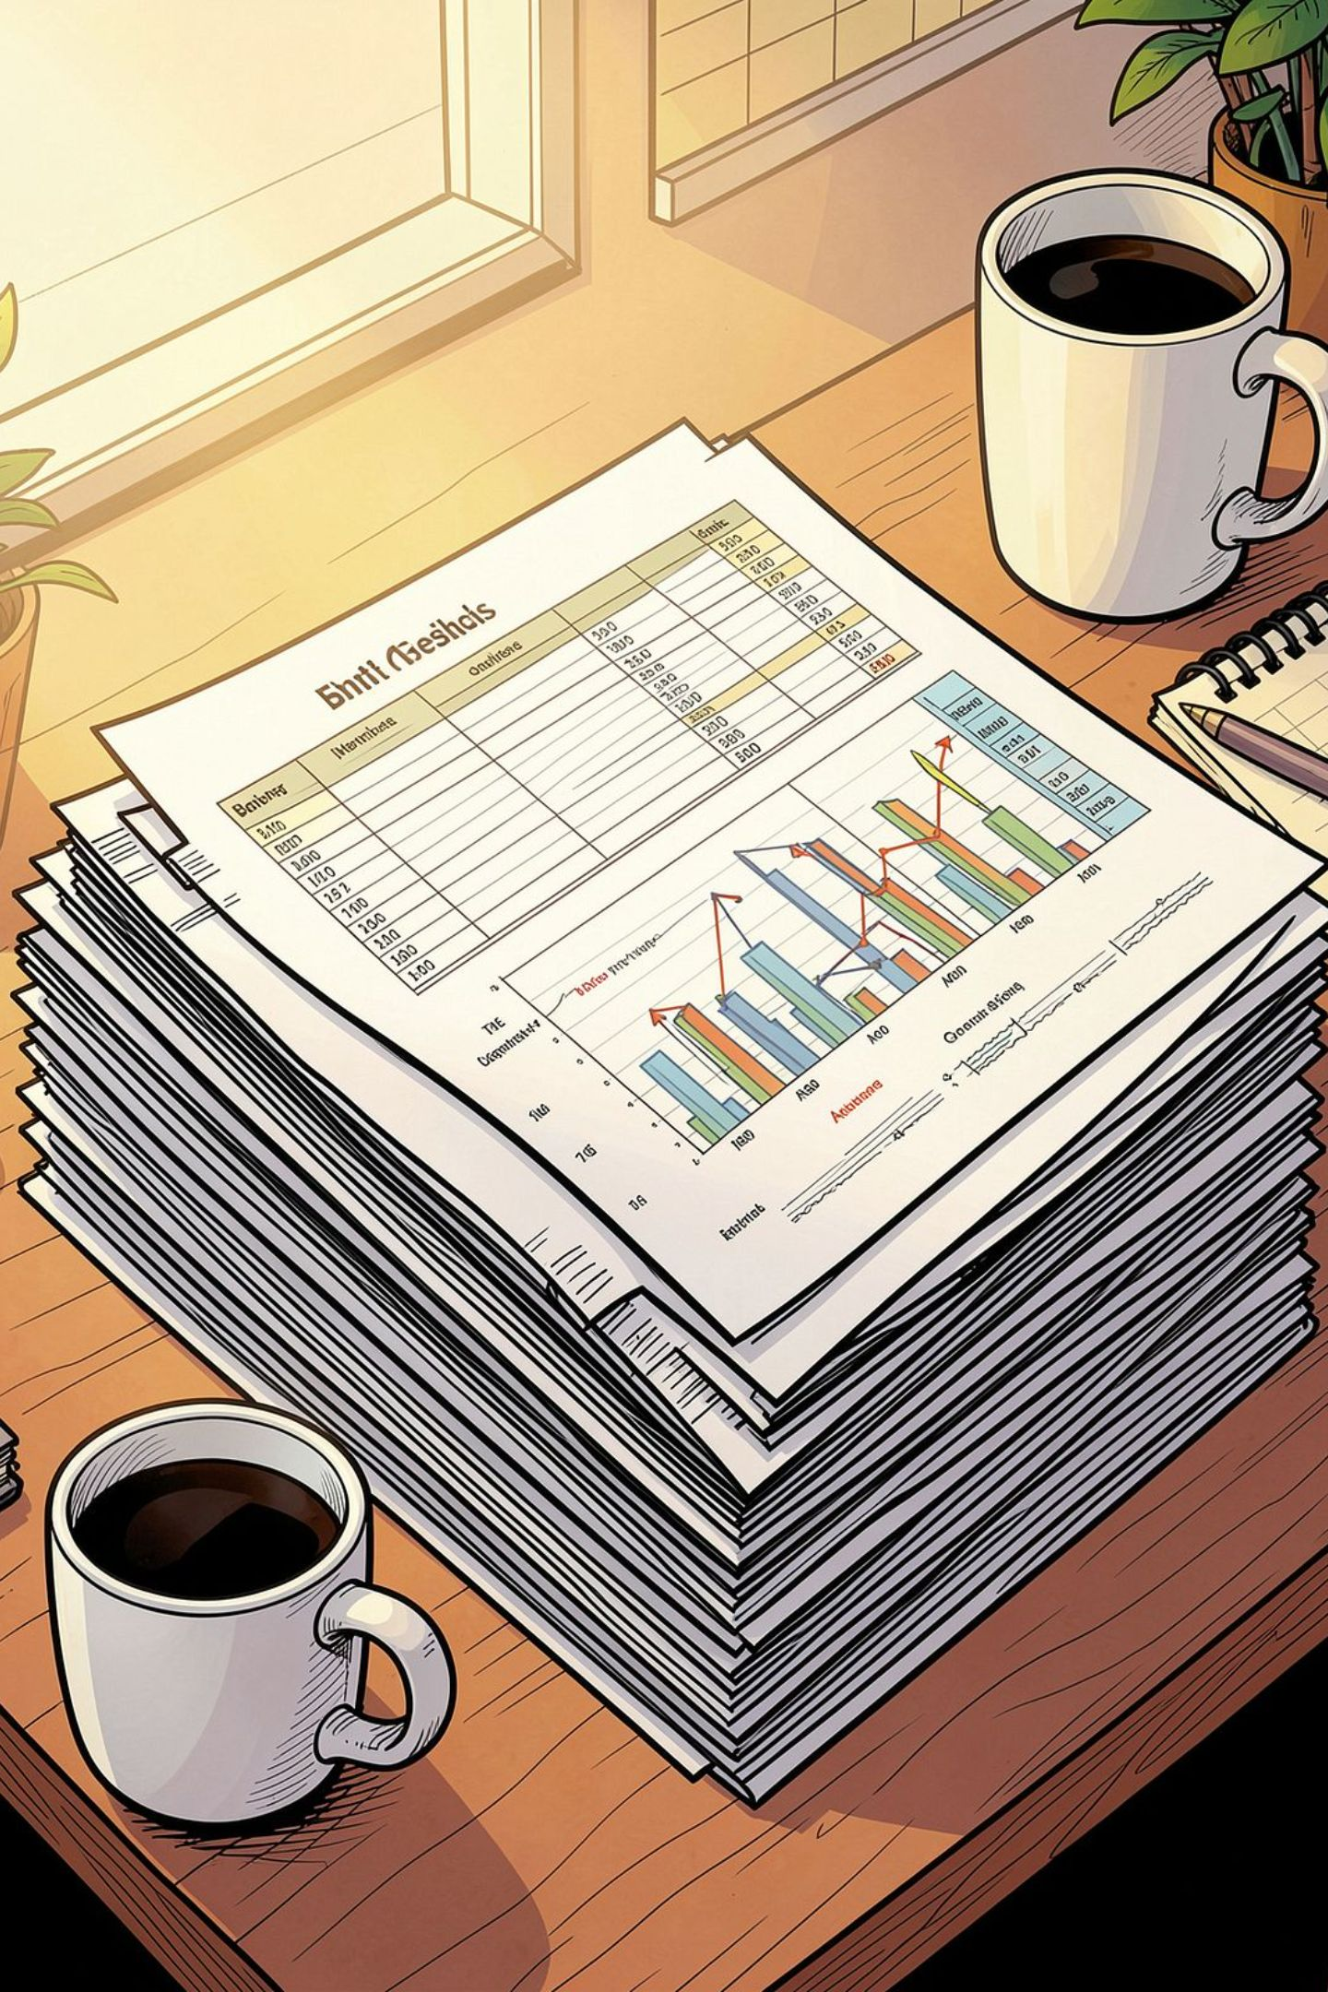
Dataset Snapshot
Rows
Columns
3,900
18
Missing
37 values in Review Rating

Slide 3
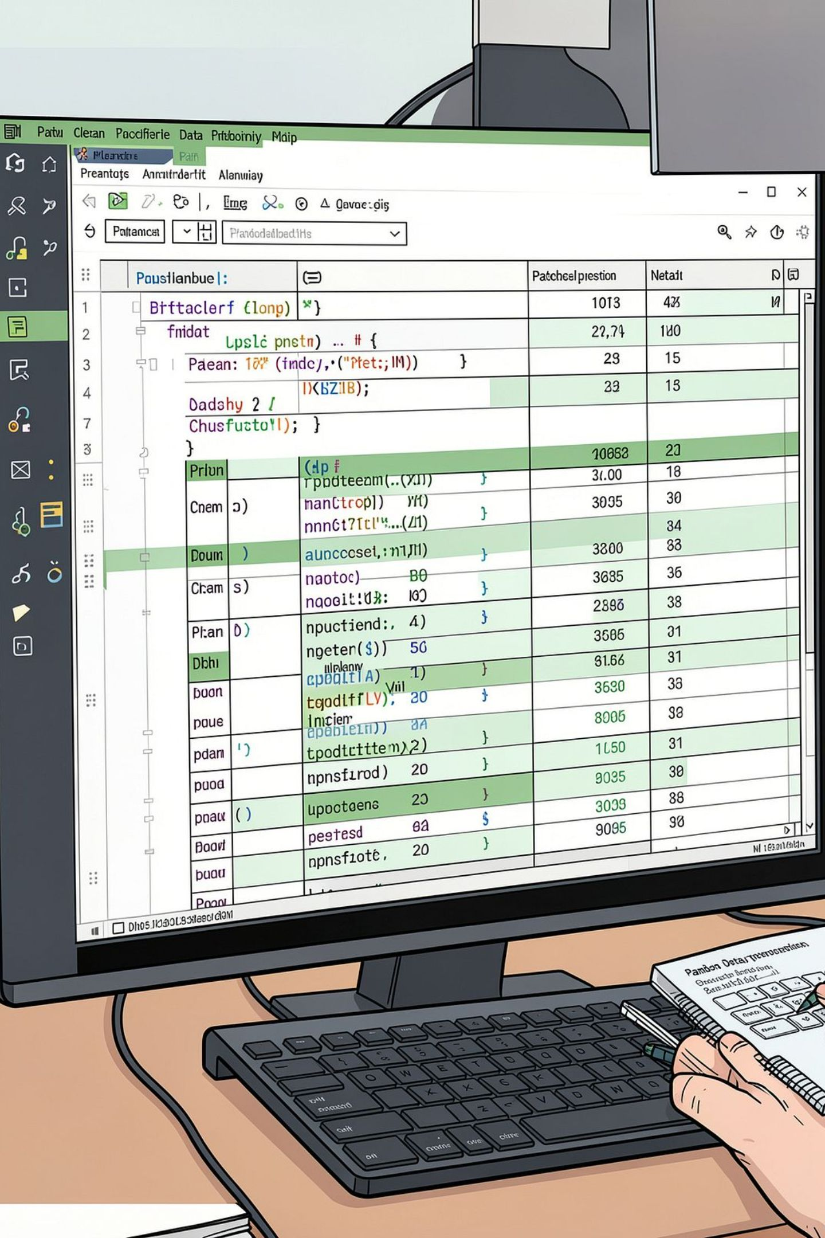
Python — EDA & Prep
01
Load & Explore
df.info(), describe()
02
Missing Values
Imputed Review Rating by category median
03
Clean & Engineer
snake_case, age_group, purchase_frequency_days
04
DB Integration
Loaded to PostgreSQL

Slide 4
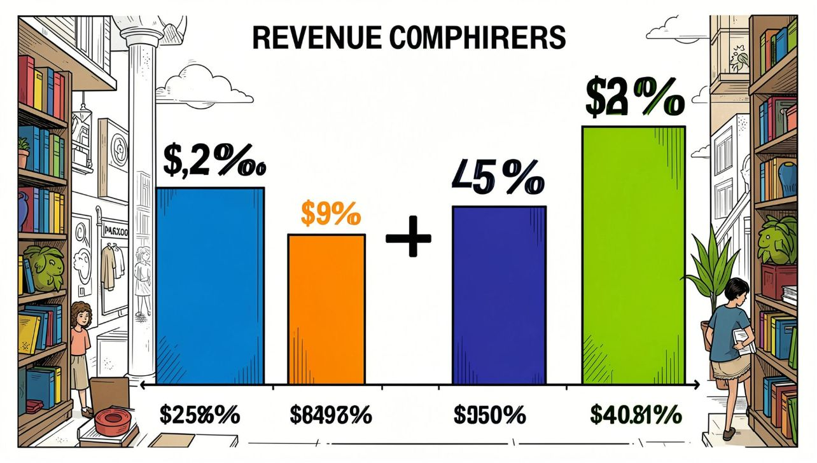

Revenue by Gender
Male: $157,890
Female: $75,191
Male customers generated higher total revenue

Slide 5
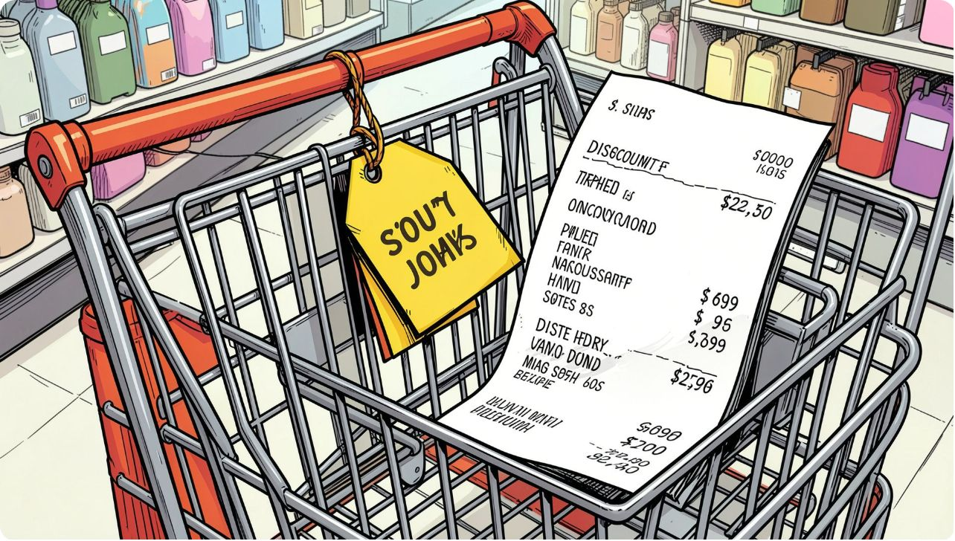
Discounts & High-Spenders
839 rows: customers who used discounts yet spent above average
Top examples: purchases like $97, $90, $88...
Review discount strategy vs margin

Slide 6



Top Rated Products
Gloves
Sandals
Boots
Avg Rating: 3.86
Avg Rating: 3.84
Avg Rating: 3.82

Slide 7
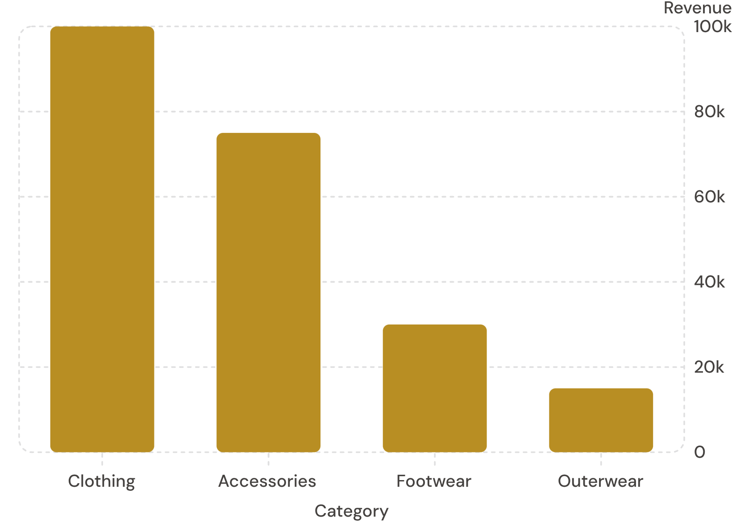
Category Performance
Revenue leader: Clothing
Sales leader: Clothing (1,800)
Accessories strong in orders; Footwear and Outerwear smaller share

Slide 8
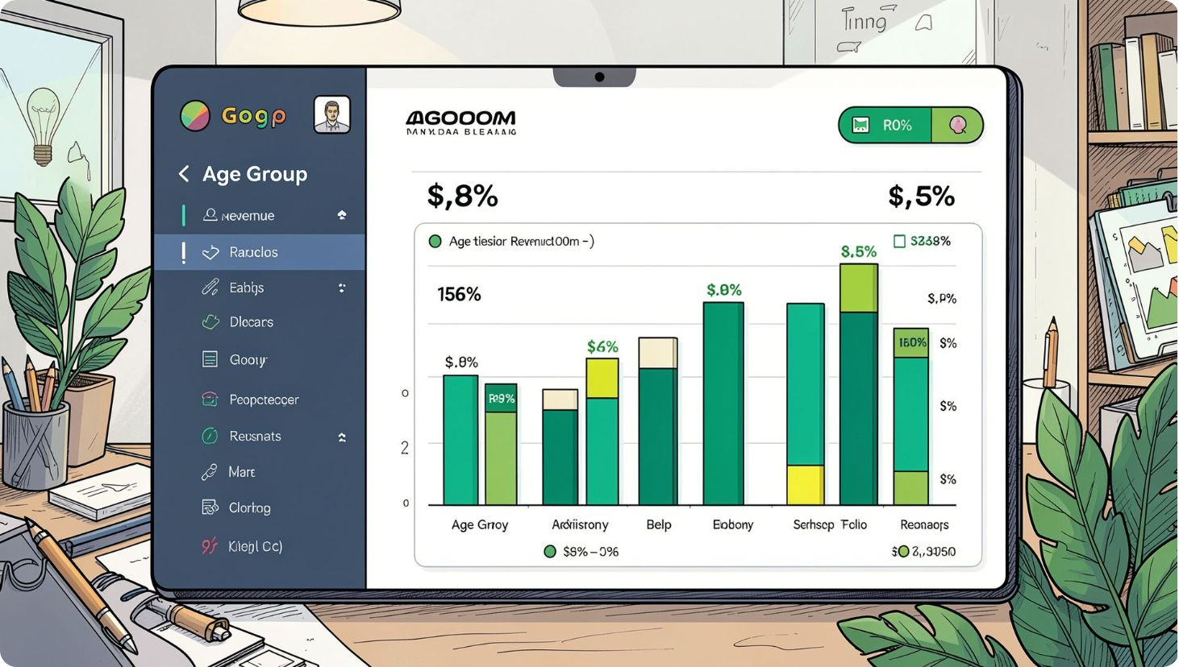
Age & Subscription Insights
Age group revenue:
Young Adult: $62,143
Middle-aged: $59,197
Adult: $55,978
Senior: $55,763
Subscribers: 1,053 (avg spend $59.49) vs Non-subscribers: 2,847 (avg $59.87)

Slide 9
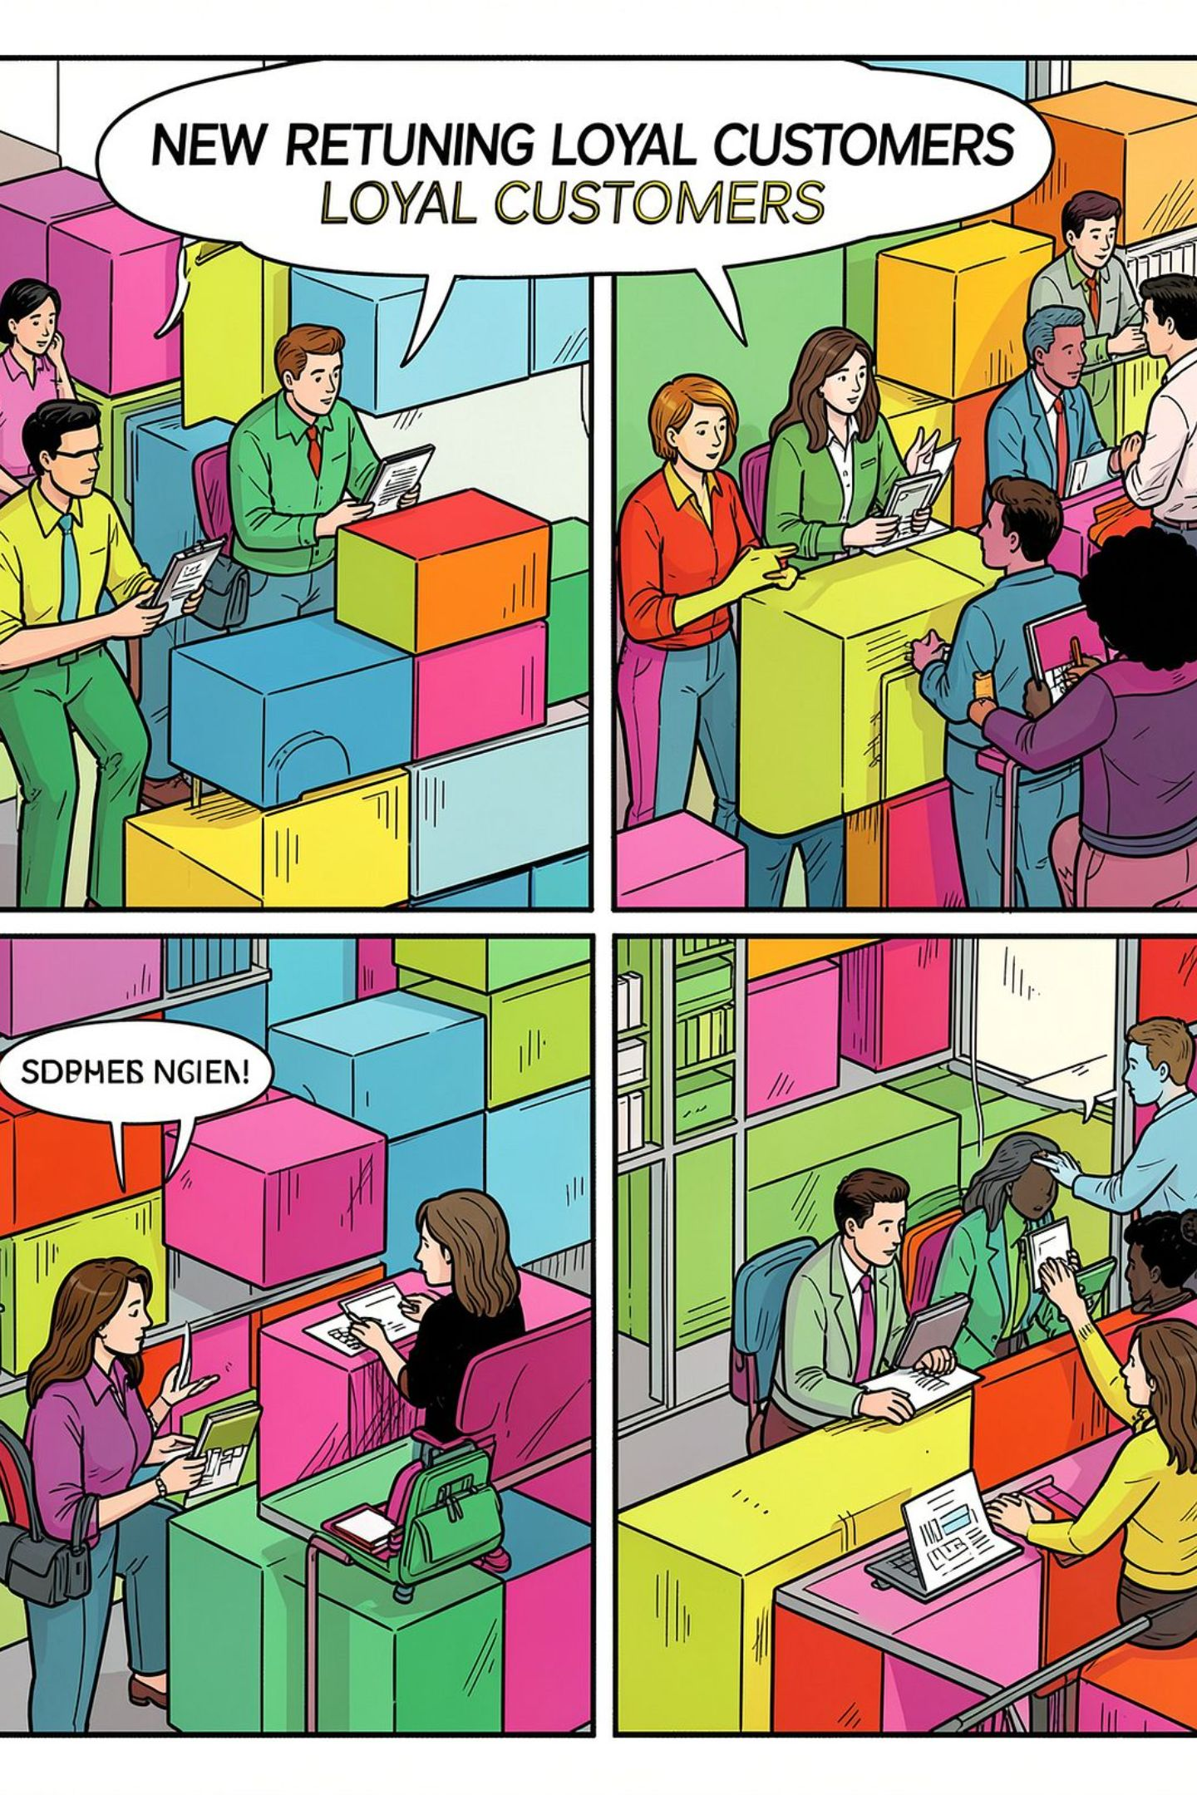



Customer Segments
Loyal
3,116 customers
Returning
701 customers
New
83 customers

Slide 10


Business Recommendations
Boost Subscriptions
Loyalty Programs
Review Discounts
Promote exclusive benefits
Reward repeat buyers
Balance sales uplift with margins
Product Positioning
Targeted Marketing
Feature top-rated & best-sellers
Focus on high-revenue ages & express-shipping users
Theme accent color: #B88E23 applied across deck

