Slide 1
SECURITY AND DATA PROTECTION
TEAM 1.6 GREEN HORIZON
Sonal Chaudhary, Namrata Maun, Shashank Poojary, Hrishikesh Desai

Slide 2

AGENDA
OBJECTIVE AND PURPOSE
BENEFITS AND DELIVERABLES
TOP-LEVEL WBS AND BUDGET
ACHIEVEMENT PLAN
MULTI-LAYER SECURITY MODEL DESIGN
MILESTONES SCHEDULE
PROJECT CONSTRAINTS

Slide 3
OBJECTIVE AND DESCRIPTION
Build security into digital media products, services and infrastructure.
Better protect applications endpoints, move faster to detect threats, guide people with security procedures or principles, and respond to security breaches to make the organization’s environment safe.
Enhance multi-level protection of data. (At software level, hardware level, network level and cyber security level.)

Slide 4
What?
45 Days project, Implementation of Security model for a digital media company
Where?
At client Location, Development of security principles by the Security Team
When?
Project start date on 20th Feb. and GO live date on 7th April
Who?
Project involves security team’s contribution and affects the Software, Hardware, Data, People (Teams and clients) and procedures after completion
Why?
To ensure data protection and enhance security principles through a secure model
How?
Security team develops multi-layer security at network level, data level, software level, hardware level and also propose risk management and disaster recovery management techniques.

Slide 5

PURPOSE
Implementing information security model at the corporate level for a digital media company to ensure data protection and risk management.
Loss of data from hacking, malware and other cyber intrusions can be very costly for business
Embarrassing notifications to clients and customers when a breach occurs
Failure to adhere to data protection rules could result in legal action and substantial fine
Accidental loss of the customer database affects marketing efforts and company’s reputations
WHY?

Slide 6





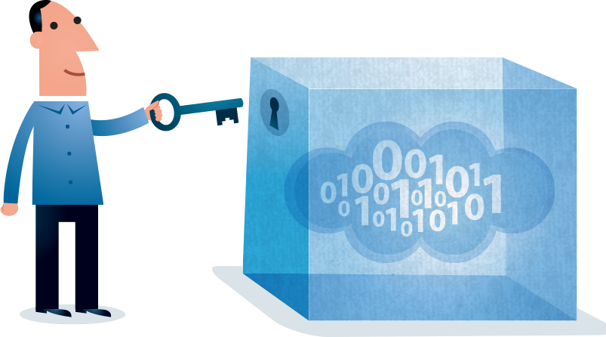
EXPECTED BENEFITS
DATA PRIVACY (Protecting corporate data)
FRAUD DETECTION AND IDENTITY THEFT
CYBER SECURITY (Secure data over network)
DEVICES SECURITY (Assets protection)
DISASTER MANAGEMENT AND RECOVERY(Periodic backups)
SAFEGUARDING INFRASTRUCTURE (Data centers and servers)

Slide 7

MAJOR DELIVERABLES
NETWORK SECURITY MODEL
SOFTWARE SECURITY MODEL
HARDWARE AND DEVICES SECURITY MODEL
Security Training Handbook or document
Security principles and data protection document
Guidance center setup
Vendors List

Slide 8
ACHIEVEMENT PLAN
Protect Identity Compromise
Detect suspicious behavior and unusual authentication
Safeguard
Infrastructure
Protect servers and workloads
Control Device security
Secure applications and Data
Secure Data centers
Detect unusual activities
Block devices posing threat
Database backups
Protect confidential corporate data
Develop strong security policies
Adhere to security restrictions
Secure connections
Control User access and privileges
Enforce two-step authentication for all employees
Protect devices with encryption

Slide 9
MULTI-LAYER SECURITY MODEL DESIGN
Risk Management Framework
Policy Security
Environment Security
Data and applications
Monitoring, Logging, Auditing
Physical and Virtual Parameter
User Control
Credential Management
Privileges Management
Authentication
Authorization
Data assurance
Systems platform security

Slide 10
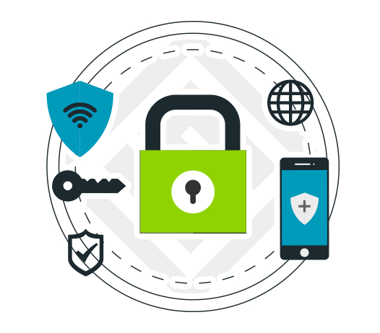

WHY MULTI-LAYER SECURITY IS NEEDED?
To adequately protect from security breaches, a multi-layered approach is recommended.
Endpoint
Network
Data and applications
Endpoint layer: Helps secure the actual device or endpoint that is connected to the Internet.
Network layer: Helps secure data in transit to and from a device that is connected. (Data over wireless and wireline connection)
Data/applications layer: Provides intrusion detection and prevention, specific security policies and controls to help protect stored data, as well as information affiliated applications used by the device user.
Threat Management
Threat analysis layer: Involves the collection and examination of data across all the layers to help identify, isolate, and manage threats.

Slide 11
TOP-LEVEL WBS
Security and Data Protection
Sonal
IDENTIFICATION OF SECURITY
RISK DISCOVERY AND TESTING
ARCHITECTURE IMPLEMENTATION
ASSESSMENT AND VALIDATION
SECURITY TRAINING
MAINTENANCE
REPORT AND DOCUMENTATION
Susan
Hrishikesh
Namrata
Shashank
Anna
Roshesh
Hrishikesh

Slide 12
MILESTONES SCHEDULE
Identify security needs
Conduct security training
Reporting and documentation
Risk discovery and analysis
Implement the architecture or security model
Assess and validate by testing
Maintenance

Slide 13
SECURITY VULNERABILITIES
Operational Constraints
Market created mandate for speedy deployment
Lack of security expertise
Cost constraints
Non-updating of software by customers
PROJECT CONSTRAINTS
INFORMATION SECURITY CONSTRAINTS can be defined as follows:
Insufficient allocation of BUDGET for multi-layer security.
Lack of security focus in the company.
Lack of resources or expertise in the security team at the company.
Lack of a common approach to Information security.

Slide 14
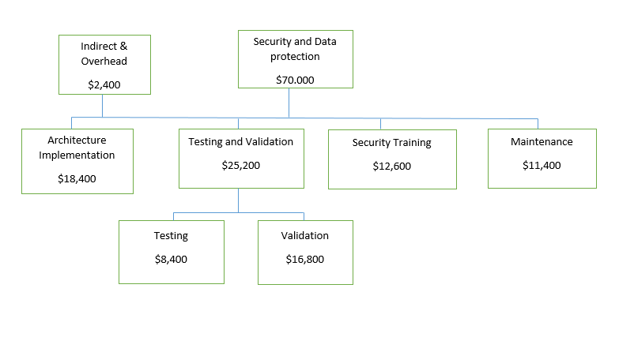
BUDGET CHART

Slide 15
THANK YOU

