Slide 1

Uber Request- Case Study
Sonal Singh

Slide 2
Business Objectives The aim of analysis is to identify the root cause of the problem (i.e. cancellation and non-availability of cars) and recommend ways to improve the situation. As a result of your analysis, you should be able to present to the client the root cause(s) and possible hypotheses of the problem(s) and recommend ways to improve them.

Slide 3
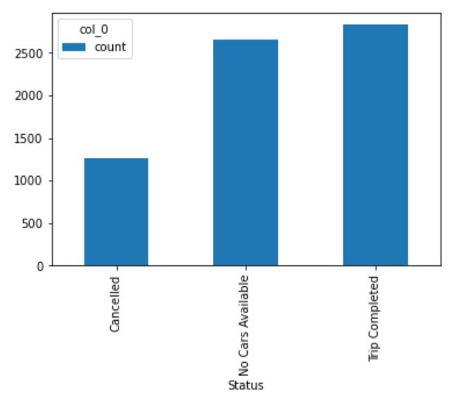
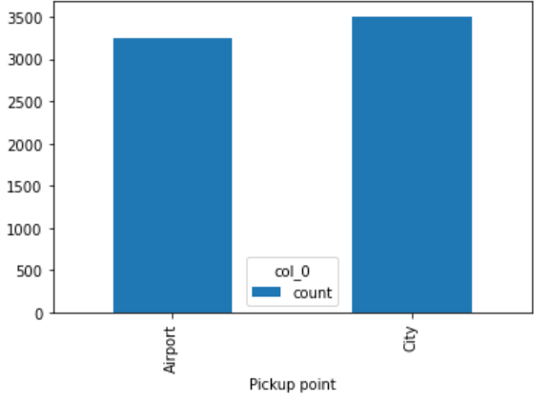
No cars available is greater than the cancelled rides
The pickup points Airport and City are almost equal times present in the dataset.

Slide 4
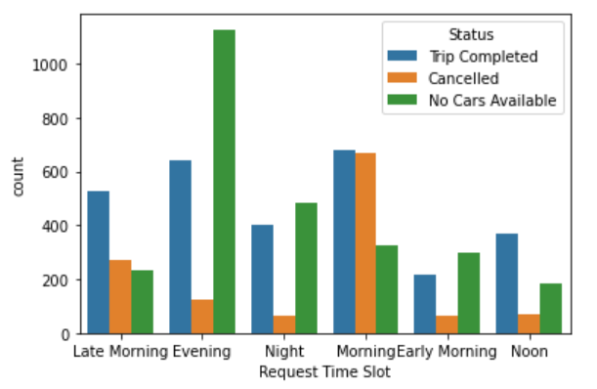
Plot 1 Bar plot to find Request Time Slot vs Count for Trip completed, cancelled trips and No Cars Available Conclusion
1) Most No Cars Available are in the Evening. 2) Most Cancelled trips are in the Morning. 3) Least Cancelled trips are at Night or Early Morning.

Slide 5
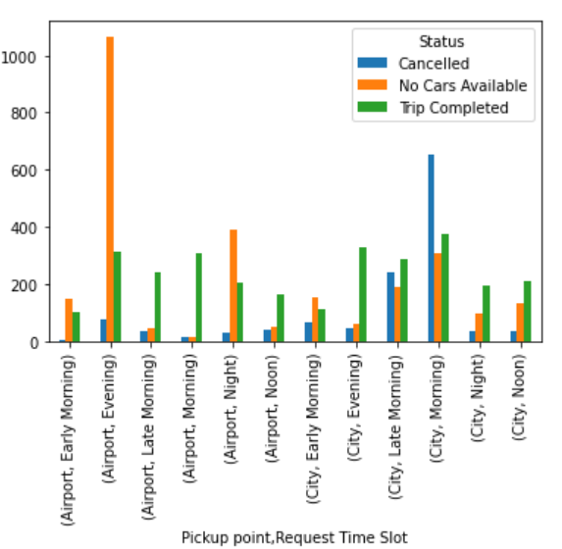
Plot 2
To find count of status according to both pickup point and time slot.
Conclusions
Maximum No Cars Available are in the evening from airport to city.
Maximum Cancelled trips are in the morning, from city to airport.

Slide 6
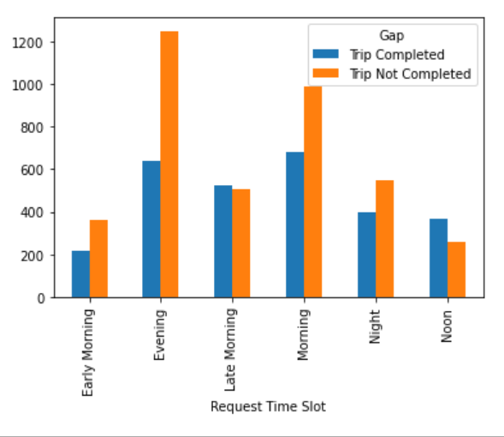
Plot 3
To count the number of requests that was completed and which was not, against the time slot.
Conclusions
Maximum trips were left incomplete in the evening time period.
Maximum trips were completed in evening and morning slots.
Least trips were completed in the early morning.

Slide 7
