Slide 1



Text Classification
SONAL BHARTI
National Institute of Technology,
Jamshedpur
Coding the next generation of automation applications

Slide 2
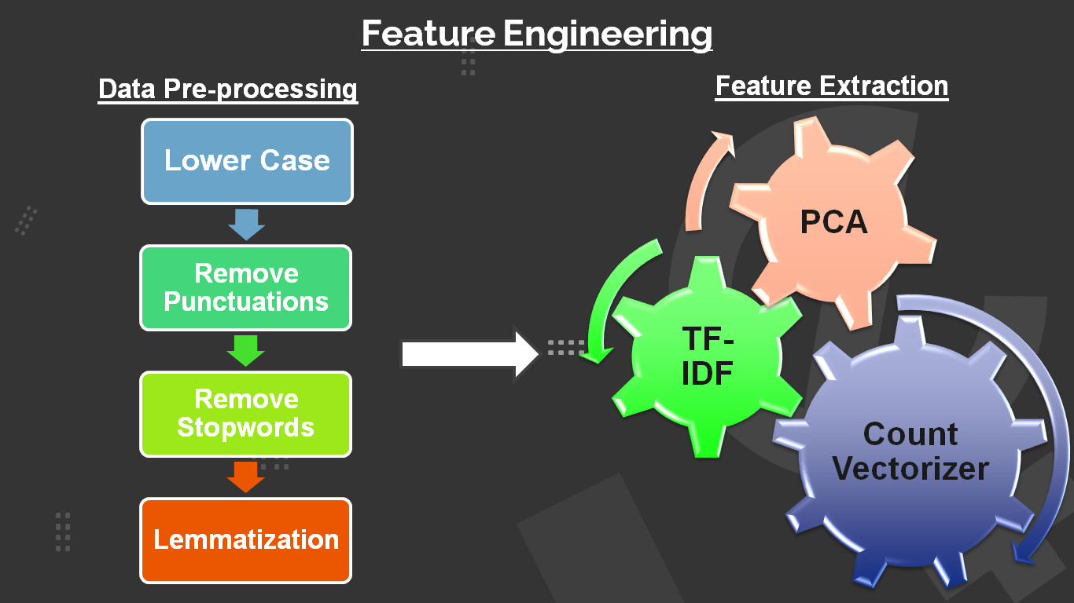

Slide 3
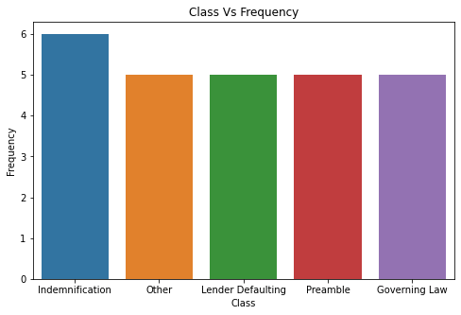
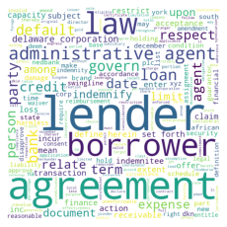
Data Visualisation
Word Cloud - used for representing text data in which the size of each word indicates its frequency or importance
Frequency distribution Class wise

Slide 4
Model Options Considered
Support Vector Classifier:-
The goal of the SVM algorithm is to create the best line or decision boundary that can segregate n-dimensional space into classes. This best decision boundary is called a hyper plane.
K-Nearest Neighbour:-
K Nearest Neighbour is a simple algorithm that stores all the available cases and classifies the new data or case based on a similarity measure.
Logistic Regression:-
Data is fit into linear regression model, which then be acted upon by a logistic function predicting the target categorical dependent variable
Naive Bayes:-
All naive Bayes classifiers assume that the value of a particular feature is independent of the value of any other feature, given the class variable.

Slide 5
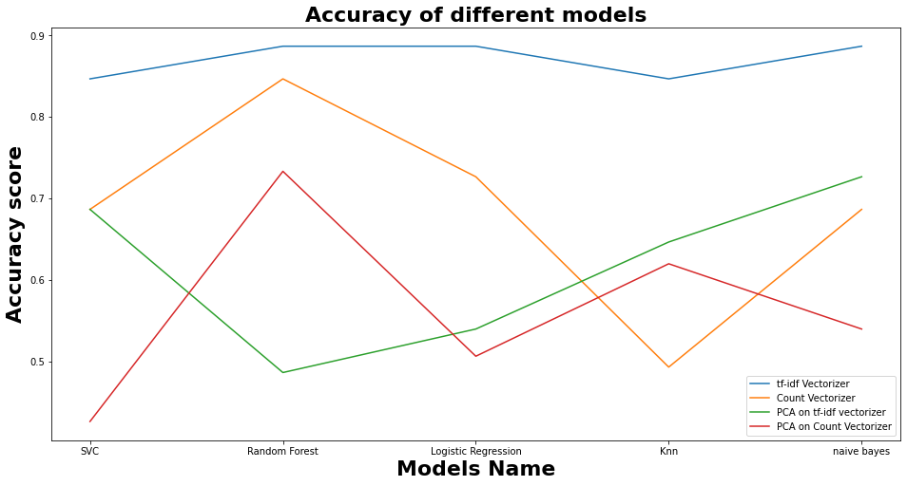
We can see from the plot that the Tf-Idf Vectorizer performs the best among all others for all the models.

Slide 6
Final Solution
Final Model - Random forest classifier
After considering the accuracy of all the models , Random forest classifier came out with highest accuracy therefore chosen as final model.
The key principle underlying the random forest approach comprises the construction of many “simple” decision trees in the training stage and the majority vote (mode) across them in the classification stage.
Pre-processing – convert text to lower case , remove stopwords and punctuations , lemmatization.
Applied TF-IDF vectorizer to convert text data into numerical forms. Then, used random forest classifier to make predictions.

Slide 7
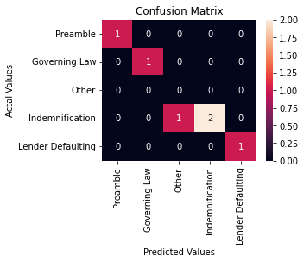
Model Metric
Accuracy=TP+TN/TP+FP+FN+TN
Score: 0.833333
Precision= TP/TP+FP
Score: 0.800000
Recall = TP/TP+FN
Score: 0.833333
F1 = 2*(Recall*Precision)/(Recall+Precision)
Score: 0.833333
ROC AUC: 1.000000

Slide 8
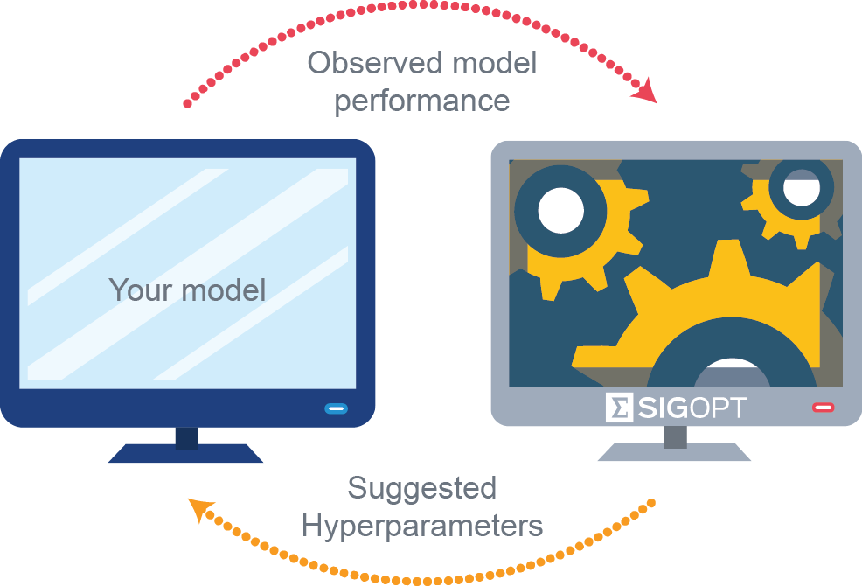
Hyperparameter Optimisation : Searching different values for model hyperparameters and choose a subset that results in a model that achieves the best performance on a given dataset.
Grid Search: Define a search space as a grid of hyperparameter values and evaluate every position in the grid.
Following values for the model hyperparameters were obtained:-
{'max_depth': 10, 'max_features': 'auto', 'min_samples_leaf': 1, 'min_samples_split': 2, 'n_estimators': 15}

Slide 9
Further Improvement Scope
If a larger dataset is provided , then we could use deep learning RNN models like LSTM and GRU for better results.
Ensemble techniques could also be used by combining several base models in order to produce one predictive model.
Further hyperparameter tuning could be done, if more time is provided.

