Slide 1



Slide 2
Intern/Data Analyst: Next Hikes IT Solutions Tools Used: MS Excell Project date: 27th July, 2025 Project by: Sonal Gaikwad
Bike Sharing Demand
Analysis

Slide 3
This project will analyze bike-sharing data using Excel, focusing on understanding how weather, time, and holidays influence bike rentals. The project will involve data cleaning, merging, visualization, and automation using VBA and AI-powered tools to create dynamic dashboards and automated reports.
Bike Sharing Demand Analysis

Slide 4
Cleaning Data: Removed duplicates, Missing value, Formating date, Added fields. Merging Data Sets: Using “instant”, “dteday” with Power Query. Created New Columns: Total Rentals, Day Type, Weekend Flag etc.
Data Set Evaluation ( Data preparation & Merging)

Slide 5
Now, I started by changing the column names in the Excel sheet to meaningful words so that it’s easier to understand the data. Then I added a new column for the season (like winter, summer, or rainy) in Column D and a ‘Holiday Week’ column in Column I to show whether the day was a weekend or not. Then I added a new column for the Actual Humidity (%) and Humidity Conditions. Next, I worked on converting the temperature. The temperature in the original data was a small number (a normalized value), so I converted it into actual temperature in Celsius using the formula:=L2 * 41 >Where 41 is used as the highest possible temperature. This gave real temperature values in Column M. Similarly, I added an ‘Actual Humidity %’ column (Column P) by converting normalized humidity values using:=O2 * 100 / 100 I also added an ‘Actual Windspeed (km/h)’ column (Column T) by converting windspeed values using =R2 * 110 > Where 110 is used as the highest possible windspeed. Then, I used the =TEXT() formula on the date column to create separate columns for year, month, and weekday, which helped in analyzing the data by time. FORMULA: (=TEXT([Date], "yyyy")=TEXT([Date], "mmmm"), and =TEXT([Date], "dddd")) These are all linked to the Entry Date column.

Slide 6
After that, I used the = IF (OR()) formula to assign season codes (like 1 for winter, 2 for summer, 3 for rainy), and then changed those numbers into season names using another = IF () formula.Based on the month, assigned a season code: =IF(OR([@Month]="Jan",[@Month]="Feb",[@Month]="Dec",[@Month]="Nov"), 1, IF(OR([@Month]="Mar", [@Month]="Apr" [@Month]="May", [@Month]="Jun"), 2, IF(OR([@Month]="Jul",[@Month]="Aug", [@Month]="Sep", [@Month]="Oct"),3))) Another, IF formula to label the season: =lF( C * 2 = 1 , "Winter", IF ( C * 2 = 2 "Summer",IF( C * 2 = 3 , "Rainy",0))) To identify if a day is a weekday or weekend, I used an =IF() formula in the holiday column-if the value is FALSE, it means weekday;if TRUE, it means weekend =IF(H2-TRUE,"Weekend", IF(H2=FALSE,"Weekday", NA)) After that, I created a weather condition column using an =IF() formula based on the actual temperature. If the temperature is below 10°C, it is "Extreme Cold"; below or equal to 20 is "Cold", below or equal to 25 is "Normal", below 35 is "Hot", and up to 45 is "Very Hot". =1F( M * 2 < 10 , Extreme Cold", IF ( M * 2 <= 20 ,"Cold", "Normal", IF( M * 2 <= 35 , "Hot",IF"Extreme Hot")))))

Slide 7
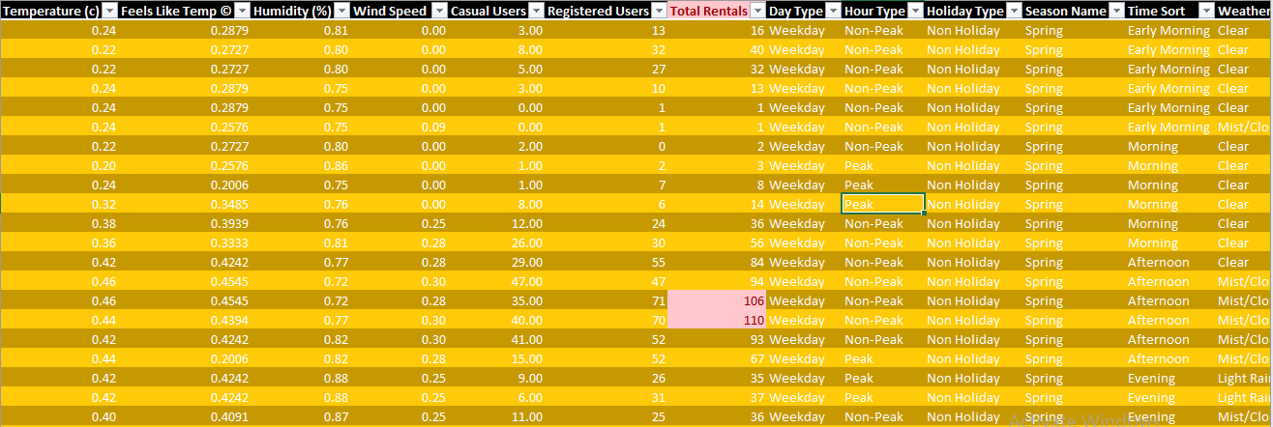
Final Merged Sheet

Slide 8
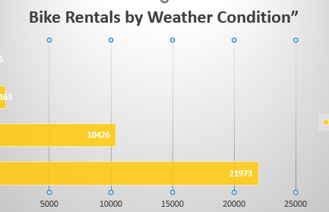
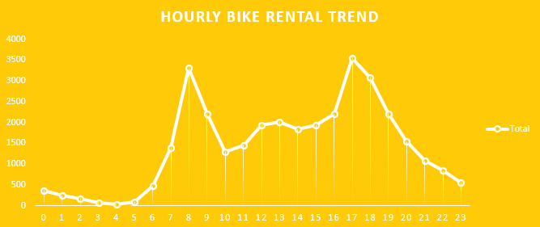
Dash created using Pivot Tables, Pivot Chart & Slicer
Pivot chart includes line chart & Bar Chart

Slide 9
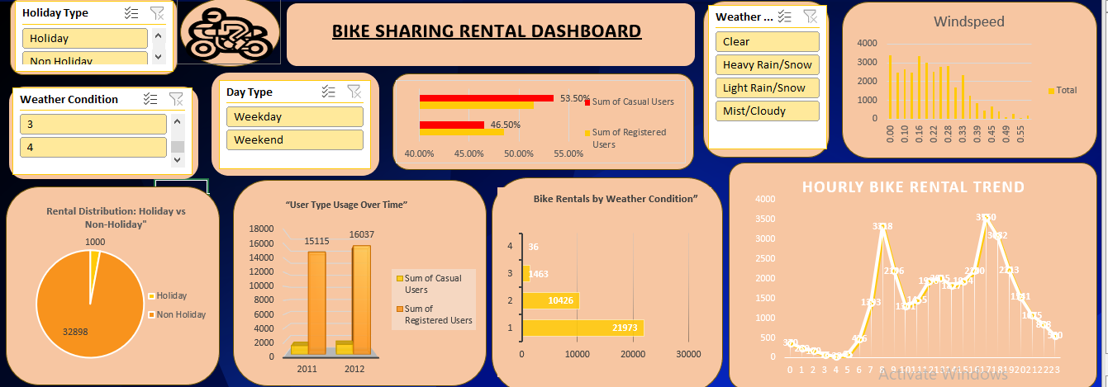
Dashboard

Slide 10
The project has been completed successfully understanding the key concepts and features of MS Excel to create an intereactive scalable dashboard which show the seasional weather time based bike demand.
Conclusion

Slide 11
Thank You

