Slide 1
Machine Learning
Overfitting and Underfitting

Slide 2
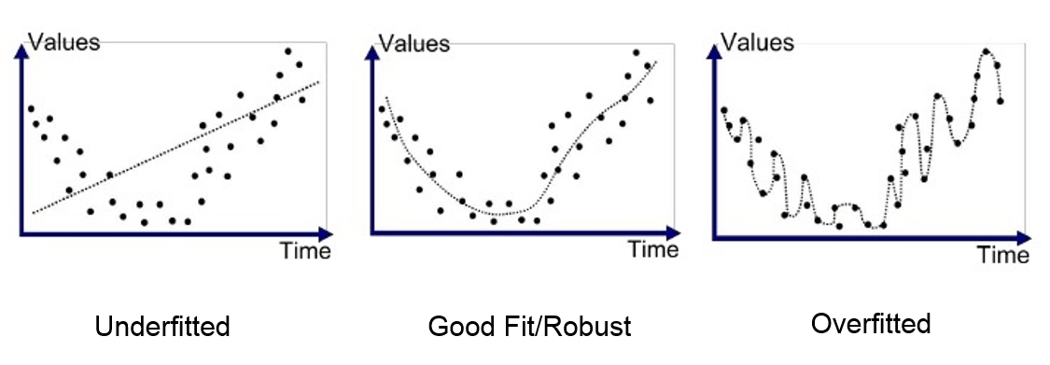

Slide 3
Bias: Assumptions made by a model to make a function easier to learn.
Variance: If you train your data on training data and obtain very low error, upon changing the data and then training the same previous model which experience high error, this is variance.

Slide 4
Good Model or Generalized Model:
Accuracy is high for both training and testing.
It performs well on both dataset.
Low training error
Low testing error
Low Bias
Low Variance

Slide 5
Overfitting:
Overfitting occurs when ML model tries to cover all data points or more than required data.
So model start caching noise and inaccurate values present in the dataset.
Accuracy during training is very high but accuracy during testing is very low then this condition is called overfitting.
Model has low bias and high variance.
This is the main problem that occurs in supervised learning.

Slide 6
How to avoid the Overfitting model:
Cross Validation
Training with more data
Removing features
Early stopping the training
Regularization
ensembling

Slide 7
Underfitting:
It occurs when our ML model is not able to capture the underlying trend of the data.
Model has high bias and low variance
Accuracy during training the model is very low but accuracy during testing is very high then this condition is called underfitting.

Slide 8
How to avoid underfitting:
By increasing the training time of the model.
By increasing the number of features.

Slide 9
Example:
Training error: 1%
Testing error: 1%
Good model or Most generalized model.
Training error: 1%
Testing error: 25%
Overfitting
Training error: 20%
Testing error: 20%
Underfitting

Slide 10
Goodness of Fit Model:
The model with a good fit is between underfitting and overfitting model.
It makes predictions with 0 error but in practice, it is difficult to achieve it.
There are two other methods by which we can get a good point for our model, which are the resampling method to estimate model accuracy and validation dataset.

Slide 11
Bias Variance Tradeoff:
When there is a huge bias it means the model has not learned the relevant relationship between the features and the target values. This is called as Underfitting. And, when there is a high variance it means that the model has learned the data well so that it includes the noise. This is also called Overfitting.
We need to have a model that is neither underfitting and nor overfitting . Which is called Bias-Variance trade-off.
if there is no balance between variance and bias then the model will not be able to generalize a failure to perform well on the new data.

