Slide 1


Slide 2
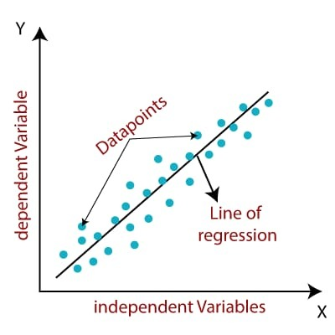
Linear Regression
Linear regression is a supervised machine learning algorithm.
Relationship between a dependent (y) and one or more independent (x) variables.
It provides sloped straight line representing the relation between variables.

Slide 3
Types of Linear Regression
Simple Linear Regression:
Single independent variable is used to predict the value of numerical dependent variable.
Multiple Linear Regression:
If more than one independent variable is used to predict the value of numerical dependent variable.

Slide 4
Equation of both type of Linear Regression :
Simple Linear Regression :
y = mx + c
where, c = intercept of the Regression line.
m = slope of the Regression line.
Multiple Linear Regression :
y = c + m1x1 + m2x2 + m3x3 + m4x4 +………………..+ mnxn

Slide 5
Example for Simple Linear Regression
Let, you are social researcher interested in relationship between income and happiness. Here dependent variable is happiness and independent variable is income.
We want to predict wt. gain based upon calories consumed. Independent variable is calories consumed and dependent variable is weight gain.
Calories Consumed | Weight Gain
500 | 1
1000 | 2
1500 | 2.5
2000 | 3

Slide 6
Example of Multiple Linear Regression :
Job performance depends on IQ, their motivation, and the social support.
Admission of students depends on Marks, Interview and Documents.

