Slide 1
CUSTOMER CHURN ANALYSIS - BY SONALI CHATTERJEE
ADVANCED DATA SCIENCE CAPTSONE PROJECT

Slide 2
USE CASE
Bank Customer Churn Data
Contains columns like Credit Score, Age, etc
Target variable is Binary i.e. whether a customer has left the bank or not. (0 or 1)
The data consists of
14 Columns
10,000 Rows

Slide 3
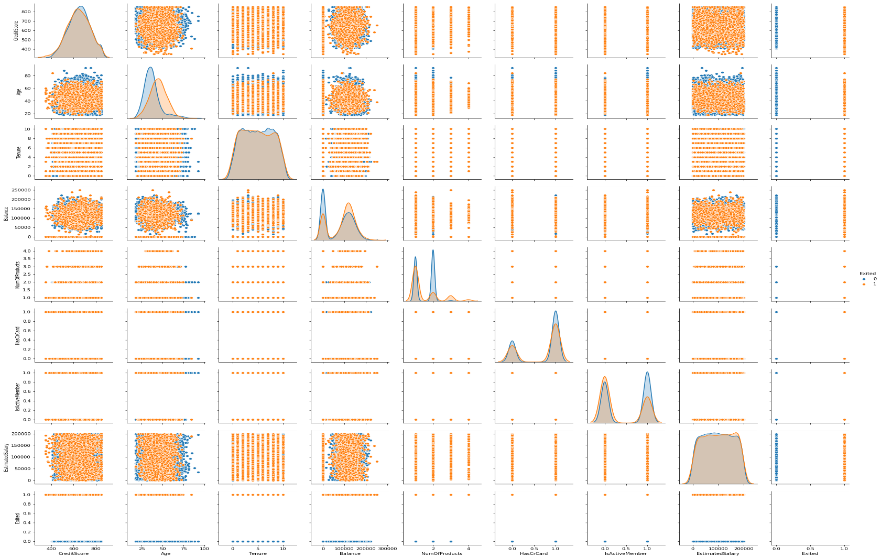
DATA VISUALISATION - PAIRPLOT

Slide 4
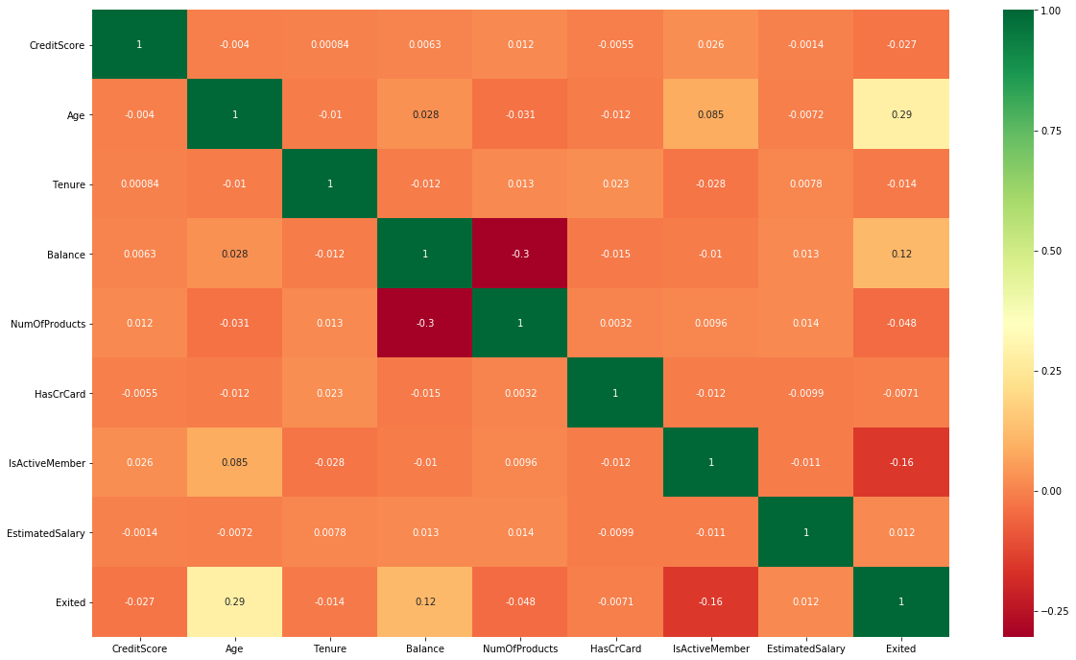
DATA VISUALISATION - HEATMAP

Slide 5
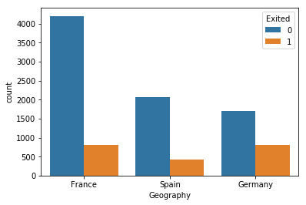
DATA VISUALISATION INFERENCES
We see that Germany has quite a number of people who have exited from the bank in comparison to Spain and France.

Slide 6
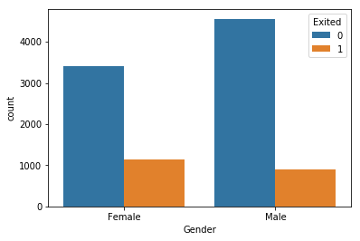
DATA VISUALISATION INFERENCES
In comparison to males, more females have left the bank.

Slide 7
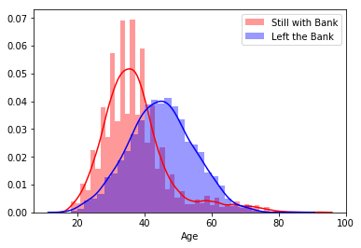
DATA VISUALISATION INFERENCES
People who are still involved with the bank belong to 20-40 years of age range.
People who exited the bank are usually peaking around 40-50 years of age range.

Slide 8
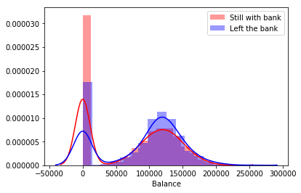
DATA VISUALISATION INFERENCE
There are fairly large amount of customers who have 0 balance and are still with the bank.

Slide 9
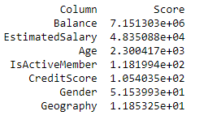

DATA PREPROCESSING
Categorical Variables
Continuous Variables
Label Encoder
Standard Scaler
Use train_test_split to divide the data into train and test sets
Univariate analysis to find k best features using chi square

Slide 10
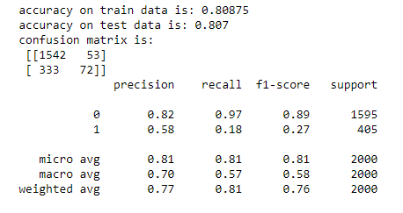
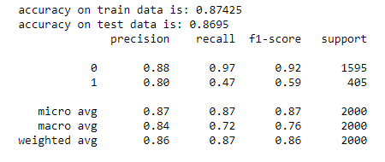
MODEL BUILDING
LOGISTIC REGRESSION
RANDOM FOREST CLASSIFIER

Slide 11
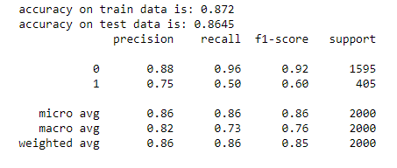
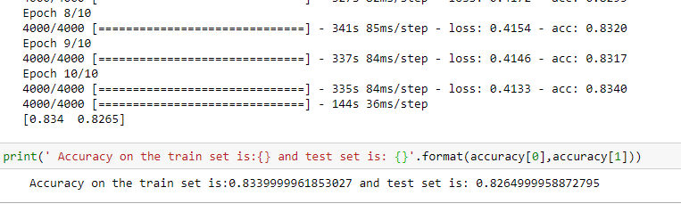
MODEL BUILDING
GRADIENT BOOSTING CLASSIFIER
ARTIFICAL NEURAL NETWORK

Slide 12
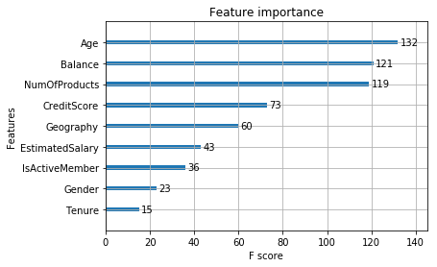
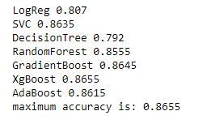
FEATURE IMPORTANCE
ACCURACY MEASURES OF DIFFERENT CLASSIFICATION MODELS
IMPORTANT FEATURES EXTRACTED USING XGBOOST CLASSIFICATION TREE

Slide 13
THANK YOU

