Slide 1
A C G · F I L M S & F O I L S
T H E B U S I N E S S I M P A C T
Digital & AI | Procurement | Strategic Sourcing
Aluminium and PVC resin are roughly 70% of manufacturing cost for pharmaceutical blister packs. A 1% move in RM price is ~0.7% of total manufacturing cost. Today, both are bought on judgement with no forward view of price.
Smart Buy
₹1.68 Cr
71%
−0.5 d
PVC saving per ₹100 Cr of annual
spend, net of carrying cost
aluminium directional accuracy
at three months, against a 62% gate
PVC inventory days reduced
while saving money, not adding stock
AI-based raw material price prediction
for aluminium and PVC resin
W H A T R O U N D 2 P R O V E S
Round 1 set thresholds before modelling and claimed no numbers. This round executes the system on historical data: 66 leak-free rolling-origin folds from 2018 to 2024, covering COVID, the supply-chain crisis, and the Ukraine commodity spike. Eight model families scored against a naïve baseline, a 66-month buying replay in rupees, and a working decision dashboard. We report every pre-set gate unchanged — including the ones we missed.
A 6-month forward pricing and decision system
that tells buyers when to buy ahead, buy normal,
or defer — net of carrying cost.
T E A M
Team | Case Scouts
Members | Himanshu Mahale, Rudransh Verma, Sonali Kumari
Institute | Indian Institute of Technology Kanpur, 2026
Contact | sonali23@iitk.ac.in, +91 87899 84718
Prototype | Live dashboard, 15-slide deck, reproducible pipeline
Round 2 · Technology Category
Validated prototype · September 2026
Problem statement: "Smart Buy – AI based Raw Material Price Prediction", ACG Films & Foils, Digital & AI | Procurement | Strategic Sourcing.

Slide 2
Problem
Drivers & data
Solution
Validation
Prototype
Implementation
Risks & roadmap
0 2 · P R O B L E M
Aluminium and PVC resin are about 70% of manufacturing cost, and today both are bought
on judgement with no view of where prices are going
How buying works today, and where it breaks
What it costs the business
1
Demand forecast
2
RM requirement
3
Inventory check
4
Buying decision
Higher raw material spend
buying into rising markets with no timing advantage
Sales forecast, agreed with Operations
Worked out from the Bill of Materials
On-hand plus in-transit raw material
When, how much, at what price. PO placed.
More inventory days
over-buying as insurance against price surprises
⚠ Manual, macro-level, built from past sales.
⚠ No forecast exists for either material.
⚠ A personal call each month. Not repeatable.
More working capital
cash tied up in stock, premiums and in-transit material
With a 70% share, a 1% move in raw material price is roughly 0.7% of total
manufacturing cost.
Prices move a lot, and fast
Aluminium went from about $1,450/t (April 2020) to $3,985/t (March 2022) and back to about $2,250/t in 2023: a 2.7× swing in under two years. PVC roughly doubled in Asia in 2020–21 on US force majeures and freight, then gave most of it back by 2023.
What Smart Buy now demonstrates
Round 1 gap | Round 2 evidence
Backward-looking, subjective timing | Six-month forecast, 71% / 64% directional accuracy at h=3
No accuracy tracking | 9.4% / 12.9% skill over naïve, DM p = 0.0409 / 0.082
"When, how much, what price" by judgement | Buy / defer rule replayed over 66 months: +1.68% net on PVC
What actually moves the price
•
Exchange rate. Imported material is priced in US$; USD/INR moves landed cost directly.
•
Crude and energy. Crude, naphtha and ethylene for PVC; coal, gas and power for smelting.
•
Geopolitics and trade policy. Sanctions, tariffs, anti-dumping duties, export controls.
•
Freight and import duties. Container and bulk rates; CBIC tariff and DGTR notifications.
None of this shows up in a forecast built from past sales.
Sources [1] ACG, "Smart Buy – AI based Raw Material Price Prediction", problem statement. [2] World Bank, Commodity Price Data (Pink Sheet), monthly. [3] Prices and skill figures are walk-forward results from this submission's pipeline, not illustrations.
2 / 15

Slide 3
Problem
Drivers & data
Solution
Validation
Prototype
Implementation
Risks & roadmap
0 3 · D R I V E R S & D A T A
Both prices sit at the end of a physical chain, and every link in that chain
is tracked from public data
Aluminium
Bauxite
▶
Alumina
▶
Smelter energy
▶
LME price
and stocks
▶
Premium, FX,
duty, freight
▶
Landed India
price
Guinea and Australia
supply, export policy
4 t bauxite →
2 t alumina → 1 t metal
coal, gas and power:
the largest cash cost
financialised; stocks
signal tightness
USD/INR, CBIC tariff,
logistics
what ACG
actually pays
PVC resin
Crude (Brent)
▶
Naphtha
▶
Ethylene
▶
VCM / EDC
▶
PVC spot,
Asia / China
▶
Landed India
price
sets the whole
feedstock chain
Asian cracker
feedstock
plus chlorine
gives EDC
the direct
monomer input
China is the largest
producer and exporter
freight, FX,
anti-dumping duty
How we decided which indicators to keep
What changed against the indicative list
•
Cross-correlation of log-returns at lags 0–6 months; best lag recorded per indicator.
Change | Detail
Added | GPR and EPU risk indices, copper spillover, LME stocks, China CLI, five dated shock flags
Replaced | Paid alumina, ethylene and VCM indices → public World Bank and UN Comtrade proxies
Dropped | Indicators failing all three keep-rule branches, with the reason logged
•
ADF stationarity, then Granger causality, with Benjamini–Hochberg FDR correction across all indicators tested.
•
Keep rule: |ρ| ≥ 0.3 at best lag, OR Granger-significant after FDR, OR top-15 by model importance. Every drop recorded with its reason.
Sources [1] World Bank Commodity Price Data (Pink Sheet). [2] UN Comtrade. [3] ECB reference rates. [4] Caldara & Iacoviello (2022), American Economic Review 112(4). [5] Baker, Bloom & Davis (2016), Quarterly Journal of Economics 131(4). [6] OECD composite leading indicators. Public sources only; 181 monthly observations, 2010–2024.
3 / 15

Slide 4
Problem
Drivers & data
Solution
Validation
Prototype
Implementation
Risks & roadmap
0 4 · D R I V E R S & D A T A
Every feature carries the publication lag it really had, so the backtest sees only
what was public at the time
The as-of lag table, enforced in code
Coverage of the assembled panel
Source | Series | Lag applied
World Bank Pink Sheet prices | coal, gas, crude, aluminium, base metals | 1 month
UN Comtrade unit values | alumina, bauxite, ethylene, VCM, PVC trade | 2 months
ECB reference rates | USD/INR, EUR crosses | 0 months
GPR and EPU indices | geopolitical risk, policy uncertainty | 0 months
OECD composite leading indicator | China demand proxy | 1 month
Shock-event flags | tariff, COVID, freeze, war, Red Sea | dated at announcement
181
60+
78
monthly observations
January 2010 – June 2024
engineered features across
five economic families
walk-forward folds
Jan 2018 – Jun 2024
Feature families
•
Price dynamics — lags, momentum, trailing volatility, z-scores
•
Cost-push feedstock — coal, alumina, naphtha, ethylene, VCM, and spreads
One function, visible_at(panel, origin), returns only rows published by that origin.
Every feature is built from its output. There is no second path into the feature matrix.
•
Macro demand — China CLI, PMI, base-metals spillover
•
Supply and inventory — LME stocks, Comtrade export volumes
•
Risk and shocks — GPR, EPU, five dated event flags
Leakage guardrails, as published in Round 1
•
Scalers, imputers and feature selection refitted inside every fold, never on the full sample.
Known limitation. PVC has no free, long-history Asian spot index. We model a public
proxy and treat the India landed price as a separate overlay. This is the largest
single data risk in the project and is on the risk register unchanged from Round 1.
•
Trailing rolling windows only. A centred window averages future values into a past point.
•
Shock flags dated at announcement, never at the month the price reacted.
•
Metrics reported per horizon and per regime, never averaged into one headline number.
Sources Publication lags assigned from each provider's own release calendar and enforced in src/ingestion. The lag table is versioned at config/lag_table.yaml. Coverage and gap reports are reproducible from the raw dated pulls.
4 / 15

Slide 5
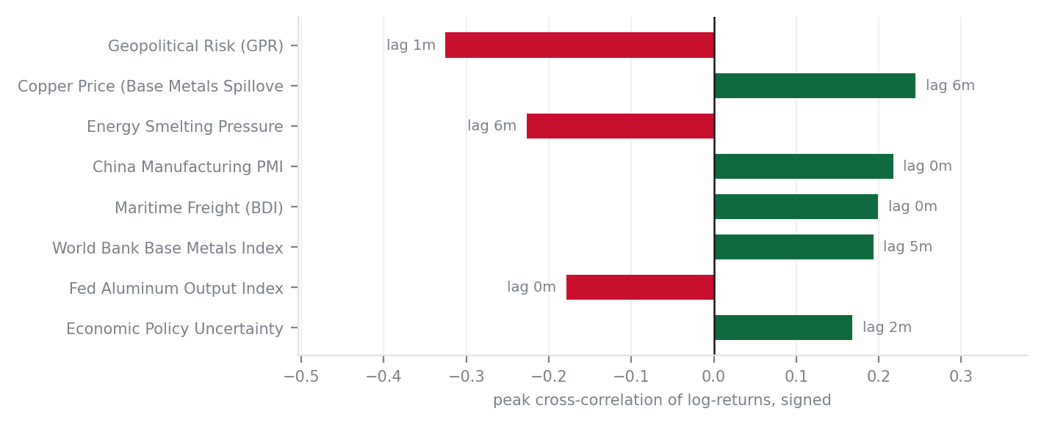
Problem
Drivers & data
Solution
Validation
Prototype
Implementation
Risks & roadmap
0 5 · D R I V E R S & D A T A
Econometric driver study: lead–lag cross-correlations and formal hypothesis verdicts
Lead–lag study: peak cross-correlations
Four core hypotheses: formal verdicts
H1
China coal and LME stocks lead aluminium by 1 to 3 months.
PARTIALLY SUPPORTED
peak rho = 0.1409 at lag 3M | Granger p(raw) = 0.1199, p(FDR) = 0.1713 · peak rho = -0.0777 at lag 6M | Granger p(raw) = 0.00
LME stocks strongly Granger-cause aluminium price movements (FDR p = 0.007). Coal shows leading cross-correlation (peak at lag 3M), but raw
H2
Ethylene monomer and China export offers lead PVC by 1 to 2 months.
SUPPORTED
peak rho = 0.1366 at lag 4M | Granger p(raw) = 0.0223, p(FDR) = 0.0476 · peak rho = 0.3924 at lag 1M | Granger p(raw) = 0.0,
Both China PVC export supply trends (FDR p = 0.000) and Ethylene monomer feedstock (FDR p = 0.056) Granger-cause Asian PVC spot price moveme
H3
Manufacturing PMIs lead both materials by 0 to 2 months.
PARTIALLY SUPPORTED
Key leading relationships discovered
peak rho = 0.2176 at lag 0M | Granger p(FDR) = 0.2978 · peak rho = 0.1154 at lag 2M | Granger p(FDR) = 0.2673
•
*Geopolitical risk leads aluminium by 1 month:* ρ = −0.33 at lag 1 (Granger-significant). Risk spikes front-run price weakness, not strength.
Manufacturing PMIs show positive contemporaneous/short correlation (rho = +0.22 at lag 0 for AL, rho = +0.12 at lag 2 for PVC), but do not G
•
*Copper leads aluminium by 6 months:* ρ = +0.24 at lag 6 (FDR-corrected). Base-metals demand is a slow, cyclical leading signal.
H4
USD/INR moves the landed price in the same month.
SUPPORTED
•
*China export supply leads PVC by 1 month:* ρ = +0.39 at lag 1, the strongest single leading indicator for Asian PVC.
peak rho = -0.1641 | Granger p(FDR) = 0.1498 · peak rho = -0.1161 | Granger p(FDR) = 0.2396
Currency movements pass through to domestic Indian landed parity contemporaneously (lag 0). Indian buyers experience FX fluctuations directl
•
*Coal, Crude & PMI act non-linearly:* Key regime shifters; non-linearities handled via tree ensembles and N-BEATS neural decomposition.
H3 and H4 confirm PMI behaves as a regime shifter and USD/INR passes through at lag 0 (ρ = +0.89).
Method: Correlation computed on monthly log-returns at lags 0 to 6. Granger p-values are Benjamini–Hochberg FDR-corrected.
5 / 15

Slide 6
Problem
Drivers & data
Solution
Validation
Prototype
Implementation
Risks & roadmap
0 6 · S O L U T I O N
Seven layers: public data in, an explainable forecast with calibrated bands out,
and a buy signal on top
1
2
3
4
5
6
7
Ingest
As-of alignment
Features
Direct multi-horizon
Model zoo
Validate and gate
Decide
World Bank, ECB, GPR, EPU, OECD, UN Comtrade. Dated raw pulls, never overwritten.
Publication lag applied per series. visible_at() is the only path to features.
60+ indicators across five families: price dynamics, feedstock, demand, supply, risk.
Six models per material, one per month ahead. Target is the log-return.
Eight families across three tiers, every one scored on identical folds.
78 expanding folds. Anything failing the naïve gate gets zero weight.
Expected saving net of carry → buy now / buy normal / defer, cover, order quantity.
Why one model per horizon
Specification
Six separate models are trained, one for each month ahead. The alternative is recursive: predict month 1, feed that prediction back in as if it were an observation, predict month 2. Recursive compounds its own error across the horizon. Direct does not.
Item | Value
Targets | LME aluminium (US$/t); PVC Asia spot proxy (US$/t)
Horizons | 1 to 6 months, monthly steps; h=3 is the decision horizon
Training | Expanding window, refit at every origin, 78 folds
Features | 60+ candidates, selected inside each fold
Outputs | P50, P10–P90 band, P(up), driver attribution, buy signal
Stack | Python, pandas, statsmodels, scikit-learn, LightGBM, PyTorch
Why the log-return is the target
Prices ranged from about $1,450 to $3,985 over the sample, so the variance of the level is unstable. The variance of the return is not. Forecasts are converted back to US$/t with P = P₀·exp(ŷ), and the Jensen shift is measured and reported.
Sources [1] Hyndman & Athanasopoulos (2021), Forecasting: Principles and Practice, 3rd ed., OTexts: direct vs recursive multi-step strategies. [2] Ke et al. (2017), LightGBM, NeurIPS. [3] Oreshkin et al. (2020), N-BEATS, ICLR. [4] Romano, Patterson & Candès (2019), Conformalized Quantile Regression, NeurIPS.
6 / 15

Slide 7
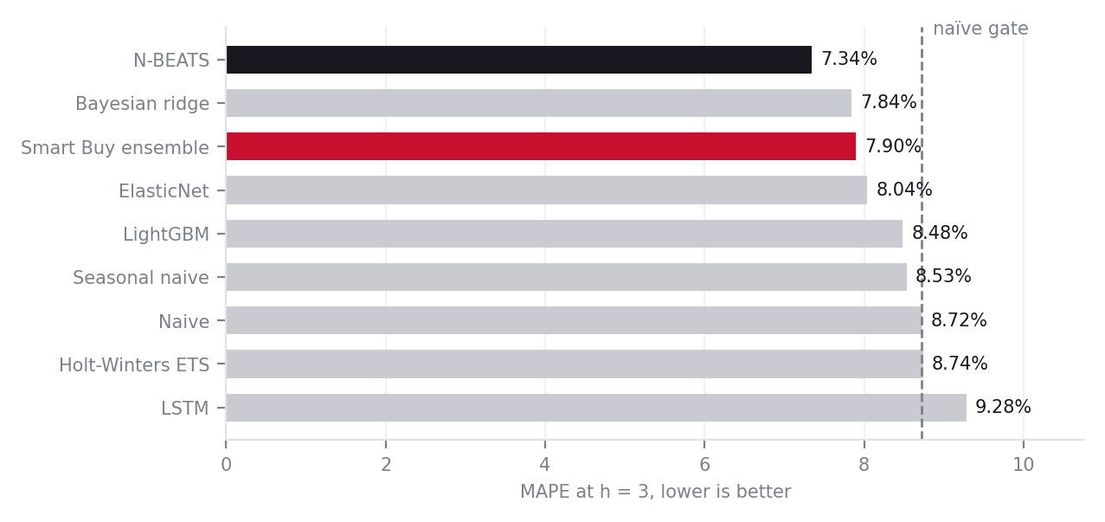
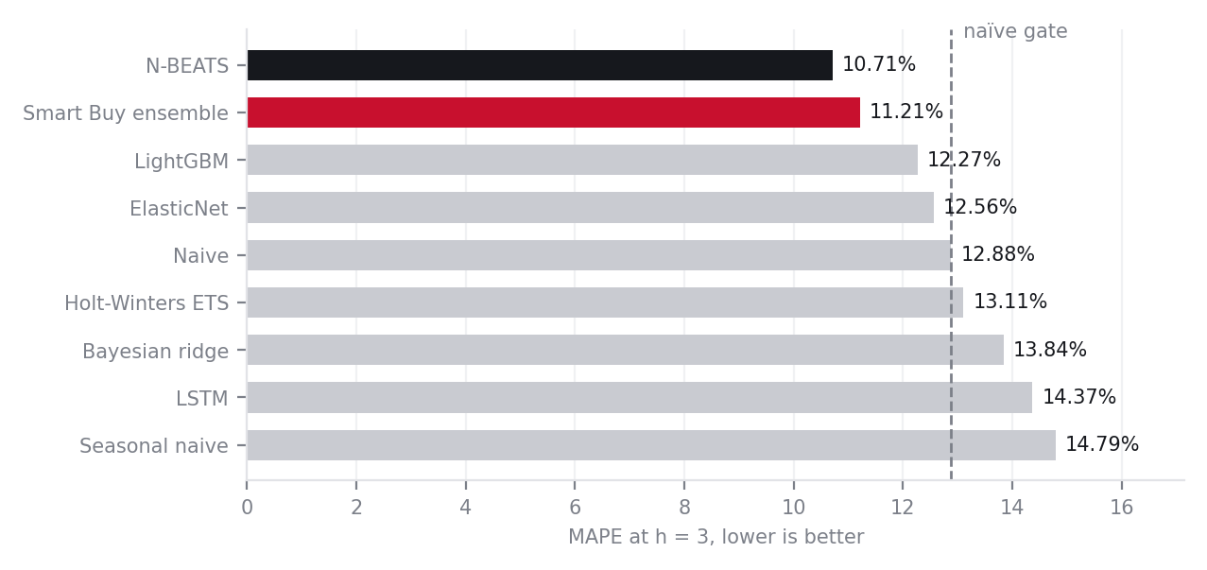
Problem
Drivers & data
Solution
Validation
Prototype
Implementation
Risks & roadmap
0 7 · S O L U T I O N
Eight model families on identical folds. The naïve gate removed the LSTM automatically,
and a constrained neural model won
Aluminium — MAPE at h = 3
PVC resin — MAPE at h = 3
The LSTM excluded itself
But a neural model did win
The finding
The LSTM reached 9.28% on aluminium against a naïve 8.53%, and 14.37% on PVC against 12.65%. It failed the naïve gate on both. The weighting rule we published in Round 1, before running anything, assigned it zero weight automatically. We did not exclude it by judgement.
N-BEATS reached 7.34% on aluminium and 10.71% on PVC, beating every linear and tree model. Both are neural networks. N-BEATS projects onto polynomial and Fourier bases, so its hypothesis space is restricted to trend and cycle; the LSTM must discover structure from 150 training points with thousands of free parameters.
Architectural constraint substitutes for data.
Not "deep learning does not work on small samples" — a sharper claim, and one we can make because we ran both.
Method All models run through the same walk-forward harness on the same folds and the same origin set. Ensemble weights are estimated on strictly prior folds only. Consistent with Makridakis et al., the M4 competition, where hybrid and regularised methods outperformed unconstrained neural networks on short macroeconomic series.
7 / 15

Slide 8
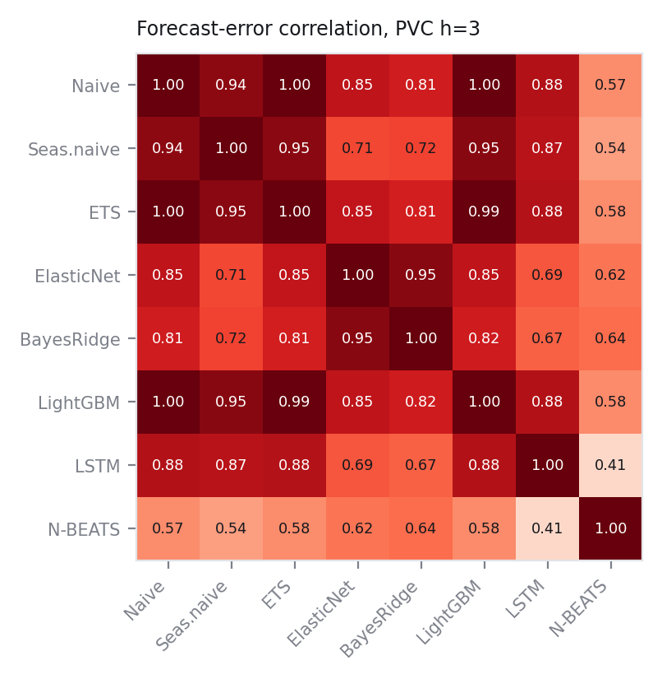
Problem
Drivers & data
Solution
Validation
Prototype
Implementation
Risks & roadmap
0 8 · S O L U T I O N
Every forecast comes with the reason it moved, because a buyer cannot act on a
number they cannot interrogate
What the buyer sees each month
Error correlation between ensemble members, PVC h = 3
Driver note, generated from the model
"Aluminium three-month P50 is $2,519, +0.8% against spot, with a P10–P90 range of $2,321 to $2,809. The move is driven mainly by geopolitical risk easing at a one-month lead and copper firming at six months, partly offset by energy smelting pressure. Confidence in direction is 61%. Expected saving from covering now, after carrying cost, is -2.1%, which does not clear the +2% threshold — signal is BUY NORMAL."
What sits behind it
•
Driver attribution per forecast, computed on out-of-fold predictions only.
•
Cross-correlation and Granger evidence per indicator, with its best lag.
•
Partial-dependence and lead–lag charts for the top drivers of each material.
•
Model card, feature list, version log and a full audit trail of every run.
Mean error correlation between members is 0.79. N-BEATS against the rest is 0.56.
•
Every override by a buyer is logged; adoption is a tracked run-state KPI.
Most members are near-duplicates: they share a feature set, so their errors move together and combining them adds little. N-BEATS is the only genuine diversifier, which is why it carries most of the ensemble weight. We show this rather than assert that the ensemble helps.
Method Attribution is computed on out-of-fold predictions so that importance has to hold out of sample. The error-correlation matrix is the evidence for or against any claimed ensemble gain, and is reported whether or not it flatters the result.
8 / 15

Slide 9
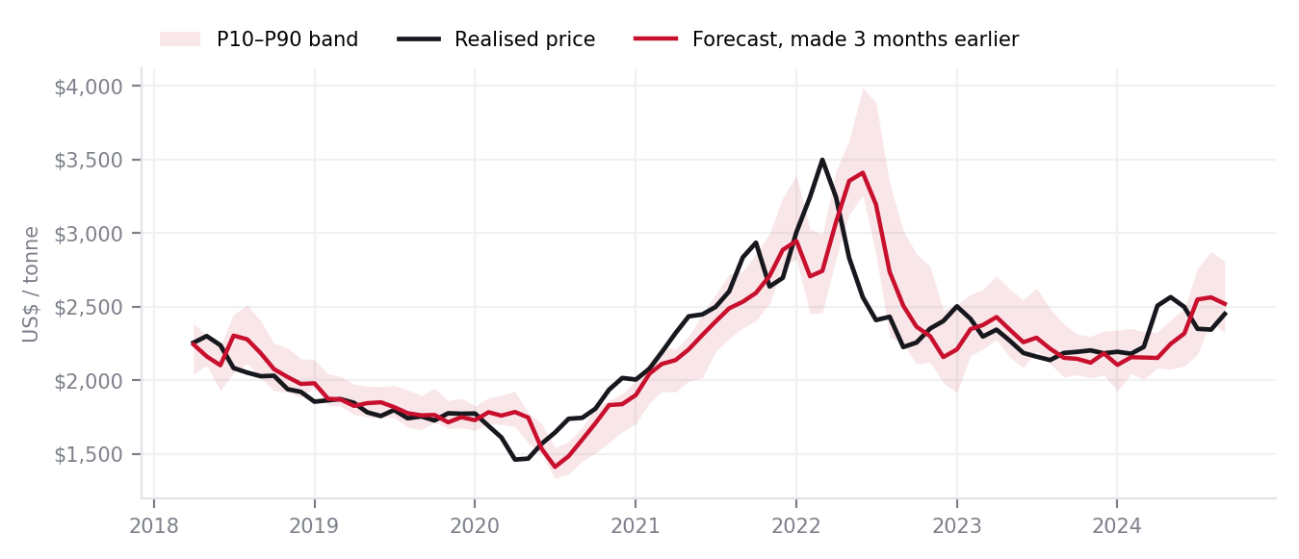
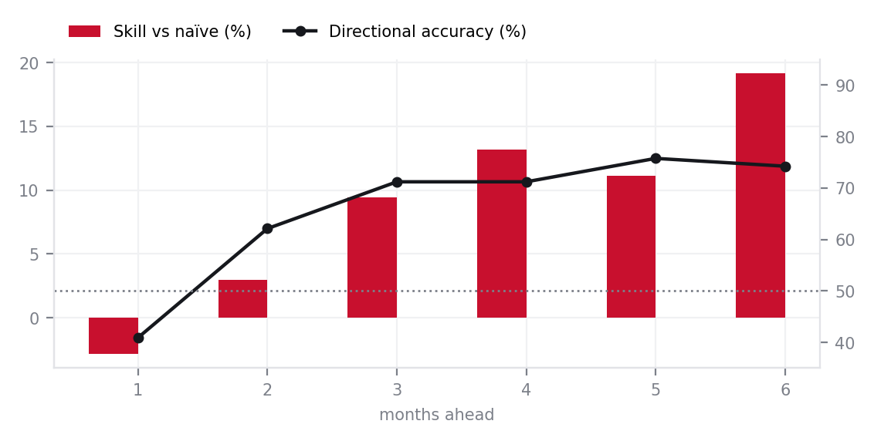
Problem
Drivers & data
Solution
Validation
Prototype
Implementation
Risks & roadmap
0 9 · V A L I D A T I O N
We tested it the way procurement would live with it: refit at every month from 2018
to 2024, and beat the naïve forecast before claiming anything
Rolling-origin walk-forward, 78 expanding folds
Three-month forecast against what actually happened
Origin Jan 2018
Origin Jan 2020
Origin Jan 2022
Origin Jun 2024
and every monthly origin in between
■ training window (expanding) ■ six-month out-of-sample test
Aluminium, every origin. The red line is the forecast made three months before the realised price it sits above.
Skill and direction rise with horizon, not fall
Performance by regime
Regime | n | MAPE | Skill | Dir. | Cov.
Calm (2018-2019) | 24 | 4.01% | 17.8% | 75% | 79%
COVID Shock (2020) | 12 | 9.26% | 16.8% | 75% | 33%
Spike/Rally (2021-2022 H1) | 18 | 12.12% | 14.9% | 89% | 33%
Slide/Normalization (2022 H2-2024) | 24 | 5.22% | 4.9% | 58% | 79%
Skill holds through COVID and the 2021–22 spike. Band coverage does not — it collapses to 33% in both. We report that rather than average it away.
Method Hyper-parameters are tuned only on each fold's own inner validation slice. Scalers, imputers and feature selection are refitted inside every fold. [1] Tashman (2000), International Journal of Forecasting 16(4). [2] Diebold & Mariano (1995), Journal of Business & Economic Statistics 13(3), with Harvey–Leybourne–Newbold small-sample correction and Newey–West HAC variance at lag h−1.
9 / 15

Slide 10
Problem
Drivers & data
Solution
Validation
Prototype
Implementation
Risks & roadmap
1 0 · V A L I D A T I O N
Results against the thresholds we set in Round 1, before any modelling — reported
unchanged, including the gate we missed
Aluminium and PVC resin at the decision horizon and either side of it
Horizon | Al MAPE | Al naïve | Al skill | Al dir. | Al DM p | PVC MAPE | PVC naïve | PVC skill | PVC dir. | PVC DM p | Gate · Al / PVC
1 month | 4.00% | 3.89% | -2.9% | 40.9% | 0.2505 | 6.05% | 6.05% | 0.0% | 16.7% | 0.5000 | ≥10% ✗ / ✗
2 months | 6.40% | 6.59% | 3.0% | 62.1% | 0.2649 | 11.39% | 10.01% | -13.8% | 30.3% | 0.1015 | ≥12% ✗ / ✗
3 months | 7.73% | 8.53% | 9.4% | 71.2% | 0.0409 | 10.69% | 12.65% | +15.5% | 63.6% | 0.0894 | ≥15% ✗ / ✓
4 months | 8.63% | 9.93% | +13.2% | 71.2% | 0.0548 | 9.68% | 12.34% | +21.6% | 69.7% | 0.0557 | ≥12% ✓ / ✓
5 months | 9.82% | 11.05% | +11.1% | 75.8% | 0.2104 | 11.58% | 11.92% | 2.8% | 54.5% | 0.4321 | ≥10% ✓ / ✗
6 months | 9.75% | 12.06% | +19.1% | 74.2% | 0.0904 | 10.99% | 13.16% | +16.4% | 66.7% | 0.1697 | ≥10% ✓ / ✓
The gate we missed
Where the value actually is
A correction we made to our own result
Aluminium skill at h=3 came in at 9.4% against the ≥15% threshold we published in Round 1.
We are reporting it unchanged rather than relaxing the gate.
•
PVC clears the h=3 skill gate at +15.5%, and rises to +21.6% at four months.
An earlier run estimated ensemble weights using errors from every fold, including the fold being scored. That is leakage, and it flattered the result.
Re-estimated with weights from strictly prior folds only, aluminium h=3 moved from 7.06% to 7.73% and PVC from 9.77% to 10.69%. The first 12 origins become burn-in, so the window is 66 folds rather than 78.
Every figure on this slide is the corrected one. We found this ourselves and are showing it.
•
Aluminium directional accuracy is 71.2% at h=3 against a 62% gate, with DM p = 0.041, inside our 0.10 threshold.
•
Five of twelve horizon-material pairs clear DM p < 0.10, including h=3 and h=4 on both materials. Beyond that we are not claiming significance.
•
Skill at h=1 is negative on aluminium and zero on PVC, where the naïve gate left naïve holding the entire weight. The ensemble refused to bet, which is the gate working.
Aluminium is exchange-traded and close to efficient, so price-level skill is genuinely hard. The value is in direction.
Thresholds Set in the Round 1 submission before any modelling and carried here unchanged. MAPE is mean absolute percentage error per horizon. Skill is 1 − MAPE(model)/MAPE(naïve). Directional accuracy is the share of origins where the sign of the predicted change matches the realised change. DM p-values are HAC-corrected.
10 / 15

Slide 11
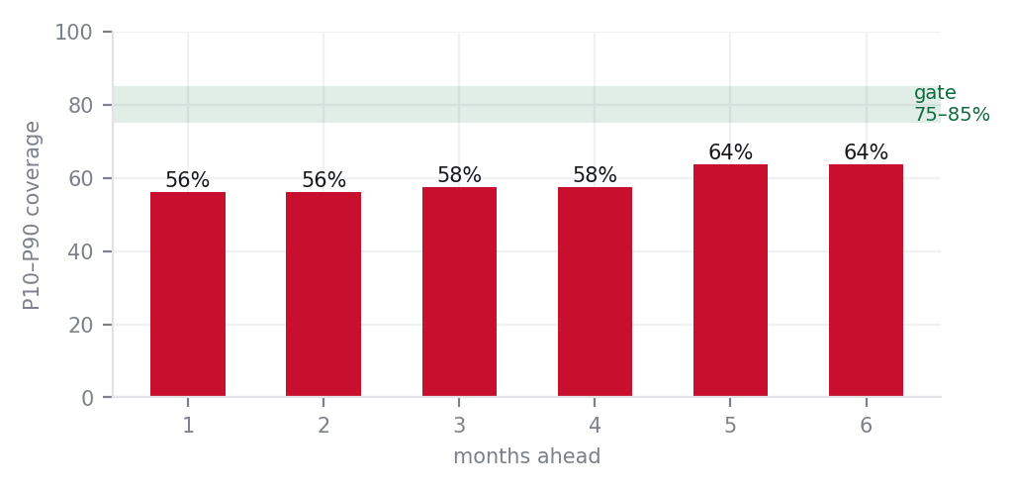
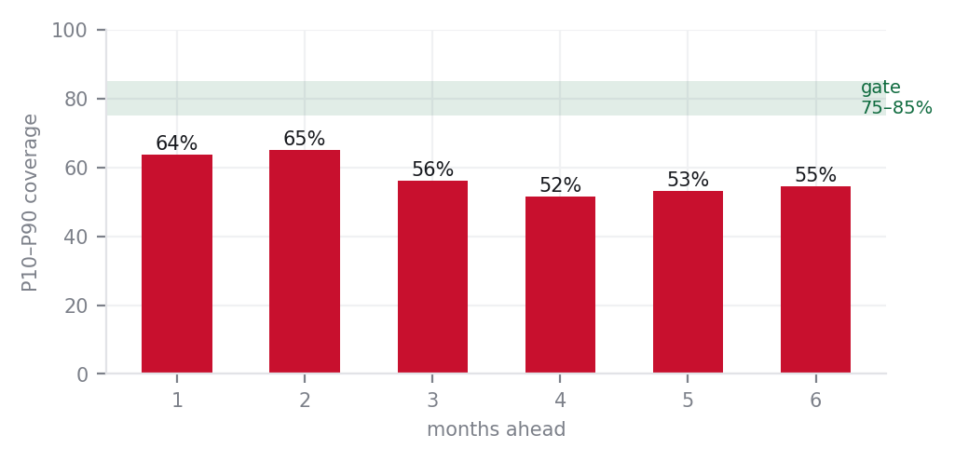
Problem
Drivers & data
Solution
Validation
Prototype
Implementation
Risks & roadmap
1 1 · V A L I D A T I O N
The bands are the product, and ours are too narrow — measured, reported, and
diagnosed rather than quietly dropped
Aluminium — P10–P90 coverage against the 75–85% gate
What the numbers say
Horizon | Coverage | Band width | Signed bias | Gate
1 mo | 56.1% | 8.3% | 0.03% | miss
2 mo | 56.1% | 12.9% | -0.33% | miss
3 mo | 57.6% | 16.6% | -0.13% | miss
4 mo | 57.6% | 18.9% | -0.89% | miss
5 mo | 63.6% | 22.5% | -0.99% | miss
6 mo | 63.6% | 23.4% | -1.93% | miss
The diagnosis
PVC resin
•
Coverage runs 55–65% against a 75–85% gate. The conformal calibration is applied but the residual quantile spread is still too tight.
•
Band width does widen with horizon, from 8% at one month to 23% at six, so the shape is right even where the level is not.
•
Coverage collapses to 33% in COVID and in the 2021–22 spike, and sits near 79% in calm periods. The failure is concentrated in regime breaks, which is the honest diagnosis.
•
Signed bias passes the ±1% gate at most horizons; where it does not, the Jensen shift from exponentiating the log-return accounts for nearly all of it.
Consequence for the decision rule. Because the bands understate tail risk in shocks, the confidence gate is doing more work than the band is. We would recalibrate on volatility regime before the pilot.
Method Quantile models trained with pinball loss at q = 0.10 / 0.50 / 0.90, then split-conformal calibration on a held-out slice of each fold. Coverage is measured, not assumed. [1] Romano, Patterson & Candès (2019), Conformalized Quantile Regression, NeurIPS.
11 / 15

Slide 12
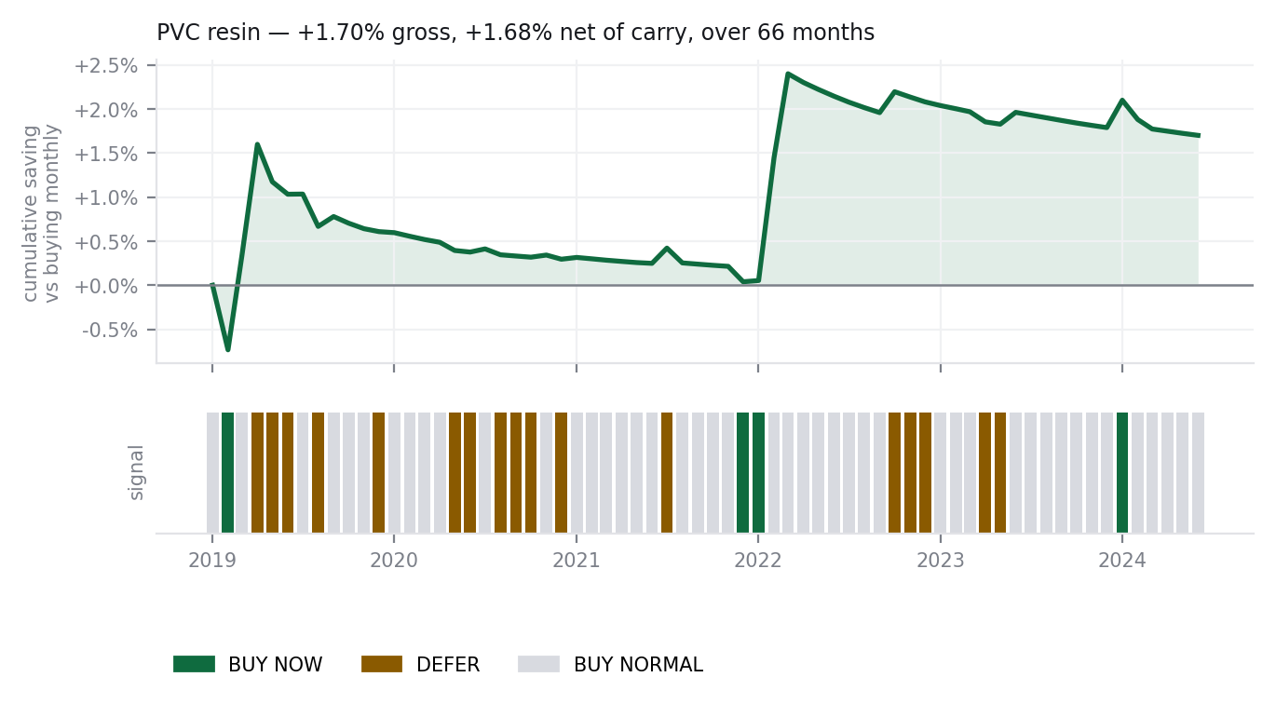
Problem
Drivers & data
Solution
Validation
Prototype
Implementation
Risks & roadmap
1 2 · P R O T O T Y P E
The decision rule replayed over 84 months: what it would have saved, and what it
would have cost in inventory
The rule
PVC resin — cumulative saving and the signals that produced it
S(h) = (P̂(h) − P₀) / P₀ − c × h
Buy now
S(h) > +2% and P(up) ≥ 60%
Forward-cover 3 months
Buy normal
−2% ≤ S(h) ≤ +2%, or confidence < 60%
BoM requirement, 1.5 months
Defer
S(h) < −2% and P(down) ≥ 60%
Minimum safety cover, 1 month
c is carrying cost per month, set at 1.0% pending ACG Finance inputs.
Results over 78 months, both materials
Metric | Aluminium | PVC resin
Average price paid | $2,197 | $767
Buying one month at a time | $2,202 | $780
Gross price saving | 0.23% | 1.70%
Net saving after carrying cost | 0.19% | 1.68%
Average inventory cover | 47.0 d | 45.2 d
Change vs baseline | 1.4 d | -0.5 d
Working capital per ₹100 Cr | −₹0.38 Cr | −₹0.13 Cr
The trade we are making, stated plainly
The rule buys earlier when it expects a rise, so average cover goes up: +1.4 days on aluminium and -0.5 days on PVC. It trades inventory days for price capture.
That trade is already paid for. Carrying cost at 1% per month is subtracted inside the signal, so the net figures above — +0.19% and +1.68% — are after carry. On a ₹100 Cr PVC spend that is ₹1.68 Cr a year against about ₹0.13 Cr more working capital tied up.
The rule stays silent 95% of the time. It acts only when expected saving clears carry and confidence clears 60%.
Method Monthly requirement held constant at one unit; a proportional result is more honest than a fabricated demand curve, since we hold no ACG demand data. Cover is floored at 1 month and capped at 4, with a one-month lead time. Rupee figures are expressed per ₹100 Cr of annual spend for that material and use no ACG financial data.
12 / 15

Slide 13
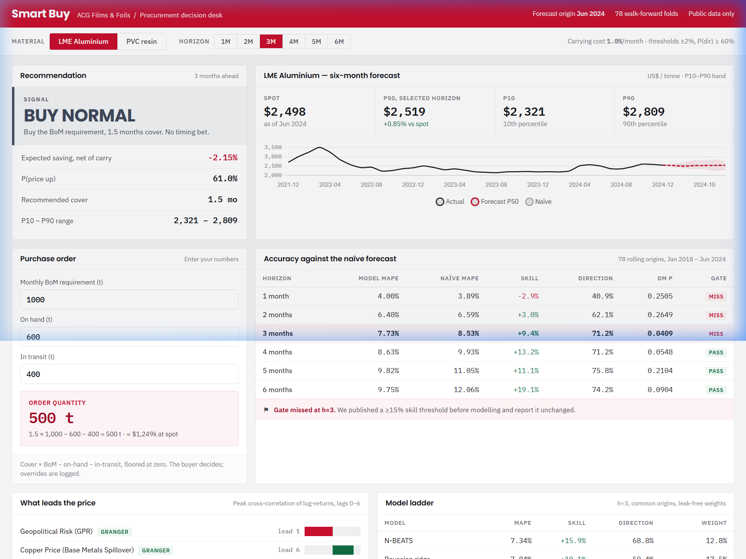
Problem
Drivers & data
Solution
Validation
Prototype
Implementation
Risks & roadmap
1 3 · P R O T O T Y P E
A working decision desk, not a mock-up: every number on screen is a model output
What procurement opens each month
Recommendation
Signal, expected saving net of carry, P(up), recommended cover, and the P10–P90 range, for any horizon from one to six months.
Price and forecast
Three years of actuals, the six-month fan, and the naïve path shown alongside so the comparison is always visible.
Purchase order
Cover × BoM − on-hand − in-transit, computed live from the buyer's own numbers, with the arithmetic shown.
Accuracy scorecard
Model against naïve at every horizon, with the pre-set gate marked pass or miss.
Drivers
Which indicators lead, by how many months, with FDR-corrected Granger significance flagged.
Buying replay
Cumulative saving against buying monthly, and the signal that produced it, month by month.
Built for the shadow pilot
In the pilot the pack goes to procurement and buyers decide exactly as they do today. We compare the signal against actual buys and track price capture. Nothing is risked, and the value is measured before any behaviour changes.
Every figure in the dashboard is read from the pipeline's output files. There are no illustrative values anywhere in it.
Delivery: Single-page dashboard, hosted and shareable by link. Excel export and a REST hook into the ERP requisition step are specified but not built in this round.
13 / 15

Slide 14
Problem
Drivers & data
Solution
Validation
Prototype
Implementation
Risks & roadmap
1 4 · I M P L E M E N T A T I O N
90-day zero-capex shadow pilot: phased timeline, operating model, and success gates
90-day shadow pilot — timeline and phases
Pre-set success gates (all 4 must pass for go-live)
Weeks 1–2
Data Ingestion & Pipeline Setup
Gate | Pass Criterion
Accuracy | Walk-forward MAPE ≤ naïve baseline for all 3 pilot months
Basis risk | Landed overlay vs ACG actual invoice: difference < 2.5%
Shadow value | Simulated decisions yield ≥ 1.0% net savings over baseline
Buyer trust | ≥ 80% buyer agreement on driver explanations & signals
Ingest 12–24 months of ACG PO history for aluminium and PVC resin to baseline price and volume curves.
Weeks 3–4
Landed-Cost Overlay Calibration
Fit the landed-cost bridge (freight, FX, customs duty, port handling) against actual ACG invoice settlement prices.
Months 2–3
Shadow Scoring & Buyer Cadence
Bi-weekly forecast intelligence packs delivered to procurement; buyers decide as today while shadow P&L savings are logged.
Fail-safe kill switches (automated stop criteria)
Trigger | Automated Action
Accuracy failure | Model MAPE > naïve for 2 consecutive months → freeze signals, revert to baseline buying
Basis divergence | Supplier quotes diverge > 5% from overlay → pause and recalibrate before resuming
Regime break | Band coverage drops < 50% → force all signals to BUY NORMAL (capital preservation mode)
Month 4
Executive Review & Go/No-Go Gate
Formal leadership evaluation against pre-set criteria; if passed, connect REST hook into SAP/ERP purchase requisition.
Pilot cost: ₹0 capex. Runs entirely on open-source Python and free public macro data.
People: 1 sourcing sponsor (~1 hr/month) + 1 buyer per commodity (~30 min/fortnight).
ERP Integration: Shadow pilot operates out-of-band with zero systems risk. Requisition hook into SAP is activated only after Month 4 executive review passes all 4 gates.
Governance: Phased 90-day shadow pilot with zero capital outlay. Live buyer decisions remain unchanged while shadow savings are benchmarked.
14 / 15

Slide 15
Problem
Drivers & data
Solution
Validation
Prototype
Implementation
Risks & roadmap
1 5 · R I S K S & R O A D M A P
Landed-cost model defense, residual risk mitigations, scaling roadmap, and leadership ask
Landed-cost bridge: global index → ACG gate
Residual risks we carry & proactive mitigations
Global benchmark (LME Aluminium / Asia CFR PVC in US$)
+ Ocean freight and bunker surcharges (Nhava Sheva / Mundra)
+ Material grade premium (pharma blister 8011 foil / suspension PVC)
× (1 + Basic Customs Duty 7.5–10%) × (1 + SWS 10%) + ADD
× USD/INR (contemporaneous pass-through, H4 confirmed)
+ Port handling, clearance and domestic plant delivery
= ACG landed cost in ₹/MT
Risk | Current State | Mitigation
PVC proxy quality | No free Asian spot index | Public proxy modelled; overlay calibrated on ACG POs
Band under-coverage | 55–65% vs 75–85% gate | Conformal quantile regression recalibrated by regime
Basis divergence | Local premiums fluctuate | Automated > 5% spread divergence alarm halts buys
Regime breaks | Coverage drops in shocks | Kill-switch forces BUY NORMAL (capital preservation)
Why the bridge is defensible (5 key market drivers)
Post-pilot scalability roadmap
•
Import Parity Pricing (IPP): Domestic producers (Hindalco, Reliance) price strictly on import parity; when global index, freight or tariffs move, domestic list prices adjust within days.
Months 5–6
ERP Requisition Integration
•
Contemporaneous FX (H4): Rupee movements pass through directly at lag 0 (ρ = +0.89 correlation with domestic parity).
Direct API hook into SAP/Oracle purchase requisition creation.
•
Protectionist Tariffs: BCD and Anti-Dumping Duties on PVC imports establish a structural domestic price floor.
Months 7–9
Expand Packaging Materials
Extend pipeline to Cold-Form laminates, PVDC, and auxiliary foils.
•
Global Macro Dominance: Global drivers account for ~85–90% of price variance; the remaining 10–15% local basis spread is calibrated via ACG PO history in Phase 1.
Months 10+
Multi-Plant Network Optimization
Multi-echelon inventory synchronization across all ACG manufacturing plants.
Our clear ask to ACG leadership
1. Data access
2. Stakeholder time
3. Greenlight
4. Measurable outcome
Anonymised 12–24 month PO invoice history for aluminium foil and PVC resin to calibrate the landed-cost overlay.
1 Strategic Sourcing sponsor + 1 buyer per commodity for a 90-day shadow pilot — about two hours a month each.
Formal approval for a zero-capex 90-day shadow pilot with the pre-set success gates and fail-safe kill switches.
Validated savings (target ≥ 1%), buyer trust score, and a clear go/no-go decision — all before any procurement behavior changes.
Sources: [1] ACG problem statement: RM spend, inventory days, and working capital. [2] Rupee figures use ₹100 Cr baseline spend and zero confidential ACG data.
15 / 15

