Slide 1
A C G · F I L M S & F O I L S
T H E B U S I N E S S I M P A C T
Digital & AI | Procurement | Strategic Sourcing
Aluminium and PVC resin are roughly 70% of manufacturing cost for pharmaceutical blister packs. A 1% move in RM price is ~0.7% of total manufacturing cost. Today, both are bought on judgement with no forward view of price.
Smart Buy
+20.7%
p = 0.002
64–78%
PVC forecast skill over naïve at one
month, significant (DM p = 0.0004)
PVC buy/defer timing beats random;
+0.45% net, ₹0.45 Cr per ₹100 Cr
band coverage after calibration,
up from 55–65%; gate is 75–85%
AI-based raw material price prediction
for aluminium and PVC resin
W H A T R O U N D 2 P R O V E S
We audited our own pipeline before this round and found three flaws: a simulated PVC price, drivers derived from the target, and a look-ahead leak in training. All three are fixed, and a test now proves the leak is gone. Under honest validation aluminium is near-efficient, while PVC shows significant 1–2 month skill. Every pre-set gate is reported unchanged, including the misses.
A 6-month forward pricing and decision system
that tells buyers when to buy ahead, buy normal,
or defer — net of carrying cost.
T E A M
Team | Case Scouts
Members | Himanshu Mahale, Rudransh Verma, Sonali Kumari
Institute | Indian Institute of Technology Kanpur, 2026
Contact | sonali23@iitk.ac.in, +91 87899 84718
Prototype | Live dashboard, 15-slide deck, reproducible pipeline with leakage tests
Round 2 · Technology Category
Audited prototype · October 2026
Problem statement: "Smart Buy – AI based Raw Material Price Prediction", ACG Films & Foils, Digital & AI | Procurement | Strategic Sourcing.

Slide 2
Problem
Drivers & data
Solution
Validation
Prototype
Implementation
Risks & roadmap
0 2 · P R O B L E M
Aluminium and PVC resin are about 70% of manufacturing cost, and today both are bought
on judgement with no view of where prices are going
How buying works today, and where it breaks
What it costs the business
1
Demand forecast
2
RM requirement
3
Inventory check
4
Buying decision
Higher raw material spend
buying into rising markets with no timing advantage
Sales forecast, agreed with Operations
Worked out from the Bill of Materials
On-hand plus in-transit raw material
When, how much, at what price. PO placed.
More inventory days
over-buying as insurance against price surprises
⚠ Manual, macro-level, built from past sales.
⚠ No forecast exists for either material.
⚠ A personal call each month. Not repeatable.
More working capital
cash tied up in stock, premiums and in-transit material
With a 70% share, a 1% move in raw material price is roughly 0.7% of total
manufacturing cost.
Prices move a lot, and fast
Aluminium went from about $1,450/t (April 2020) to $3,985/t (March 2022) and back to about $2,250/t in 2023: a 2.7× swing in under two years. US resin prices rose 62% from May 2020 to August 2021 on force majeures and freight, then gave back about 40% of that rise by 2023.
What Smart Buy now demonstrates
Round 1 gap | Round 2 evidence
Backward-looking, subjective timing | Six-month forecast; PVC +20.7% / +15.9% skill at 1–2 months (significant)
No accuracy tracking | Every forecast scored vs naïve; aluminium ≈ naïve (+3.7%, n.s.), reported as is
"When, how much, what price" by judgement | Rule replayed over 78 months: PVC +0.45% net, beats random timing (p = 0.002)
What actually moves the price
•
Exchange rate. Imported material is priced in US$; USD/INR moves landed cost directly.
•
Crude and energy. Crude, naphtha and ethylene for PVC; coal, gas and power for smelting.
•
Geopolitics and trade policy. Sanctions, tariffs, anti-dumping duties, export controls.
•
Freight and import duties. Container and bulk rates; CBIC tariff and DGTR notifications.
None of this shows up in a forecast built from past sales.
Sources [1] ACG, "Smart Buy – AI based Raw Material Price Prediction", problem statement. [2] World Bank, Commodity Price Data (Pink Sheet); BLS PPI WPU066 via FRED. [3] Skill and replay figures are embargoed walk-forward results from this submission's pipeline, not illustrations.
2 / 15

Slide 3
Problem
Drivers & data
Solution
Validation
Prototype
Implementation
Risks & roadmap
0 6 · S O L U T I O N
Seven layers: public data in, an explainable forecast with calibrated bands out,
and a buy signal on top
1
2
3
4
5
6
7
Ingest
As-of alignment
Features
Direct multi-horizon
Model zoo
Validate and gate
Decide
World Bank, BLS and Fed via FRED, ECB, GPR, EPU, OECD. Real published series only.
Publication lag per series. Training rows embargoed until their outcome is published.
41 / 36 trailing-window features; a 74-series panel for the global models.
Six models per material, one per month ahead. Target is the log-return.
Ten models in three tiers: statistical, ML with drivers, and global ML on 74 series.
78 scored origins plus holdout. A model earns weight only by beating naïve on its own past.
Expected saving net of carry → buy now / buy normal / defer, cover, order quantity.
Why one model per horizon
Specification
Six separate models are trained, one for each month ahead. The alternative is recursive: predict month 1, feed that prediction back in as if it were an observation, predict month 2. Recursive compounds its own error across the horizon. Direct does not.
Item | Value
Targets | LME aluminium (US$/t); US PPI plastic resins WPU066 (PVC proxy)
Horizons | 1 to 6 months, monthly steps; h=3 is the decision horizon
Training | Expanding window, embargoed; refit monthly (global models quarterly / yearly)
Features | Real drivers only; ElasticNet selects 15 and tunes inside each fold
Outputs | P50, conformal P10–P90 band, P(up), SHAP attribution, buy signal
Stack | Python, pandas, statsmodels, arch, scikit-learn, LightGBM, JAX
Why the log-return is the target
Prices ranged from about $1,450 to $3,985 over the sample, so the variance of the level is unstable. The variance of the return is not. Forecasts are converted back with P = P₀·exp(ŷ), the median of the forecast distribution.
Sources [1] Hyndman & Athanasopoulos (2021), Forecasting: Principles and Practice, 3rd ed.: direct vs recursive multi-step. [2] Ke et al. (2017), LightGBM, NeurIPS. [3] Oreshkin et al. (2020), N-BEATS, ICLR. [4] Vovk, Gammerman & Shafer (2005), conformal prediction. [5] Bollerslev (1986), GARCH.
6 / 15

Slide 4
Problem
Drivers & data
Solution
Validation
Prototype
Implementation
Risks & roadmap
1 0 · V A L I D A T I O N
Results against the thresholds we set in Round 1, before any modelling — reported
unchanged, after fixing our own leak
Headline ensemble, development window: 78 origins, January 2018 – June 2024
Horizon | Al MAPE | Al naïve | Al skill | Al dir. | Al DM p | PVC MAPE | PVC naïve | PVC skill | PVC dir. | PVC DM p | Gate · Al / PVC
1 month | 3.73% | 3.79% | +1.5% | 51.3% | 0.2881 | 1.40% | 1.78% | +21.4% | 71.4% | 0.0004 | ≥10% ✗ / ✓
2 months | 6.13% | 6.37% | +3.8% | 53.8% | 0.1583 | 2.65% | 3.15% | +16.0% | 66.7% | 0.0286 | ≥12% ✗ / ✓
3 months | 7.87% | 8.19% | +3.9% | 64.1% | 0.1419 | 3.94% | 4.37% | +10.0% | 61.5% | 0.1164 | ≥15% ✗ / ✗
4 months | 8.98% | 9.44% | +4.9% | 64.1% | 0.1147 | 5.41% | 5.43% | +0.2% | 43.8% | 0.4896 | ≥12% ✗ / ✗
5 months | 10.15% | 10.59% | +4.2% | 57.7% | 0.1618 | 6.16% | 6.25% | +1.4% | 52.6% | 0.4218 | ≥10% ✗ / ✗
6 months | 11.22% | 11.74% | +4.4% | 62.8% | 0.1298 | 6.77% | 6.81% | +0.5% | 51.3% | 0.4733 | ≥10% ✗ / ✗
The gates we missed
Where the value actually is
We audited our own Round 2 result
At h=3, skill is +3.9% (aluminium) and +10.0% (PVC) against the ≥15% gate.
PVC clears its gate at 1 and 2 months. We report every miss unchanged.
•
PVC: +21.4% skill at 1 month (DM p = 0.0004) and +16.0% at 2 months (p = 0.029).
Our draft trained on rows whose outcome came after the forecast date, simulated the PVC price, and built drivers from the target.
Closing the leak alone took one model from +8% to −6% skill. A perturbation test now proves v2 is leak-free.
•
PVC direction is 71.4% at 1 month against a 65% gate, and 66.7% at 2 months against 63%.
•
PVC holdout 2025–26 (14–19 origins) does not beat naïve at h=3 (−13.7%).
•
Driver data ended Dec 2024, so the holdout ran without its inputs. Inconclusive until the data is refreshed.
Aluminium is exchange-traded and near-efficient: a few percent better than naïve, never significant.
Thresholds Set in the Round 1 submission before any modelling and carried here unchanged. MAPE is mean absolute percentage error per horizon. Skill is 1 − MAPE(model)/MAPE(naïve). Directional accuracy is the share of origins where the sign of the predicted change matches the realised change. DM p-values are HAC-corrected.
10 / 15

Slide 5
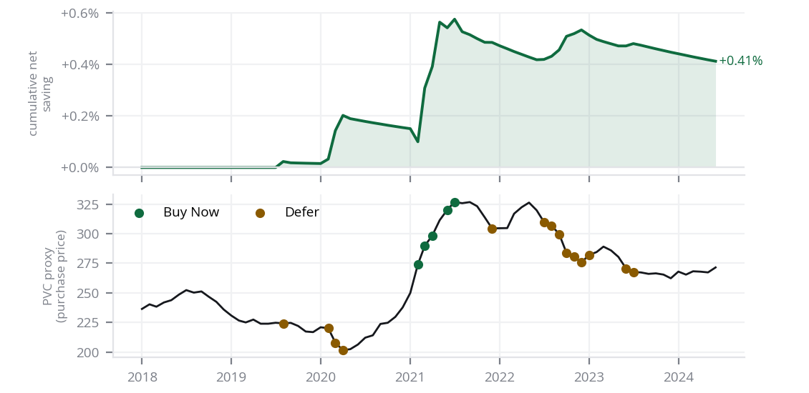
Problem
Drivers & data
Solution
Validation
Prototype
Implementation
Risks & roadmap
1 2 · P R O T O T Y P E
The decision rule replayed over 78 months: PVC timing beats random (p = 0.003);
aluminium timing does not
The rule
PVC proxy — cumulative net saving and the signals that produced it
S(h) = (P̂(h) − P₀) / P₀ − c × h
Buy now
S(h) > +2% and P(up) ≥ 60%
Forward-cover 3 months
Buy normal
−2% ≤ S(h) ≤ +2%, or confidence < 60%
BoM requirement, 1.5 months
Defer
S(h) < −2% and P(down) ≥ 60%
Minimum safety cover, 1 month
c is carrying cost per month, set at 1.0% pending ACG Finance inputs.
Results over 78 months (2018–2024), both materials
Metric | Aluminium | PVC proxy
Signals: now / normal / defer | 2 / 72 / 4 | 5 / 59 / 14
Gross price saving | −0.16% | +0.45%
Net saving after carrying cost | −0.19% | +0.41%
Beats random timing? (permutation p) | No (0.83) | Yes (0.003)
Perfect-foresight ceiling | +2.93% | +1.31%
Inventory days vs baseline | +0.6 d | +0.6 d
Working capital per ₹100 Cr (− = released) | +0.16 Cr | +0.16 Cr
What this does and does not show
On PVC the rule captured about a third of the perfect-foresight ceiling with 0.6 more days of stock, and random placement of the same signals saves nothing (median −0.03%).
On aluminium it acted 6 times in 78 months and lost 0.19%. In the 2025–26 PVC holdout it was flat: net −0.08%, p = 0.44.
The rule stays at BUY NORMAL 92% (Al) / 76% (PVC) of the time.
Method Constant monthly requirement; purchases at next month's average price; leftover stock valued at the final price. Permutation test: same signals at random months, 2,000 draws. Rupee figures per ₹100 Cr of annual spend.
12 / 15

Slide 6
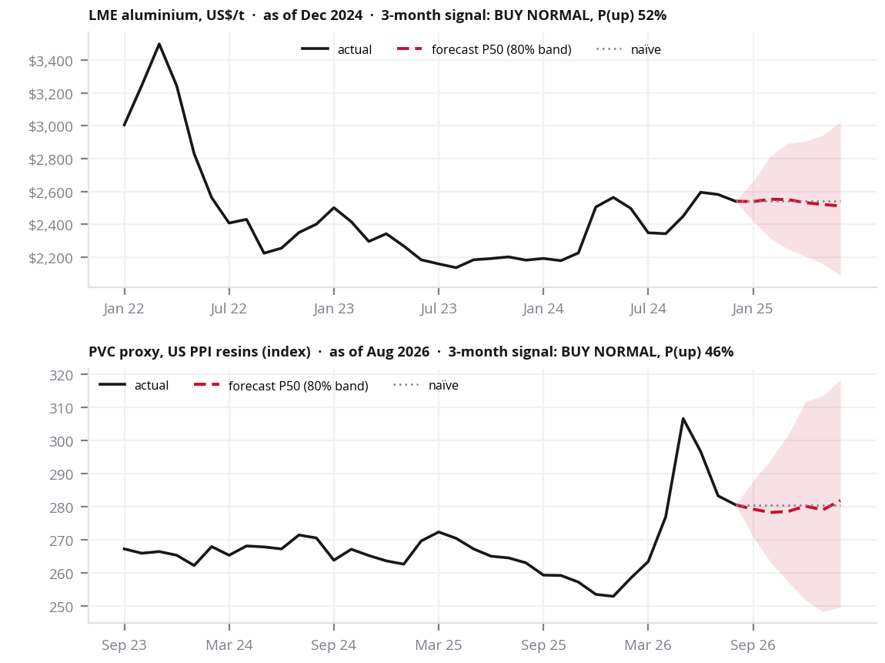
Problem
Drivers & data
Solution
Validation
Prototype
Implementation
Risks & roadmap
1 3 · P R O T O T Y P E
A working decision desk, not a mock-up: every number on screen is a model output
What procurement opens each month
Recommendation
Signal, expected saving net of carry, P(up), recommended cover, and the P10–P90 range, for any horizon from one to six months.
Price and forecast
Three years of actuals, the six-month fan, and the naïve path shown alongside so the comparison is always visible.
Purchase order
Cover × BoM − on-hand − in-transit, computed live from the buyer's own numbers, with the arithmetic shown.
Accuracy scorecard
Model against naïve at every horizon, development and holdout, with the pre-set gate marked pass or miss.
Drivers
Which indicators lead and by how much, FDR-corrected Granger flags, and SHAP drivers for the live forecast.
Buying replay
Net saving, a permutation test against random timing, the perfect-foresight ceiling, and every signal.
Built for the shadow pilot
In the pilot, buyers decide exactly as today while we log each signal against actual buys. Nothing is risked; the value is measured first.
Forecast panels as shown on the desk, drawn from the same output files. Live view: dashboard/index.html. A stale-data banner shows until the data is refreshed.
Delivery: Single-page dashboard, hosted and shareable by link. Excel export and a REST hook into the ERP requisition step are specified but not built in this round.
13 / 15

Slide 7
Problem
Drivers & data
Solution
Validation
Prototype
Implementation
Risks & roadmap
0 4 · D R I V E R S & D A T A
Every feature carries the publication lag it really had, so the backtest sees only
what was public at the time
The as-of lag table, enforced in code
Coverage of the assembled panel
Source | Series | Lag applied
World Bank Pink Sheet prices | aluminium, Brent, coal, gas, base metals | 0 months
BLS producer price indices | PVC target (WPU066), monomers, primary Al | 0 PVC · 1 Al
Fed industrial production | resins, aluminium, total industry | 1 month
ECB reference rates | USD/INR | 0 months
GPR, EPU, OECD China CLI | risk, uncertainty, China demand | 0 PVC · 1 Al
BTS freight index | US freight transportation services | 2 months
74
41 / 36
78
commodity series in the
global training panel
features for aluminium and
PVC, all from real data
scored origins 2018–24,
plus a 2025–26 holdout
Feature families
•
Price dynamics — momentum, trailing volatility, z-scores
•
Cost-push — coal, gas, Brent, monomer PPI, resin/feedstock spreads
One function, visible_panel(material), applies every lag. Training rows are embargoed:
a row is used only if its h-month outcome was published before the forecast day.
•
Demand — OECD China CLI, US industrial production, base metals
•
Currency — USD/INR, also used in the landed-cost overlay
•
Risk and shocks — GPR, EPU, data-driven shock indicators
Leakage guardrails, enforced and tested
•
Embargo on every training row, asserted in the backtest itself.
Known limitation. No free long-history Asian PVC spot price exists. We use the real
BLS producer price index for plastic resins (WPU066) as the proxy: a US index,
not Asian spot. The India landed price is a separate overlay, calibrated on ACG POs.
•
Future-perturbation test: scramble all post-origin data; no forecast may change.
•
The Round 2 draft logic fails that test; version 2 passes it.
•
Trailing windows only, no back-fill; selection and tuning inside every fold.
Sources Publication lags set per material from each provider's release calendar (config/pipeline.yaml) and applied in one place. Aluminium is forecast on the 1st of the month; PVC on BLS PPI release day.
4 / 15

Slide 8
Problem
Drivers & data
Solution
Validation
Prototype
Implementation
Risks & roadmap
1 4 · I M P L E M E N T A T I O N
90-day zero-capex shadow pilot: phased timeline, operating model, and success gates
90-day shadow pilot — timeline and phases
Pre-set success gates (all 4 must pass for go-live)
Weeks 1–2
Data Ingestion & Pipeline Setup
Gate | Pass Criterion
Accuracy | Walk-forward MAPE ≤ naïve baseline for all 3 pilot months
Basis risk | Landed overlay vs ACG actual invoice: difference < 2.5%
Shadow value | Signals beat random timing (permutation p < 0.10), net saving > 0 after carry
Buyer trust | ≥ 80% buyer agreement on driver explanations & signals
Refresh public data (with ALFRED vintages); ingest 12–24 months of ACG PO history for aluminium and PVC resin.
Weeks 3–4
Landed-Cost Overlay Calibration
Fit the landed-cost bridge (freight, FX, customs duty, port handling) against actual ACG invoice settlement prices.
Months 2–3
Shadow Scoring & Buyer Cadence
Bi-weekly forecast intelligence packs delivered to procurement; buyers decide as today while shadow P&L savings are logged.
Fail-safe kill switches (automated stop criteria)
Trigger | Automated Action
Accuracy failure | Model MAPE > naïve for 2 consecutive months → freeze signals, revert to baseline buying
Basis divergence | Supplier quotes diverge > 5% from overlay → pause and recalibrate before resuming
Regime break | Band coverage drops < 50% → force all signals to BUY NORMAL (capital preservation mode)
Month 4
Executive Review & Go/No-Go Gate
Formal leadership evaluation against pre-set criteria; if passed, connect REST hook into SAP/ERP purchase requisition.
Pilot cost: ₹0 capex. Runs entirely on open-source Python and free public macro data.
People: 1 sourcing sponsor (~1 hr/month) + 1 buyer per commodity (~30 min/fortnight).
ERP Integration: Shadow pilot operates out-of-band with zero systems risk. Requisition hook into SAP is activated only after Month 4 executive review passes all 4 gates.
Governance: Phased 90-day shadow pilot with zero capital outlay. Live buyer decisions remain unchanged while shadow savings are benchmarked.
14 / 15

Slide 9
Problem
Drivers & data
Solution
Validation
Prototype
Implementation
Risks & roadmap
1 5 · R I S K S & R O A D M A P
Landed-cost model defense, residual risk mitigations, scaling roadmap, and leadership ask
Landed-cost bridge: global index → ACG gate
Residual risks we carry & proactive mitigations
Global benchmark (LME Aluminium / Asia CFR PVC in US$)
+ Ocean freight and bunker surcharges (Nhava Sheva / Mundra)
+ Material grade premium (pharma blister 8011 foil / suspension PVC)
× (1 + Basic Customs Duty 7.5–10%) × (1 + SWS 10%) + ADD
× USD/INR (same-month, one-for-one pass-through; H4)
+ Port handling, clearance and domestic plant delivery
= ACG landed cost in ₹/MT
Risk | Current State | Mitigation
PVC proxy quality | Real US PPI; no free Asian spot | Licensed Asian feed; overlay fitted on ACG POs
Band under-coverage | 64–78% vs 75–85% gate | Regime-aware conformal; widen bands in shocks
Stale public data | Pink Sheet file ends Dec 2024 | Monthly refresh job; stale-input warnings live
Regime breaks | Coverage 42–67% in shocks | Kill-switch forces BUY NORMAL (capital preservation)
Why the bridge is defensible
Post-pilot scalability roadmap
•
Import Parity Pricing (IPP): Domestic producers (Hindalco, Reliance) price strictly on import parity; when global index, freight or tariffs move, domestic list prices adjust within days.
Months 5–6
Futures curve and licensed PVC feed
•
Contemporaneous FX (H4): pass-through is one-for-one by construction; FX is ~1% of aluminium's monthly rupee-price variance and ~36% for the PVC index.
Add LME/SHFE futures as baseline and feature; licensed Asian PVC price.
•
Protectionist Tariffs: BCD and Anti-Dumping Duties on PVC imports establish a structural domestic price floor.
Months 7–9
ERP Requisition Integration
Direct API hook into SAP/Oracle purchase requisition creation.
•
Local basis is measured, not assumed: the gap between global index and ACG's price is fitted on ACG PO history in Phase 1.
Months 10+
Expand Packaging Materials
Extend pipeline to cold-form laminates, PVDC, and auxiliary foils.
Our clear ask to ACG leadership
1. Data access
2. Stakeholder time
3. Greenlight
4. Measurable outcome
Anonymised 12–24 month PO history for aluminium foil and PVC resin, to calibrate the overlay.
1 sourcing sponsor + 1 buyer per commodity for 90 days, about two hours a month each.
Approval for a zero-capex 90-day shadow pilot with pre-set gates and kill switches.
Measured net saving, a timing test against random, buyer trust and a go/no-go, before buying changes.
Sources: [1] ACG problem statement: RM spend, inventory days, and working capital. [2] Rupee figures use a ₹100 Cr baseline spend and no confidential ACG data. [3] Audit trail: CHANGES.md in the submitted repository.
15 / 15

Slide 10
A C G · F I L M S & F O I L S
T H E B U S I N E S S I M P A C T
Digital & AI | Procurement | Strategic Sourcing
Aluminium and PVC resin are roughly 70% of manufacturing cost for pharmaceutical blister packs. A 1% move in RM price is ~0.7% of total manufacturing cost. Today, both are bought on judgement with no forward view of price.
Smart Buy
+20.7%
p = 0.002
64–78%
PVC forecast skill over naïve at one
month, significant (DM p = 0.0004)
PVC buy/defer timing beats random;
+0.45% net, ₹0.45 Cr per ₹100 Cr
band coverage after calibration,
up from 55–65%; gate is 75–85%
AI-based raw material price prediction
for aluminium and PVC resin
W H A T R O U N D 2 P R O V E S
We audited our own pipeline before this round and found three flaws: a simulated PVC price, drivers derived from the target, and a look-ahead leak in training. All three are fixed, and a test now proves the leak is gone. Under honest validation aluminium is near-efficient, while PVC shows significant 1–2 month skill. Every pre-set gate is reported unchanged, including the misses.
A 6-month forward pricing and decision system
that tells buyers when to buy ahead, buy normal,
or defer — net of carrying cost.
T E A M
Team | Case Scouts
Members | Himanshu Mahale, Rudransh Verma, Sonali Kumari
Institute | Indian Institute of Technology Kanpur, 2026
Contact | sonali23@iitk.ac.in, +91 87899 84718
Prototype | Live dashboard, 15-slide deck, reproducible pipeline with leakage tests
Round 2 · Technology Category
Audited prototype · October 2026
Problem statement: "Smart Buy – AI based Raw Material Price Prediction", ACG Films & Foils, Digital & AI | Procurement | Strategic Sourcing.

Slide 11
Problem
Drivers & data
Solution
Validation
Prototype
Implementation
Risks & roadmap
0 3 · D R I V E R S & D A T A
Both prices sit at the end of a physical chain, and every link in that chain
is tracked from public data
Aluminium
Bauxite
▶
Alumina
▶
Smelter energy
▶
LME price
and stocks
▶
Premium, FX,
duty, freight
▶
Landed India
price
Guinea and Australia
supply, export policy
4 t bauxite →
2 t alumina → 1 t metal
coal, gas and power:
the largest cash cost
financialised; stocks
signal tightness
USD/INR, CBIC tariff,
logistics
what ACG
actually pays
PVC resin
Crude (Brent)
▶
Naphtha
▶
Ethylene
▶
VCM / EDC
▶
Resin price
(US PPI proxy)
▶
Landed India
price
sets the whole
feedstock chain
Asian cracker
feedstock
plus chlorine
gives EDC
the direct
monomer input
no free Asian spot history;
US index modelled
freight, FX,
anti-dumping duty
How we decided which indicators to keep
What changed against the indicative list
•
Cross-correlation of log-returns at leads 0–6 months on real series; best lead recorded.
Change | Detail
Added | GPR, EPU, China CLI, copper/zinc, US PPIs and output, shock indicators
Replaced | Simulated PVC price, formula drivers → real BLS PPI WPU066 and published data
Not testable | LME stocks, China export offers, ethylene/VCM: no free history
•
ADF stationarity, then Granger at a fixed 3-month lag, FDR-corrected across 24 tests.
•
Every real driver is offered to the models; ElasticNet keeps 15 inside each fold, and the naïve gate decides what earns weight.
Sources [1] World Bank Pink Sheet. [2] BLS and Federal Reserve via FRED. [3] ECB. [4] Caldara & Iacoviello (2022), AER 112(4). [5] Baker, Bloom & Davis (2016), QJE 131(4). [6] OECD leading indicators. Public sources only.
3 / 15

Slide 12
Problem
Drivers & data
Solution
Validation
Prototype
Implementation
Risks & roadmap
0 4 · D R I V E R S & D A T A
Every feature carries the publication lag it really had, so the backtest sees only
what was public at the time
The as-of lag table, enforced in code
Coverage of the assembled panel
Source | Series | Lag applied
World Bank Pink Sheet prices | aluminium, Brent, coal, gas, base metals | 0 months
BLS producer price indices | PVC target (WPU066), monomers, primary Al | 0 PVC · 1 Al
Fed industrial production | resins, aluminium, total industry | 1 month
ECB reference rates | USD/INR | 0 months
GPR, EPU, OECD China CLI | risk, uncertainty, China demand | 0 PVC · 1 Al
BTS freight index | US freight transportation services | 2 months
74
41 / 36
78
commodity series in the
global training panel
features for aluminium and
PVC, all from real data
scored origins 2018–24,
plus a 2025–26 holdout
Feature families
•
Price dynamics — momentum, trailing volatility, z-scores
•
Cost-push — coal, gas, Brent, monomer PPI, resin/feedstock spreads
One function, visible_panel(material), applies every lag. Training rows are embargoed:
a row is used only if its h-month outcome was published before the forecast day.
•
Demand — OECD China CLI, US industrial production, base metals
•
Currency — USD/INR, also used in the landed-cost overlay
•
Risk and shocks — GPR, EPU, data-driven shock indicators
Leakage guardrails, enforced and tested
•
Embargo on every training row, asserted in the backtest itself.
Known limitation. No free long-history Asian PVC spot price exists. We use the real
BLS producer price index for plastic resins (WPU066) as the proxy: a US index,
not Asian spot. The India landed price is a separate overlay, calibrated on ACG POs.
•
Future-perturbation test: scramble all post-origin data; no forecast may change.
•
The Round 2 draft logic fails that test; version 2 passes it.
•
Trailing windows only, no back-fill; selection and tuning inside every fold.
Sources Publication lags set per material from each provider's release calendar (config/pipeline.yaml) and applied in one place. Aluminium is forecast on the 1st of the month; PVC on BLS PPI release day.
4 / 15

Slide 13
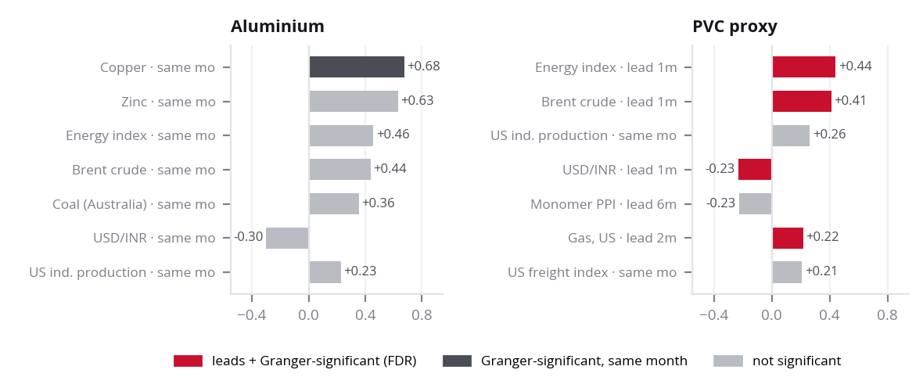
Problem
Drivers & data
Solution
Validation
Prototype
Implementation
Risks & roadmap
0 5 · D R I V E R S & D A T A
Econometric driver study: lead–lag cross-correlations and formal hypothesis verdicts
Lead–lag study: peak cross-correlations
Four core hypotheses: formal verdicts
H1
China coal and LME stocks lead aluminium by 1 to 3 months.
NOT SUPPORTED
Coal: best lead 0m, ρ = +0.36, Granger q = 0.83 · LME stocks: no free history, not testable
Coal moves with aluminium in the same month but does not lead it. Round 2's stocks result came from a series computed from the price itself.
H2
Feedstock and China export offers lead PVC by 1 to 2 months.
PARTIAL
Brent: lead 1m, ρ = +0.41, q < 0.001 · Monomer PPI: lead 6m, ρ = −0.23, q = 0.63
Crude feeds through to resin prices within a month. The monomer proxy does not lead; export offers cannot be tested.
H3
Manufacturing activity leads both materials by 0 to 2 months.
SUPPORTED
What the real data shows
China CLI: lead 2m, ρ = +0.20 (Al, q = 0.02), +0.18 (PVC, q = 0.004) · US output: same month, n.s.
•
Aluminium moves with its peers, in the same month: copper ρ = +0.68, zinc +0.63, energy +0.46 at lag 0. These explain moves; they cannot forecast them.
The OECD China leading indicator is the one genuine early signal for aluminium. PMIs are paywalled; the CLI is the free proxy.
•
China leading indicator leads both by ~2 months: ρ = +0.20 (Al) and +0.18 (PVC), Granger-significant after FDR (q = 0.02 / 0.004).
H4
USD/INR moves the landed price in the same month.
PARTIAL
•
Brent crude leads the PVC proxy by 1 month: ρ = +0.41, Granger q < 0.001. The energy index (+0.44) and US gas also lead it.
FX share of monthly rupee-price variance: Al 1%, PVC 36% · FX → US$ price: Al n.s., PVC q = 0.002
Pass-through is one-for-one by construction, but aluminium's US$ swings dwarf FX. FX belongs in the landed-cost overlay.
•
Not testable with free data: LME stocks and China PVC export offers. We say so rather than simulate them.
Only leads forecast. Leads surviving FDR: China CLI (both); Brent, energy, US gas, USD/INR (PVC).
Method: real series only, 2000–2024, monthly log-returns at leads 0–6. Granger at a fixed 3-month lag; Benjamini–Hochberg FDR across all 24 tests. Source: outputs/drivers.
5 / 15

Slide 14
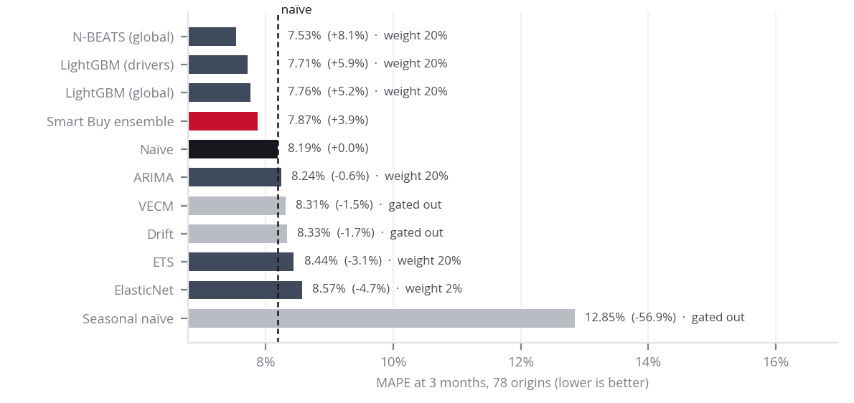
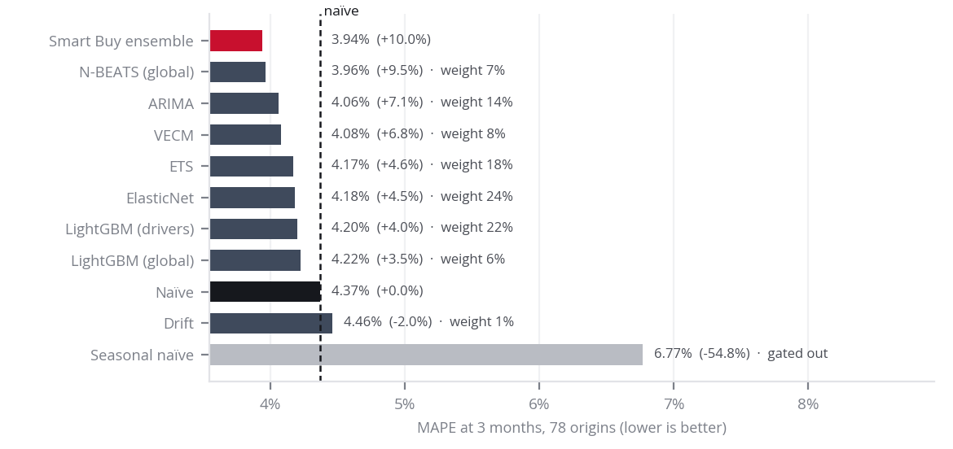
Problem
Drivers & data
Solution
Validation
Prototype
Implementation
Risks & roadmap
0 7 · S O L U T I O N
Ten models on identical embargoed origins. Trained on 74 commodity series, a real
N-BEATS became the best single forecaster on both materials
Aluminium — MAPE at h = 3, development window
PVC proxy — MAPE at h = 3, development window
What the gate did
N-BEATS, done properly, won
The finding
A model earns a share of the forecast only in months when it has beaten naïve on its own realised past forecasts. Seasonal naïve never did, on either material. No model was excluded by judgement; the LSTM was dropped after the audit found it was fed the wrong inputs.
Real N-BEATS (trend and seasonality stacks) is the best single model on both: aluminium 7.53% vs naïve 8.19% (+8.1%), PVC 3.96% vs 4.37% (+9.5%). It came out best in every training run; its exact skill varies from run to run. Round 2's "N-BEATS" was a plain MLP; that result is withdrawn.
Pooling data substitutes for data.
One model trained on 74 commodity series beats models trained on one 180-point series. That is the M4 lesson, reproduced.
Method All models run through one walk-forward harness on the same 78 origins, with embargoed training rows. Headline = equal-weight average of the models that beat naïve on realised past forecasts. N-BEATS uses early stopping on an in-fold validation slice. Consistent with Makridakis et al., M4 (2020).
7 / 15

Slide 15
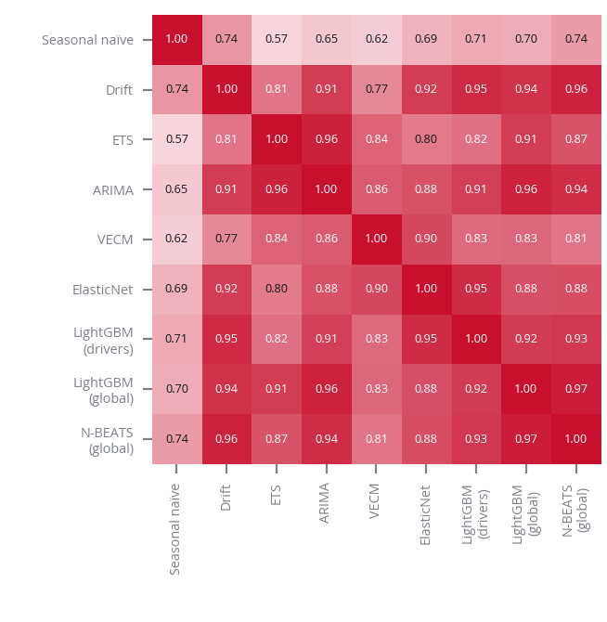
Problem
Drivers & data
Solution
Validation
Prototype
Implementation
Risks & roadmap
0 8 · S O L U T I O N
Every forecast comes with the reason it moved, because a buyer cannot act on a
number they cannot interrogate
What the buyer sees each month
Error correlation between ensemble members, PVC h = 3
Driver note, generated from the model
"PVC proxy, Aug 2026: three-month P50 278.6 (−0.7%), 80% range 257.4 to 301.6. Probability higher: 46%. After 3% carrying cost, buying ahead is worth −3.7%: BUY NORMAL. Largest pushes: seasonality (−1.1%), own price momentum (−0.4%), Brent crude (−0.3%). Models trusted now: enet, lgb_local, nbeats. Caution: Brent and gas inputs are stale until the data is refreshed."
What sits behind it
•
SHAP attribution (LightGBM TreeSHAP) on the live forecast, grouped by driver.
•
Lead–lag and FDR-corrected Granger evidence per indicator, with its best lead.
•
The models trusted at that horizon are named on every forecast.
•
Stale-input warning: any driver over 3 months old is flagged in the note.
Mean error correlation between members is 0.84 (aluminium 0.87).
•
Every override by a buyer is logged; adoption is a tracked run-state KPI.
Members are highly correlated, so averaging adds less than it seems. The most independent are seasonal naïve, VECM and ETS. N-BEATS earns its place by accuracy, not by diversity. Round 2's "N-BEATS is the only diversifier" claim is withdrawn.
Method SHAP values from LightGBM's built-in TreeSHAP on the embargoed local driver model. The error-correlation matrix is the evidence for or against any ensemble gain, reported either way.
8 / 15

Slide 16
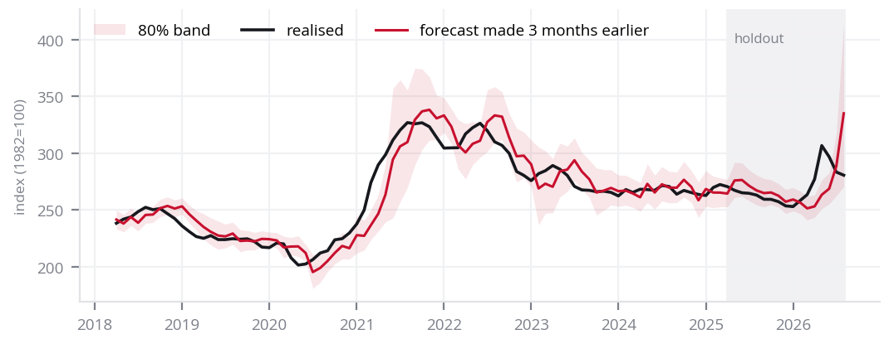
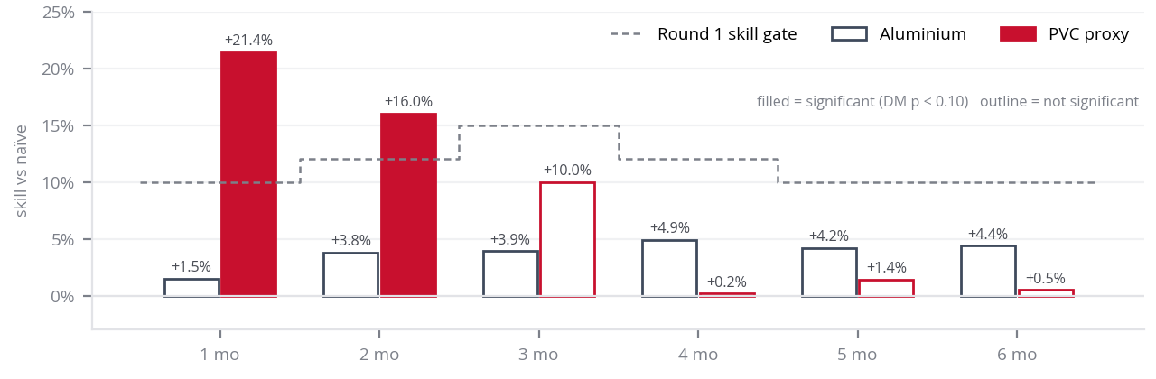
Problem
Drivers & data
Solution
Validation
Prototype
Implementation
Risks & roadmap
0 9 · V A L I D A T I O N
We tested it the way procurement would live with it: refit every month from 2018,
embargoed, and beat the naïve forecast before claiming anything
Rolling-origin walk-forward: 78 expanding origins, plus a 2025–26 holdout
PVC proxy: three-month forecast against what actually happened
Origin Jan 2018
Origin Jan 2020
Origin Jan 2022
Origin Jun 2024
and every monthly origin in between
■ training window (expanding) ■ six-month out-of-sample test
Every origin 2018–2026, with the 80% band. Shaded area is the 2025–26 holdout.
Skill vs naïve by horizon: highest at short horizons, as it should be
Performance by regime, h = 3
Regime | n | Al skill | Al cov. | PVC skill | PVC cov.
Calm (2018-2019) | 24 | +1.1% | 79% | +4.3% | 71%
COVID Shock (2020) | 12 | +8.8% | 50% | +13.9% | 42%
Spike/Rally (2021-2022 H1) | 18 | +5.8% | 56% | +12.5% | 67%
Slide/Normalization (2022 H2-2024) | 27/30 | −1.6% | 89% | +1.0% | 93%
Band coverage still drops in shocks (42–67%), so the regime kill switch stays.
Method Training rows embargoed: outcome published before the origin. Selection, tuning and early stopping happen inside each fold. [1] Tashman (2000), IJF 16(4). [2] Diebold & Mariano (1995), JBES 13(3), with Harvey–Leybourne–Newbold correction and Newey–West variance at lag h−1.
9 / 15

Slide 17
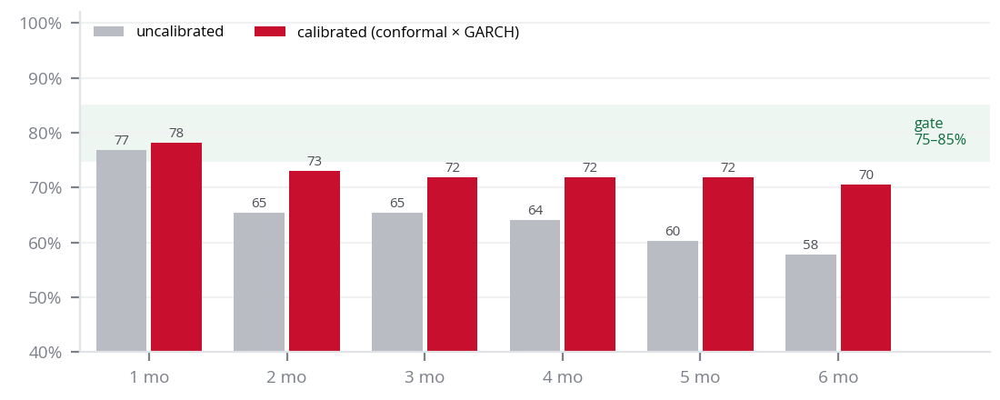
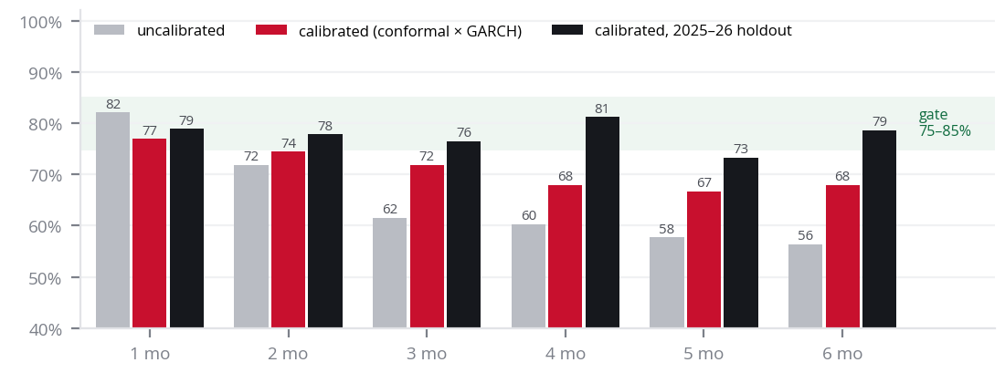
Problem
Drivers & data
Solution
Validation
Prototype
Implementation
Risks & roadmap
1 1 · V A L I D A T I O N
The bands are the product: calibration now exists and lifts coverage to 64–78%,
still short of the gate at longer horizons and in shocks
Aluminium — 80% band coverage against the 75–85% gate
What the numbers say
Horizon | Al calibrated | PVC calibrated | PVC holdout | Gate Al / PVC
1 mo | 78.2% | 76.9% | 78.9% | pass / pass
2 mo | 73.1% | 74.4% | 77.8% | miss / miss
3 mo | 71.8% | 71.8% | 76.5% | miss / miss
4 mo | 71.8% | 67.9% | 81.2% | miss / miss
5 mo | 71.8% | 66.7% | 73.3% | miss / miss
6 mo | 70.5% | 67.9% | 78.6% | miss / miss
The diagnosis
PVC proxy
•
Normalised split-conformal around the forecast, scaled by a GARCH(1,1) volatility forecast, using only realised past errors.
•
It lifts coverage by up to 13 points over the uncalibrated band (aluminium h=6: 57.7% → 70.5%).
•
Round 2 claimed this step, but the code never had it: its 55–65% was raw, uncalibrated coverage.
•
Coverage still drops in shocks (42–67% at h=3). The PVC holdout lands at 71–81%.
Consequence for the decision rule. The 60% confidence gate and the regime kill switch stay, because the band still understates tail risk in shocks.
Method Score = |error| / GARCH σ on realised past forecasts; band = forecast ± conformal 80% quantile × current σ. Coverage is measured, not assumed. [1] Vovk, Gammerman & Shafer (2005). [2] Bollerslev (1986).
11 / 15

