Slide 1
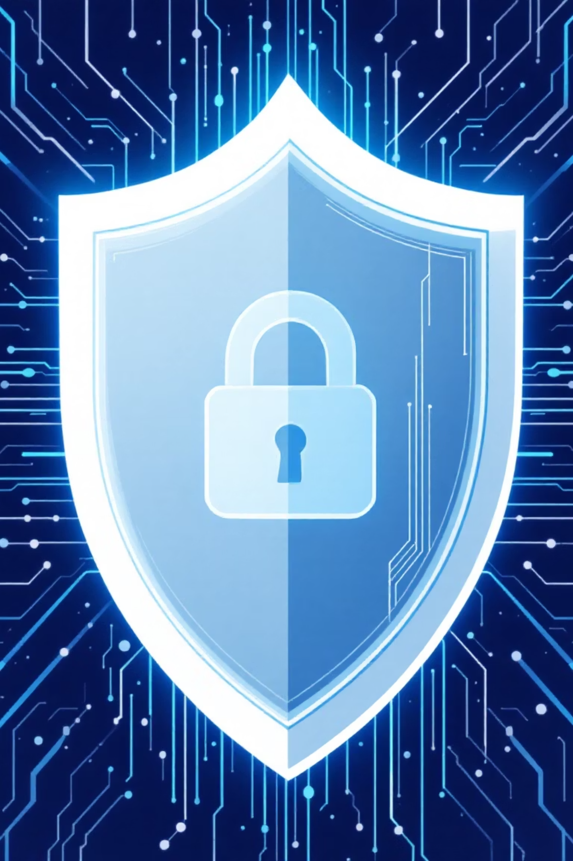
Cyber Security
Protecting Data in the Digital World
Presented by:
Konderu Deepika
24H51A66E8

Slide 2
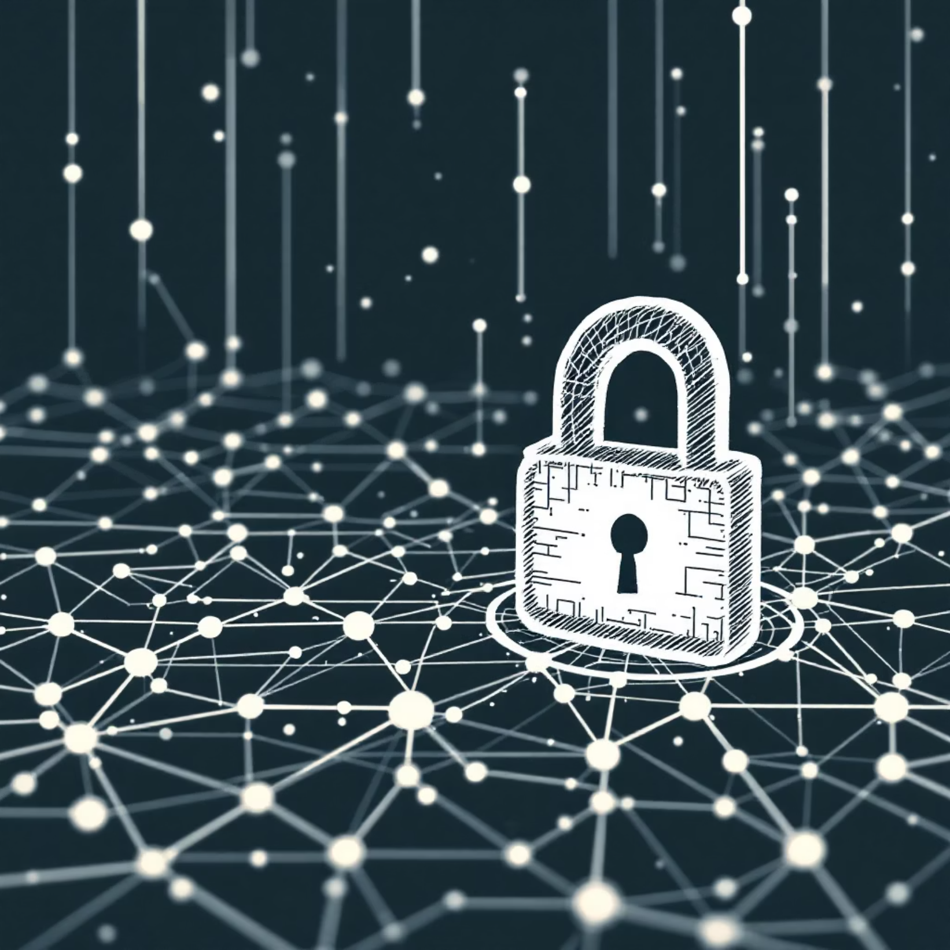
What is Cyber Security?
Cyber security is the practice of protecting computers, networks, and data from digital attacks, theft, and damage. It involves technologies, processes, and practices designed to safeguard our information in the online world.
Think of it as a digital lock and alarm system that keeps your personal information, passwords, and sensitive data safe from hackers and cybercriminals.

Slide 3
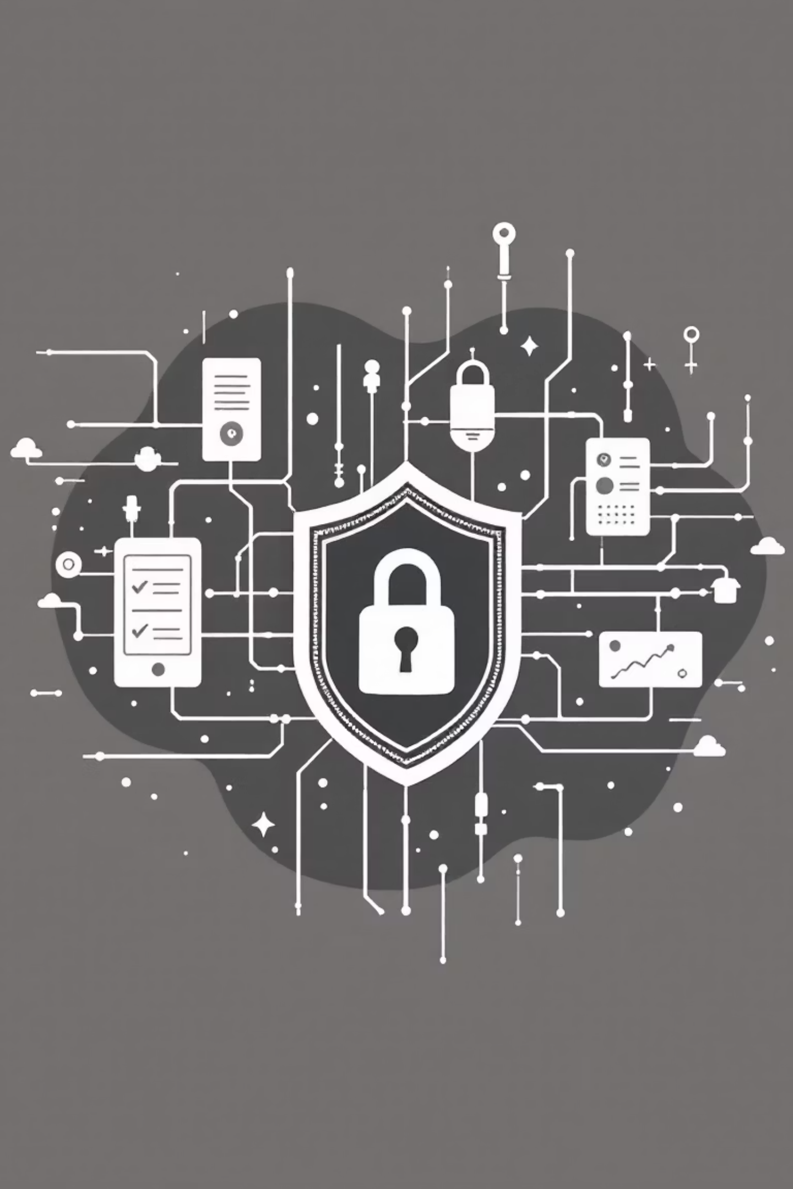
Why Cyber Security Matters
Personal Protection
Business Security
Safeguards your identity, financial data, and private information from theft and misuse
Protects company secrets, customer records, and prevents costly data breaches
National Safety
Defends critical infrastructure like power grids, hospitals, and government
systems

Slide 4
Common Cyber Threats
Phishing
Malware
Ransomware
Fake emails or messages that trick you into sharing passwords or clicking dangerous links
Harmful software like viruses that infect devices to steal data or cause damage
Malicious programs that lock your files and demand payment to release them
Password Attacks
Identity Theft
Attempts to guess or crack passwords to gain unauthorized access to accounts
Stealing personal information to impersonate someone for financial gain

Slide 5
How Cyber Attacks Happen
Target Selection
Exploitation
Hackers identify vulnerable systems or users to attack
They find and exploit weaknesses in software or human behavior
Access Gained
Data Theft
Attackers infiltrate systems through malware or stolen
credentials
Sensitive information is stolen, encrypted, or destroyed

Slide 6
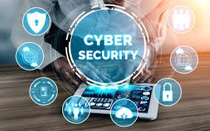
Basic Cyber Safety Practices
Use Strong, Unique Passwords
Create passwords with 12+ characters mixing letters, numbers, and symbols. Use different passwords for each account.
Enable Two-Factor Authentication
Add an extra security layer by requiring a code from your phone in addition to your password.
Keep Software Updated
Install security patches and updates immediately to fix vulnerabilities hackers could exploit.
Think Before You Click
Verify sender authenticity before clicking links or downloading attachments, especially in unexpected emails.

Slide 7
Cyber Security in Daily Life
Mobile Devices
Social Media
Online Shopping
Home Networks
Use screen locks, avoid public Wi-Fi for banking, and only download apps from official stores
Review privacy settings regularly and be cautious about sharing personal details publicly
Shop only on secure websites (look for HTTPS), and monitor bank statements for suspicious activity
Change default router passwords and use strong Wi-Fi encryption to protect your connection

Slide 8
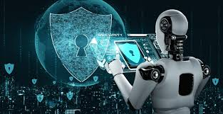
The Future of Cyber Security
AI-Powered Defense
Quantum Encryption
Artificial intelligence will detect and respond to threats faster than humans ever could, learning from each attack
Next-generation encryption methods will make data virtually impossible to hack using quantum technology
Zero Trust Security
Systems will verify every user and device constantly, never automatically trusting anyone inside the network
Stay Safe, Stay Vigilant
Cyber security isn't just about technology—it's about being aware, informed, and proactive. Every click matters. Every password counts. By following basic safety practices and staying educated about digital threats, we can all contribute to a safer online world. Remember: your security starts with you.

Slide 9
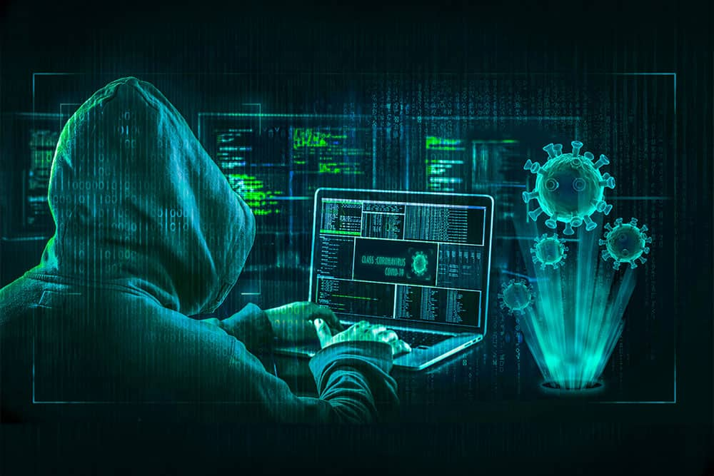
Conclusion
cyber security is very important in today’s digital world.
It protects our personal data, our online accounts, and our digital systems from cyber attacks.
By using strong passwords, updating our devices, and being careful online, we can keep ourselves safe.
Cyber security is not only a technology - it is also our responsibility.

Slide 10
