Slide 1


A Clinical Performance Dashboard
CLINIPET × HEALTHTAIL
Unifying registration, visit, and invoice data in BigQuery to power a self-serve Looker Studio dashboard for medication spend and disease trend analysis.
Prepared by | BI Analyst, Clinipet
Notes:
Good morning everyone, thank you for making time. Quick scene-setting: I'm presenting as the BI Analyst from Clinipet, and today I'm walking you through the work we did for HealthTail - one of the largest veterinary hospitals in the city. The headline is simple: HealthTail was auditing medication purchases and tracking diagnoses manually, and our job was to replace that manual grind with a clean, unified data foundation and a dashboard they can actually use day to day. I'll walk through the brief we received, what the raw data looked like - warts and all - how we cleaned it, and then I'll take you through the dashboard itself and what it tells us. Let's start with the client and the problem they came to us with.

Slide 2






ROADMAP
What We'll Cover Today
01
02
The Client & The Ask
Our Brief
Who HealthTail is and the two problems they brought to us
How Clinipet's role was scoped after the kickoff meeting
03
04
The Raw Data
What Was Wrong With It
Three source systems - registration, visits, invoices
The data quality issues we found before trusting a single number
05
06
How We Cleaned It
The Dashboard, Walked Through
The fixes applied before anything hit the dashboard
Nine views answering HealthTail's real operating questions
Clinipet | HealthTail Engagement
2
Notes:
Quick map of where we're going. I'll start with who HealthTail is and what they actually asked for, then how Clinipet's role got scoped. Then - and I think this is the part that matters most for trust in the numbers - I'll show you exactly what was wrong with the raw data and what we did to fix it before a single chart was built. Then we get into the dashboard itself, walked through view by view, the way you'd actually use it operationally.

Slide 3


PROJECT CONTEXT
The Client & The Challenge
HealthTail
Challenge 1 — Auditing Medication Purchases
One of the largest veterinary hospitals in the city
They need a streamlined, repeatable way to track and analyze annual medication spending - instead of reconciling invoices by hand.
They approached Clinipet to automate a manual auditing process for medications - one that was eating staff time and slowing down decisions about staffing and procurement.
Challenge 2 — Monitoring Diagnoses & Disease Trends
Why it matters
Faster, trustworthy answers on spend and disease trends translate directly into smarter staffing and procurement decisions.
Identify the most common diagnoses and diseases by pet type and breed, to plan staffing needs and optimize medication procurement.
Clinipet | HealthTail Engagement
3
Notes:
So who are we working with. HealthTail is one of the largest vet hospitals in the city, and they came to Clinipet with a very manual problem: every month, someone was auditing medication purchases by hand. That manual process actually masked two distinct needs. First, they need a streamlined way to track and analyze their annual medication spending - basically, where is the money going and is it trending the way it should. Second, and this is the one I find more interesting, they want to know what's actually showing up in the clinic - the most common diagnoses and diseases, broken down by pet type and breed - because that tells them how to staff and what to stock. Those two challenges are what shaped everything we built after this.

Slide 4


SCOPE OF WORK
How Our Role Was Defined
After the kickoff meeting with HealthTail's management team, Clinipet's role was clarified into three concrete deliverables:
1
2
3
Unify the Data in BigQuery
Answer the Research Questions
Build a Foundation for Looker Studio
Integrate HealthTail's three source systems into a clean, aggregated dataset in BigQuery - built for seamless analysis, not manual reconciliation.
Directly address HealthTail's questions on medication auditing and diagnosis trends, to make audits faster and more accurate.
Create a data layer that can be explored and visualized in Looker Studio, supporting day-to-day operational and planning decisions.
Clinipet | HealthTail Engagement
4
Notes:
Once we sat down with HealthTail's management, our scope got narrowed into three clear deliverables. One: integrate and unify their data in BigQuery - that's the unglamorous but essential part, turning three separate, messy source systems into one clean, aggregated dataset. Two: actually address their research questions - not just hand over tables, but make sure the audit and the diagnosis trend questions are directly answerable. Three: build that data foundation in a way that plugs cleanly into Looker Studio, so their team can explore it themselves for operational and planning decisions, not just look at a static report once a quarter. Everything I show you for the rest of this presentation maps back to one of these three things.

Slide 5

THE RAW MATERIAL
Three Source Systems, One Picture
HealthTail gave us three primary data sources. Each tells part of the story - together they cover the patient, the visit, and the money.
healthtail_reg_cards
visits
invoices
Patient & Owner Registry
Diagnoses & Prescriptions
Supplier Purchases
patient_id, owner_id, owner_name
pet_type, breed, patient_name
gender, patient_age
date_registration, owner_phone
visit_id, patient_id, visit_datetime
doctor, diagnosis
med_prescribed, med_dosage
med_cost
month_invoice, invoice_id, supplier
med_name, packs, price
total_price (= packs x price)
Clinipet | HealthTail Engagement
5
Notes:
Before any cleaning, here's what we actually received: three tables. The registration cards give us the patient and the owner - who the pet is, what type and breed, and the owner's contact details. The visits table is the clinical record - every visit, which doctor saw the pet, what was diagnosed, and what was prescribed, including the cost of that medication for that visit. And invoices is the procurement side - what Clinipet... sorry, what HealthTail bought from suppliers, in what quantity, and at what price. Put together, these three answer both of HealthTail's challenges: visits plus reg_cards gives us the diagnosis trends by pet type and breed, and visits plus invoices gives us the medication spend audit.

Slide 6
BEFORE WE TRUST A SINGLE NUMBER
Issues We Found In The Raw Data
Before anything reached the dashboard, we audited each source. Two of the three tables needed real intervention.
healthtail_reg_cards
invoices
3 distinct quality problems
Clean on nulls and duplicates, but total_price can't be blindly trusted - it should be re-derived as packs x price in case of upstream rounding drift.
Missing breed values
246 rows have a blank breed, and the label "No Breed" is also used elsewhere - two spellings of the same thing.
Corrupted phone numbers
Roughly 980 of 9,435 owner_phone values contain stray junk characters - ( ) # & @ ! - breaking the +44 XXXX XXXXXX format.
visits
Inconsistent name casing
patient_name mixes cases inconsistently, e.g. "charlie" vs "Luke", which breaks clean grouping and search.
Clean on nulls and duplicates - just needed proper DATE typing on visit_datetime and trimmed text fields before joining.
Clinipet | HealthTail Engagement
6
Notes:
This is the slide I think is actually most important for trust. Before building a single chart, we profiled all three tables. The registration cards needed the most work. First, breed was missing in 246 rows, and on top of that, the same 'unknown' concept was being recorded two different ways - blank, and the literal text 'No Breed' - which would have silently split our breed groupings in two. Second, about 980 of the 9,435 phone numbers had junk characters injected into them - parentheses, hashes, ampersands - breaking the expected UK phone format. Third, pet names had inconsistent casing, 'charlie' versus 'Luke', which matters less for charts but matters a lot if you ever want to search or de-duplicate by name. Invoices and visits were actually in much better shape - no nulls, no duplicates. The only catches were: in invoices, we chose not to trust total_price as given, and instead recomputed it as packs times price, just in case there was rounding drift upstream. And in visits, we just needed correct date typing and trimmed whitespace before joining.

Slide 7





FROM ISSUES TO FIXES
What We Did To Clean The Data
Standardized breed
Repaired phone numbers
Normalized text casing
Collapsed blanks and "No Breed" into a single, consistent "Unknown" category so breed-level analysis isn't artificially split.
Stripped stray junk characters ( ) # & @ ! from owner_phone and re-validated against the +44 XXXX XXXXXX format.
Applied consistent title casing to patient_name (and other text fields) for reliable grouping and search.
Re-derived total_price
Fixed date typing
Unified into BigQuery
Recomputed invoices.total_price as packs x price rather than trusting the stored value, to remove any upstream rounding drift.
Cast visit_datetime to a proper DATE/DATETIME type and trimmed whitespace across visits text fields.
Joined all three cleaned sources into a single aggregated dataset in BigQuery, ready for Looker Studio.
Clinipet | HealthTail Engagement
7
Notes:
So here's exactly what we did about each of those issues, mapped one-to-one with the problems on the last slide. Breed: we collapsed blank and 'No Breed' into one consistent Unknown category. Phone numbers: we stripped out the junk characters and re-validated the format. Pet names: normalized casing across the board. On the invoices side, we recomputed total_price ourselves from packs times price rather than trusting the stored figure. On visits, we made sure visit_datetime was a real date type and trimmed stray whitespace from text fields - small thing, but it matters when you're joining on diagnosis or medication names later. And then the last step ties it all together: once each source was clean individually, we unified all three into one aggregated dataset in BigQuery. That's the single source of truth that everything you're about to see is built on.

Slide 8
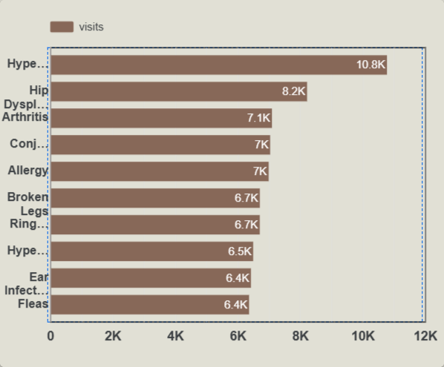
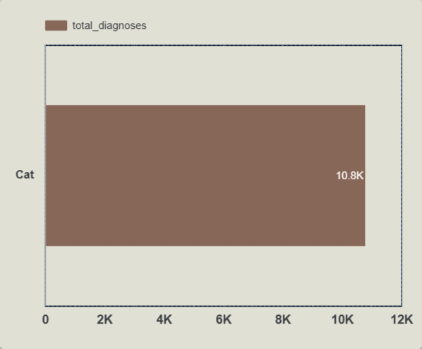
DISEASE TRENDS · VIEW 1
What Are Pets Actually Coming In For?
10.8K
TOP DIAGNOSIS - VISIT VOLUME
Hypertrophic Cardiomyopathy (HCM) is the single largest driver of visits at roughly 10.8K, well ahead of every other condition - nearly a third more than the next item, Hip Dysplasia at 8.2K.
Arthritis, Conjunctivitis and Allergy form a tight middle band, each around 7K visits - these are the steady, recurring volume that staffing should be sized around.
The remaining categories - broken legs, ringworm, hyperthyroidism (recheck), ear infections and fleas - cluster tightly between 6.4K and 6.7K, suggesting a fairly even 'long tail' of routine care.
Bottom line: this ranking is the direct input HealthTail asked for - it tells them which conditions to plan medication stock and specialist time around first.
Clinipet | HealthTail Engagement
8
Notes:
This is the first view that speaks directly to Challenge 2 - disease trends. We're ranking diagnoses by visit volume. Hyperthyroidism sits clearly at the top at about ten point eight thousand visits - that's the one condition HealthTail should be planning around first, both for medication stock and for vet time. Hip Dysplasia is a distant second at eight point two thousand, and then you get this tight cluster - Arthritis, Conjunctivitis, Allergy - all hovering right around seven thousand. Below that the rest of the list - broken legs, ringworm, a recheck category for hyperthyroidism, ear infections, fleas - they're all bunched closely together in the six point four to six point seven thousand range, so it's a long, fairly even tail of routine care rather than a sharp drop-off. The takeaway for HealthTail is simple: hyperthyroidism deserves dedicated stock and staffing attention, and the next four conditions need steady, reliable coverage.

Slide 9
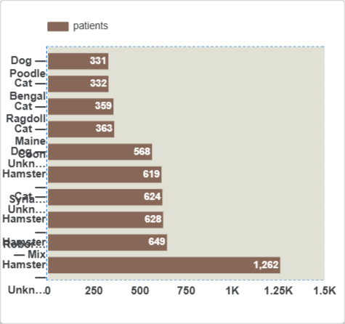
DISEASE TRENDS · VIEW 2
Which Pet Types & Breeds Make Up The Patient Base?
1,262
LARGEST SINGLE GROUP
Hamsters, taken together across their breed groupings, are the single largest patient population - one Hamster group alone accounts for 1,262 patients, far ahead of any individual cat or dog breed.
Cat breeds (Maine Coon, Ragdoll, Bengal) and common dog breeds sit in a much narrower band, roughly 330 to 650 patients each.
This segmentation is exactly what HealthTail needs for staffing - if small-mammal cases dominate volume, exam rooms, handling expertise and medication packaging should reflect that, not just assumptions based on cats and dogs.
Pairing this view with the diagnosis ranking lets cross-check: which breeds drive which conditions, and stock accordingly.
Clinipet | HealthTail Engagement
9
Notes:
This view answers the 'segmented by pet type and breed' half of Challenge 2 directly. The standout here, and honestly a bit of a surprise if you assume vet hospitals are mostly cats and dogs, is that hamsters - across their breed groupings - make up the single largest patient population, with one group alone at twelve sixty-two patients. Compare that to the common cat breeds like Maine Coon and Ragdoll, or typical dog breeds, which sit in a much tighter band of roughly three hundred thirty to six hundred fifty patients each. For HealthTail, this directly informs staffing and supply planning - if small mammals are this large a share of the patient base, you need exam setups, handling expertise, and medication packaging sized for that, not just for cats and dogs. And when you put this next to the diagnosis chart we just looked at, you can start cross-referencing which breeds are driving which conditions, which is exactly the staffing and procurement lens they asked for.

Slide 10
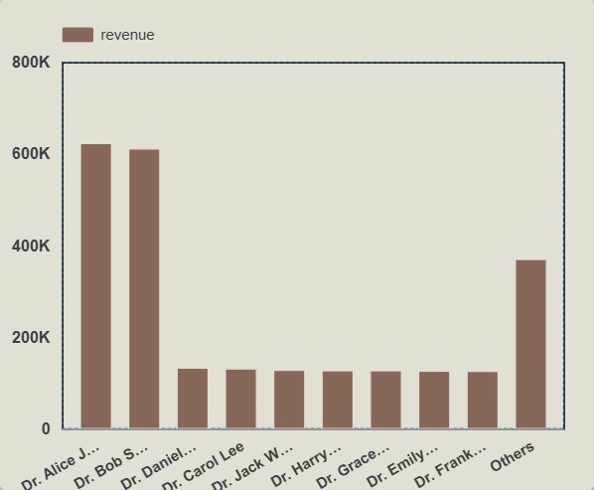
MEDICATION AUDIT · VIEW 3
How Is Revenue Distributed Across Doctors?
~620K
TOP DOCTOR - REVENUE
Dr. Alice and Dr. Bob each generate roughly 600-620K in revenue - more than four times any other individually named doctor.
A second tier of seven doctors (Daniel, Carol, Jack, Harry, Grace, Emily, Frank) each contribute a similar, steady ~120-130K.
The 'Others' bucket - smaller or part-time contributors grouped together - still totals around 365K, a meaningful share worth monitoring as it grows.
This view turns a manual audit question - 'who is driving revenue, and is it concentrated or spread out' - into a one-glance answer.
Clinipet | HealthTail Engagement
10
Notes:
Now we shift to the medication audit side, and revenue by doctor is a good entry point because it's exactly the kind of question that used to take manual digging through invoices and visit logs. Two doctors - Alice and Bob - clearly lead, each bringing in somewhere around six hundred to six hundred twenty thousand, which is more than four times what any other single named doctor generates. Then there's a very even second tier - seven doctors, each landing around one hundred twenty to one hundred thirty thousand - so that's a stable, broad base of contribution. And the 'Others' bar - that's everyone else bucketed together - still adds up to around three hundred sixty-five thousand, which is sizeable enough that HealthTail should keep an eye on it as that group grows or shrinks over time. The real win here is speed: this used to be a spreadsheet exercise, now it's a single glance.

Slide 11
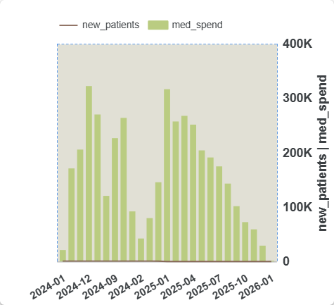
MEDICATION AUDIT · VIEW 4
Monthly Medication Spend, Jan 2024 - Jan 2026
~330K
PEAK MONTHLY SPEND
Medication spend shows two clear seasonal peaks - around December 2024 and again in January 2025 - each reaching roughly 330K, with a dip into February each year.
This is precisely the rhythm a manual annual audit would miss month-to-month: the dashboard turns it into a recurring, predictable pattern.
Knowing the peak falls in December/January lets HealthTail negotiate supplier terms and stock up ahead of the seasonal surge, rather than reacting to it.
The tail-off into early 2026 reflects the most recent months still accumulating data, not a real drop in spend - worth flagging when reading the live dashboard.
Clinipet | HealthTail Engagement
11
Notes:
This is the heart of the medication audit automation. Instead of someone manually tallying invoices month by month, we now have a running view of medication spend over the full two-year window. Two things jump out. First, there's a clear seasonal pattern - spend peaks around December into January, both in the 2024 and the 2025 cycle, each time getting up to around three hundred thirty thousand, and then dipping noticeably in February. That's a genuinely useful operational signal - HealthTail can use this to negotiate supplier pricing or pre-stock ahead of that December-January surge instead of being caught reacting to it. One honest caveat I want to flag now, because it'll come up again: the very end of the chart, into early 2026, tapers down - that's not a real collapse in spend, it's simply that the most recent months haven't fully accumulated data yet. I'll flag this same pattern again later so it doesn't get misread as a trend.

Slide 12
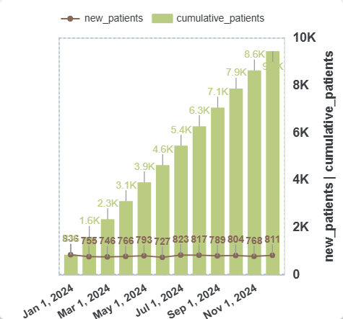
MEDICATION AUDIT · VIEW 5
Patient Base Growth Through 2024
~9.7K
CUMULATIVE PATIENTS BY NOV 2024
The registered patient base grew steadily and almost linearly across 2024, from under 1,000 in January to roughly 9.7K by November.
New patient additions stayed remarkably stable month to month - typically 750-840 new registrations - meaning growth is consistent, not driven by spikes or campaigns.
Stable, predictable intake is good news for procurement planning: HealthTail can scale medication ordering in line with this steady growth rate rather than guessing.
This view directly supports staffing forecasts too - a known, steady intake rate translates into a known, steady demand on doctor time.
Clinipet | HealthTail Engagement
12
Notes:
This one is about growth, not spend. We're tracking the cumulative patient base across 2024, and what's notable is how steady it is - it climbs from under a thousand registered patients in January to around nine point seven thousand by November, essentially in a straight line. If you look at the new-patient line overlaid on top, monthly additions are remarkably consistent - typically somewhere between seven hundred fifty and eight hundred forty new patients every single month. There's no big spike from a marketing push, no sudden drop-off. That consistency is actually valuable for planning - it means HealthTail can scale their medication ordering and staffing in line with a known, steady growth rate, rather than guessing or over-provisioning for a spike that might not come.

Slide 13
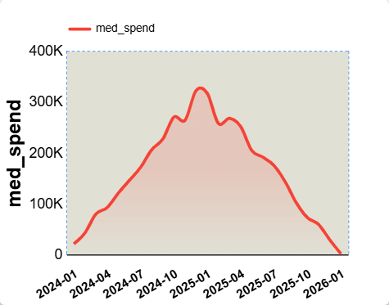
MEDICATION AUDIT · VIEW 6
The Full Medication Spend Curve
Up, Then Down
SPEND TRAJECTORY
Spend builds gradually through 2024, peaks around the December 2024/January 2025 window at roughly 330K, then eases back down through 2025.
The smooth, single-peak shape (versus the choppier monthly bars on the previous view) makes the overall seasonal arc easy to read at a glance for non-technical stakeholders.
The decline into 2026 mirrors the prior slide - again, this reflects partial, still-accumulating data for the most recent months rather than an actual spend reduction.
Recommendation: treat any current-month or trailing-quarter figure on this dashboard as provisional until the month fully closes.
Clinipet | HealthTail Engagement
13
Notes:
This is the same medication spend story as the last view, but smoothed into a single trend line instead of monthly bars - and I'm including both because they serve different audiences. The bar version is great for precise monthly comparisons; this smoothed view is what you'd put in front of leadership to show the overall shape of the year in one glance. You can see the build-up through 2024, the peak right around that December-January window again at about three hundred thirty thousand, and then the gradual decline through 2025. And yes - same caveat as before - that drop-off into 2026 at the very end is the data still accumulating for recent months, not a real decline. I'd recommend we treat any current month or trailing quarter figure on this live dashboard as provisional until the month has fully closed out.

Slide 14
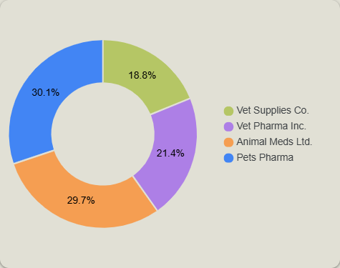
MEDICATION AUDIT · VIEW 7
Who Are We Buying Medication From?
30.1%
TOP SUPPLIER SHARE
Spend is fairly evenly split across four suppliers: Pets Pharma (30.1%), Animal Meds Ltd. (29.7%), Vet Pharma Inc. (21.4%), and Vet Supplies Co. (18.8%).
No single supplier dominates - the top two together account for roughly 60% of spend, which limits HealthTail's exposure to any one vendor's pricing or supply issues.
This balance is itself a useful audit finding: it confirms HealthTail isn't over-reliant on one supplier, a real risk in medication procurement.
Worth tracking quarter to quarter - a meaningful shift in this split would be an early signal of pricing or availability changes worth investigating.
Clinipet | HealthTail Engagement
14
Notes:
Last piece of the procurement picture - where the money is actually going, by supplier. And honestly this is a reassuring result. Spend is fairly balanced across four suppliers - Pets Pharma at thirty point one percent, Animal Meds Ltd close behind at twenty-nine point seven, then Vet Pharma Inc at twenty-one point four, and Vet Supplies Co at eighteen point eight. No single supplier dominates the relationship - the top two combined are only around sixty percent, which is healthy diversification and limits HealthTail's exposure if any one supplier raises prices or has a supply disruption. I'd suggest tracking this split over time on the live dashboard - if it ever starts to concentrate sharply toward one supplier, that's worth a conversation before it becomes a dependency.

Slide 15
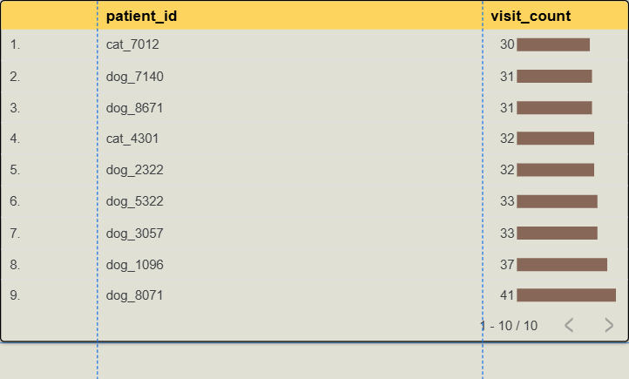
OPERATIONAL DETAIL · VIEW 8
Which Patients Visit Most Frequently?
41
HIGHEST VISIT COUNT
The most frequent patient, dog_8071, has visited 41 times - well above the rest of the top 10, which cluster between 30 and 37 visits.
Dogs dominate this list - 7 of the top 9 records are dogs, versus 2 cats - which may reflect chronic-condition follow-ups more common in certain breeds.
This patient-level drill-down is what makes the dashboard genuinely operational - HealthTail can flag these records for case review or chronic-care planning, not just look at aggregate trends.
It's also a useful data-quality check: an unusually high visit count is worth a quick manual look to confirm it's a real chronic case and not a duplicate patient ID.
Clinipet | HealthTail Engagement
15
Notes:
This last operational view drills all the way down to the individual patient - it's a top-ten list by visit count. The top record, dog eight zero seven one, has come in forty-one times, clearly ahead of the rest of the list, which clusters between thirty and thirty-seven visits. Dogs dominate this particular list - seven of the nine records shown are dogs versus two cats - which could point to chronic conditions that need repeat visits being more common in certain dog cases. I included this view specifically because it's what makes the dashboard genuinely useful day to day, not just a quarterly report - HealthTail's team can use this to flag patients for chronic-care planning, or honestly, as a quick data-quality check, because a visit count this high is also worth a manual glance to rule out a duplicate patient record.

Slide 16
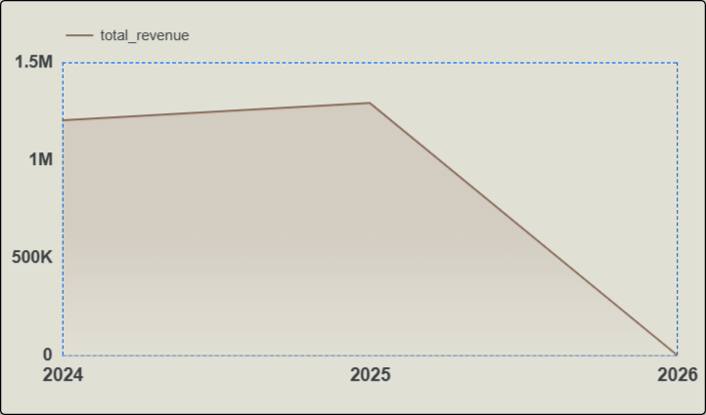
A READ-BEFORE-YOU-PANIC SLIDE
Total Revenue, 2024 - 2026
Read This Chart Carefully
Total revenue held steady at roughly 1.2-1.3M across 2024 and 2025, even ticking slightly upward into 2025.
The sharp drop shown for 2026 is not a real collapse in revenue - 2026 has only just begun, so that bar reflects partial, still-accumulating data, the same pattern we flagged on the spend charts.
Read this as: "two full, healthy years of ~1.2-1.3M revenue, with year three still in progress" - not as a downward trend.
Recommendation: add a clear "data as of" date or a partial-period flag to this view in the live dashboard, so it can't be misread by anyone seeing it for the first time.
Clinipet | HealthTail Engagement
16
Notes:
I want to spend a moment on this one because if you saw it cold, it would look alarming - revenue cliff-diving toward 2026. So let's read it properly. 2024 and 2025 both sit at a healthy, stable one point two to one point three million in total revenue, even nudging up slightly into 2025. That's the real signal - two strong, consistent years. The sharp drop into 2026 is the same artifact we saw on the medication spend charts - 2026 has barely started, so that data point is partial and still accumulating, not a genuine collapse. The honest way to read this chart is: two full, healthy years, with year three still in progress - not a downward trend. My recommendation, and this is a genuine action item for us, is to add a clear 'data as of' marker or a partial-period flag directly on this view in the live dashboard, so nobody stumbles into reading it the wrong way the first time they open it.

Slide 17



BRINGING IT TOGETHER
Key Takeaways & Recommendations
The data foundation is solid
Two conditions deserve focus
All three sources are unified, cleaned and validated in BigQuery - audits no longer start from raw spreadsheets.
Hyperthyroidism and Hip Dysplasia lead diagnosis volume - prioritize stock and specialist time around these.
Plan staffing for the real mix
Spend is seasonal, not random
Hamsters are a larger share of the patient base than expected - exam setup and handling expertise should reflect that.
Medication spend peaks every December-January - negotiate supplier terms ahead of that window.
Supplier risk is low
Flag partial periods clearly
Spend is well-diversified across four suppliers, with no single vendor dominating.
Add a "data as of" marker to live time-series views so the most recent, still-accumulating month isn't misread as a drop.
Clinipet | HealthTail Engagement
17
Notes:
So pulling everything together into the takeaways HealthTail's management should walk away with. First - the unglamorous but critical one - the data foundation is genuinely solid now, all three sources cleaned, unified and sitting in BigQuery, so future audits start from a trustworthy base, not raw spreadsheets. Clinically, hyperthyroidism and hip dysplasia are the two conditions to prioritize for stock and specialist time. On staffing, the hamster population is a bigger share of the patient base than you'd assume, so exam room setup and handling training should reflect that, not just the cat-and-dog default. On the money side: spend is seasonal and predictable, peaking every December into January, so that's the window to negotiate supplier terms in advance. Supplier risk itself is low - good diversification across four vendors. And the one process recommendation I'd really push for: add a 'data as of' flag to the live time series views, so nobody on HealthTail's side mistakes a still-accumulating month for an actual decline, the way that revenue chart could be misread.

Slide 18
Thank You
Clinipet | BI Analyst | HealthTail Engagement
Notes:
That's everything I had prepared. To summarize in one breath: we took three messy, manual data sources, cleaned and unified them in BigQuery, and turned them into a Looker Studio dashboard that answers both of HealthTail's original questions - medication spend auditing and diagnosis trend monitoring - in a few clicks instead of a spreadsheet marathon. Happy to take questions now, or if anyone wants, I can pull up the live Looker Studio dashboard and drill into anything specific - a particular doctor, a particular month, a particular breed.

