Slide 1

MSIT Program
Sonali Biswas
TravelTide
Business Analyst
Analytics
Project
Customer Behavioral Segmentation & Retention Strategy
June 2026
Notes:
Good [morning / afternoon], everyone. Thank you for making the time today.
My name is Sonali Biswas, and I am the Business Analyst on the TravelTide Analytics Project.
Over the next 12 minutes, I am going to walk you through what we built, what the data told us, and — most importantly — what we recommend doing next.
The core question we set out to answer was: how do we keep TravelTide users coming back? And the answer required us to go from raw clickstream data all the way to a segmentation strategy with personalised perks.

Slide 2
Agenda
01
02
03
Data Foundation
Customer Segmentation
Perk Recommendations
Raw to Session & User Aggregated Tables + EDA
RFM Scoring & Behavioral Grouping
Matching the Right Perk to the Right User
04
05
A/B Testing & Monitoring
Strategic Recommendations
Measuring Retention Impact
Next Steps for Improved Retention
Notes:
We start with the data foundation — how we built the session and user tables that power everything else. Then we move into customer segmentation using a classic RFM approach. From there we look at which perks were recommended for which users, how we tested those perks with a controlled A/B experiment, and finally I will close with three concrete strategic recommendations for the next rollout.

Slide 3
Project Deep Dive
BUSINESS REQUIREMENT
GOAL
Bridge the gap between user interaction data and final booking behaviors by creating a unified, holistic view of the customer journey — capturing page clicks, session lengths, and discount.
Build a customer segmentation model to assign every user in the cohort to a single rewards perk.
The segmentation must be defensible both through a rule-based RFM scoring approach, so that the business can confidently deploy personalized perk offers and measure their effect on user retention
Notes:
Before we dive into data, I want to ground everyone in why this project exists.
The business requirement was straightforward: TravelTide needed to move beyond knowing who its users are, and start understanding how they behave. Clicks, sessions, search depth, discount usage — all of that needed to be connected into a single view of each customer.
The goal was to take that behavioural data and assign every user in our target cohort to exactly one rewards perk — one that genuinely matches their travel habits. Not generic. Not guesswork. Data-driven and much more centralised.

Slide 4
01
Session Data
Analysis
Exploratory analysis of user sessions — understanding engagement patterns, booking behaviors, and platform drop-off points.
Notes:
Let's start with what we built. The data foundation.

Slide 5
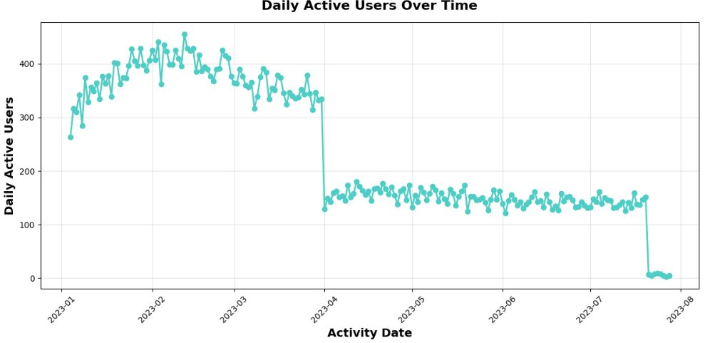
Daily Active User Trend
Key Insight
Post-April 2023 Decline
Our platform's DAU peaked in Q1 2023 and has experienced a steady downward trajectory — signaling a post-launch engagement retraction that requires immediate retention intervention.
Action Required: Deploy targeted re-engagement campaigns before further user attrition occurs.
Notes:
What you are looking at is our Daily Active User count over the course of 2023. You can see we peaked in early Q1, and then we have had a steady, consistent decline ever since.
This is not a blip. This is a structural disengagement trend.
The good news is that we are catching it early enough to act. But the window is closing. Every month we do not intervene, we are losing users who are already familiar with the platform — and those are the hardest users to win back once they leave.

Slide 6
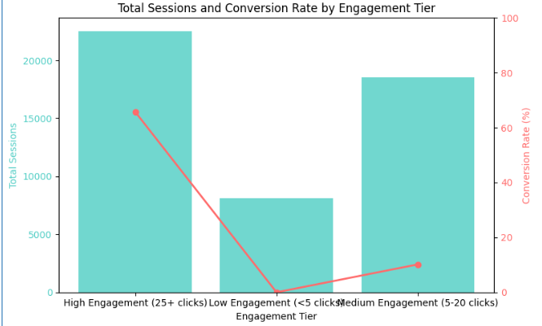
Engagement Level vs. Conversion Rate
65%+
conversion for 25+ click users
The checkout funnel is not broken
High-engagement users convert exceptionally well. The opportunity is to move more users into that 25+ click zone earlier in their journey through smarter personalization.
Notes:
When users are highly engaged — meaning they clock 25 or more page interactions in a session — they convert at over 65%. That is a remarkable conversion rate.
What this tells us is that the checkout experience is not broken. Users who engage deeply do buy. The problem is that most users never reach that level of engagement.
So our opportunity is not to fix the funnel — it is to pull more users into that high-engagement zone earlier in their journey. Through smarter personalisation, better cross-sell triggers, and the right perk at the right moment.
.

Slide 7
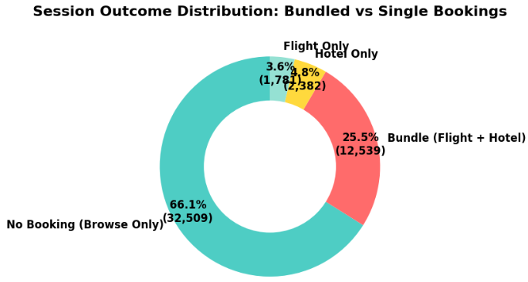
The Flight–Hotel Bundle Revenue Gap
75%
25%
flight-only sessions
bundled bookings
The Untapped Opportunity
Current Gap: 75% of flight bookings have no hotel attached — our largest single revenue leakage point. Revenue Action: Capturing even 10% of un-bundled flight bookers into hotel bundlers represents a significant incremental revenue uplift.
Notes:
[~40 seconds | Flight–Hotel Bundle Gap]
This slide shows our single largest revenue leakage point.
[Point to the 75% stat] Three quarters of all flight-booking sessions have no hotel attached. These users landed on our platform, found a flight, and left without seeing the hotel opportunity.
[Point to 25%] Only 25% of sessions result in a bundle.
Now here is the business implication: if we could convert even 10% of those unbundled flight bookers into hotel bundlers, the incremental revenue would be substantial. That is not a product problem — it is a timing and personalisation problem. We need to surface the hotel offer during the session when the user is already in a booking mindset.

Slide 8
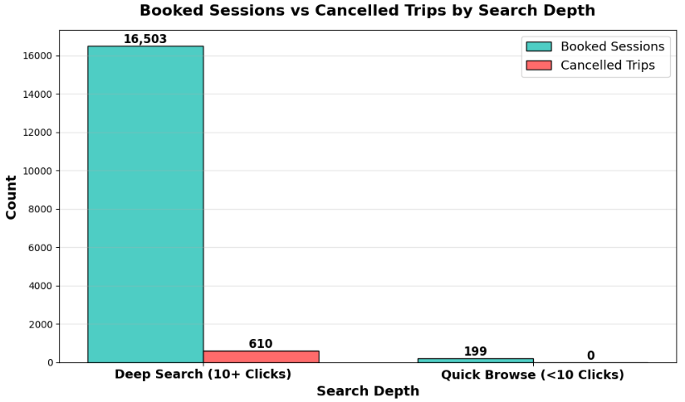
Booked vs. Cancelled Sessions by Search Depth
Intent-Driven Decisions
Cancellations and bookings are both fueled by deep, highly engaged browsing — not impulsive one-click behaviour.
Research Converts
Users who research deeply are your highest-value intent signals. These sessions must trigger personalized cross-sell overlays.
Optimize the Window
Intervene during high-click sessions with targeted hotel and activity bundles to capture users when intent is strongest.
Notes:
This chart looks at search depth — how many searches a user conducts — and correlates it with whether they book or cancel.
The key insight here is that both bookings and cancellations come from deeply engaged, high-search sessions. These are not impulsive users — they are researchers.
when a user is deep in a search journey, that is our highest-value intervention window. That is exactly when a personalised hotel bundle or a discount overlay will have the most impact — because the user's intent is already high.

Slide 9
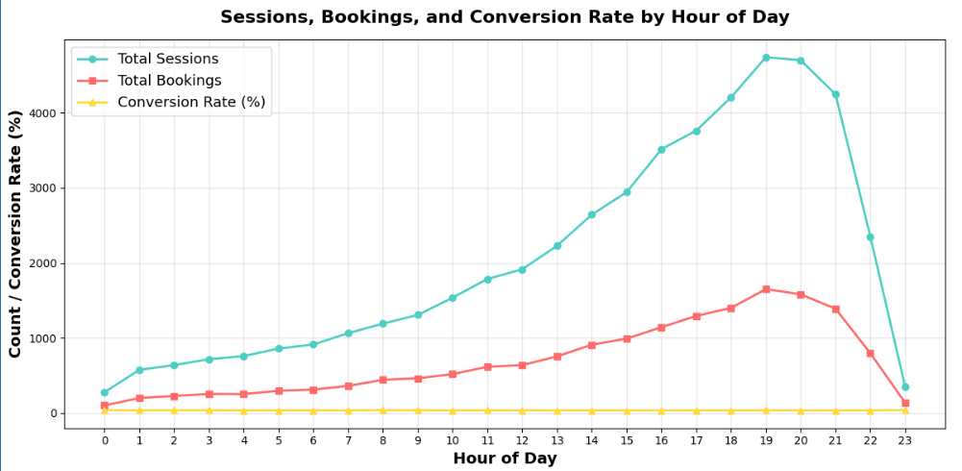
Sessions, Bookings & Revenue by Hour of Day
Peak Window
17:00 – 21:00
Sessions, bookings, and revenue move in high synchrony and climb sharply from 5 PM, peaking in the evening window before dropping overnight.
Marketing Recommendation
Schedule all retention campaigns, push notifications, and cross-sell prompts to fire between 17:00 and 21:00 to maximize total revenue impact.
Notes:
[Point to the peak window] Sessions, bookings, and revenue all converge in a single peak window: 5 PM to 9 PM.
If our marketing team is sending push notifications, running retargeting campaigns, or firing any kind of re-engagement message at 10 AM — we are wasting that spend. The data is clear: users are active, engaged, and ready to book in the evening.
This is a quick win. Simply shifting campaign timing to this window could improve conversion without any additional budget.

Slide 10
02
User Data
Analysis
Understanding who our users are — signup trends, demographics, geography, and age distribution.

Slide 11
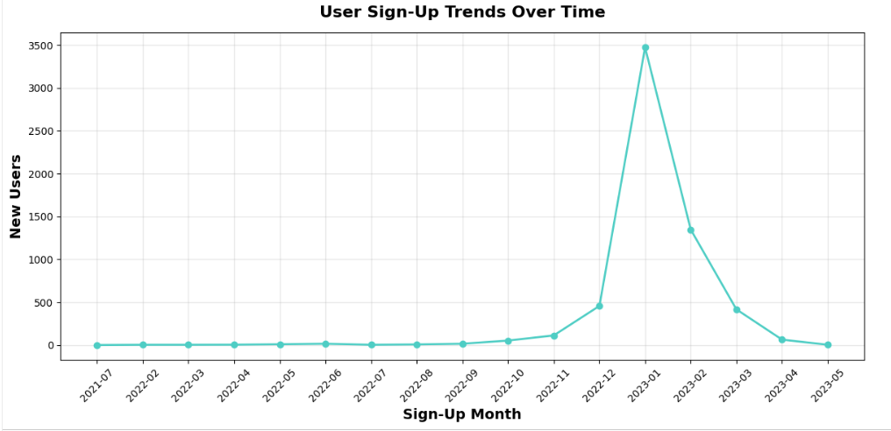
User Sign-Up Trends Over Time
~3,500
new users in January 2023 spike
A dramatic spike in January 2023 — reaching nearly 3,500 new users — sandwiched between near-zero activity from late 2021 through mid-2022.
This cohort, triggered by our Winter Sale Campaign, is our most strategically important user group for re-engagement.
Notes:
This spike is January 2023. In a single month, we onboarded approximately 3,500 new users — sandwiched between very low activity in late 2021 and mid-2022.
This was not organic growth. It was driven by a Winter Sale Campaign. And this cohort is now three years old on the platform.
Why does that matter? Because this group represents our most valuable and most at-risk segment simultaneously. They know the platform, they came in with purchase intent — and if they are drifting, now is the time to win them back before they are gone for good.

Slide 12
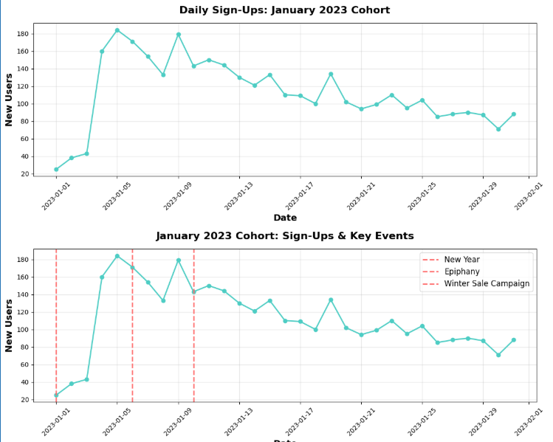
Analysing the January 2023 Cohort
Winter Sale Trigger
Growth was directly triggered by our Winter Sale Campaign (Jan 10) and surrounding holiday travel intent.
Peak Impact
Daily sign-ups spiked from ~20 to 180 per day during the campaign window.
Strategic Priority
Leverage this cohort for targeted cross-sell and retention campaigns before long-term churn accelerates.
Notes:
When we zoom into that January 2023 spike, we can see the mechanics clearly.
[Point to the three insight cards] The Winter Sale Campaign launched on January 10th. Daily signups went from roughly 20 per day to over 180 at peak. That is nearly a 10x multiplier from a single campaign.
This cohort is our anchor audience for everything we are about to recommend. They are a known quantity — we know how they came in, we know their tenure, and we know their behavioural patterns. They are the right group to test retention strategies on.

Slide 13
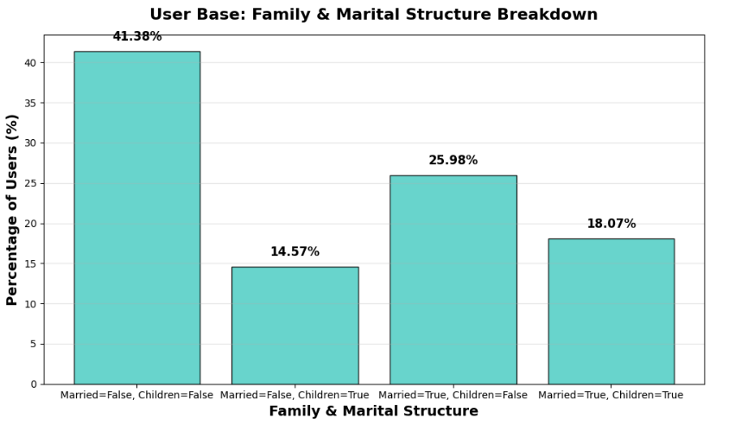
User Base: Family & Marital Structure
67%
33%
no children
with children
Platform Profile
Our platform is heavily favored by independent travelers, couples, and young professionals rather than family planners.
This means current product features, pricing, and marketing channels are optimized for solo/couple travel — a strength to double down on.
Notes:
[Point to the 67% stat] Two thirds of our users do not have children. Our platform skews strongly toward independent travellers and couples.
This is not a problem — it is a positioning insight. It tells us where our product already resonates and where we should double down. It also tells us that family-oriented perks — like hotel add-ons for kids — may not move the needle for the majority of our base.
Conversely, for the 33% who do have children, the family perk is likely a high-relevance offer.

Slide 14
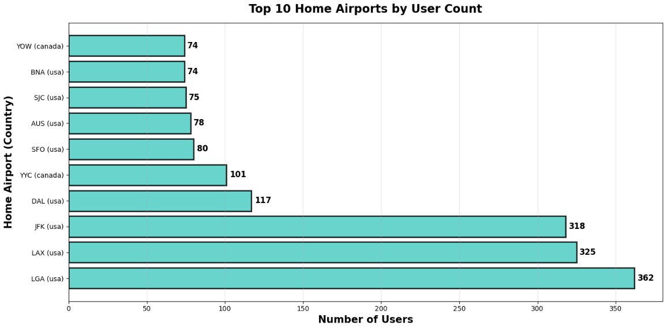
Top Home Airports by User Count
Geo-Targeting Priority
LGA
LaGuardia, New York
JFK
JFK, New York
LAX
Los Angeles
Hyper-localize digital campaigns to these three hubs to maximize Return on Ad Spend (ROAS).
Notes:
[~25 seconds | Top Home Airports]
Geography matters for campaign targeting.
[Point to LGA, JFK, LAX] Our top three home airports are LaGuardia, JFK, and LAX — all major US hubs. This tells us where to concentrate geo-targeted digital advertising to get the highest Return on Ad Spend.
Rather than a broad national campaign, we can hyper-localise to New York and Los Angeles and reach the bulk of our highest-value users at a fraction of the cost.

Slide 15
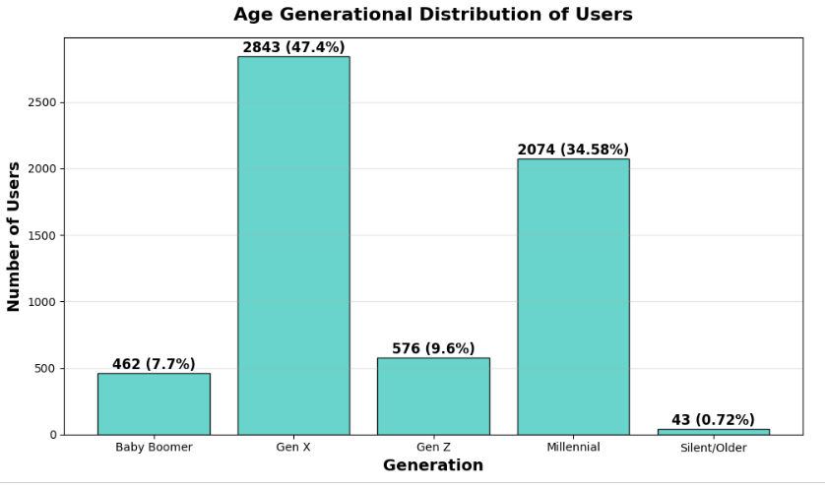
Age-Concentrated Distribution of Users
Demographic Gap
Working-age adults & families are well-represented.
We are significantly underleveraged with:
Older retirees (60+)
Gen Z budget travelers (18–24)
Product and marketing adaptation is required to capture these high-growth demographics before competitors do.
Notes:
[~25 seconds | Age Distribution]
Our platform is well-indexed against working-age adults — the 25-to-55 range.
[Point to the demographic gap box] But we are significantly underleveraged at both ends. Retirees aged 60 and over have high disposable income and flexible travel schedules — a natural fit for a travel platform. And Gen Z travellers aged 18 to 24 are the next decade of travel spend.
If we do not build relevance with these groups now, a competitor will.

Slide 16
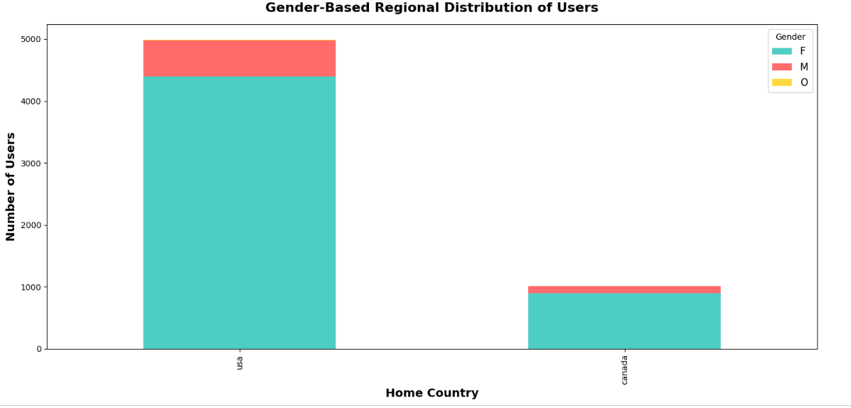
Gender-Based Regional Distribution of Users
85–90%
of US users are female
USA is our primary market, where female users represent ~85–90% of the entire customer base. We are capturing almost no traction with male or alternative gender demographics.
Opportunity: Launch male-targeted campaigns around business travel, sports travel, and adventure tourism to diversify the user base.
Notes:
] In the United States — our primary market — 85 to 90 percent of our users identify as female.
This is a strong signal that our current product design, marketing voice, and campaign creative are resonating with women. That is a strength. But it also means we have an almost entirely untapped male audience.
Business travel, sports travel, adventure tourism — these are high-spend categories that skew male. There is a meaningful diversification opportunity here.

Slide 17
03
Customer
Segmentation
Traditional RFM scoring approach — how Recency, Frequency, and Monetary scores were constructed and applied.

Slide 18
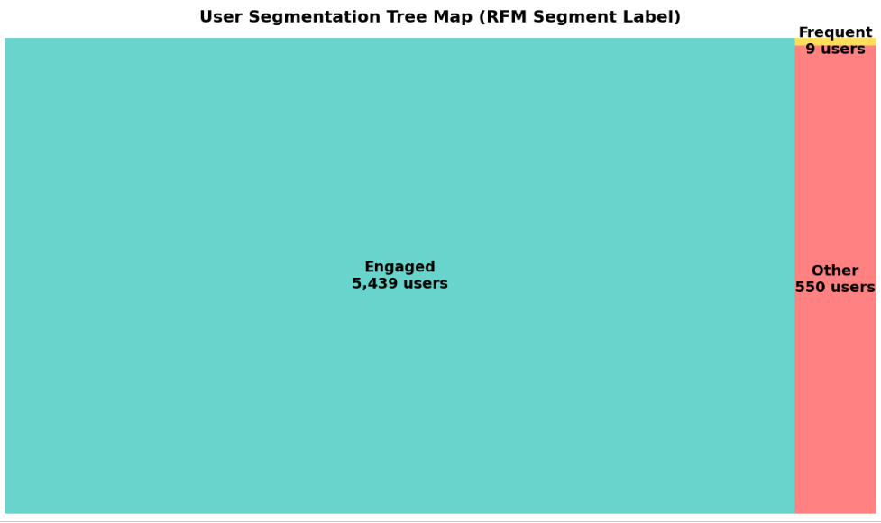
Traditional RFM Approach & Segmentation Rules
R
User Segmentation Tree Map
Recency
Days since sign-up date
< 90 days → New | 90–365 → Regular | 365+ → Loyal
F
Frequency
Total number of sessions created
< 5 sessions → Low | 5–20 → Medium | 20+ → High
M
Monetary
Avg flight fare + avg hotel spend
< $200 → Low | $200–800 → Medium | $800+ → High
RFM Score: R + F + M scores summed → grouped into segments: New | Engaged | Frequent using hardcoded thresholds
Notes:
We used a classic RFM framework — three dimensions.
[Point to R] Recency measures how long a user has been on the platform, using days since sign-up as a proxy for platform tenure.
[Point to F] Frequency counts the total number of sessions. This tells us how actively a user engages.
[Point to M] Monetary combines average flight fare and average hotel spend to estimate financial value.
Each user receives a score on all three dimensions, and those scores are summed and thresholded to place users into one of three segments.
[Point to treemap] And this treemap on the right shows the result. The vast majority of our cohort — over 5,400 users — fall into the Engaged segment. A small group of 9 are Frequent, and around 550 are in the Other category.
This distribution makes intuitive sense: our January 2023 cohort is a relatively homogeneous group in terms of tenure, which compresses the RFM spread.

Slide 19
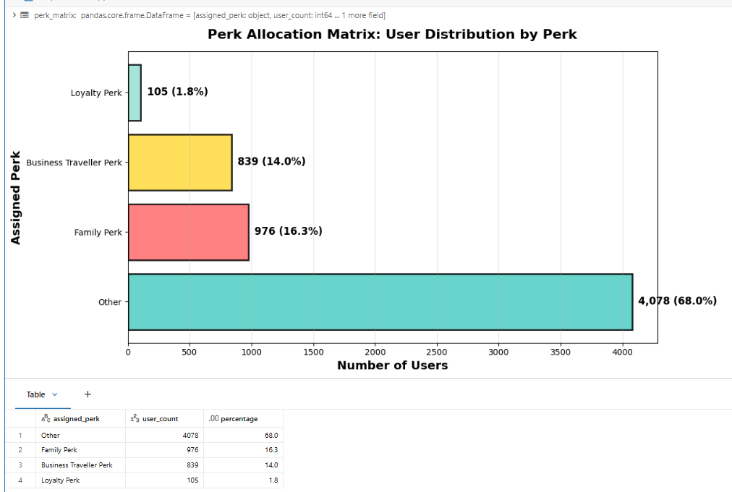
Recommended Perks by Segment & Rationale
New Users
Onboarding discount (10% off first booking)
Lower the first-booking barrier and accelerate time-to-conversion.
Engaged Users
Hotel upgrade vouchers
Increase per-booking value and encourage flight+hotel bundling.
Frequent Users
Priority boarding + early check-in
Reward loyalty and reinforce platform stickiness for high-frequency bookers.
Other / At-Risk
Cashback on next booking
Re-activate dormant users with an immediate financial incentive.
Notes:
[~40 seconds | Perk Recommendations]
Based on the segmentation, we mapped each user type to the perk most likely to resonate with their behaviour.
[Walk through each row briefly]
New users get an onboarding discount — lower the first booking barrier and get them transacting quickly.
Engaged users get hotel upgrade vouchers — they are already booking, so the goal is to increase the value of each booking.
Frequent users get priority boarding and early check-in — these are recognition rewards that reinforce their loyalty.
At-risk or Other users get cashback on their next booking — an immediate financial incentive to re-activate.
The logic is simple: match the incentive to where the user is in their journey.

Slide 20
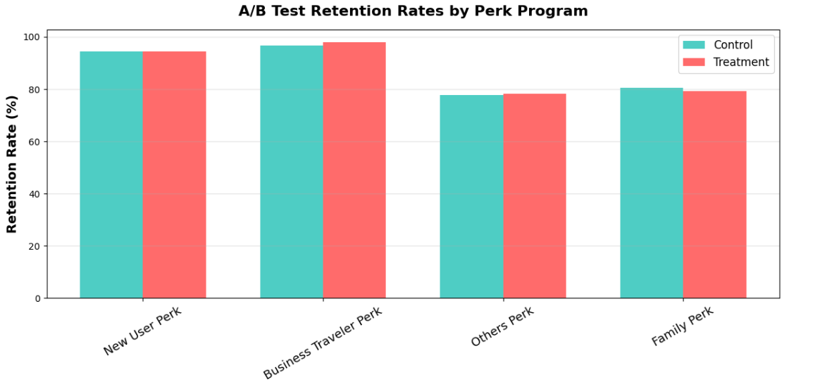
Data-Driven A/B Testing: Validating Perk Impact
Test Design
Control: No perk assigned Treatment: Segment-matched perk assigned KPI: 90-day retention rate
Result: Neutral Signal
Control and treatment retention rates are closely matched across all four perk types — indicating the perk design, not the segmentation, is the variable to optimize next.
Notes:
[~45 seconds | A/B Testing — the honest results slide, own it]
Now I want to be transparent with you about what the data actually showed.
We ran a controlled experiment. Control group received no perk. Treatment group received their segment-matched perk. We tracked 90-day retention as our primary KPI.
[Point to the chart] The result was neutral. Control and treatment retention rates were nearly identical across all four perk types.
I want to be clear about what that means and what it does not mean. It does not mean the segmentation was wrong. It means the perks themselves — the specific incentives we tested — were not compelling enough to change behaviour.
The segmentation framework is sound. The incentive design is the variable we need to optimise next. And we now have a clean baseline to improve from.

Slide 21
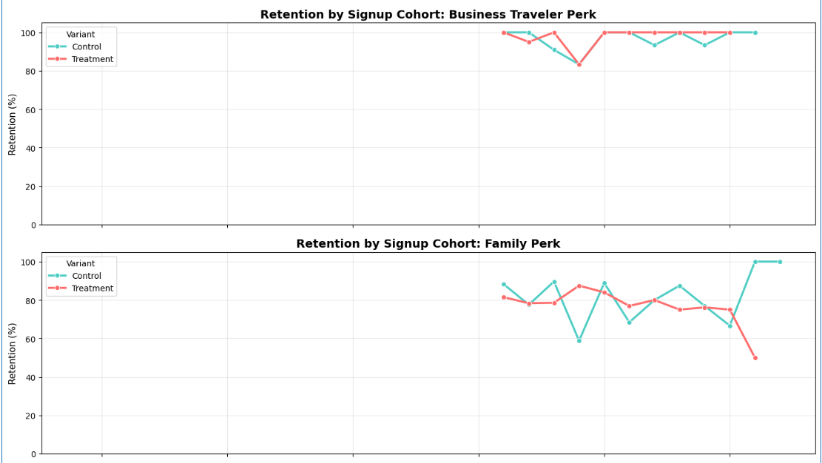
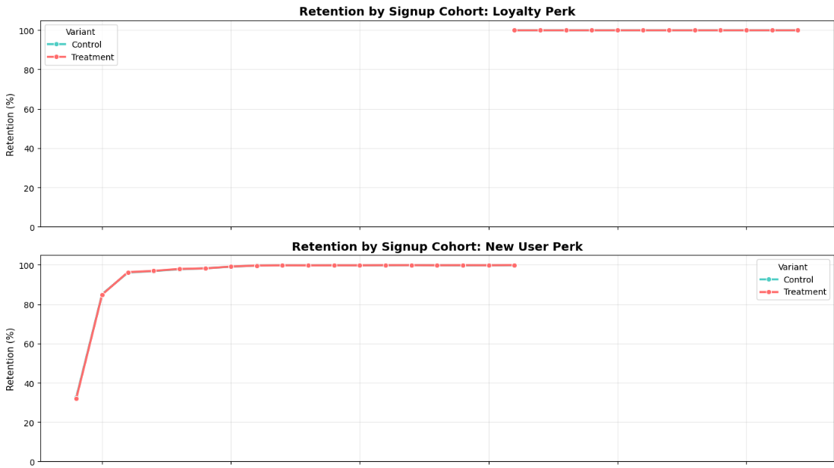
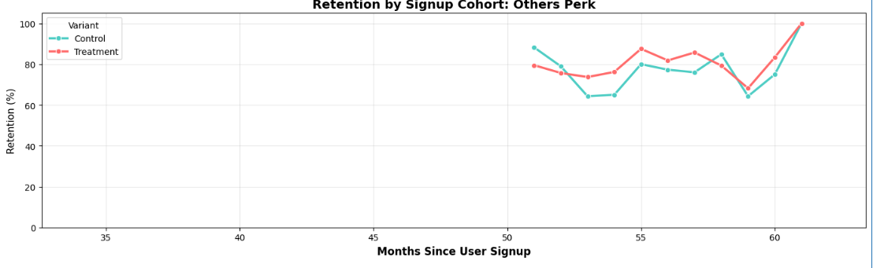
Did the Perks Program Drive Retention?
Retention by Signup Cohort (All Perks)
Retention by Signup Cohort (Perk Types)
Monthly Retention Trend
Monitoring Interpretation
If perks worked, we would expect the treatment cohort's retention line to sit consistently above the control line over 3–6 months. Current data shows the lines are closely intertwined — confirming the neutral A/B result. The segmentation framework is sound; the incentive design is the next lever to optimize.
Notes:
[~35 seconds | Monitoring Dashboard]
This slide shows how we monitored the results over time.
[Point to the three charts] We tracked monthly retention across three views: by cohort overall, by perk type, and as a monthly trend.
[Point to the interpretation box] If the perks had worked, we would expect the treatment cohort's retention line to sit consistently above the control line over three to six months. What we see instead is that the lines are tightly interwoven — which confirms the neutral A/B result.
The monitoring infrastructure is in place. When we redesign the perks — which I will recommend in a moment — we have the measurement framework ready to detect a real signal.

Slide 22
Key Takeaways
65%+
75%
17–21h
High-engagement conversion
Flight-only booking gap
Peak engagement window
Users with 25+ clicks per session convert at over 65%. Personalization must move users into this zone faster.
75% of flight bookings have no hotel attached — our single largest revenue leakage and cross-sell opportunity.
Sessions, bookings, and revenue all peak sharply in the evening. All campaigns should fire in this window.
RFM ✓
3,500
Segmentation validated
Jan 2023 anchor cohort
Segments are correct. The neutral A/B result tells us incentive design — not segmentation — is the next lever.
High-value users acquired in the Winter Sale campaign. Deploy re-engagement before churn accelerates.
Notes:
[~35 seconds | Key Takeaways — let each card land, do not rush]
Before I go to recommendations, let me give you the five numbers that summarise everything we found.
[Point to each card as you speak]
65% conversion for users with 25 or more clicks — the funnel works when users are engaged.
75% of flight sessions have no hotel attached — that is our biggest revenue gap.
17 to 21 hundred hours is the peak engagement window — all campaigns should fire here.
RFM segmentation is validated — the method is right, the perks need redesigning.
And 3,500 users from January 2023 are our anchor cohort — they need attention now.

Slide 23
Strategic Recommendations: Driving the Next Rollout
01
Target Low-Ceiling Segments
Prioritize the Family and budget-conscious traveler segments where baseline retention is lowest. These segments have the most headroom for uplift and will show the clearest signal in future perk tests.
02
Redesign the Perk Value Proposition
Current perks showed neutral retention effect — incentives didn't compel behavioral change. Test high-impact alternatives: instant cashback on next booking, free hotel upgrade vouchers, or priority boarding. Validate through user interviews first.
03
Fix the Experimentation Window
Current measurement uses historical signup dates (3–5 years back) as the baseline, which dilutes the perk signal. Restructure the next A/B test to measure from Day 0 of perk delivery for a clean, actionable signal.
Notes:
[~50 seconds | Strategic Recommendations — the most important slide]
So where do we go from here? Three recommendations.
[Point to 01] First — target the low-ceiling segments. The Family segment and budget-conscious travellers have the lowest baseline retention, which means they have the most room for improvement. These are the segments where a well-designed perk will show the clearest, most measurable uplift.
[Point to 02] Second — redesign the perk value proposition. Our current perks — small discounts, upgrade vouchers — did not move the needle. We need to test higher-impact incentives: instant cashback on the next booking, a free hotel night, or priority boarding. Before we run another A/B test, I would recommend short qualitative interviews with 10 to 15 users from each segment to understand what would actually change their behaviour.
[Point to 03] Third — fix the measurement window. Our current A/B test measured retention from historical sign-up dates, which in some cases go back three to five years. That baseline dilutes the perk signal entirely. The next test must measure from Day Zero of perk delivery — the day the user receives the incentive — so we can isolate its direct effect.
These three changes together will give us a clean, credible test in the next round.

Slide 24
Thank You
Questions & Discussion
TravelTide Analytics Project
Customer Behavioral Segmentation & Retention Strategy
Sonali Biswas | Business Analyst | MSIT Program | June 2026
Notes:
[~20 seconds | Closing — be warm, invite questions]
That is the full picture.
We started with raw behavioural data, built a segmentation model, tested a perk strategy, and came back with honest results and a clear path forward.
The infrastructure is built. The framework is validated. The next step is redesigning the incentives and running a cleaner experiment.
I am happy to go deeper on any of these areas — the methodology, the data, or the recommendations. Thank you.

