Slide 1


Slide 2
AGENDA:
OBJECTIVE
VISUALISATION AND INSIGHTS
INFERENCES
APPENDIX:
DATA ATTRIBUTES
DATA METHODOLOGY

Slide 3
OBJECTIVE
For the past few months, Airbnb has seen a major decline in revenue. Now that the restrictions have started lifting and people have started to travel more, Airbnb wants to make sure that it is fully prepared for this change.

Slide 4

DATA VISUALIZATION AND INSIGHTS

Slide 5
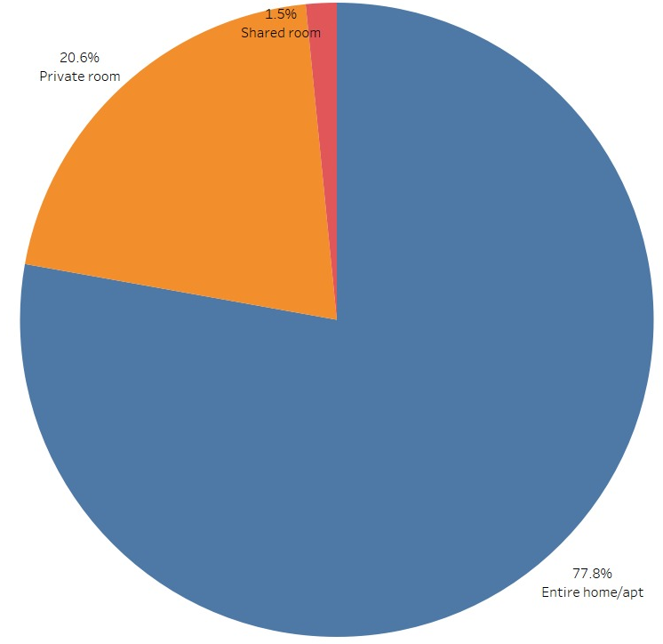
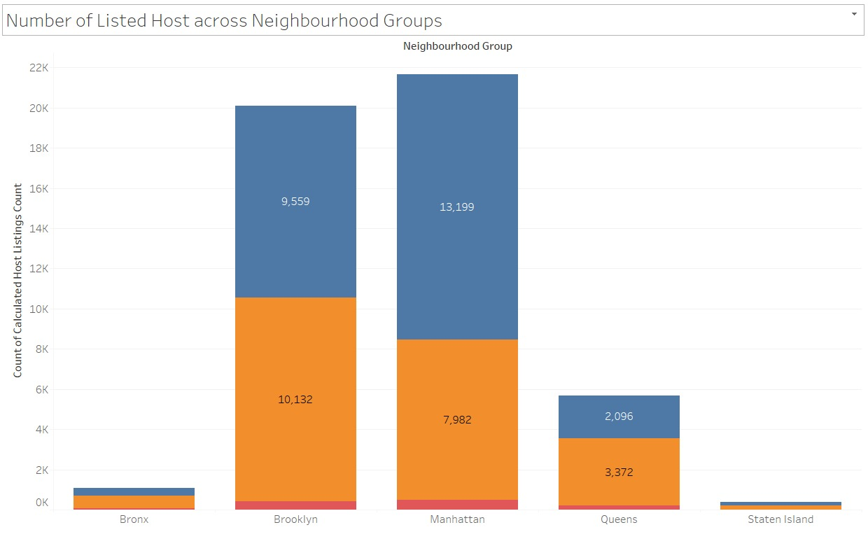
HOST LISTING DISTRIBUTION
About 78% of the properties listed are Entire Homes/Apartments.
This stacked bar plot shows that across neighbourhood groups the highest number of hosts are listed in Manhatten and Brooklyn and the minimum number of listings are in Staten Island.

Slide 6
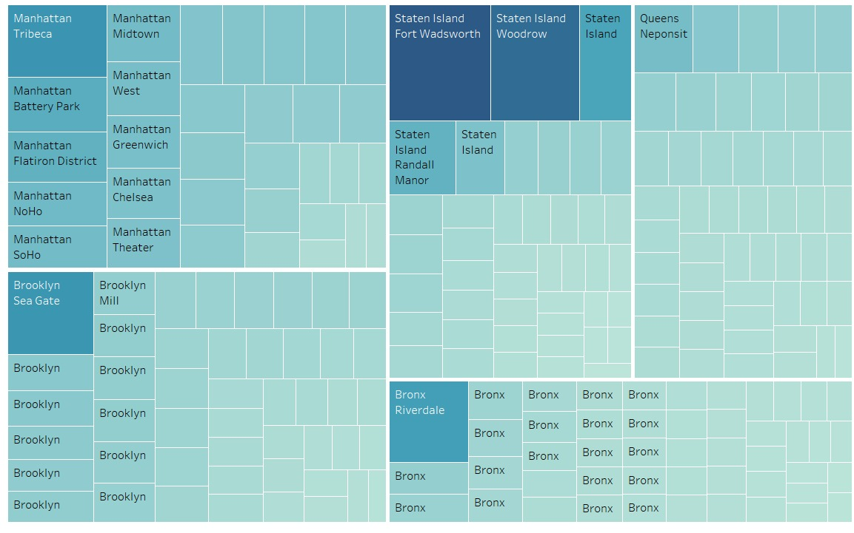
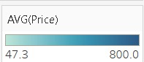
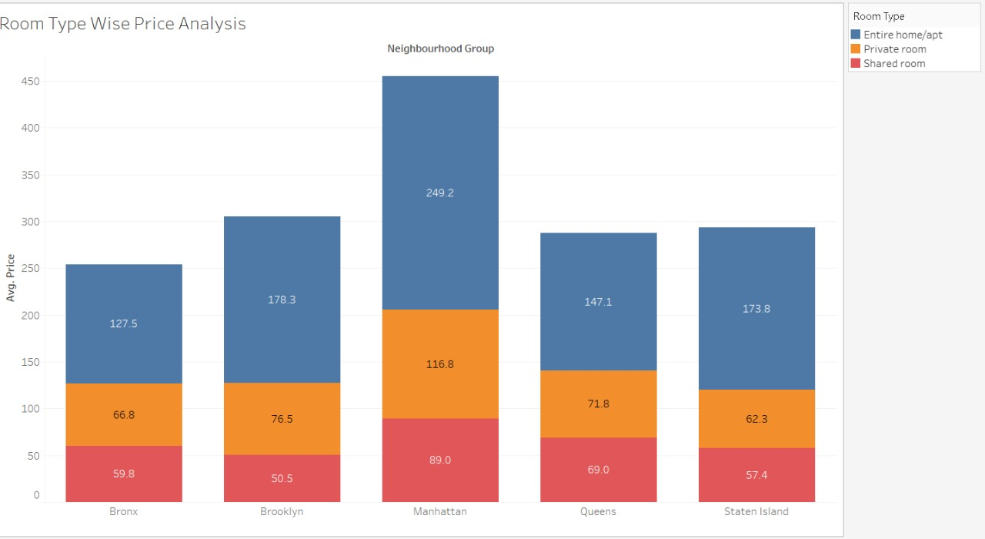
PRICE DISTRIBUTION ANALYSIS ACROSS NEIGHBOURHOODS
Visualising neighbourhood groups against average price(capped) shows that:
Fort Wadsworth and Woodrow in Staten Island have the highest average price shown by the dark blue boxes in the heat map although Staten Island has the lowest median price of 105.
Most of the localities in all the neighbourhood groups have moderate average price.
Manhatten and Brooklyn have higher median prices compared to other neighbourhoods.

Slide 7
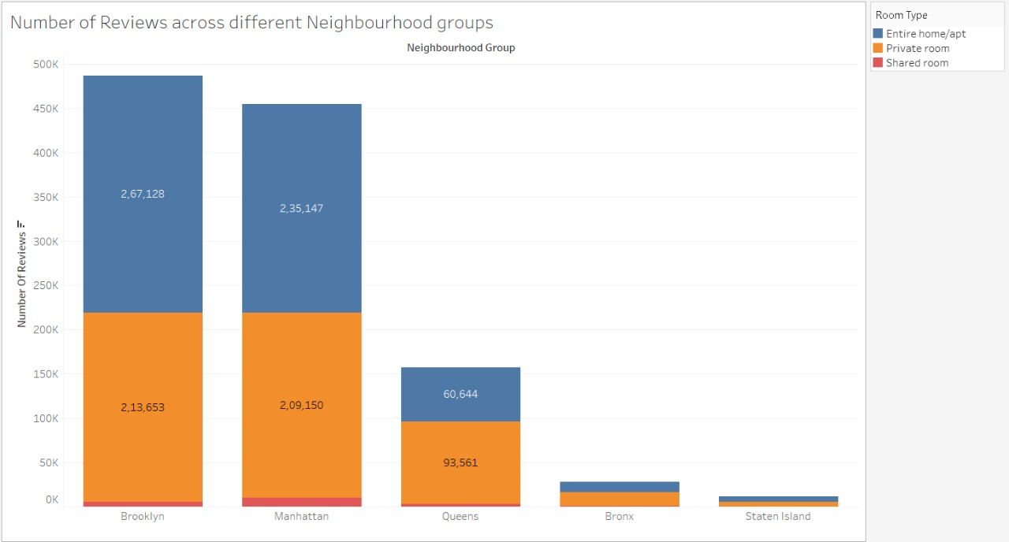
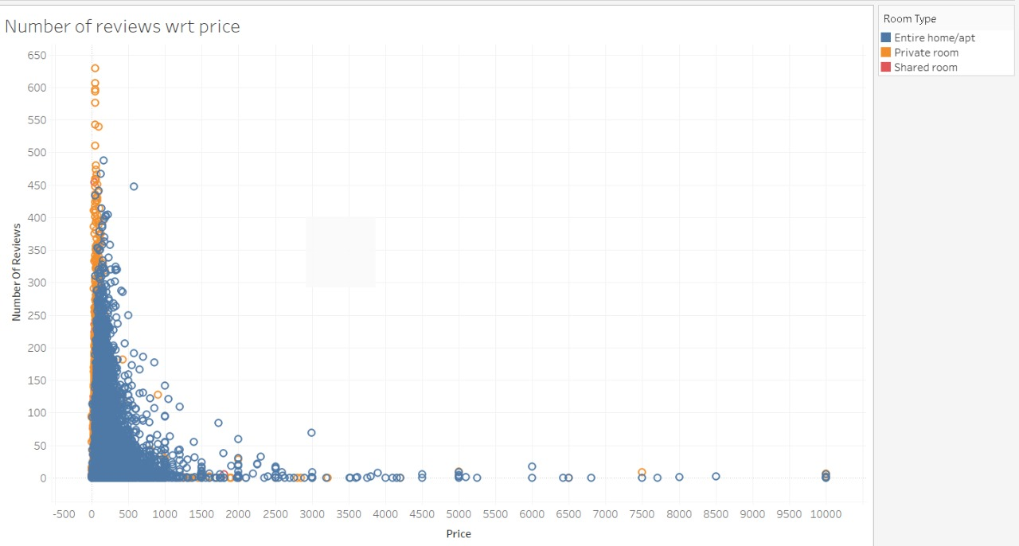
POPULARITY INSIGHTS
Brooklyn and Manhattan have the highest number of reviews.
The reviews are evenly distributed between Entire Home and Private Room.
In the scatter plot we can see that the number of reviews are highest in the low price bin that is 0-500, followed by the mid-price bin 500-100 and then scarce for high priced bin.
DATA ASSUMPTION: Popularity has been measured by the number of reviews attribute.

Slide 8
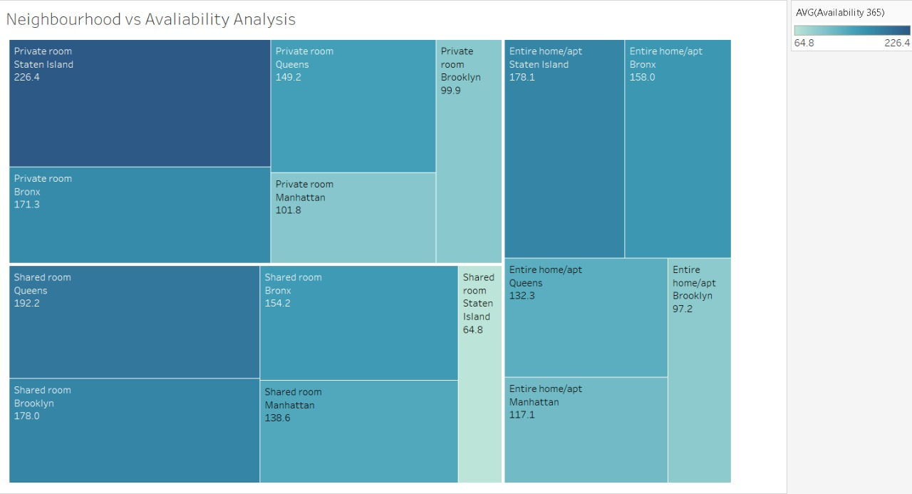
PROPERTY AVALIABILITY ANALYSIS
Staten Island has the highest average availability that is 199.68 followed by Bronx at 165.76.
In Staten Island Private Rooms have an average availability of 226.4 and the average availability of Entire Homes is 178.1.
Shared Rooms have the highest average avaliability across all neighbourhood groups.

Slide 9
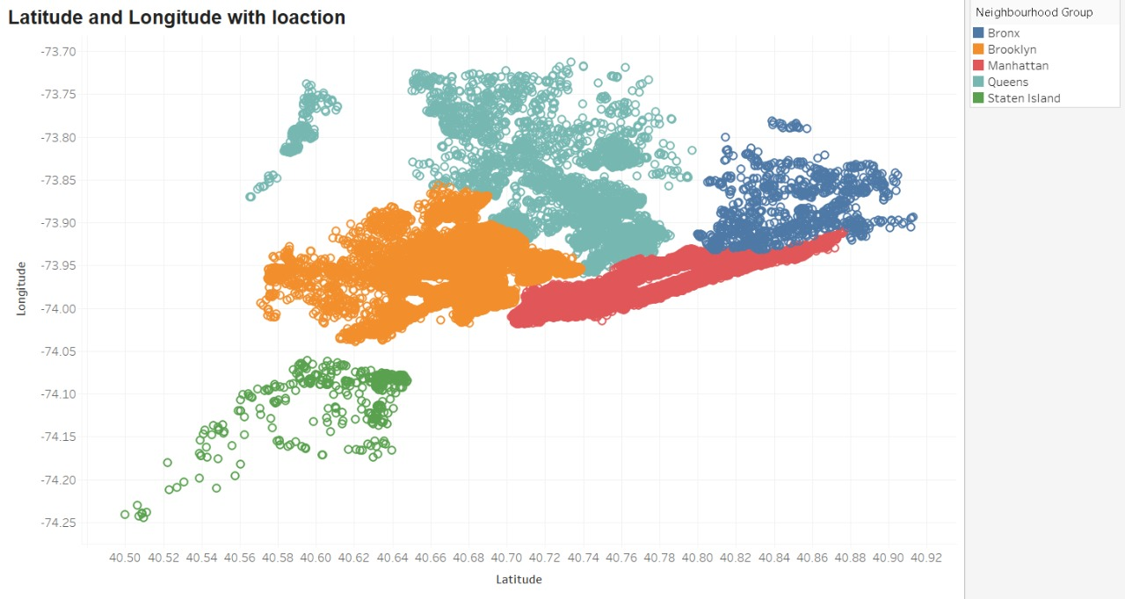
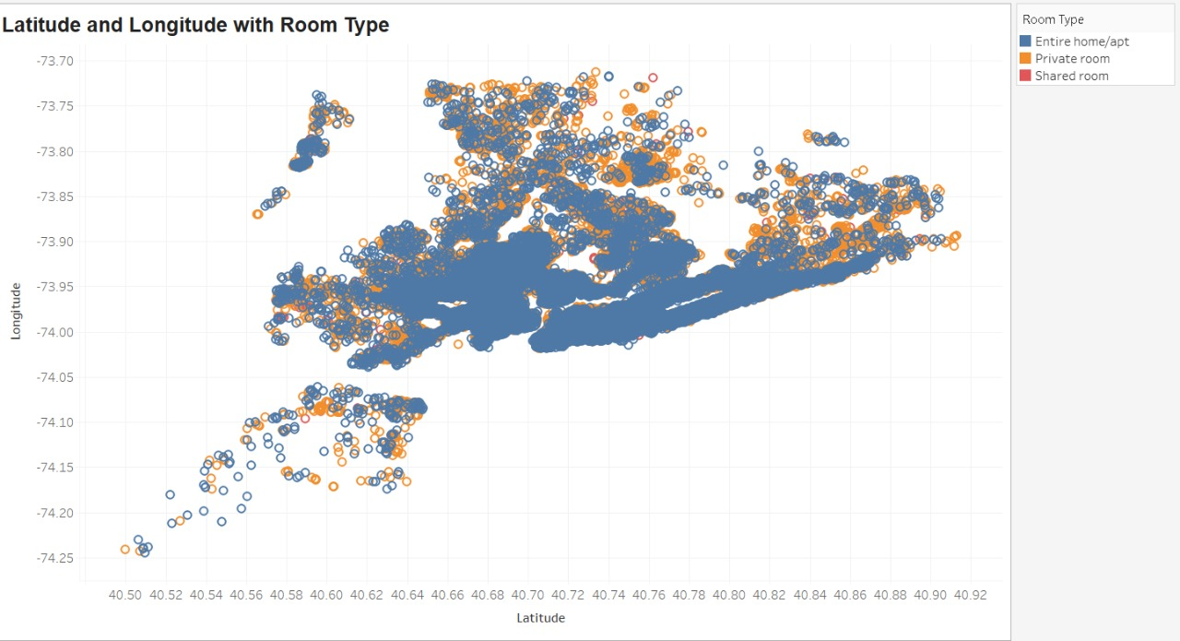
LOCATION WISE ANALYSIS
Plotting the Lattitude and Longitude of all the listed hots on the scatterplot shows that:
A high density of properties are listed in the high price areas like Manhatten and Brooklyn.
Staten Island has a very low density of properties listed.
Th density of Entire Homes is much higher as compared to Private Rooms which is almost as popular.

Slide 10

INFERENCES

Slide 11
Private Rooms are almost as popular as Entire homes but only 20% of the total listed properties are Private Rooms.
Private Rooms also have a lower average price as compared to Entire Homes.
Price wise Manhatten and Brooklyn have the highest price, and also the highest number of host listings.
Staten Island has a lower average price compared to Manhatten and Brooklyn, but a very low number of host listings.
Private Rooms in Staten Island have the highest availability.
The customers can be divided into 3 groups on the basis of price of property they prefer, the low price customers from 0-500 most customers fall into this group, the mid price customers 500-1000 a density of customers in this group is much lower, and the last group is high price customers 1000< these are very few in number.
According to the analysis Staten Island is the most under used neighbourhood with the lowest number of host listed, marketing it to the low to mid price level customers and getting more private rooms and entire homes listed on the Island can lead to an increase in revenue.

Slide 12

METHODOLOGY

Slide 13
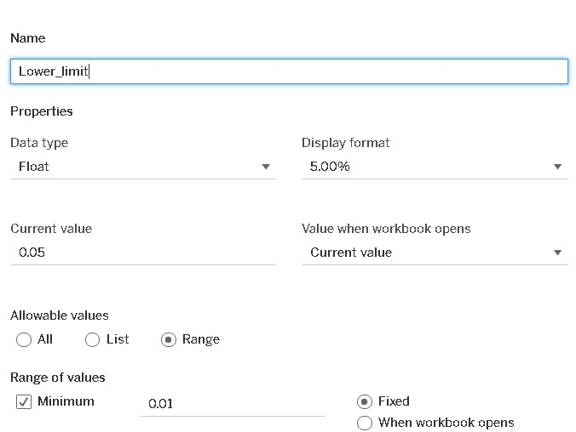
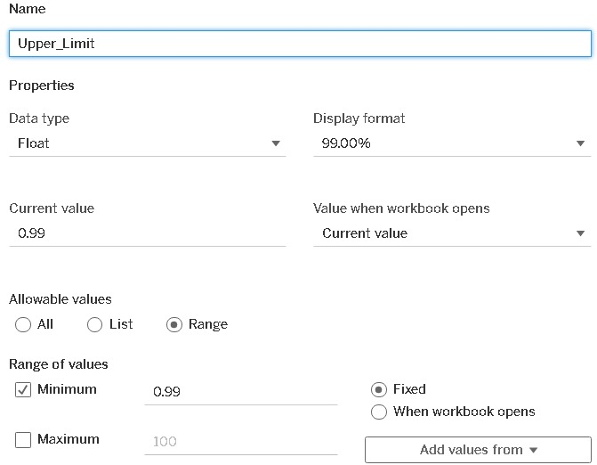
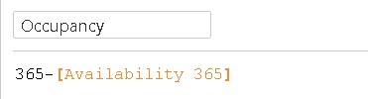
DATA WRANGLING AND ANALYSIS:
Read and understood the data by using python.
The data had 48895 rows and 16 attributes.
Changed the data type of ‘last_review’ column to date time using pandas.
Checked and imputed the missing values in ‘reviews_per_month’ and ‘last_review’ columns.
Capped the outliers in ‘price’ and ‘minimum-nights’ columns using Parameters ‘Lower limit’ and ‘Upper limit’ in tableau.
Created a column called ‘Occupancy’ to using the formula :

