Slide 1

Airbnb Case study
Made by:
Sonali Joseph
Bhargav Kale

Slide 2

AGENda
Objective
Key Findings
Inferences
Appendix:
Methodology

Slide 3

OBJECTIVE:
For the past few months, Airbnb has seen a major decline in revenue. Now that the restrictions have started lifting and people have started to travel more, Airbnb wants to make sure that it is fully prepared for this change. So, analysis has been done on a dataset consisting of various Airbnb listings in New York.

Slide 4



Visualization
INFERENCES
By visualizing the data , we got some insights by analysing various attributes such room distribution , neighbourhood , availability , and number of reviews etc.
The recommendations have been given based on the insights gave from analyzing the data.

Slide 5
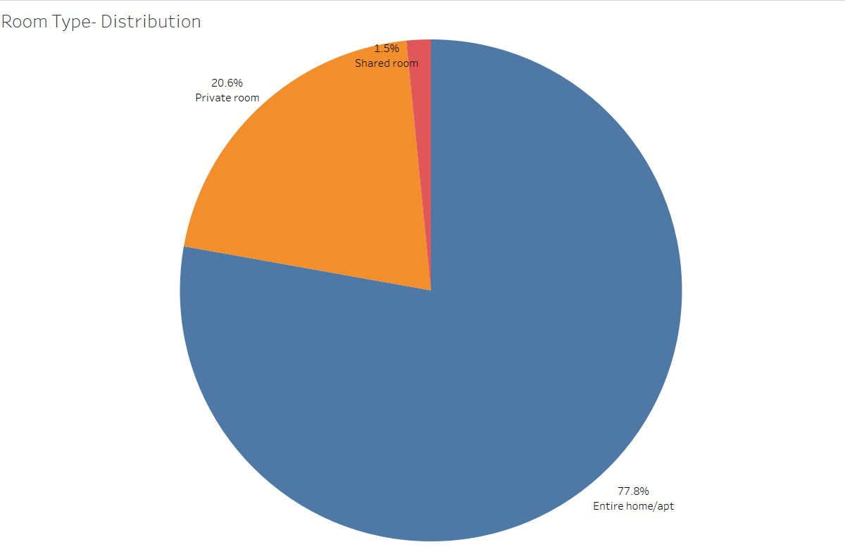
HOST LISTINgs FOR Different room type
Most of the host listing are for Entire homes, about 78% and only 21% for Private Rooms and 1.5% for Shared Rooms.

Slide 6
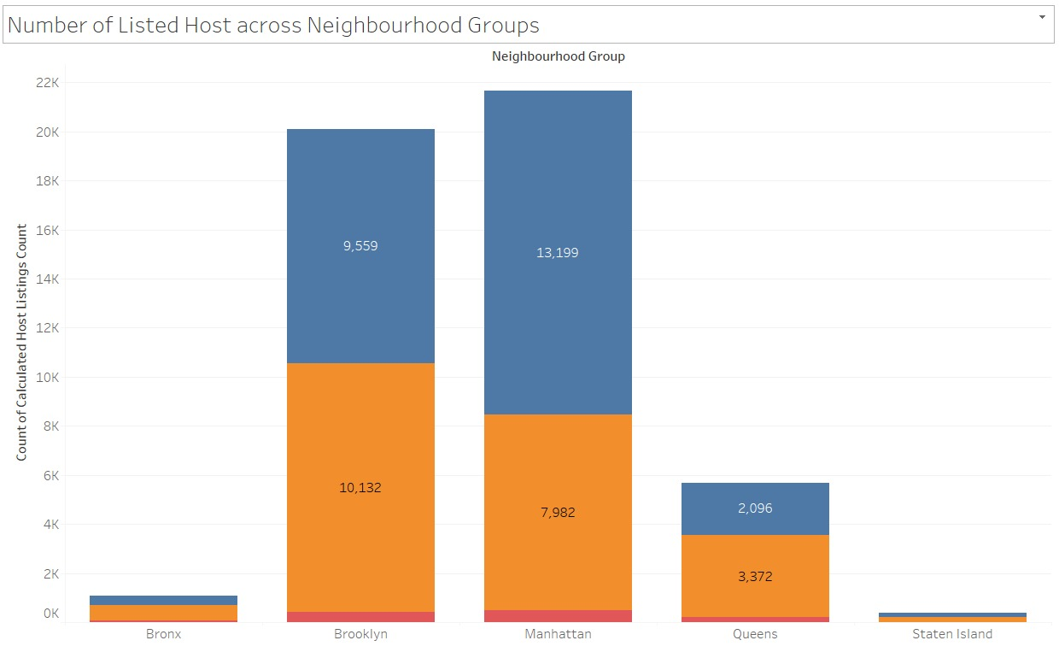
Neighbourhood popularity insights
Brooklyn and Manhatten are the most popular among customers and also have the highest number of host listings.
The popularity of Entire Homes and Private Rooms is the same but listings are higher for Entire Homes.
Bronx and Staten Island have the lowest listings.

Slide 7
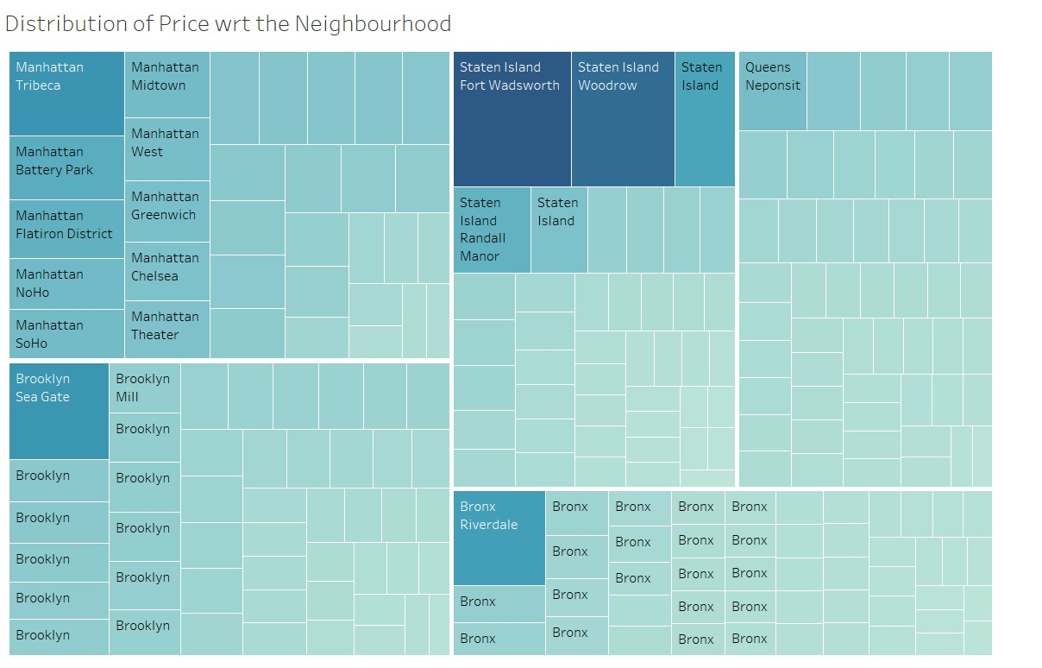
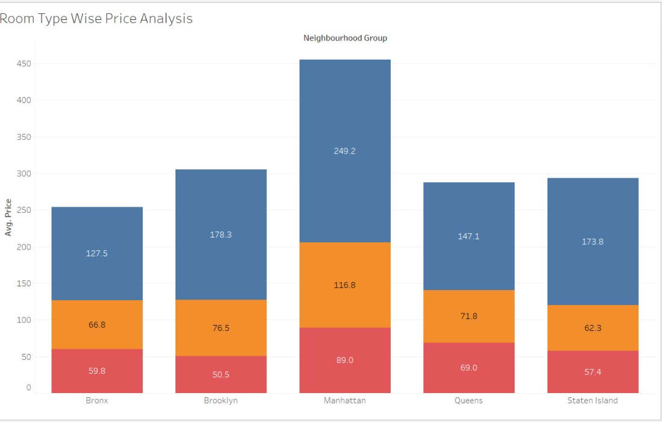
Cost insights
Manhatten and Brooklyn have the highest average price across neighbourhood groups but Fort Wadsworth and Woodrow in Staten Island have the highest average price as per the locality.

Slide 8
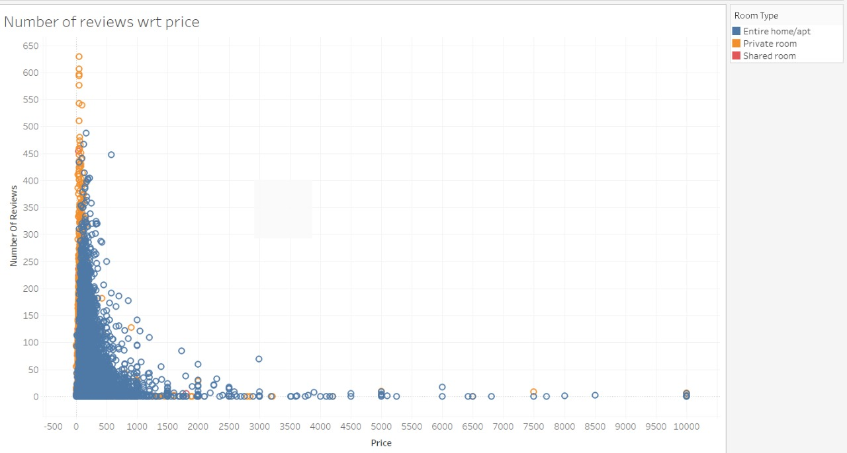
CUSTOMER Groups
The customers can be grouped into three groups , the low price group between 0-500 most of the customers fall into this group, followed by the mid price group 500-100 and then scarce for high price group.

Slide 9
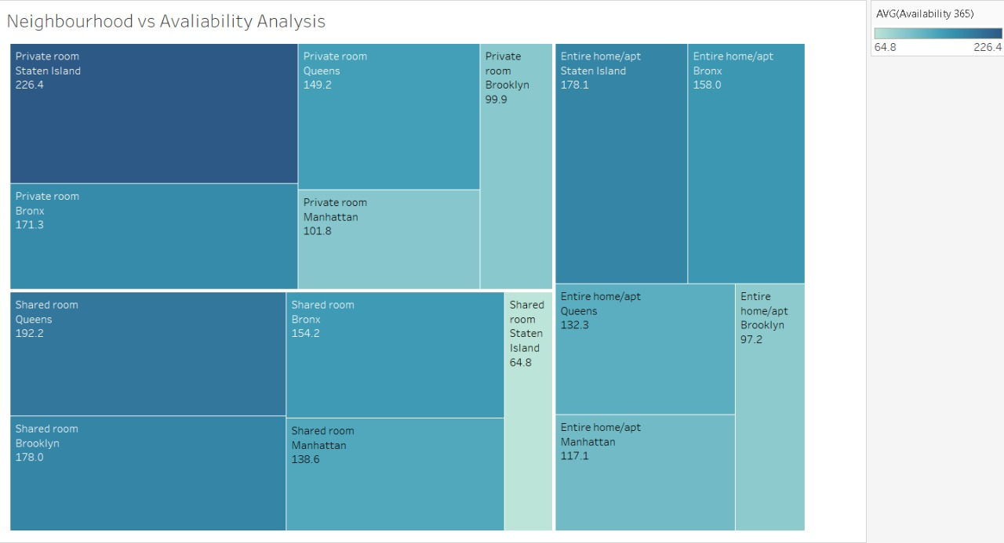
AVALIABILITY INSIGHTS
Private Rooms are available for most days.
Staten Island have some of the most available properties.

Slide 10
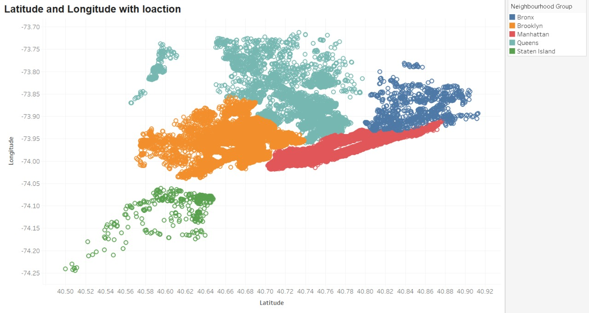
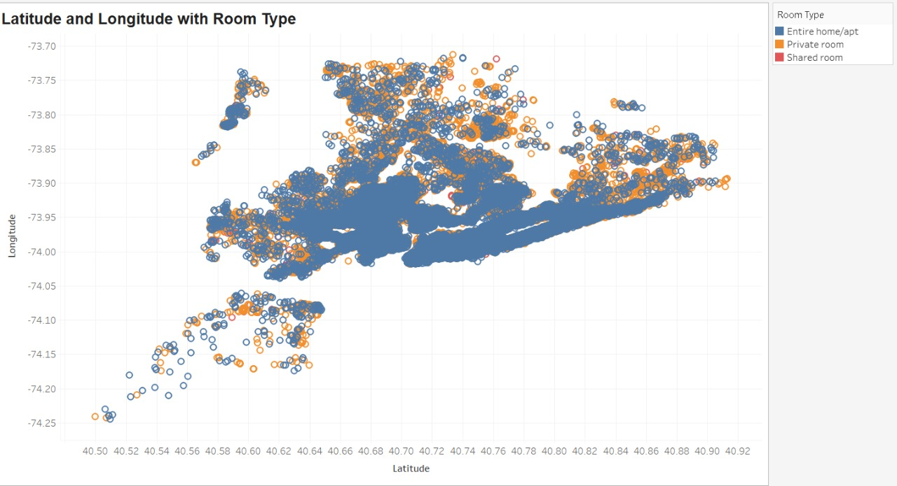
LOCATION WISE DISTRIBUTION OF PROPERTIES ACROSS NY
Most of the properties are located in the mainland area of New York that is Manhatten, Brooklyn, Queens. Staten Island has a very few number of listed properties.
Most of the listed properties are Entire homes.

Slide 11

INFERENCES
We saw that people like to visit the center of New York from where they can see the beauty of the city.
Number of listings of shared rooms are limited but their average price is placed less and availability is high.
Number of reviews and reviews per month are more at less price than the higher price as there is less chance of people going for a high price room.
Manhattan and Brooklyn are very costly neighnourhood groups.

Slide 12
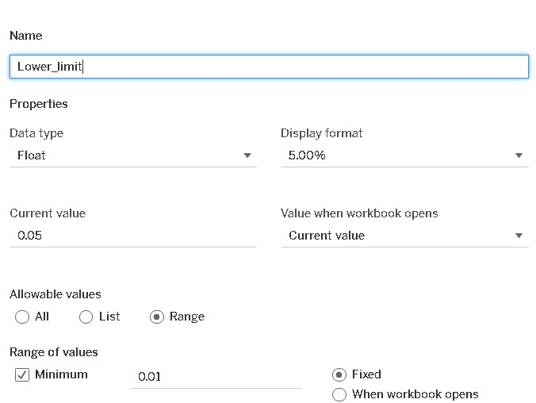
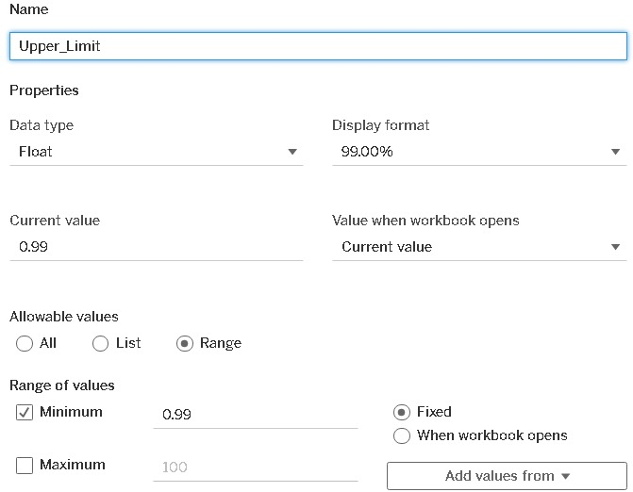
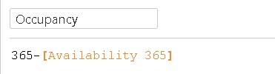
METHODOLOGY
Read and understood the data by using python.
The data had 48895 rows and 16 attributes.
Changed the data type of ‘last_review’ column to date time using pandas.
Checked and imputed the missing values in ‘reviews_per_month’ and ‘last_review’ columns.
Capped the outliers in ‘price’ and ‘minimum-nights’ columns using Parameters ‘Lower limit’ and ‘Upper limit’ in tableau.
Created a column called ‘Occupancy’ to using the formula :

