Slide 1
AdTech Insight Report
Automated Analysis Report
December 03, 2025

Slide 2
Executive Summary
📊 Key Findings:
• Dataset contains 1000 records across 18 dimensions
• Total Impressions: 50,326,622.00
• Average Impressions: 50,326.62
• Calculated 6 derived metrics

Slide 3
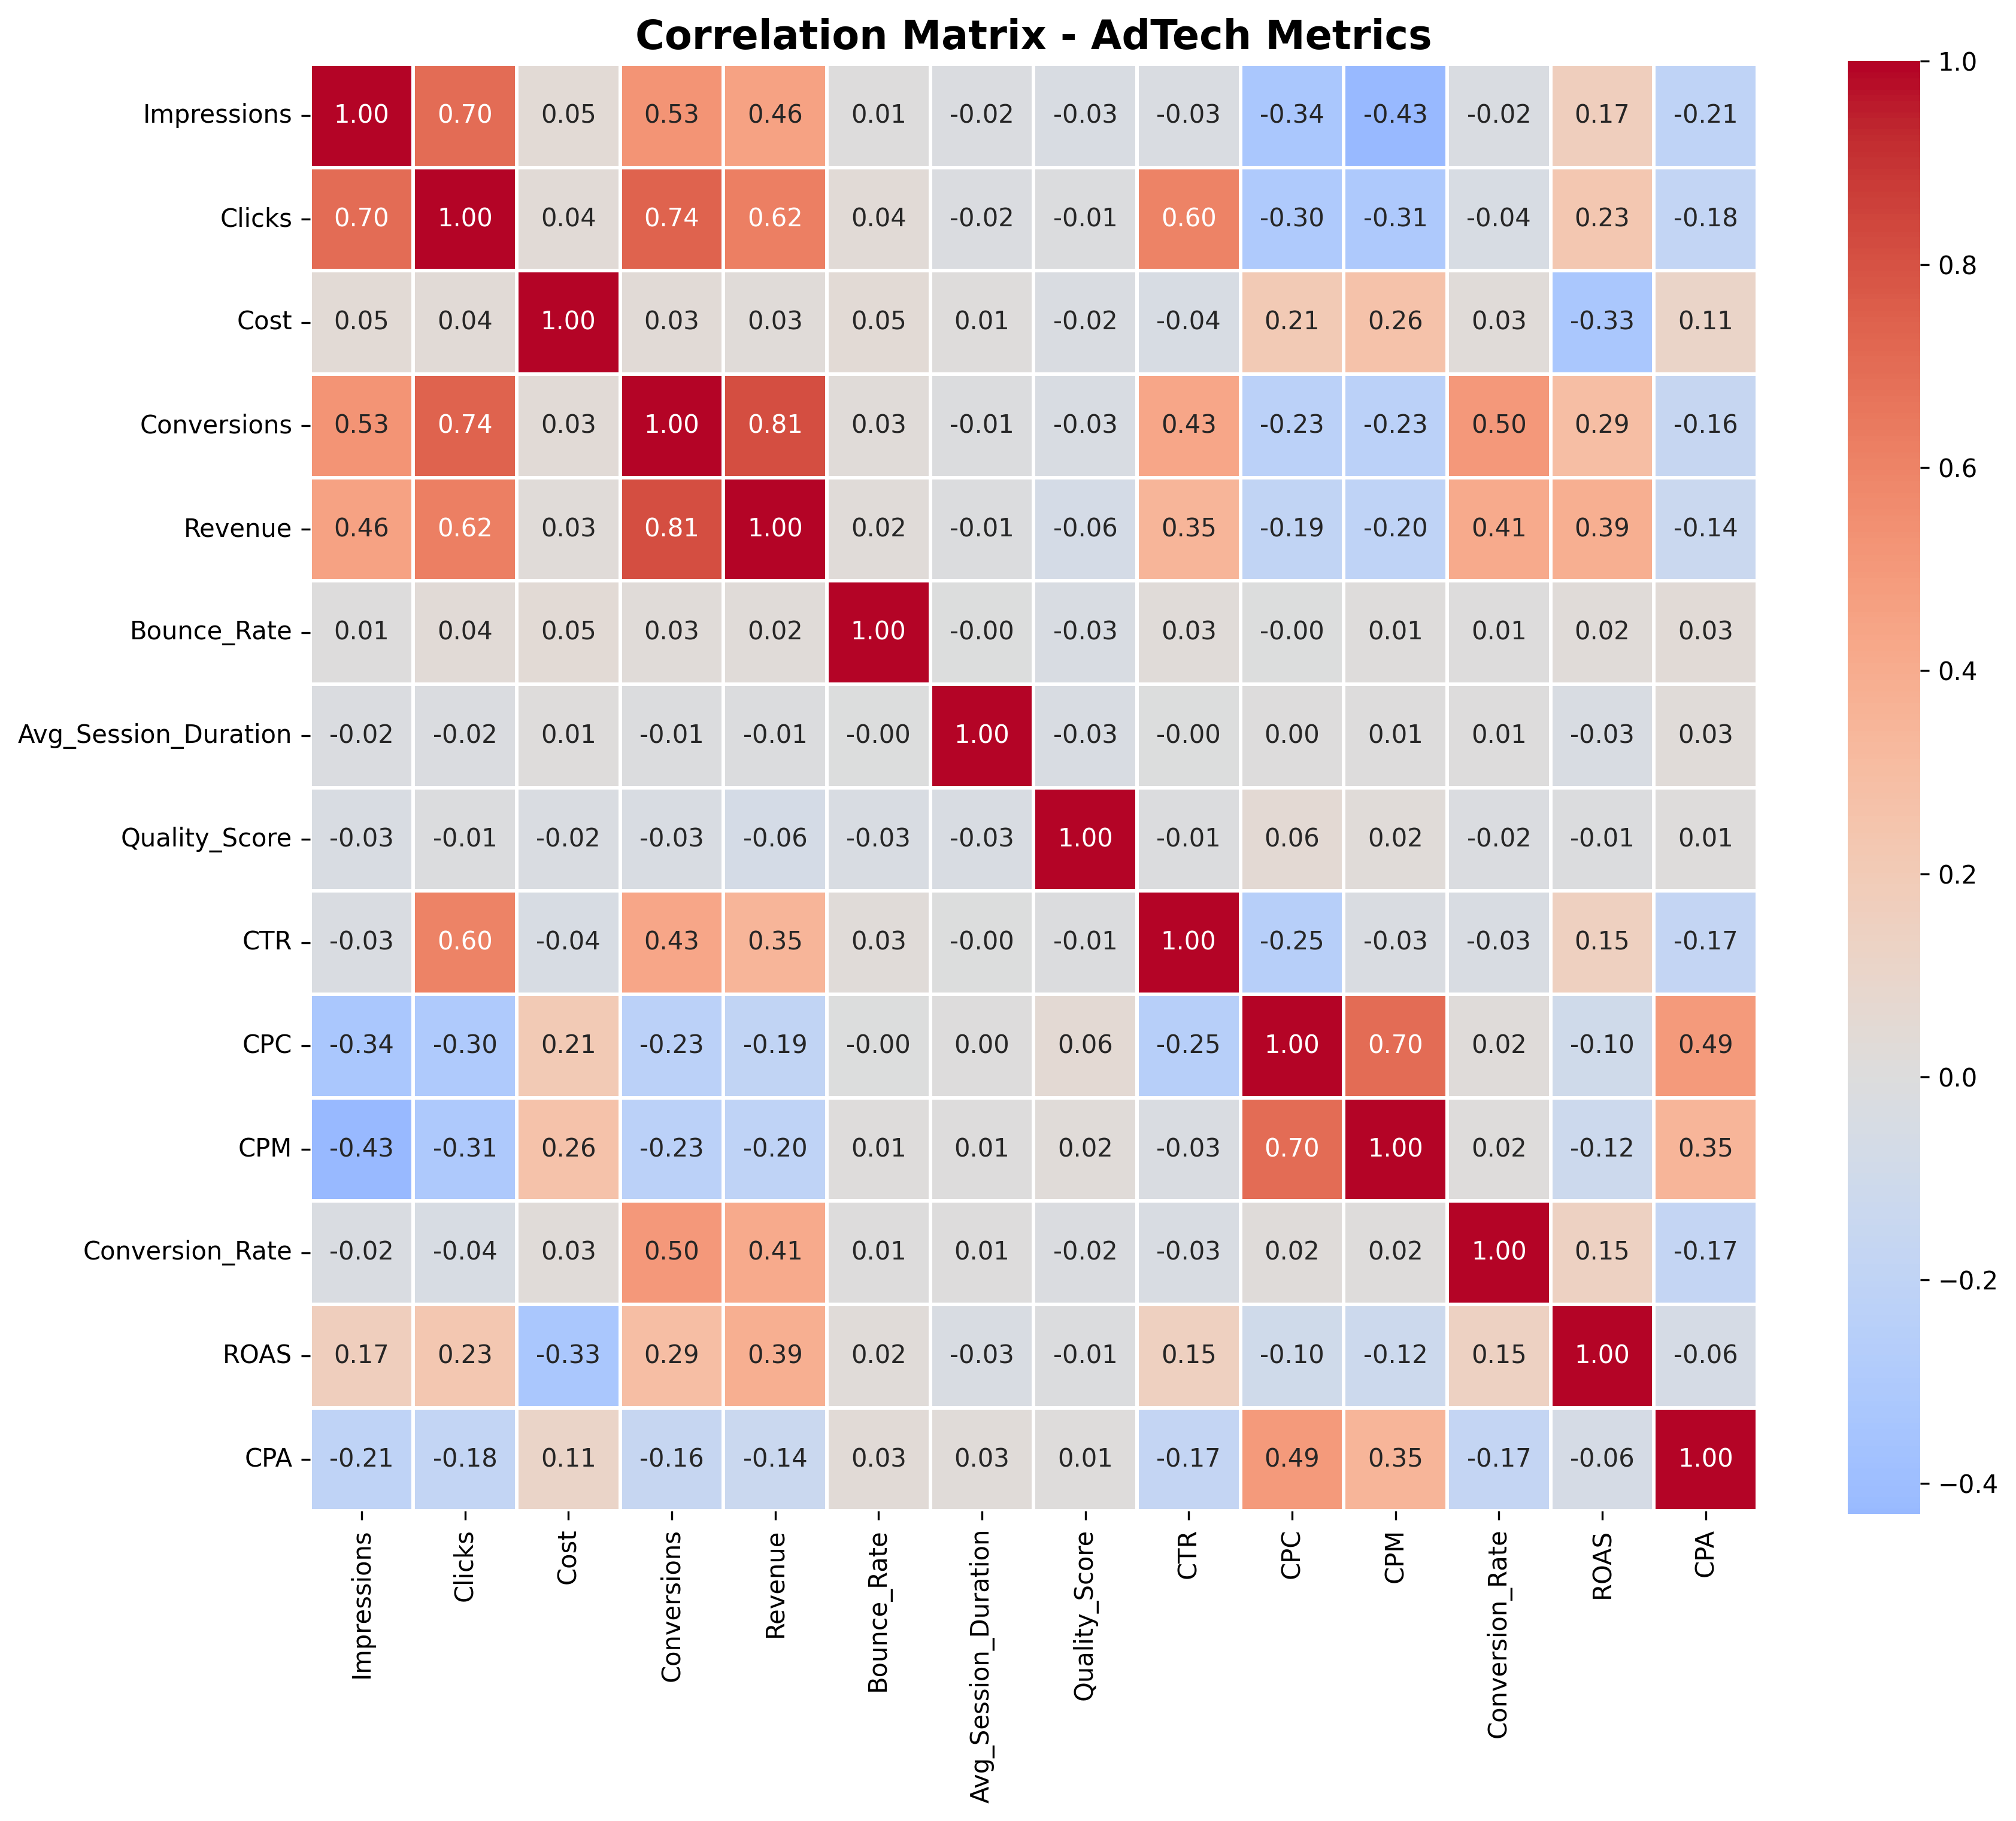
Correlation Analysis

Slide 4
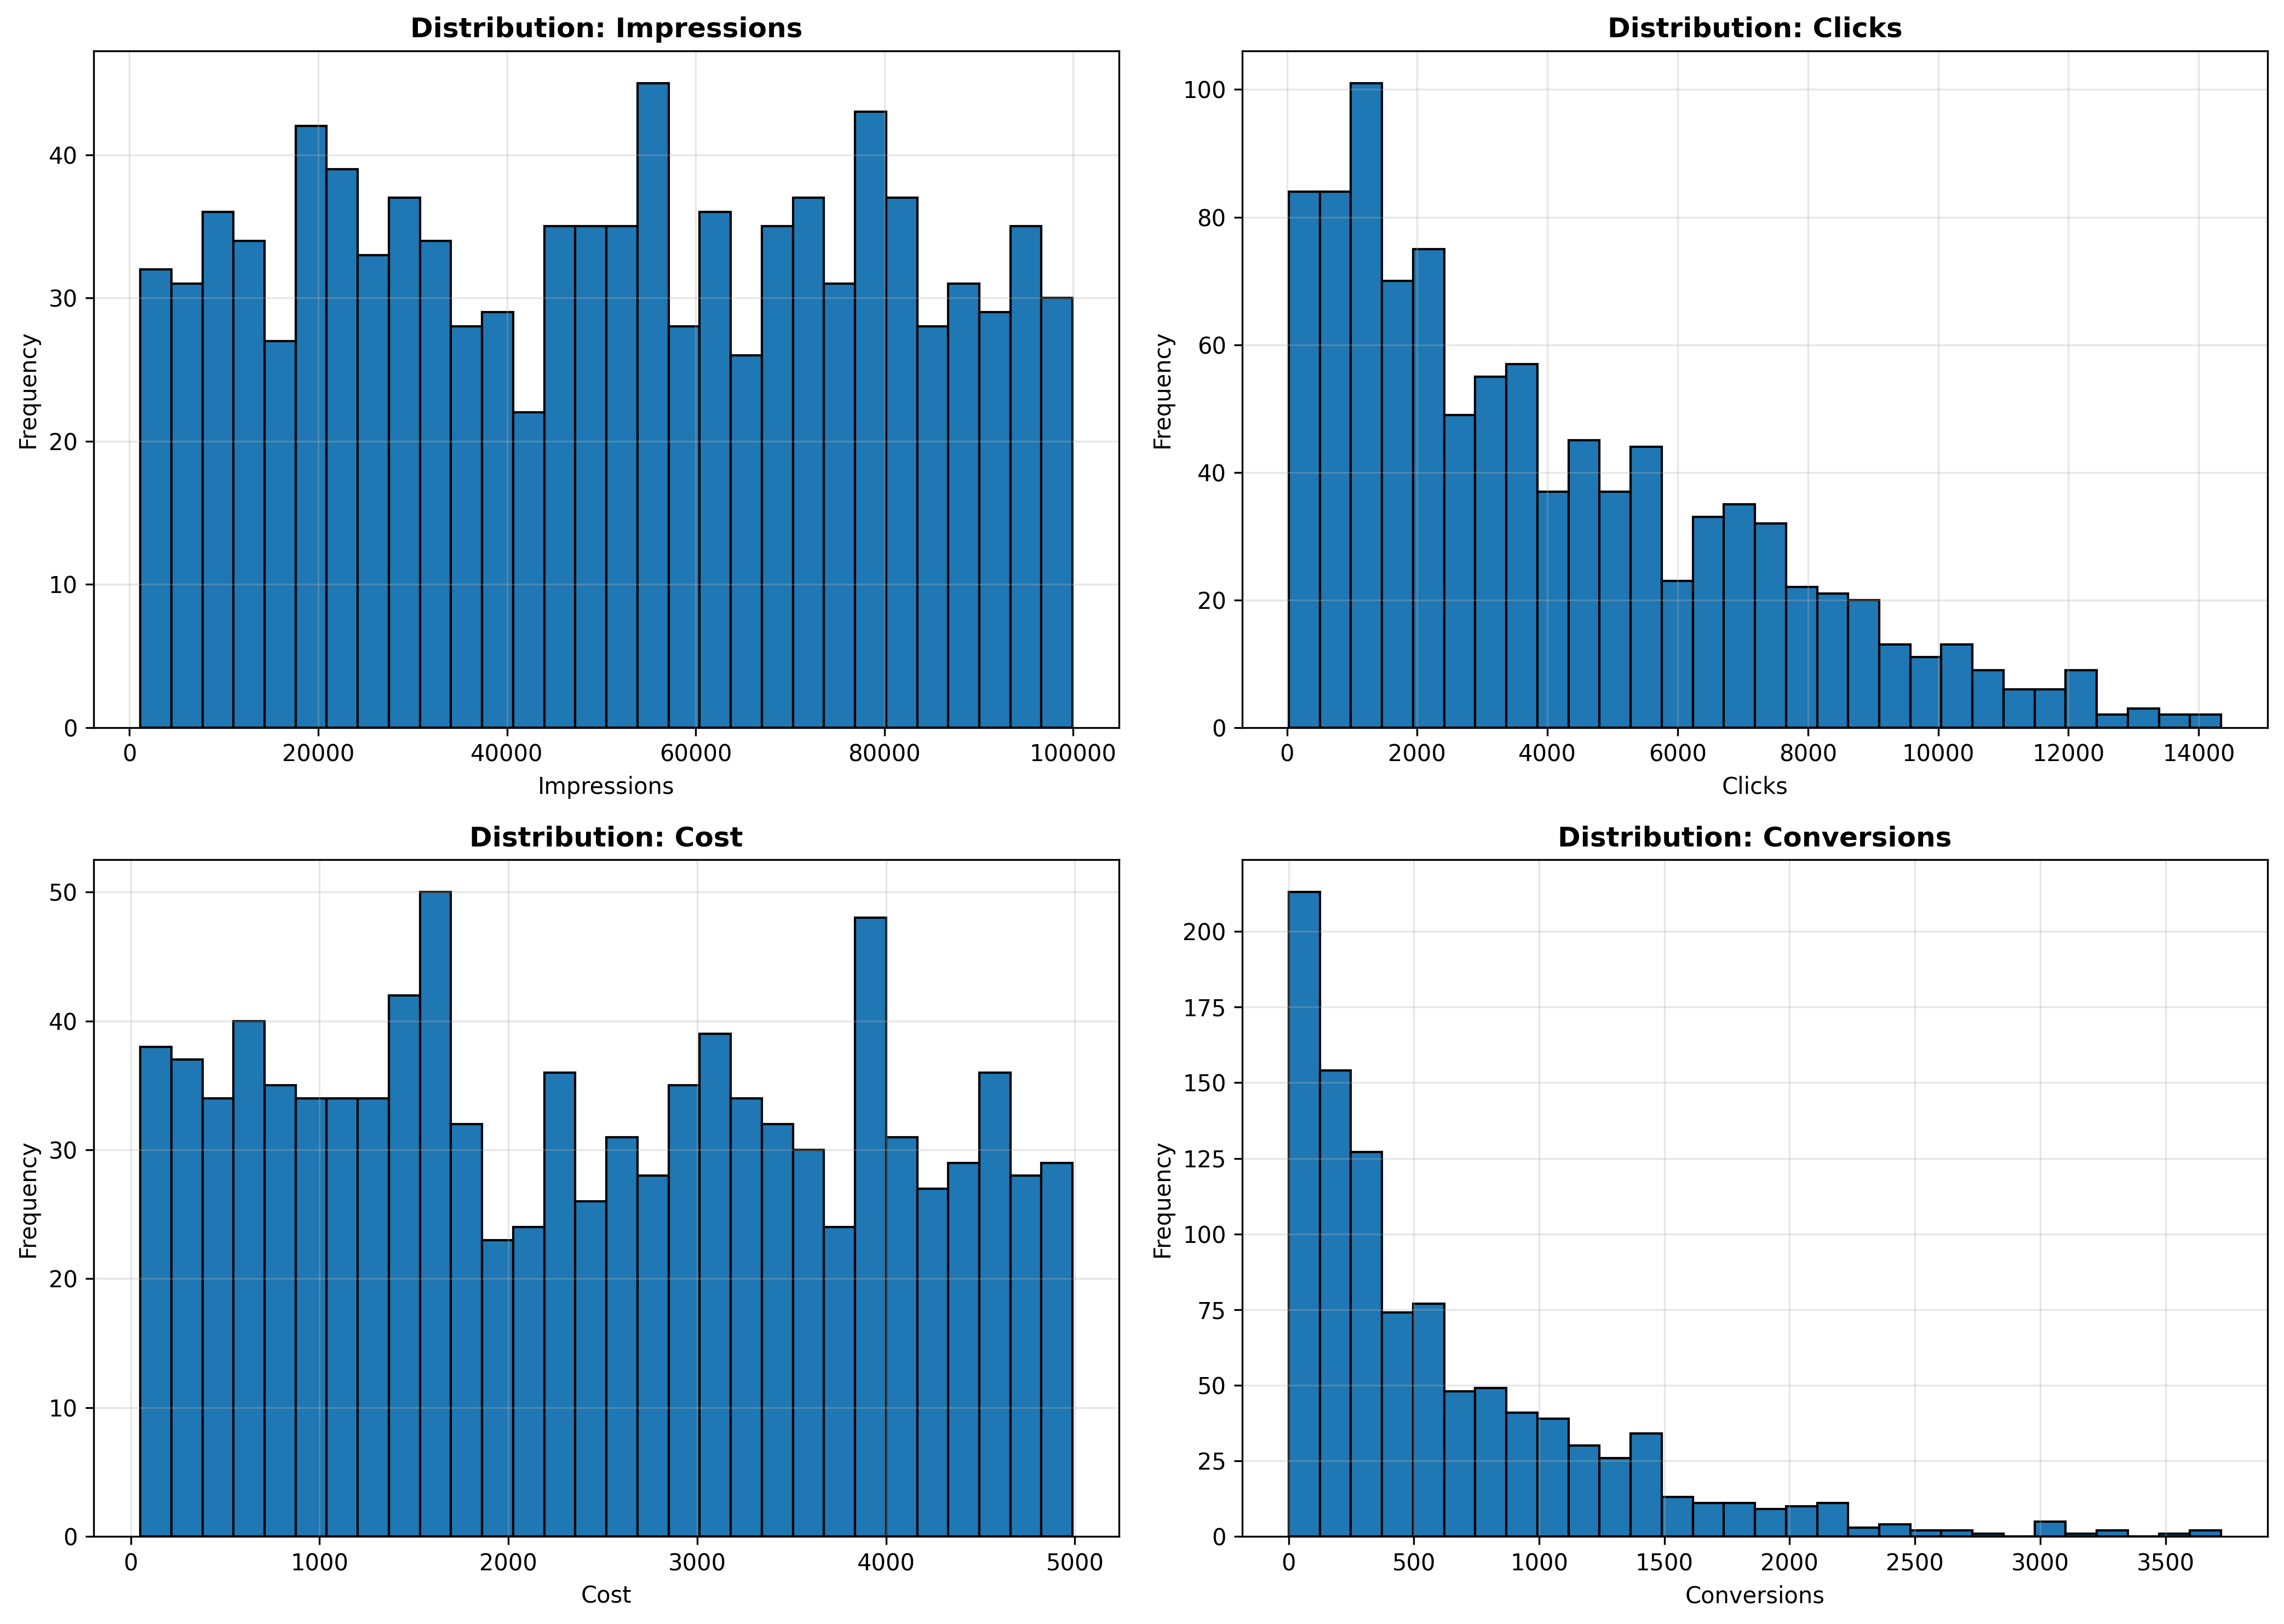
Metric Distributions

Slide 5
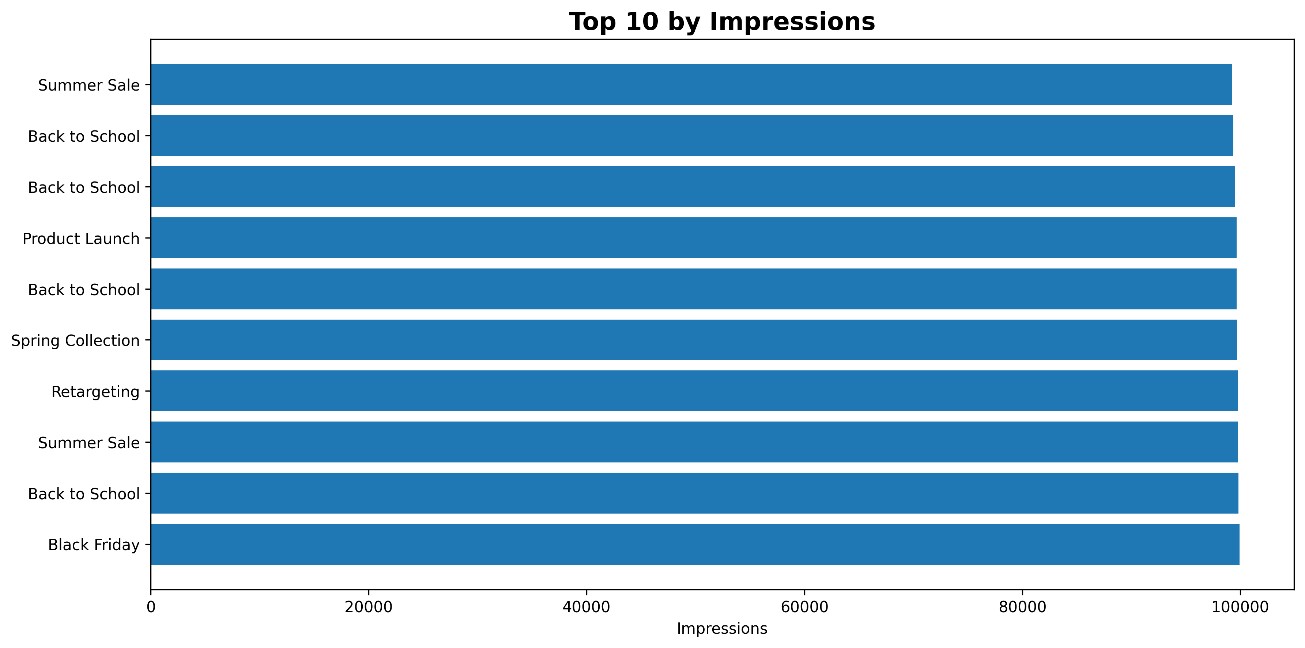
Top Performers

Slide 6
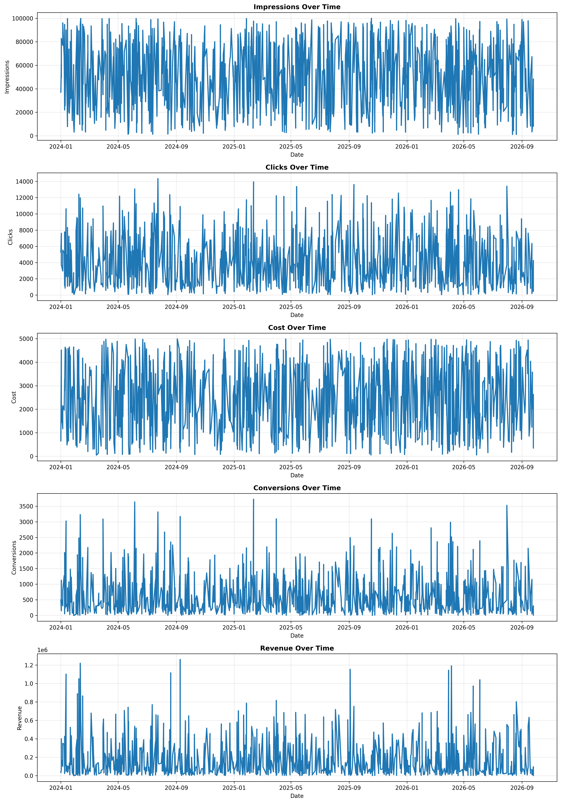
Trends Over Time

Slide 7
Key Metrics
Total Rows: 1000
Total Columns: 12
Numeric Columns: 8
Derived Metrics: CTR (%), CPC, CPM, Conversion Rate (%), ROAS, CPA

