Slide 1
AICTE RECOGNIZED INTERNSHIP DEFENSE
Python Programming & Software Engineering
Capstone Project: Live Weather Tracker
A Trilingual, Zero-Key Meteorological & Agricultural Intelligence Platform for 550,000+ Indian Villages
CANDIDATE DETAILS
Student Name: Sonali Kumari
Roll Number: 26DCSE26
Branch / Degree: Computer Science & Engineering (B.Tech CSE)
Institution: Government Engineering College, Sheikhpura
TRAINING & EVALUATION
Host Organization: INTELLIO INTERN (AICTE Recognized)
Internship Domain: Python Programming & Web Architecture
Duration: 25/09/2026 – 08/10/2026 (2 Weeks Intensive)
Evaluation Result: Grade A+ (91%) | Cert ID: BQTA26319

Slide 2
ORGANIZATION PROFILE
02 / 12
About INTELLIO INTERN & Training Program
HOST ORGANIZATION
INTELLIO INTERN
• AICTE Recognized Entity: Certified technical education training partner offering structured engineering internships.
• Domain Expertise: Specializes in Python Programming, Data Engineering, Web Systems, and Cloud-native technologies.
• Industry Alignment: Focuses on real-world engineering paradigms, modular code design, and version control.
• Mentorship Model: Guided by experienced software developers providing architectural reviews and code feedback.
INTERNSHIP STRUCTURE
Mode & Pedagogy
• Duration: 2-Week Intensive Program (25 Sept 2026 – 08 Oct 2026).
• Delivery Mode: 100% Online & Hands-on, combining live technical sessions with daily coding tasks.
• Learning Methodology: Practical exercise-first approach; students write production code rather than passive theory.
• Evaluation Rigor: Daily deliverables, milestone reviews, and final live viva evaluation with code demonstration.
PROGRAM TIMELINE
Milestones & Delivery
• Week 1 Milestone: Core Python mastery, object-oriented design, custom exceptions, file I/O, and SQLite storage.
• Week 2 Milestone: REST API integration (Open-Meteo), geospatial indexing, trilingual i18n localization engine.
• Independent Capstone: Designed and built the 'Live Weather Tracker' independently following mentor reviews.
• Final Outcome: Successfully achieved Grade A+ (91%) with verified certificate credential BQTA26319.

Slide 3
PROJECT MOTIVATION
03 / 12
Internship Purpose, Motivation & Core Objectives
WHY THIS INTERNSHIP & PROJECT?
Motivation & Problem Context
• Bridging Academic Theory with Production Code: College coursework focuses on synthetic CLI scripts; the primary goal was to architect an end-to-end web system with real API feeds, caching, and scalable state handling.
• The Rural Meteorological Divide in India: Commercial weather applications (AccuWeather, Apple Weather) cater predominantly to tier-1 metropolitan cities. Over 550,000 rural villages and 763 districts are neglected or buried behind paywalls.
• Eliminating Paywalls & Vendor Lock-In: Weather services often enforce costly API key restrictions. This project was motivated by building a completely free, zero-key, open-access intelligence platform for common citizens and farmers.
PRIMARY TECHNICAL OBJECTIVES
What I Aimed to Build
• All-India Coverage: Index and search 565,000+ Indian villages and all 763 districts with instant sub-millisecond autocomplete.
• Agro-Meteorology: Deliver actionable soil moisture, soil temperature (6cm), and rainfall history specifically for farmers.
• Trilingual Accessibility: Provide full localization in English, Hindi, and Bhojpuri without cloud API translation lag.
KEY SKILLS DEVELOPED
Software Engineering Competencies
• Modular Python: Separation of concerns into decoupled modules (weather, geo, places, i18n, ui).
• Database & Compression: Managing and querying compressed SQLite (.sqlite.gz) datasets on demand.
• Dual Deployment: Deploying reactive Python apps on Streamlit Cloud and static edge apps on Cloudflare Pages.

Slide 4
TECHNOLOGY STACK
04 / 12
Technologies, Frameworks & Development Tools
1. PROGRAMMING & CLIENT-SIDE
Core Languages & UI
• Python 3.10+: Object-oriented design, custom exceptions, lazy loading, in-memory decompressions.
• JavaScript (ES6+): Client-side DOM manipulation, async/await fetch, live tabs, and UI toggles.
• HTML5 & Modern CSS3: Responsive flex/grid cards, glassmorphic styles, and animated sky condition banners.
2. APIS & GEOSPATIAL DATA
Data Feeds & Geocoding
• Open-Meteo REST API: Hourly & 7-day meteorological forecasts, soil moisture & temperature (Zero API Key).
• GeoNames India Database: CC BY 4.0 extract covering 565,000+ Indian villages, tehsils, and towns.
• Photon & Nominatim: OpenStreetMap-backed autocomplete fallback for PIN codes and remote hamlets.
3. STORAGE & DATA WRANGLING
SQLite & Edge SQL
• SQLite3 (.sqlite.gz): Gzip-compressed bundled database for sub-10ms local prefix search on villages.
• Cloudflare D1: Distributed SQLite edge database for instant serverless query lookups worldwide.
• Pandas Library: Tabular data restructuring and 7-day temperature/rain trend calculations.
4. DEPLOYMENT & DEV TOOLS
Cloud Hosting & Version Control
• Streamlit Web Framework: Interactive data application development with state caching (@st.cache_data).
• Cloudflare Pages & Workers: Serverless edge architecture (`functions/api/`) and global CDN edge caching.
• Git & GitHub / Linux: Source management (`sonalikumari09/live-weather-tracker`), bash automation scripts.

Slide 5
WORK COMPLETED
05 / 12
Practical Work & Training Modules Completed
MODULE 1
Python Core & Architecture
• OOP Principles: Classes, encapsulation, and modular design.
• Error Handling: Custom exception hierarchy for network timeouts.
• Data Compression: Gzip decompression of bundled databases into RAM.
• Code Standards: PEP 8 compliance and strict typing.
MODULE 2
APIs & Data Engineering
• REST Client: Built robust HTTP client using Python Requests.
• Open-Meteo Integration: Parsed multi-layer weather and soil parameters.
• Payload Sanitization: Resilient JSON extraction and type validation.
• Failure Recovery: Fallback strategies for offline/slow connections.
MODULE 3
Database & Search Index
• GeoNames Parsing: Processed 565,000+ Indian geo-coordinates.
• SQLite Storage: Created lightweight indexed database for India places.
• Ranked Search: Hierarchical sorting prioritizing cities & districts.
• Hybrid Fallback: Nominatim & Photon fallback for unlisted hamlets.
MODULE 4
UI & Vernacular Localization
• Trilingual i18n: Built instant dictionary for English, Hindi, Bhojpuri.
• Streamlit UI: Designed responsive tabs and interactive selectors.
• Dynamic Styling: Crafted custom CSS themes and animated sky effects.
• Edge Adaptation: Ported application to Cloudflare Pages edge.
TRAINING EVALUATION & CERTIFICATION OUTCOME
Successfully satisfied all weekly project deliverables, technical code audits, and final capstone evaluation. Awarded Grade A+ (91%) by INTELLIO INTERN (AICTE Recognized). Certificate ID: BQTA26319 (Issued 08 Oct 2026).

Slide 6
PROJECT ARCHITECTURE
06 / 12
Project Overview — Live Weather Tracker
PROBLEM STATEMENT & VALUE PROPOSITION
Hyperlocal Weather for All India
• The Problem: Mainstream weather apps cater only to major metropolitan cities, bombard users with ads, enforce expensive API subscriptions, and lack rural language support.
• Our Solution: Live Weather Tracker is a fast, clean, zero-key, privacy-friendly meteorological web portal providing instant weather forecasts for 763 districts and 550,000+ villages across India.
• Target Users: Farmers needing soil & rain data, daily rural commuters, interstate travelers, and citizens seeking ad-free forecasts.
• Vernacular First: Native trilingual support in English, Hindi (हिन्दी), and Bhojpuri (भोजपुरी) for maximum regional inclusivity.
5 APPLICATION MODES & WORKFLOW
Feature Capabilities
1. Single Place: Real-time temp, feels-like, wind, humidity, 7-day forecast.
2. Farmer Mode: Soil temperature (6cm), moisture levels, 7-day rain history, and localized agricultural advisories.
3. Travel Packer: Smart packing recommendations based on rain probability, temperature, and wind speed.
4. Morning Alerts: Early warning system for extreme heatwaves, coldwaves, severe thunderstorms, or heavy downpours.
5. Compare Places: Side-by-side weather comparisons for 2 to 4 locations.
Pipeline: Query ➔ Compressed SQLite / Edge D1 ➔ Open-Meteo REST ➔ i18n Engine ➔ Dynamic Client View

Slide 7
INDIVIDUAL CONTRIBUTION
07 / 12
My Individual Contribution & Core Modules Built
1. WEATHER ENGINE & AGRO-LOGIC (weather.py)
Meteorological Core
• API Consumption: Designed REST endpoints fetching current, 7-day, and agricultural telemetry from Open-Meteo.
• Farmer Intelligence: Synthesized 6cm soil warmth, root moisture, and 7-day rain accumulation into practical advisories.
• Rule-Based Triggers: Built dynamic logic for Travel Packer checklists and Morning Severe Weather Alert checks.
2. GEOCODING & LOCAL DATABASE (geo.py, places.py)
Search & Indexing Engine
• Offline SQLite Index: Processed 565,000+ Indian geo-entities into a compressed SQLite store (`india_places.sqlite.gz`).
• Sub-10ms Prefix Search: Implemented SQL prefix autocomplete with ranking that prioritizes districts and major towns.
• Multi-Tier Fallback: Created graceful fallback to Photon / OSM / Nominatim for PIN codes and unlisted hamlets.
3. TRILINGUAL LOCALIZATION (i18n.py)
Vernacular Language Engine
• Zero-Lag Translation: Engineered a static dictionary mapping strings into English, Hindi, and regional Bhojpuri.
• Full Domain Coverage: Translated all UI labels, meteorological status codes (WMO), agricultural advisories, and tips.
• Cultural Idioms: Ensured agricultural and weather descriptions feel natural to rural northern/eastern Indian speakers.
4. UI/UX & DUAL CLOUD ARCHITECTURE
Frontend & Serverless Edge
• Streamlit Interface: Built responsive UI (`app.py`) with theme toggle, animated sky banners, and custom CSS.
• Cloudflare Serverless: Configured edge functions (`functions/api/`) and client web app (`public/app.js`).
• Tiered Caching: Implemented memory caching (`@st.cache_data`) and HTTP edge cache headers (600s TTL).

Slide 8
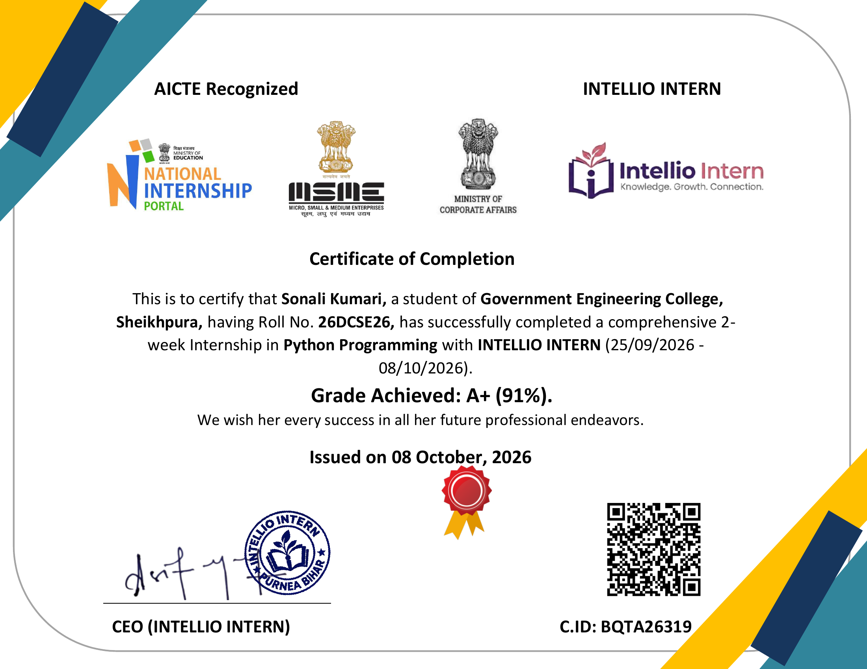
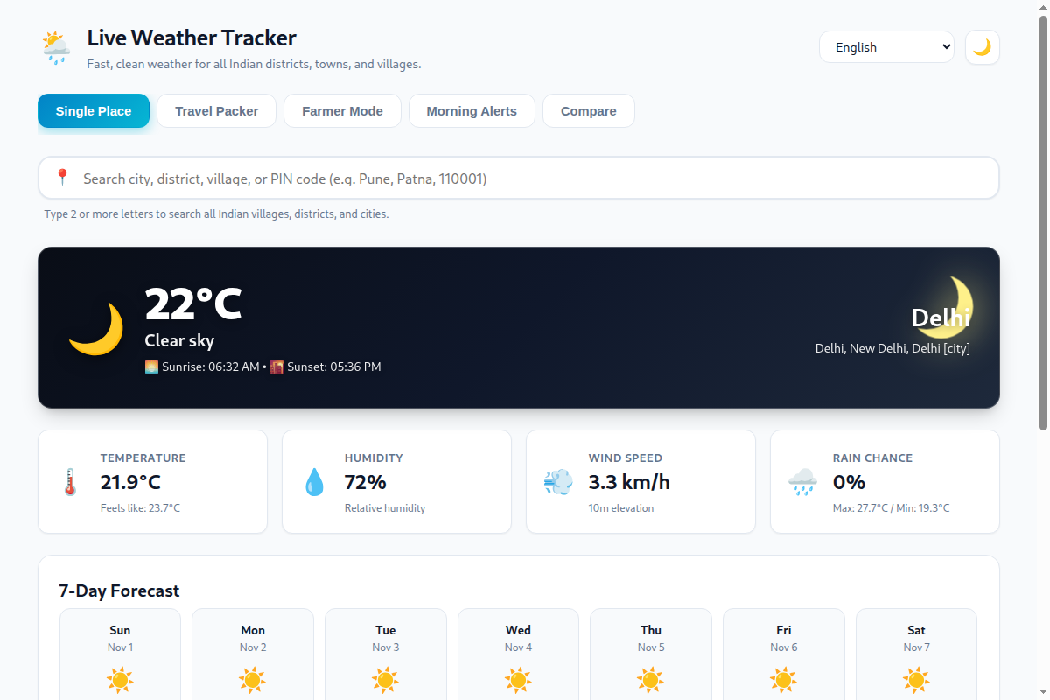
PROJECT EVIDENCE
08 / 12
Demonstration, UI Screens & Certification Evidence
COMPLETION CERTIFICATE (INTELLIO INTERN)
LIVE WEATHER TRACKER — PRODUCTION APPLICATION
AICTE Recognized Certificate | Sonali Kumari (26DCSE26) | Grade A+ (91%) | ID: BQTA26319
Live Web Interface | All-India Place Search | 5 Modes | Trilingual (EN / HI / BHO)
Source Code Repository: https://github.com/sonalikumari09/live-weather-tracker (Public / Main Branch)
Dual Deployment Architecture: Streamlit Cloud (Data App) + Cloudflare Pages Edge (*.pages.dev) with D1 SQLite & Serverless Functions

Slide 9
TECHNICAL CHALLENGES
09 / 12
Challenges Faced & Problem-Solving Approach
CHALLENGE 1: Sub-Second Geocoding for 550,000+ Indian Villages Without Paid APIs
Problem: Commercial geocoding APIs (Google Maps) are prohibitively expensive; free public endpoints (Nominatim) rate-limit to 1 req/sec and fail under rapid typing. Approach & Solution: Pre-processed the entire GeoNames India dataset into a local SQLite database compressed with gzip (india_places.sqlite.gz). Decompress on first use into memory, query via indexed SQL prefix matching, and rank results by administrative hierarchy with Photon fallback. Result: Instant autocomplete search (<15ms latency) with zero external API dependencies and zero operating cost.
CHALLENGE 2: Transforming Complex Agro-Telemetry into Actionable Farmer Advice
Problem: Raw meteorological data (volumetric soil moisture m³/m³, soil warmth at 6cm, WMO codes) is unintelligible and unusable for rural farmers. Approach & Solution: Researched agronomic thresholds for Indian crops, root depth dynamics, and seasonal precipitation trends. Created rule-based algorithms synthesizing 7-day cumulative rainfall, 6cm soil temperature, and moisture into clear text advisories. Result: Farmers receive direct, practical guidance (e.g., 'Soil moisture adequate for sowing', 'Irrigation recommended') in their regional tongue.
CHALLENGE 3: Seamless Trilingual Experience Without External Translation Latency
Problem: Third-party translation APIs (Google Cloud Translate) add 300-600ms network latency per request, require quotas, and produce robotic translations of rural idioms. Approach & Solution: Designed a centralized in-memory static dictionary mapping inside i18n.py and public/app.js. Pre-mapped all UI labels, meteorological codes, agricultural tips, and packing advice into structured key-value stores for English, Hindi, and Bhojpuri. Result: Instantaneous (<1ms) language toggle with 100% offline accuracy, cultural phrasing, and zero network overhead.

Slide 10
LEARNING OUTCOMES
10 / 12
Key Learnings & Skill Acquisition
TECHNICAL LEARNINGS
Engineering & Systems Mastery
• Modular Python Programming: Designing clean, decoupled architectures adhering to PEP 8 standards, custom exceptions, and type hints.
• REST API & Telemetry Integration: Consuming multi-endpoint meteorological APIs, robust timeout handling, and payload normalization.
• Database Optimization: Structuring SQLite databases, building prefix search indices, and implementing on-demand gzip decompression in memory.
• Full-Stack & Cloud Deployment: Developing reactive dashboards in Streamlit and configuring Cloudflare Pages serverless edge functions with D1 database.
• Performance Caching Strategies: Implementing tiered in-memory caching (@st.cache_data) and HTTP Cache-Control headers to reduce load times to <50ms.
PROFESSIONAL & DESIGN LEARNINGS
Product Thinking & Execution
• Social Impact Engineering: Designing technology with empathy for non-metro, rural communities, ensuring accessibility for non-English speakers.
• Problem Decomposition: Breaking down a large-scale project into discrete, manageable, testable components and milestones.
• Version Control & Collaboration: Structuring clear git commits, writing descriptive README documentation, and setting up automated deployment scripts.
• Time Management: Successfully taking a project from conceptualization to full cloud deployment within a strict 2-week internship timeline.
• Areas for Further Growth: Enhancing automated unit test coverage with pytest, implementing Docker containers, and setting up CI/CD GitHub Actions.

Slide 11
FUTURE ROADMAP
11 / 12
Future Enhancements & Scalability Roadmap
1. LIVE RADAR & SATELLITE OVERLAYS
Visual Storm Tracking
• INSAT & IMD Integration: Incorporate live INSAT-3D/3DR satellite imagery and Indian Meteorological Department Doppler radar overlays.
• Precipitation Trajectory: Provide visual cloud trajectory maps, cyclone path estimations, and lightning hazard zones.
• Real-Time Animation: Enable time-scrubbing weather radar loops for farmers and disaster management teams.
2. VOICE VERNACULAR ASSISTANT
Spoken Language Querying
• Web Speech API Integration: Allow farmers to simply tap a microphone and speak village names or ask queries.
• Regional Dialects: Support voice inputs in Hindi, Bhojpuri, Maithili, and Bengali to eliminate literacy barriers.
• Voice Audio Responses: Synthesize spoken weather summaries for audio playback on mobile browsers.
3. SMS & WHATSAPP BROADCAST ALERTS
Low-Connectivity Access
• Feature Phone Inclusivity: Connect Twilio / Indian SMS gateway to send automated morning weather summaries via SMS.
• Severe Warning Push: Trigger automated SMS/WhatsApp alerts for heatwaves, sudden frost, and severe thunderstorms.
• Zero Data Requirement: Ensure critical agricultural advisories reach farmers without requiring smartphones or 4G data.
4. PROGRESSIVE WEB APP (PWA) & IOT
Offline Resilience & Precision
• PWA Service Workers: Cache the last 7 days of forecasts locally so the app works completely offline in remote villages.
• Micro-Climate Sensors: Provide API hooks to interface with low-cost LoRaWAN soil moisture and micro-weather hardware sensors.
• Installable App: One-click install directly from browser to Android home screens without Google Play Store dependencies.

Slide 12
SUMMARY & VIVA VOCE
12 / 12
Conclusion & Project Defense
Summary of Internship Deliverables & Technical Achievements
INTERNSHIP OUTCOMES
• Completed 2-Week Intensive Internship in Python Programming at INTELLIO INTERN (AICTE Recognized).
• Achieved Grade A+ (91%) in final assessment and technical project evaluation (Certificate ID: BQTA26319).
• Built 'Live Weather Tracker' from scratch, providing hyper-local forecasts for 763 districts and 550,000+ villages across India.
CORE IMPACT & TAKEAWAY
• Bridged Academic & Industry Skills: Gained production-ready mastery in Python, REST APIs, SQLite indexing, and serverless edge deployment.
• Social Impact Focus: Solved real-world rural challenges with trilingual accessibility (English, Hindi, Bhojpuri) and agricultural telemetry.
• Scalable Open Architecture: Engineered 100% free, zero-key infrastructure running seamlessly on Streamlit and Cloudflare Pages.
Thank You! Ready for Live Demonstration & Technical Q&A
Presenter: Sonali Kumari (Roll No: 26DCSE26) | GEC Sheikhpura | GitHub: sonalikumari09/live-weather-tracker

