Slide 1

Secure Clinic IT Infrastructure: Implementation, Deployment, and Security Validation
Provides a secure, Azure-based IT infrastructure that protects healthcare data and enables safe, reliable access for small healthcare clinics.
Team members — Justin Barroso, Demetrius Smith, Sonali Mohammed, Santiago Ferreira Rolon, David Alonso
Instructor: Prof. Masoud Sadjadi
Information Technology · Capstone 2 · Summer 2026 Virtual Showcase · FIU KFSCIS

Slide 2
The Team
Name | Role | Email | Presentation Topic
Sonali Mohammed | Team Lead | smoha094@fiu.edu | Introduction, Team, Problem
Justin Barroso | Identity & Access Management | jbarr327@fiu.edu | Stakeholders & Solution
Demetrius Smith | Infrastructure & Testing | dsmit332@fiu.edu | Architecture & Live Demo
Santiago Ferreira Rolon | Project Coordinator | Sferr109@fiu.edu | Future Work & Closing
David Alonso | Quality Assurance & Security Testing | dalon065@fiu.edu | Systems & Operations, Results

Slide 3
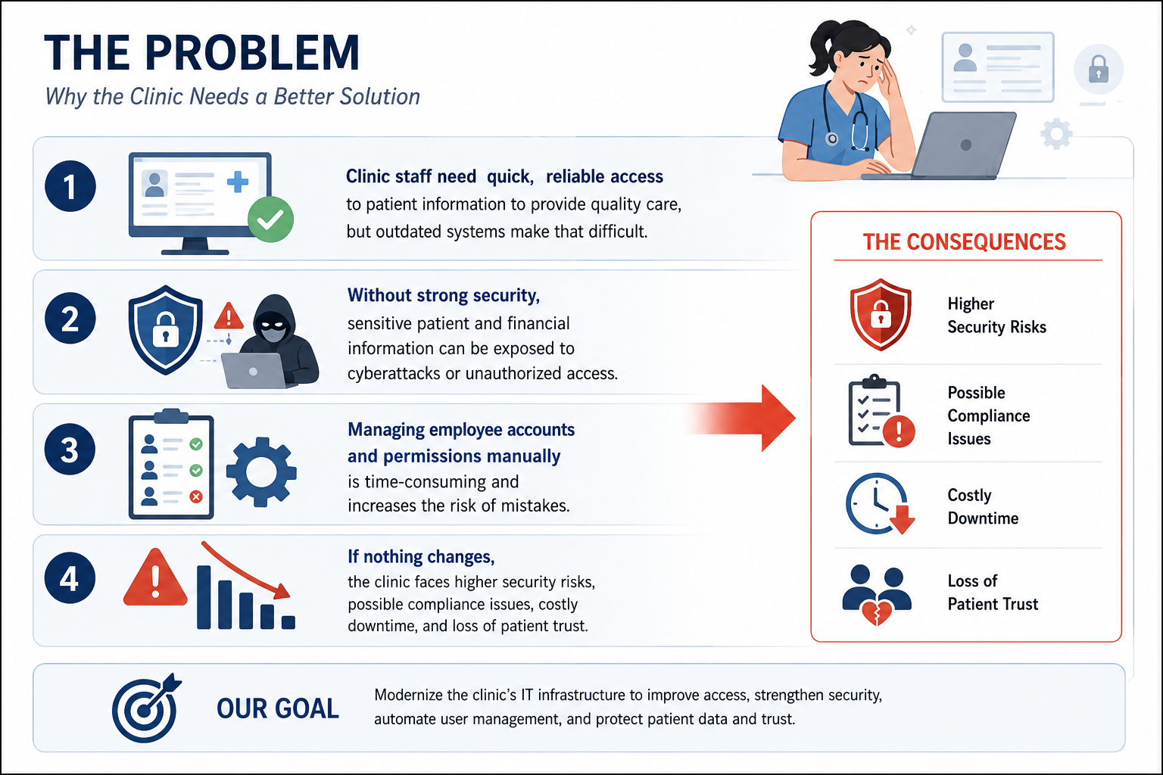
The Problem
Clinic staff need quick, reliable access to patient information to provide quality care, but outdated systems make that difficult.
Without strong security, sensitive patient and financial information can be exposed to cyberattacks or unauthorized access.
Managing employee accounts and permissions manually is time-consuming and increases the risk of mistakes.
If nothing changes, the clinic faces higher security risks, possible compliance issues, costly downtime, and loss of patient trust.
Optional: a photo, quote, or one number that makes the problem real
Notes:
End the 3-minute intro here; hand off to the demo driver.

Slide 4
Stakeholders & Requirements
Stakeholders:
Clinic administrators
Healthcare staff
IT administrators
Patients
RBAC, MFA, VPN, Active Directory, logging, backups, firewall protection
Key Functional:
Centralized user authentication with Active Directory
Role-Based Access Control for department-specific permission
Secure remote access through VPN with Multi-Factor Authentication
Key Non-Functional:
High reliability
Strong security and data protection
Scalable cloud infrastructure

Slide 5
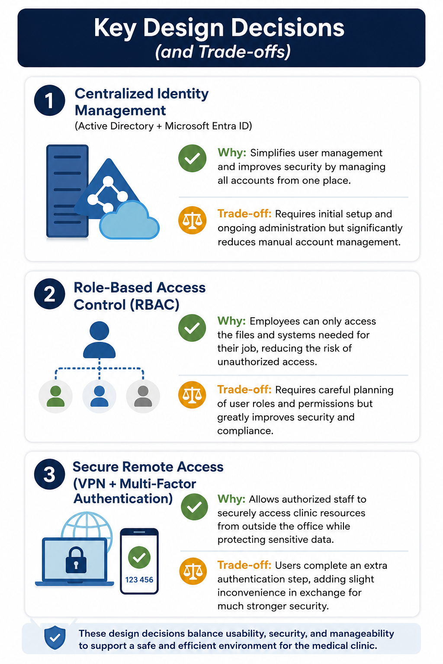
Our Solution
We built a secure, cloud-based IT infrastructure for a small healthcare clinic using Microsoft Azure. The solution centralizes user management, protects sensitive patient data, enables secure remote access, and provides continuous monitoring to help the clinic operate safely and efficiently.
Solution overview graphic
Key Designs:
1. Centralized Identity Management (Active Directory + Microsoft Entra ID)
2. Role-Based Access Control
3. Secure Remote Access (VPN + Multi-Factor Authentication)

Slide 6
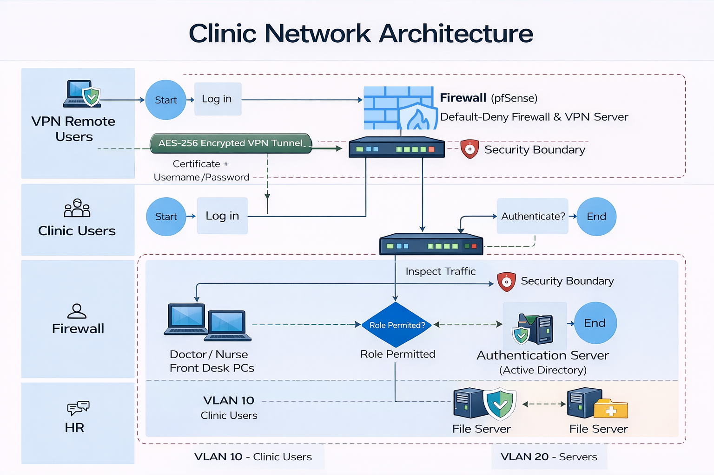
Architecture
REPLACE with your architecture diagram — full width, large labels

Slide 7
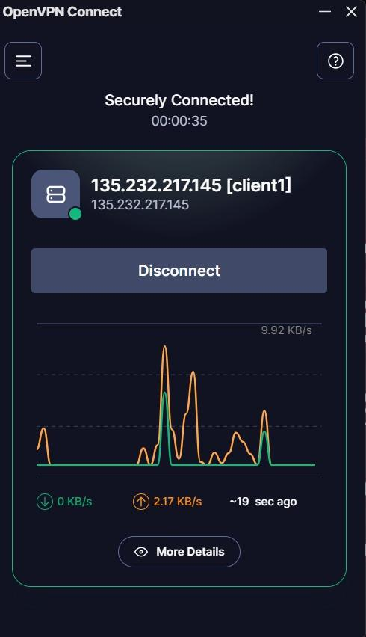
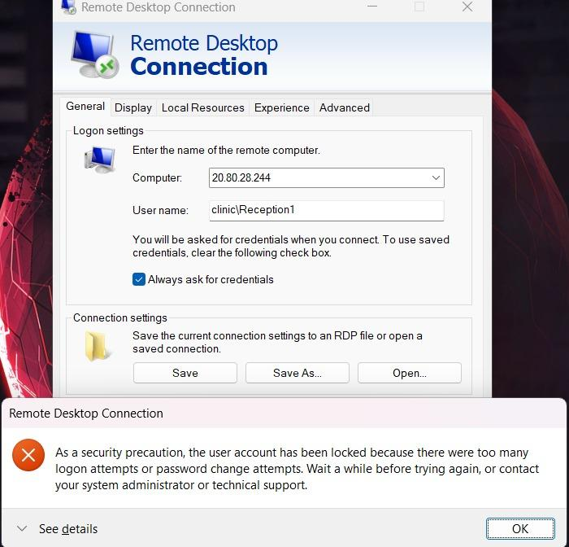
Live Demo
10 minutes — the heart of your session
Here's the link: https://youtu.be/jxOTyCcKHVg

Slide 8
Systems & Operations (SO6)
SO6 for Information Technology — Building and Managing a Secure IT Infrastructure
We designed a secure network with VLAN segmentation, pfsense firewall, and OpenVPN for secure remote access.
We implemented Active Directory, Microsoft ID, and Role Based Access control for centralized identity management.
We developed a deployed the clinic infrastructure in Microsoft Azure using Windows Server 2022 Virtual Machines
We enforced Multi-Factor Authentication, group policies, password complexity, and account lockout policies.
We used GitHub for team collaboration.
We managed users, security groups, devices, and endpoint compliance using Microsoft Intune and Active Directory.

Slide 9
Results & Evaluation
what you measured, not what you hope
Security Validation Results:
Verified audit logging, password policies, account lockout
Successfully validated Active Directory authentication, VPN connectivity, multi-factor Authentication and firewall protection
Key Outcomes:
Centralized identity management
Secure remote access
Layered security controls
Scalable Azure infrastructure
Metric | Result
Security Validation Tests | 9/9 Passed
Authentication | Successful
RBAC Verification | Passed
VPN + MFA | Verified
Firewall Protection | Passed
Audit Logging | Verified
Backup Validation | Successful

Slide 10
How We Worked
SO5 teamwork · SO4 professional judgment
Agile Team Collaboration:
Followed a Scrum-based workflow with regular sprint planning, progress reviews, and task assignments.
Used GitHub to manage project documentation, version control, and team collaboration.
Held frequent team meetings to coordinate development, testing, and deployment activities.
Challenge We Overcame:
Challenge: Configuring and integrating Azure Virtual Machines, Active Directory, Microsoft Entra ID, and secure VPN connectivity while maintaining a secure environment.
Solution: Through collaboration, troubleshooting, repeated testing, and instructor feedback, we successfully deployed and validated the complete infrastructure.

Slide 11
What's Next
Future Work:
Expand cloud security monitoring by integrating Microsoft Sentinel or a SIEM solution for real-time threat detection and incident response.
Enhance disaster recovery with automated backups, replication, and failover capabilities to improve business continuity.
Strengthen endpoint security by expanding Microsoft Intune policies, automated patch management, and device compliance monitoring.
Scale the infrastructure to support additional clinic locations, more users, and future healthcare applications while maintaining strong security.

Slide 12
Thank you — questions?
Secure Clinic IT · ‹https://github.com/sonalililah/Secure_clinic_IT›
KFSCIS Capstone Program · Prof. Masoud Sadjadi · sadjadi@fiu.edu · capstone.cs.fiu.edu
Judges: evaluation window is now — thank you!

