Slide 1

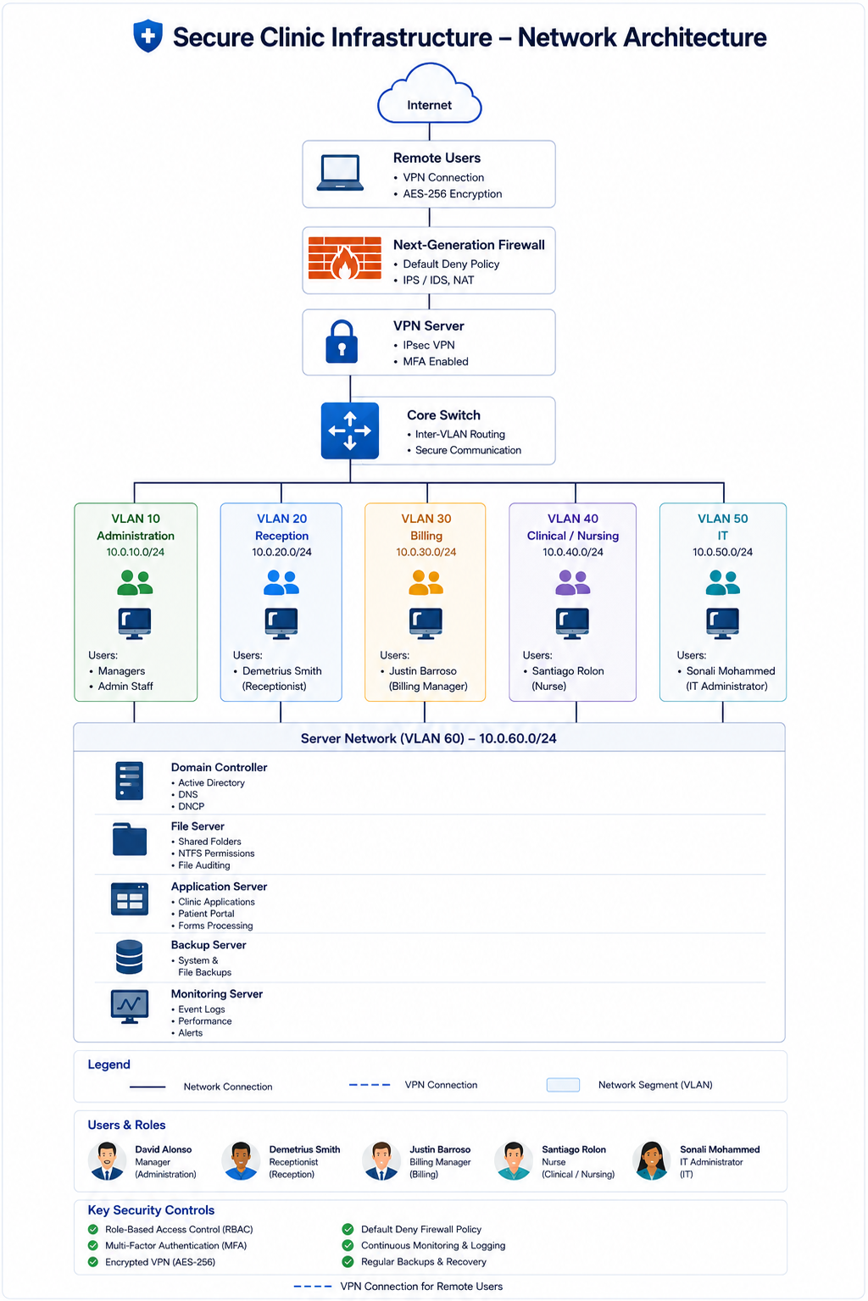
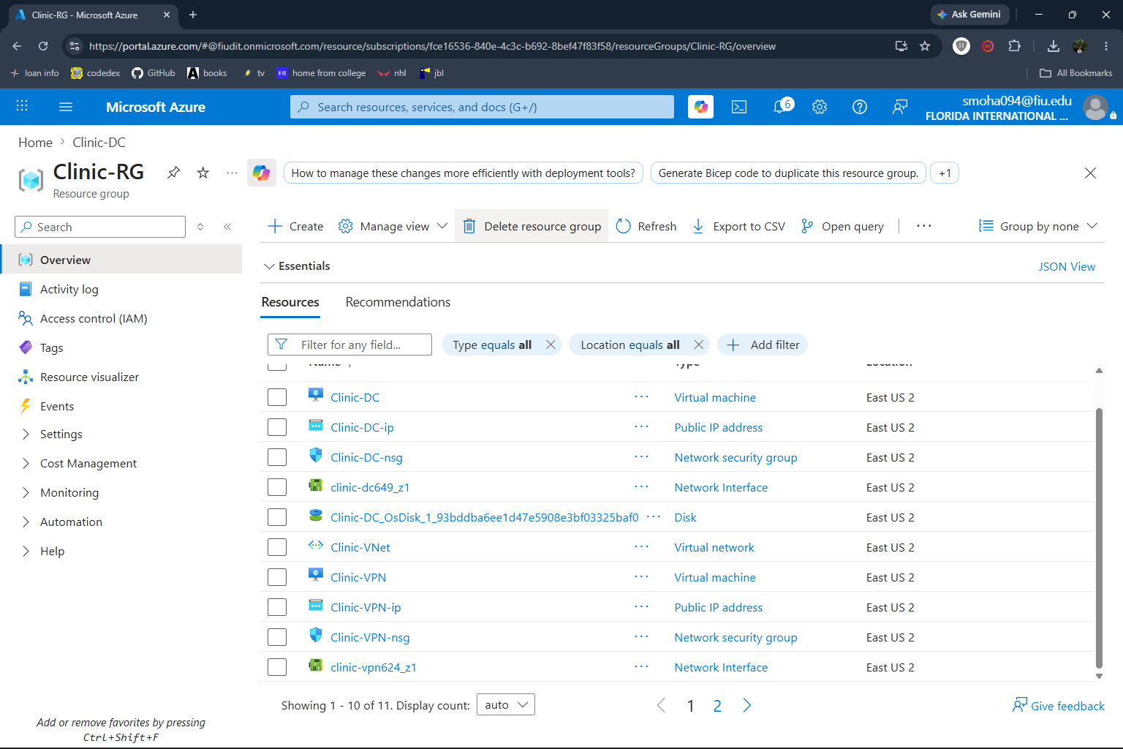
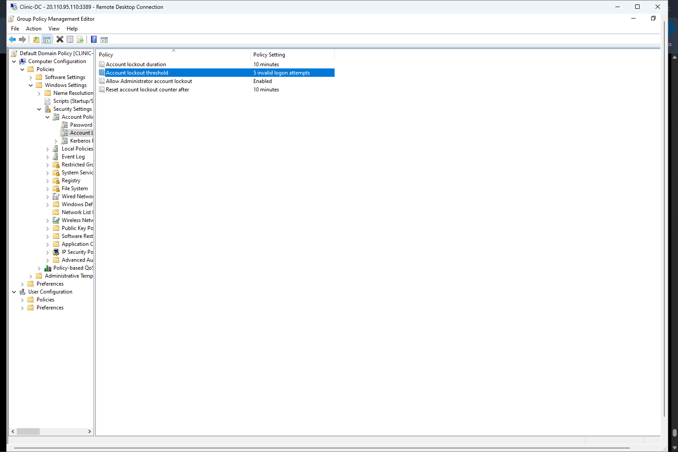
Capstone Project Virtual Showcase
Secure Clinic IT Infrastructure:
Implementation, Deployment, and Security Validation
Summer 2026 — Capstone Showcase
Information Technology
The Problem
Architecture & How It Works
Key Features & Results
The Team
Small healthcare clinics handle sensitive patient data but often lack enterprise-level security, centralized authentication, and secure remote access.
• Risk of unauthorized access
• Increasing cyber threats
• Need for scalable cloud infrastructure
• Limited IT resources
Insert Secure Clinic Network Architecture Diagram
Deployment Guide
Sonali Mohammed — Project Lead linkedin.com/in/sonali-lilah
Justin Barroso — Identity & Access www.linkedin.com/in/justin-barroso-7a9756228
Santiago Ferreira Rolon — Azure & Documentation https://www.linkedin.com/in/santiago-ferreira-77a489231/
David Alonso — Testing https://www.linkedin.com/in/david-alonso-8345423a3
Demetrius Smith — Deployment https://www.linkedin.com/in/ds3065______
Configuration Documentation
Our Solution
Our project implements a secure cloud-based IT infrastructure using Microsoft Azure. The solution integrates Active Directory, Microsoft Entra ID, Microsoft Intune, OpenVPN, Windows Defender Firewall, and Role-Based Access Control (RBAC) to protect patient information and improve system management.
Technologies
Microsoft Azure
Windows Server 2022
Microsoft Entra ID
Microsoft Intune
OpenVPN
Windows Defender Firewall
PowerShell
• Azure-based deployment
• RBAC & MFA implemented
• Account lockout and Active Directory security policies successfully configured.
• Audit logging & backups verified
• Azure-hosted infrastructure
• Secure remote VPN access with MFA
• Centralized identity & endpoint management
• Azure Virtual Machines
• Active Directory & Microsoft Entra ID
• Secure VPN and firewall protection
Acknowledgments
Instructor: Dr. Masoud Sadjadi
Florida International University
FIU College of Engineering & Computing — Knight Foundation School of Computing and Information Sciences
capstone.cs.fiu.edu

