Slide 1
529 Data Analytics
Group #7
Merck & Co. Inc., Morgan Stanley,
Ford Motors and Coca Cola
Sonali Nimbalkar
Tanmay Gole
Jeegar Mav

Slide 2
Table of Content
Overview
Data Selection
Automation Process for Data Extraction, Data Cleaning and Loading
Merck Co. Inc, Morgan Stanley, Ford Motor
CEO’s Salary Analysis
CEO’s Vested Stock and Option Awards Analysis
Stock Trading Activity
Coca Cola Stock Trading Activity
Text Data Analysis (KEI’s) - ‘Q&A with chairman and CEO’ and ‘Q&A on Proxy Material’ sections of Coca Cola
Document Term Matrix
Association
Frequency Graph
Word Cloud
Summary
Conclusion

Slide 3
Overview
Merck & Co. Inc.
Merck is world’s largest pharmaceutical company which was established in 1891 as the United States subsidiary of the German company Merck. It’s researchers have helped to find new ways to treat and prevent illness - from the discovery of vitamin B1, to the first measles vaccine, to cold remedies and antacids, to the first companies to treat high cholesterol. Company developed products to improve animal health, including vaccines and antibiotics.
Morgan Stanley
Morgan Stanley is an American multinational financial services corporation headquartered in the New York City and it was founded in 1935 by partners Henry Morgan and Harold Stanley. The main areas of business for the firm today are Global Wealth Management, Institutional Securities, and Investment Management. It works in Investment banking, asset management, commercial banking, prime brokerage, investment management, retail brokerage, commodities sectors. Company’s last year revenue was around $38 billion.

Slide 4
Overview
Ford Motor
The Ford Motor Company is an American multinational automaker headquartered in Michigan. It was founded by Henry Ford in1903. The company sells automobiles and commercial vehicles under the Ford brand and most luxury cars under the Lincoln brand. Ford also owns Brazilian SUV manufacturer, Troller, and Australian performance car manufacturer FPV. Ford introduced methods for large-scale manufacturing of cars and large-scale management of an industrial workforce using elaborately engineered manufacturing sequences typified by moving assembly lines; by 1914 these methods were known around the world as ‘Fordism’. Ford is the second-largest U.S.-based automaker and the fifth-largest in the world based on 2010 vehicle sales.
Coca Cola Inc.
The Coca-Cola Company is a beverage company. It was founded in 1886, by John S. Pemberton. “It owns or licenses more than 500 nonalcoholic beverage brands”. It primarily serves sparkling beverages but also wide range of still beverages such as: water, juices, ready-to-drink teas and coffees, sports drinks. Brands introduced by company are Diet Coke, Diet Coke Caffeine-Free, Coca-Cola Cherry, Coca-Cola Zero, Coca-Cola Vanilla, and special versions with lemon, lime, or coffee.

Slide 5
Data Selection
Below links are used to download company’s DEF 14A files-
Merck & Co. Inc : https://www.sec.gov/cgi-bin/browse-edgar?action=getcompany&CIK=0000310158&type=DEF+14A&dateb=&owner=exclude&count=40
Morgan Stanley : https://www.sec.gov/cgi-bin/browse-edgar?action=getcompany&CIK=0000895421&type=DEF+14A&dateb=&owner=include&count=40
Ford Motor : https://www.sec.gov/cgi-bin/browse-edgar?action=getcompany&CIK=0000037996&type=DEF+14A&dateb=&owner=include&count=40
Coca Cola : https://www.sec.gov/cgi-bin/browse-edgar?action=getcompany&CIK=0000021344&type=DEF+14A&dateb=&owner=exclude&count=40
These files are Definitive Proxy Statement; it is generally filled by or filled on behalf of the registrant when vote of shareholder is required. It is most commonly used in conjunction with the annual meeting proxy.
This form is the only way to provide information to security holders, so that they can make an informed vote on an upcoming security holder’s meeting.

Slide 6
Part A
Executive compensation tables and Q&A sections from DEF 14A files are used for further analysis.
Executive Compensation is a term used for the financial compensation awarded to a firm's executives and these executive compensation packages are designed by a company's Board of Directors.
Executive compensation table includes below fields -
Name and Position
Year
Salary
Bonus
Value Of stock Award
Value of Option award
All other compensation
Total Compensation
Only Chief Executive Officer’s compensation is analyzed from compensation table.

Slide 7
Automation Process for Data Extraction, Data Cleaning and Loading
We implemented complete automated process using R code and followed below steps to parse HTML table into data frame, clean it and to store only required data:
Parsed all tables from HTML file using 'htmltab'
Fetched summary compensation table from all tables into proxy. table data frame using keyword search
Replaced all garbage values to NA
Removed unwanted columns and renamed headers
Removed duplicated columns because in few cases, column appears twice after parsing.
Deleted NULL rows
Selected only CEO specific rows
Removed NULL columns if any
Merged proxy. table into final summary table by comparing years. So if year already exists in the final summary table then again it will not get added. For loop of corpus will execute in descending order so it will execute latest year's file first and oldest in the end so while merging, only latest filing year's record will maintained over previous year.
Exported table into excel sheet after fetching data for all years.

Slide 8
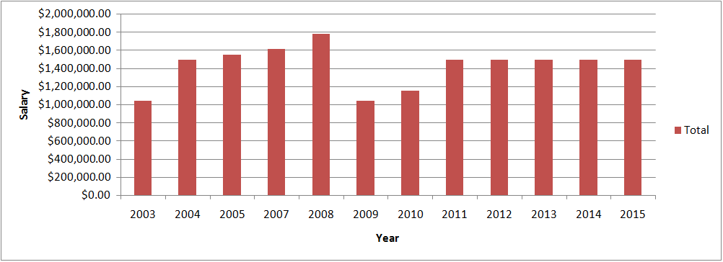
Merck & Co. Inc. CEO’s Salary Analysis
Company’s performance was negatively affected by several factors, including manufacturing and supply problems , resulting drop in 2009 CEO compensation
In 2011, some of the industry’s biggest products went off patent, reporting flat sales that resulted no increments over CEO salary from 2011 to 2015
No salary increments were given to the CEO’s over the last 5 years, however there has been increasing trend over the years from 2003 to 2008 with highest compensation trends).

Slide 9
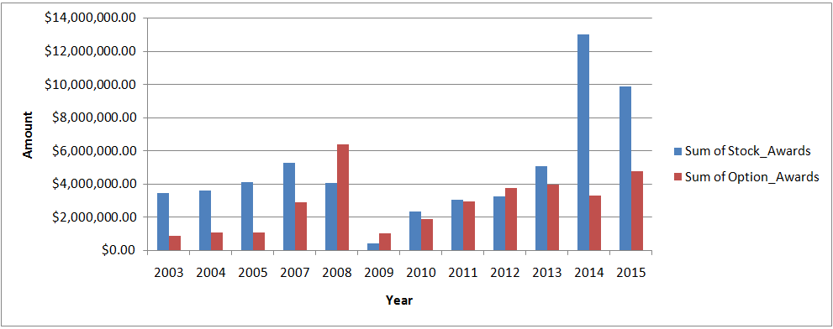
Merck & Co. Inc. CEO’s Vested Stock and Option Awards Analysis
Increase in stock price led high vested stock & option awards for CEO’s during 2014 and 2015 from $9M to $13M.
Apart from recession, higher dilution risk during 2009 also depicts a steep downfall in stock and option awards for the CEO’s

Slide 10
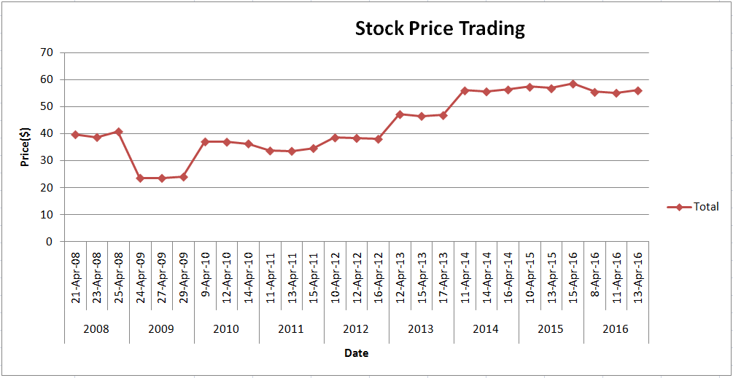
Merck & Co. Inc. Stock Trading Activity
As we can see during out Stock Price Analysis, Stock prices of the company are consistently increasing after the big recession in 2009 and it did actually dropped to around 23$ in 2009. Thankfully, Merck’s healthy dividend payouts have been a boon to investors, that actually helped moving up the stocks since 2009 as seen below.

Slide 11
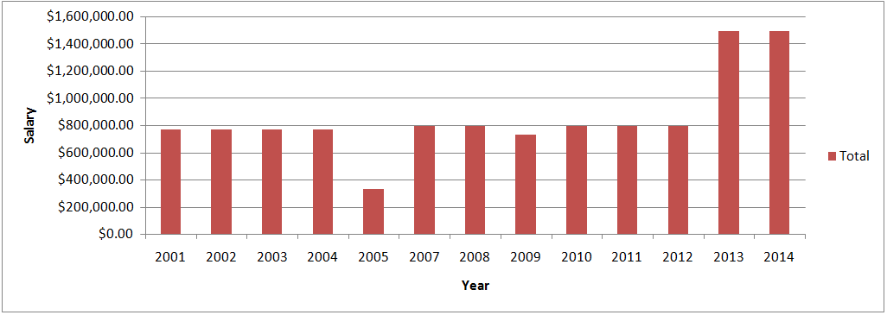
Morgan Stanley CEO’s Salary Analysis
Morgan Stanley paid its top executive James Gorman $1.5 million straight for year 2013 and 2014. That is a huge increase of 20% as his performance gained steam, lifting profits and firm stock price. Its been recorded highest since 2010.
CEO compensation plunged in 2005 , as the giant experienced lose during fourth fiscal year and had received $10 billion under the government’s Troubled Asset Relief Program that helped earned $1.59 billion, or$1.45 per share, during fiscal 2008.

Slide 12
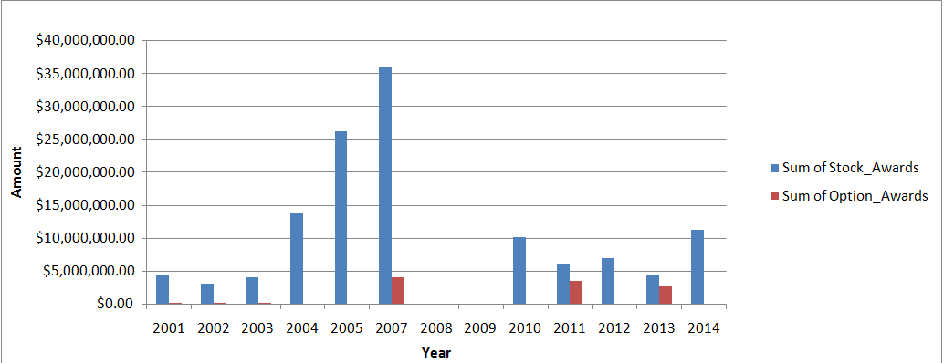
Morgan Stanley CEO’s Vested Stock and Option Awards Analysis
Financial firms has been hit the most during the recession bubble and Morgan Stanley was no exception, CEO’s didn’t received Stock and option awards during 2008 and 2009.
The company has been doing pretty well before the recession and CEO’s has been consistently awarded with high Vested Stock and option awards.

Slide 13
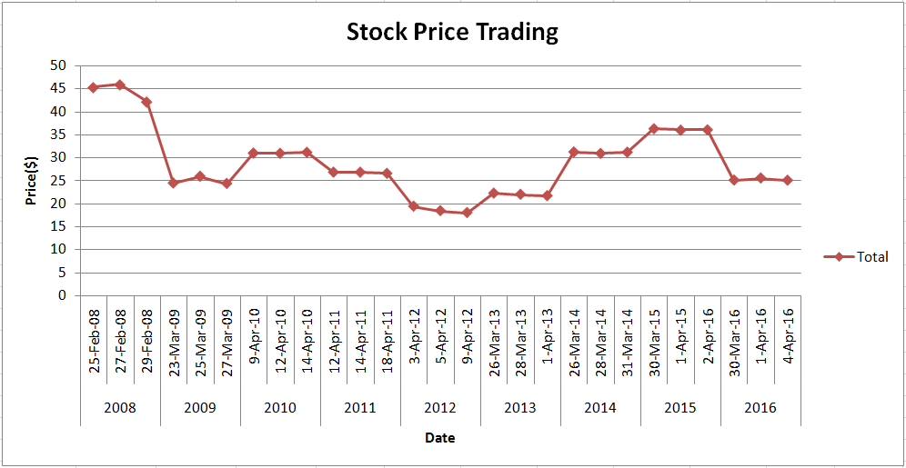
Morgan Stanley Stock Trading Activity
Stock prices of Morgan Stanley showed slight inconsistencies over last 9 years, after the recession in 2008.
Stock price in 2012 dropped drastically as investors weighed a potential credit-rating cut, Europe’s debt crisis and lowest trading revenue.
Fragility in Stock Price trading has a lot to do with lack of core funding structure, as it lack the same core deposit base that a Bank of America, JPMorgan and Citigroup owns.

Slide 14
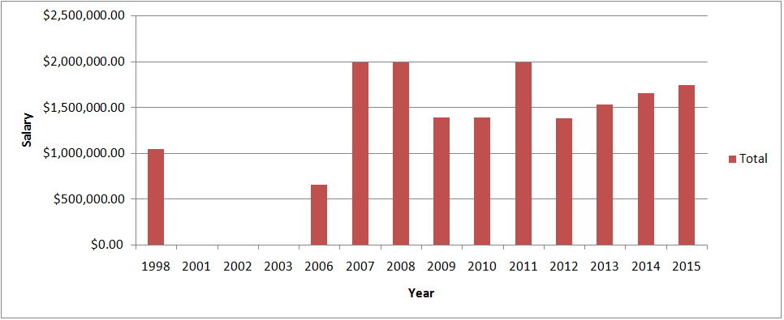
Ford Motor CEO’s Salary Analysis
Ford CEO ‘Alan Mulally’, a former Boeing exec. Received salary compensation of $2 million within four months of year 2007 as he brought the company into profitable levels after a steep decline in 2006, he established partnership with UAW union for R&D investment while using available resources wisely hence launching innovative products
Note: 2000-2005 salary data is not present as files didn’t parse properly.

Slide 15
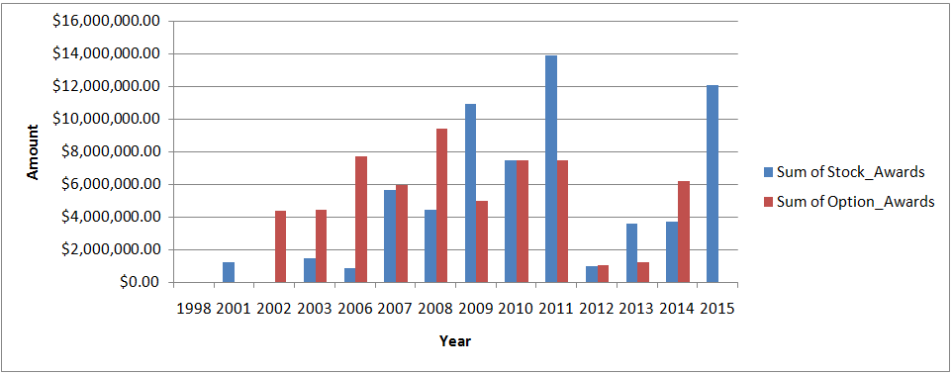
Ford Motor CEO’s Vested Stock and Option Awards Analysis
Mulley received the highest stock awards in 2011 after he raised the quality of cars, trucks and shifted model lineups from trucks to SUV’s and crossovers
In 2012 both the Stock and Option Awards had dropped drastically as a result of low operating profit after a loss of $1 billion in Europe, where the deepening economic crises had resulted very less sales.
Note: 2000, 2004-2005 data is not present as files didn’t parse properly.

Slide 16
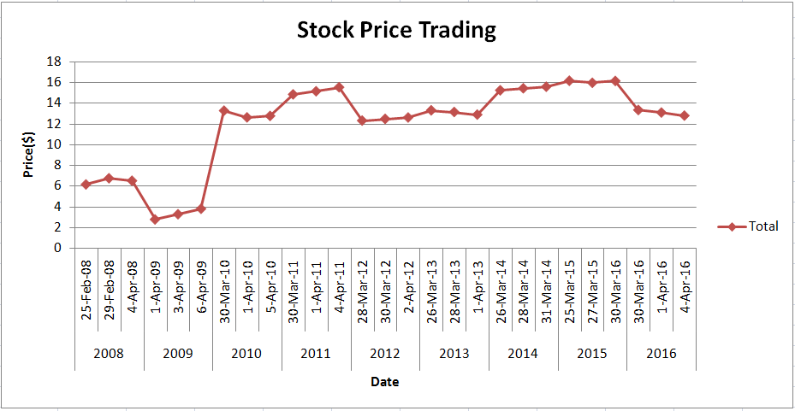
Ford Motor Stock Trading Activity
Stock Trading activity increased drastically after last quarter of 2009 as a result of stable dividends, increased cash flow and share price after collaboration with UAW
Stock price was highest in 2015 after the successful launch of revamped F-Series trucks
Stock prices were very low i.e around 4-6$ in 2008 and 2009 but it drastically raised to ~14$ in 2010 and thereafter not much changes in stock price.

Slide 17
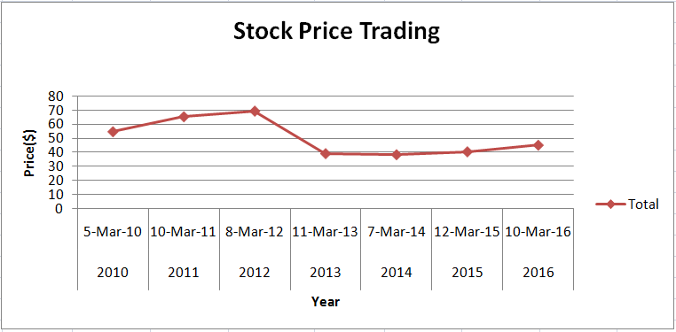
Coca Cola Stock Trading Activity
Stock prices dropped in 2013 by 30$ as a result of disappointing third-quarter results.
Coca-Cola blamed poor weather in North America for a drop in soft-drink sales.
However after the analysis, it has been found out that its been due to emerging-markets weakness, foreign exchange & facing fierce competition from PepsiCo.

Slide 18
Text Data Analysis – Part B
Below are the steps performed for text data analysis –
Used last 6 years’ DEF 14A files of Coca Cola company to analyze ‘Q&A with chairman and CEO' and ‘Q&A on proxy material’ sections.
Corpus of all files is created.
Only Q&A sections are cropped and used to create document term matrix.
Word matrix is analyzed to find trends among all words.
Plotted frequency of all the words that are repeated in the Q&A sections.
Created Word Cloud of pre-acquired Frequency.
Traced KEIs by finding relations among highly frequency and low frequency words.
Findings gathered from the analysis also reflects on the Coca Cola Stock Trading graph.

Slide 19
Coca Cola ‘Q&A with chairman and CEO' Section Analysis
'Q&A with chairman and CEO' section is used from proxy filing and term document matrix is created to analyze and find trends among all words.
Below document term matrix is showing top 30 high frequency words
board, business, shareowner, directors, proxy are most frequently used words in Q&A sections.
Also, words like ‘strategic’, ‘growth’, ‘issue’ ,’accelerate’ which are medium frequent words indicates some actions/events i.e. actions that are not that common.
Document Term Matrix -

Slide 20
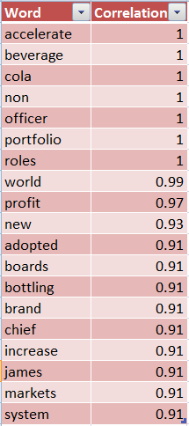
Coca Cola ‘KEI - Q&A with chairman and CEO' Section Analysis
Associated words with "coca" term.
KEI - "coca" word has good association with "profit", "new","adopted","brands", "beverages","boards","increase", "portfolio” which addresses company’s increase in profit or growth of company. Profit margin increased by 6% in 2015.Also, there is increasing trend in stock prices from 2010 to 2012 which supports this analysis. (slide 17)
Also, company has portfolio of refreshing brands in the nonalcoholic beverages industry.
"coca" word is also showing association with "officer" and "james". Both words are low frequency words indicates that event is happened only once. James Quincey was appointed as chief operating officer in 2014.
‘New’ ,’bottling’ and ‘brand’ words have correlation which addresses information on launching of new brand of coca cola. Again these words appeared together rarely which indicates this event is not common and it doesn’t happen every year.

Slide 21
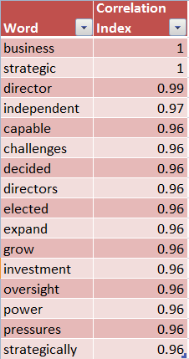
Coca Cola ‘KEI - Q&A with chairman and CEO' Section Analysis
Associated words with “board" term.
“board” word has good association with “business” , “strategic” , “director” , “grow” , “expand” , “power” , “pressure” , “investment” which explains overall plan of actions of board of directors to expand the business.
New Directors have been elected to the Board in 2011.
“event”,”shareowner”,”day” also have good correlation and ‘event’,’day’ words appeared together only once .Coca-cola launched new event Coca-Cola Shareowner Day in 2015.
KEI - “challenges” word has association with “board” word and it occurred more frequently in 2013 ; we checked this using inspect function. This word more prominently appeared in 2013 matrix which indicates tough time of company. Also, company didn’t do well in 2013; stock prices dropped by 30$ which supports this analysis. (slide 17)

Slide 22
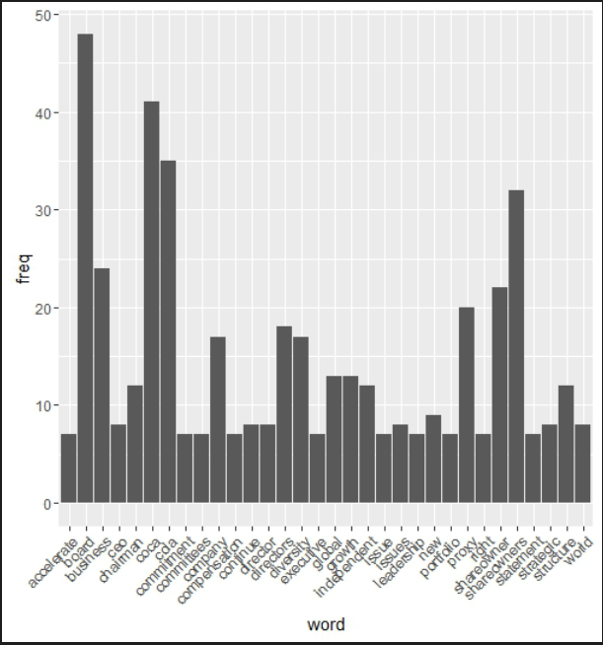
Coca Cola ‘KEI - Q&A with chairman and CEO' Section Analysis
Frequency graph
‘board’ word is very frequently used in Q&A section.
‘shareowner’ word is also used frequently. Shareowners approaches board of directors to question company’s growth.
Frequency graph is showing high frequency of “accelerate” , “strategic” , “growth” , “business” words. Coca-cola announced strategic actions designed to transform the business, accelerate growth.

Slide 23
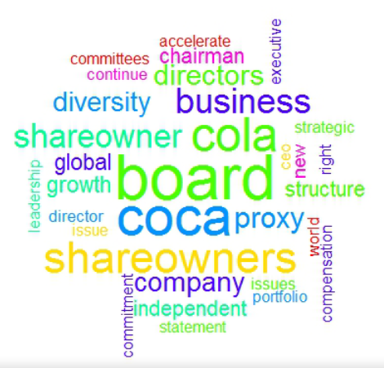
Coca Cola ‘KEIs - Q&A with chairman and CEO' Section Analysis
Word Cloud
shareowners and issue words have correlation and indicates shareowner’s issues related to proxy statement.
Diversity is a cornerstone value of the Coca-cola Company.

Slide 24
Coca Cola ‘Q&A Section on Proxy Materials’ Analysis
Frequency Graph
Word ‘PROXI’ and ‘VOTE’ are repeated for most number of times.
Word ‘Proxi’ and ‘Vote’ are repeated most of the time, as ‘Proxi’ statement is most commonly used in company for voting purpose.
‘Vote’ is frequently used because as per Q &A section, we can figure out that most of the conversations revolves around answering questions on voting process in organization.

Slide 25
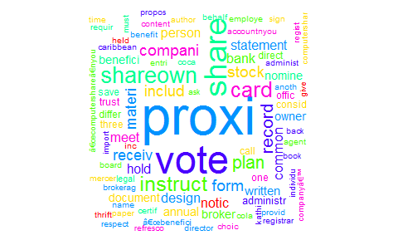
Coca Cola ‘Q&A Section on Proxy Materials’ Analysis
Word Cloud
The word ‘vote’, ‘stockholder’ and ‘share’ are prominent in the word cloud
This shows that ‘shares’, ‘stocks’ and ‘votes’ are the main agenda for all the meetings

Slide 26
Summary – Part A
Merck & Co. 12 year analysis showed that the company did pretty well overall except 2009, though it has shown increased pattern for stock growth until 2008. Merck & Co. also increased the Stock and Option Awards of CEO in 2014 & 2015.
‘James Gorman’, The CEO and President of Morgan Stanley since 2009 received compensation close to $1.5 Million with long-term incentive Stock Bonus awards as he considerably helped the firm with increased return-on-equity target. Analysis findings showed that the financial firm got hit hard in terms of revenue and had lost shares during recession in 2008 & 2009 resulting in no stock and option awards for CEO’s at that particular point of time.
As per the findings, Morgan Stanley experienced another rough patch with drop in stocks during 2012 when investors showed concerns with credit-rating cut followed with Europe debt crises resulting in lower trading revenue.
Ford CEO ‘Alan Mulally’ received highest compensation in 2007 since 1998, thanks to his innovative ideas and strategies that enormously helped the automobile giant.
Having performed the analysis we also found that ‘Alan’, received highest stock awards in 2011 after successful launch of SUV’s and Crossovers under Ford’s lineup.
Ford’s Stock Trading Activity reflects that the company’s stocks took up the pace after 2009 and had seen tremendous growth in 2010 until 2015, followed with slight downfall in 2016 which has been associated with strong marketing and new vehicles from its direct competitors ‘Toyota and Nissan’.

Slide 27
Summary – Part B
KEIs –
"coca" word has good association with "profit","new","adopted","brands", "beverages","boards","increase", "portfolio” which addresses company’s increase in profit or growth of company. Profit margin increased by 6% in 2015. Also, there is increasing trend in stock prices from 2010 to 2012 which supports this analysis.
“challenges” word has association with “board” word and it occurred more frequently in 2013 ; we checked this using inspect function. This word more prominently appeared in 2013 matrix which indicates tough time of company. Also, company didn’t do well in 2013; stock prices dropped by 30$ which supports this analysis.
Events –
James was appointed as chief operating officer in 2014.
coca-cola launched new event, Coca-Cola Shareowner Day in 2015.
Coca-cola launched new brands of coca cola as a global marketing strategy in 2015.
In 2014, shareowners raised issue on proxy statement demanding for the right to place their own director candidates. Most shareowners want companies to adopt some form of proxy access.
New board of directors elected.

Slide 28
Conclusion
From last 10 years, Merck is showing increasing trend in their stock prices which is the good indication of company’s growth.
Morgan Stanley has shown lot of inconsistency in their performance but still company did well last year.
Overall Ford Motor is doing well but stock prices are almost consistent from 2010.
Coca cola is not doing really good from 2013 and company needs some new marketing strategies to get into the competition and expand their business.

