Slide 1
527 Data Analytics - Assignment Week 9
October, 26 2015
Sonali Nimbalkar

Slide 2
Table of Content
24 Cluster Code and Scatter Plot Graph
24 Cluster with variable standardization
Cluster Analysis

Slide 3
24 cluster analysis using FASTCLUS
proc fastclus data=census.psam_h17_subset1 radius=0 replace=full maxclusters=24
converge=0 OUTSTAT=subset1_24clusters_stat OUT=subset1_24clusters distance;
id SERIALNO;
var VALP HINCP;
run;
proc sgplot;
scatter y=HINCP x=VALP / group=cluster;
title ’ACS PUMS 2013 1 YR 24-Cluster Analysis’;
title2 ’of Data Containing Property Value and Household Income’;
run;;

Slide 4
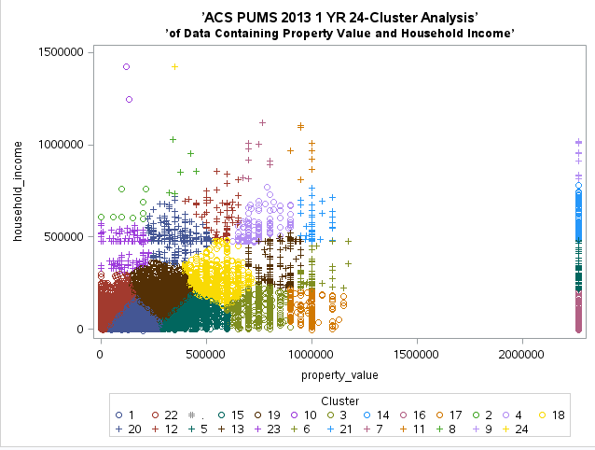
Scatter plot 1

Slide 5
24 cluster analysis using FASTCLUS with variable standardization
proc standard data=census.psam_h17_subset1 out=Stand mean=0 std=1;
var VALP HINCP;
run;
proc fastclus data=Stand radius=0 replace=full maxclusters=24
converge=0 OUTSTAT=subset1_24clus_stat_stan OUT=subset1_10clus_stan
distance;
id SERIALNO;
var VALP HINCP;
run;
proc sgplot;
scatter y=HINCP x=VALP / group=cluster;
title ’ACS PUMS 2013 1 YR 24-Cluster Analysis (w standardized data)’;
title2 ’of Data Containing Property Value and Household Income’;
run;

Slide 6
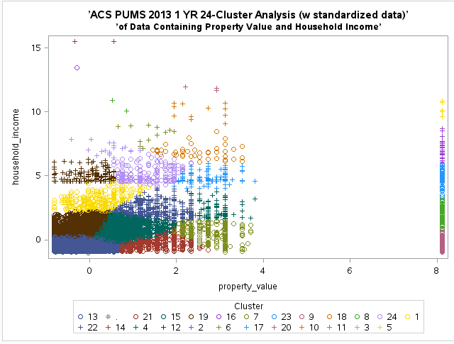
Scatter plot 2

Slide 7
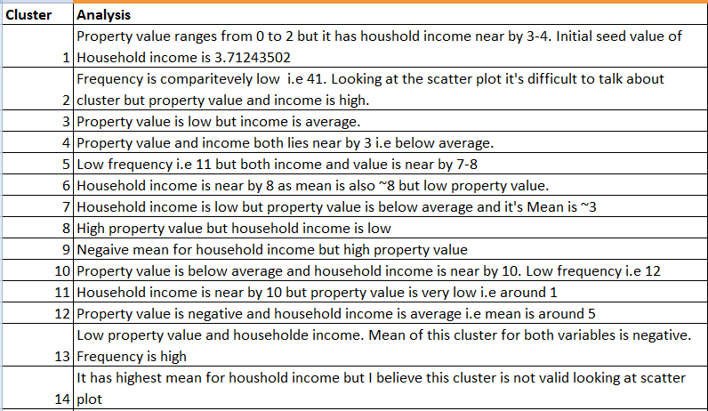
24 Cluster Analysis (With standardized variables)

Slide 8
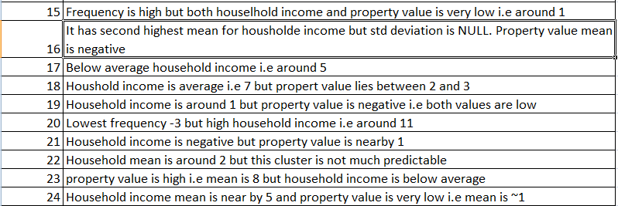
24 Cluster Analysis (With standardized variables)

