Slide 1
527 Data Analytics – Cluster Profiling
November 14, 2015
Sonali Nimbalkar

Slide 2
Objective
Objective of this assignment is to perform cluster analysis and profiling of housing data of Illinois state (year- 2013) which will further help in deciding tax strategy for Illinois state.
Data Source
PUMS Data Link:
http://www.census.gov/programs-surveys/acs/data/pums.html
Total Record Count : 58206

Slide 3
Data Information
Data Dictionary
HINCP: Household income (past 12 months)
TAXP: Property taxes (yearly amount)
VALP: Property value
◆ WIF: Workers in family during the past 12 months
◆ SMX: Second or junior mortgage or home equity loan status
◆ MV: When moved into this house or apartment
◆ WORKSTAT: Work status of householder or spouse in family households
More details are available on below Link:
http://www2.census.gov/programs-surveys/acs/tech_docs/pums/data_dict/PUMSDataDict13.pdf

Slide 4
Background
20 Clusters are created in SAS using FASTCLUS method to perform data profiling of housing records.
Code –
/*20 Cluster run of FASTCLUS*/
libname census "/folders/myfolders/census";
proc fastclus data=census.psam_h17_subset1
radius=0 replace=full
converge=0 maxiter=200
maxclusters=20
OUTSTAT=census.psam_h17_subset1_20clusters_stat
OUT=census.psam_h17_subset1_20clusters
distance;
id SERIALNO;
var VALP HINCP;
run;
proc sgplot;
scatter y=HINCP x=VALP / group=cluster;
title ’ACS PUMS 2013 1 YR 20-Cluster Analysis’;
title2 ’of Data Containing Property Value and Household Income’;
run;

Slide 5
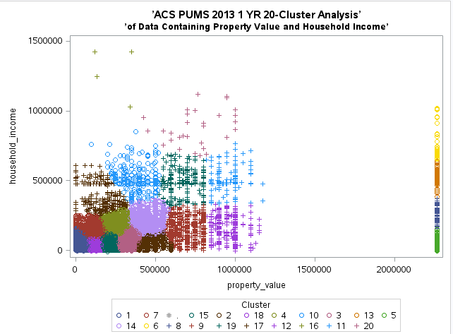
Background Scatter Plot of 20 clusters
This graph represents 20 clusters which are formed on the basis of property value and household income variables.

Slide 6
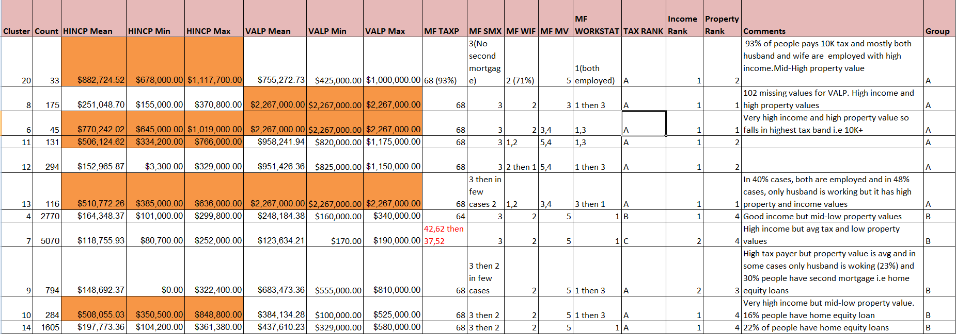
Characterization of variables
Each cluster is characterized on TAXP, VALP, HNCP, MV, WIF, WORKSTAT and SMX variables
Orange colored values fall in very high range

Slide 7
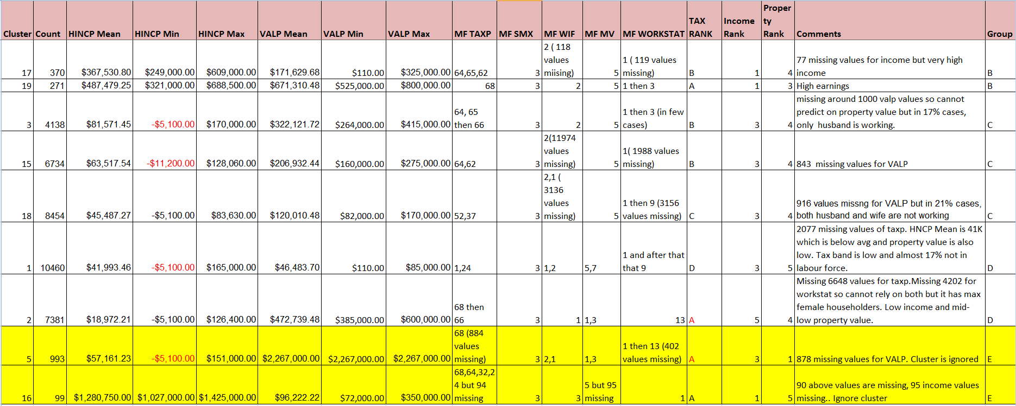
Characterization of variables
Yellow clusters are ignored due to high missing values, Red marked values are negative but no impact on analysis.

Slide 8
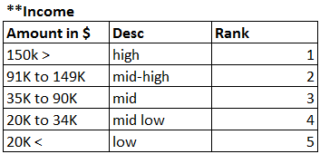
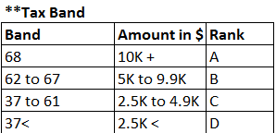
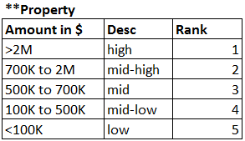
Cluster Analysis & Profiling
Excel sheet for Characterization:
Ranking is done on the basis of below ranges. (These ranges are decided looking at overall data set values i.e considering minimum, maximum and median values)

Slide 9
Cluster Analysis & Profiling
Detailed description for each cluster from above characterization.
Cluster 1 :
High frequency band – 10460 i.e lot of people fall in this criteria.
Average income and low property value.
Pays no tax or very low i.e around 1200$.
17% are non-workers.
Cluster 2 :
High frequency band – 7381 i.e lot of people fall in this criteria.
Poor income (~18K$) and mid-low property value.
Female householders.
Mostly one worker in family.

Slide 10
Cluster Analysis & Profiling
Cluster 3 :
Medium frequency band – 4138
Above average income and low property value.
Pays tax more than 6000$.
In 17% cases only husband is working.
Moved in house approx. 10 years back.
Cluster 4:
Good income and mid-low property value.
Pays tax more than 6000$.
Husband and wife both employed
Cluster 5 :
Average income and high property value i.e over 2 Millions.
90% property values are missing so cluster is ignored.

Slide 11
Cluster Analysis & Profiling
Cluster 6 :
Low frequency band – 45 i.e only few people fall in this criteria.
Very high income i.e around 770K$ and high property value i.e over 2M.
Falls in highest tax band i.e 10K $+
2 workers in family
Cluster 7 :
High income but mid-low property value.
Pays tax more than 3K $
Both husband and wife employed
Cluster 8 :
Low frequency band – 175 i.e few people fall in this criteria.
High income and very high property value.
Falls in highest tax band i.e 10K $+
2 workers in family

Slide 12
Cluster Analysis & Profiling
Cluster 9 :
High income and average property value.
Falls in highest tax band i.e 10K $+
2 workers in family
30% people have home equity loans
Cluster 10 :
Low frequency band – 284 i.e few people fall in this criteria.
Very high income and low property value.
Pays tax more than 6000$.
17% are non-workers.
Cluster 11 :
Low frequency band – 101 i.e very few people fall in this criteria.
Very high income i.e around 500K $ and mid-high property value.
Falls in highest tax band i.e 10K $+
Both husband and wife employed.

Slide 13
Cluster Analysis & Profiling
Cluster 12 :
Low frequency band – 294 i.e few people fall in this criteria.
Good income and mid-high property value.
Falls in highest tax band i.e 10K $+
Mostly both husband and wife are employed.
Cluster 13 :
Low frequency band – 116 i.e few people fall in this criteria.
Very high income (>500K $) and very high property value i.e over 2M $.
Falls in highest tax band i.e 10K $+
Cluster 14 :
Good income and low property value.
Falls in highest tax band i.e 10K $+
22% of people have home equity loans
Both husband and wife are employed.

Slide 14
Cluster Analysis & Profiling
Cluster 15 :
Average income and low property value.
Pays tax more than 5000$.
Moved in house approx 10 years back.
Cluster 16 :
Low frequency band – 99 i.e very few people fall in this criteria.
Lot of income values are missing so cluster is ignored
Cluster 17 :
High income and low property value.
Pays tax more than 5000$.
Moved in house approx 10 years back.

Slide 15
Cluster Analysis & Profiling
Cluster 18 :
High frequency band – 8454 i.e lot of people fall in this criteria.
Average income and low property value.
Pays tax more than3K $.
In 21% cases, both husband and wife are not working
Cluster 19 :
High income and average property value.
Falls in highest tax band i.e 10K $+
Mostly both husband and wife are employed.
Cluster 20 :
Very low frequency band i.e only 33 people fall in this criteria.
Very high income i.e around 800K $ and mid-high property value.
Falls in highest tax band i.e 10K $+
Mostly both husband and wife are employed.

Slide 16
Cluster Analysis & Profiling
Clusters are grouped on the basis of their similar characteristics and divided it into 4 groups as follows –
Group A –Affluent Class (Cluster : 20,8,6,11,12,13)
Mid-High or high property value
High income
2 workers in family
Highest tax payer i.e 10K $+
Both husband and wife are employed
Group B –Upper-middle Class (Cluster : 4,7,9,10,14,17,19)
Mid or mid-low property value
Mid-high or High income
2 workers in family
Pays tax more than 5K $
Owning house for more than 10 years
Both husband and wife are employed
Home equity loans as second mortgage

Slide 17
Cluster Analysis & Profiling
Group C –Middle Class (Cluster : 3,15,18)
Mid-low property value
Average or medium income
2 workers in family and also includes cases where only husband is working
Pays tax in between $2.5K to $4.9K
Group D –Lower Class (Cluster : 1,2)
Low or mid-low property value
Medium or below average income
No tax or less than 3K $
Non-working, female household

Slide 18
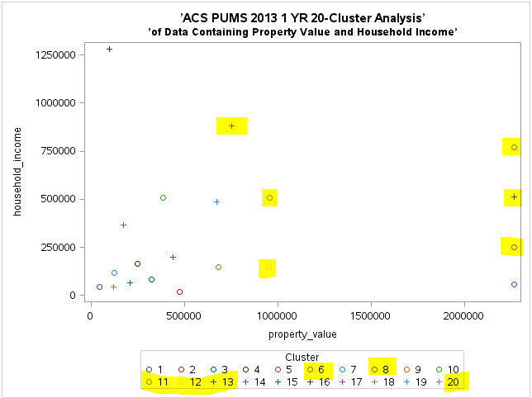
Groups on scatter plot
Group A - Affluent

Slide 19
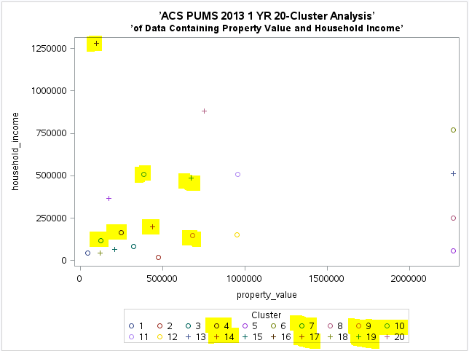
Groups on scatter plot
Group B – Upper middle

Slide 20
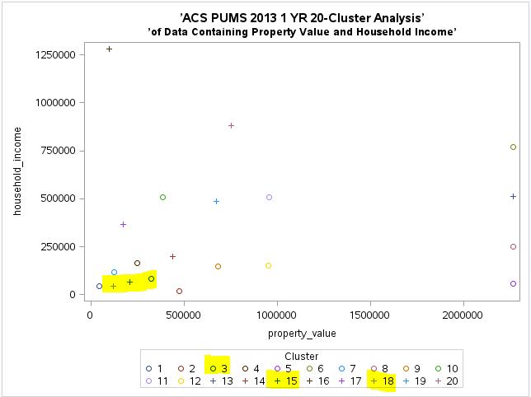
Groups on scatter plot
Group C - Middle

Slide 21
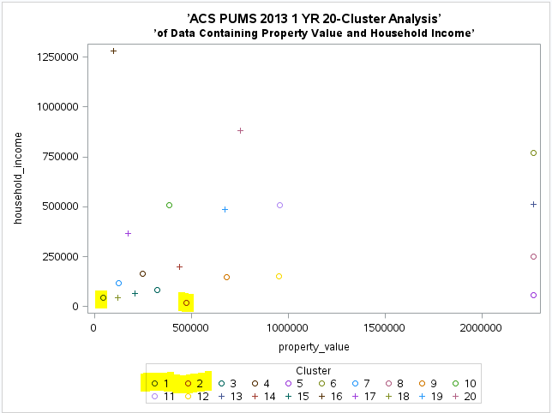
Groups on scatter plot
Group D - Lower

Slide 22
Conclusion
All clusters are finally grouped into 4 classes or financial income brackets which will help to decide what tax strategy to be applied in future.

