Slide 1
527 Data Analytics – Clustering in SAS
November 14, 2015
Sonali Nimbalkar

Slide 2
Introduction
Introduction
The data used for this analysis is of Joey Bag O’ Donuts Wholesale Wine Emporium. It’s an import-export business focused on bringing bulk wine to the states and selling it to select wine and liquor stores across the country. Objective of this assignment is to transpose wine_matrix in SAS, use of CLUSTER proc and then calculating deals by clusters.
Statistic
Total number of transactions/deals - 324
Total number of offers - 32
Total number of customers - 100

Slide 3
Part-1 – Transpose of matrix in SAS
Wine matrix data imported in SAS using import utility and then transposed using TRANSPOSE procedure of SAS. Unwanted columns are removed using DROP function and new table winekmc.matrix_transposed is created which contains transposed data.
/*Removal of unwanted columns */
data winekmc.wine_matrix;
set winekmc.matrix (drop = Campaign Varietal Minimum_Qty__kg_ VAR5 Origin Past_Peak);
run;
/*Transpose of matrix data*/
PROC TRANSPOSE DATA=winekmc.wine_matrix
OUT=winekmc.matrix_transposed (drop=_label_) name = cust_name;
ID offer__;
run;

Slide 4
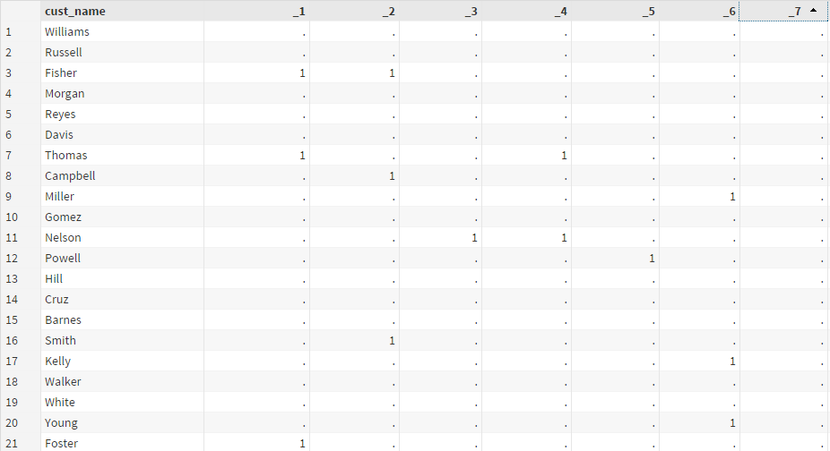
Part-1 – Transpose of matrix in SAS
Output -

Slide 5
Part-2 – Count deals by clusters in SAS
Step 1 - Replaced missing values to 0 in transposed matrix data set.
/*Replaced missing values with 0*/
data winekmc.matrix_transposed_nomissing;
set winekmc.matrix_transposed;
array change _numeric_;
do over change;
if change=. then change=0;
end;
run;

Slide 6
Part-2 – Count deals by clusters in SAS
Step 2 - 3 clusters are generated using CLUSTER proc and tree data is stored in winekmc.wine_tree_3_cluster data set.
/* Created clusters using CLUSTER proc */
proc cluster data=winekmc.matrix_transposed_nomissing method=ward
outtree=winekmc.wine_3_cluster noeigen simple;
var _1 -- _32;
id cust_name;
run;
proc tree data=winekmc.wine_3_cluster out=winekmc.wine_tree_3_cluster nclusters=3 noprint;
copy cust_name;
run;

Slide 7
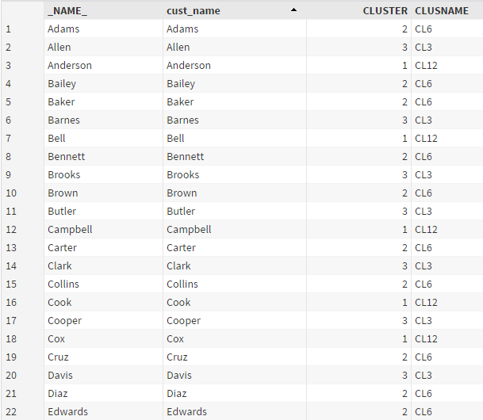
Part-2 – Count deals by clusters in SAS
Output -

Slide 8
Part-2 – Count deals by clusters in SAS
Step 3 – cluster result is combined with matrix_transposed_nomissing to assign clusters in matrix and result is stored in wine_3_cluster_agg
proc sql;
create table winekmc.wine_3_cluster_agg as
select a.*, b.CLUSTER
from winekmc.matrix_transposed_nomissing as a inner join winekmc.wine_tree_3_cluster as b
on a.cust_name=b.cust_name;
run;

Slide 9
Part-2 – Count deals by clusters in SAS
Step 4 – Summed up matrix binary values for each offer by clusters ; it came up with count of deals per cluster per offer. Result is stored in winekmc.wine_3_cluster_sum table.
proc sql;
create table winekmc.wine_3_cluster_sum as
select CLUSTER,sum(_1) as offer_1,sum(_2) as offer_2,sum(_3) as offer_3,sum(_4) as offer_4,
sum(_5) as offer_5,sum(_6) as offer_6,sum(_7) as offer_7,sum(_8) as offer_8,sum(_9) as offer_9,
sum(_10) as offer_10,sum(_11) as offer_11,sum(_12) as offer_12,sum(_13) as offer_13,
sum(_14) as offer_14,sum(_15) as offer_15,sum(_16) as offer_16,sum(_17) as offer_17,
sum(_18) as offer_18,sum(_19) as offer_19,sum(_20) as offer_20,sum(_21) as offer_21,
sum(_22) as offer_22,sum(_23) as offer_23,sum(_24) as offer_24,sum(_25) as offer_25,
sum(_26) as offer_26,sum(_27) as offer_27,sum(_28) as offer_28,sum(_29) as offer_29,
sum(_30) as offer_30,sum(_31) as offer_31,sum(_32) as offer_32
from winekmc.wine_3_cluster_agg
group by CLUSTER;
run;

Slide 10
Part-2 – Count deals by clusters in SAS
Step 5 – Again transposed result to show clusters as columns and offers as row and combined it with original matrix to regain all information about offer.
PROC TRANSPOSE DATA=winekmc.wine_3_cluster_sum OUT=winekmc.wine_3_cluster_sum_transposed (drop=_label_)
name = offer prefix = cl_;
ID CLUSTER;
run;
/*Joined with original matrix*/
proc sql;
create table winekmc.wine_3_cluster_final as
select b.*,a.cl_1,a.cl_2,a.cl_3
from winekmc.wine_3_cluster_sum_transposed as a inner join winekmc.matrix as b
on input(substr(a.offer,7,length(a.offer)),18.) = b.Offer__ ;
run;

Slide 11
Output
It contains result of Part 1 and Part 2. Part 2 intermediate results are exported from SAS data sets into each sheet step wise.

