Slide 1
527 Data Analytics – Cluster Comparison
November 14, 2015
Sonali Nimbalkar

Slide 2
Objective
Objective of this assignment is to compare clusters with and without standardization.
Data Dictionary
HINCP: Household income (past 12 months)
TAXP: Property taxes (yearly amount)
VALP: Property value
◆ WIF: Workers in family during the past 12 months
◆ SMX: Second or junior mortgage or home equity loan status
◆ MV: When moved into this house or apartment
◆ WORKSTAT: Work status of householder or spouse in family households

Slide 3
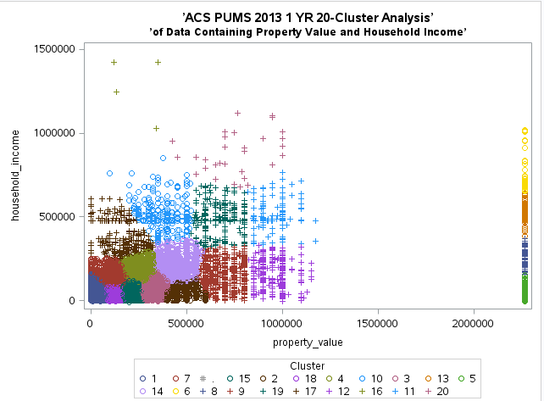
Background Scatter Plot of 20 clusters
This graph represents 20 clusters which are formed on the basis of property value and household income variables.

Slide 4
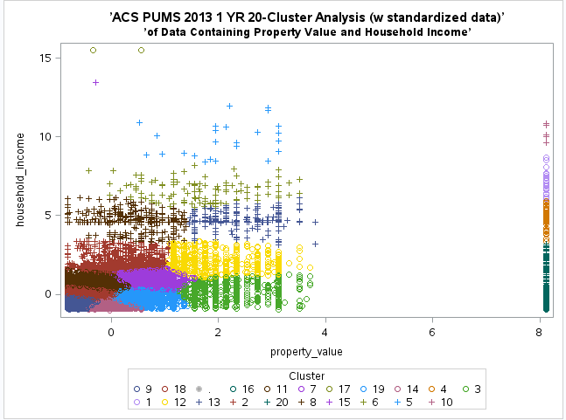
Scatter Plot of 20 clusters with standardization
This graph represents 20 clusters which are formed on the basis of property value and household income standardized variables.

Slide 5
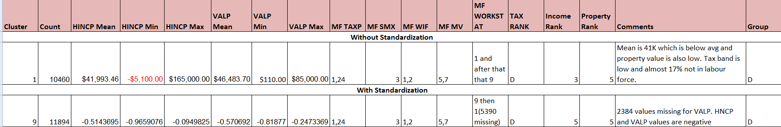
Characterization
As per above plots, cluster 1 is closest to (0,0) in without standardized variables where as cluster 9 is very much closer to (0,0) in standardized variable’s graph so I have compared cluster 1 versus cluster 9.

Slide 6
Cluster Analysis & Profiling
Detailed description for each cluster from above characterization.
Cluster 1 :
High frequency band – 10460 i.e lot of people fall in this criteria.
Average income and low property value.
Pays no tax or very low i.e around 1200$.
17% are non-workers.
Moved in house more than 10 years ago.
No second mortgages
Cluster 9 :
High frequency band – 11894 i.e lot of people fall in this criteria.
All income and property values are negative which represents low income and property value.
Pays no tax or very low i.e around 1200$.
21% are non-workers.
Moved in house more than 10 years ago.
No second mortgages

Slide 7
Conclusion
It shows slightest difference in percentage of values for each variable but still priority remains the same. For e.g cluster 1 has 17% of non-workers where as cluster 9 has 21% of non-workers still both contains non-workers with almost similar numbers and so category remains same. Also, cluster 1 has 10% of people as non tax payers and cluster 9 has 7% but both clusters have majority for non tax payers.
Looking at above comparison, it’s clear that there is no much difference between standardized and non-standardized clusters as characteristics of both represents ‘D’ group i.e lower class.
I assume, Standardized and non-standardized variables changes cluster numbering and formation because in above case cluster 1 is closest to 0 where as in standardized graph, cluster 9 is closest. Secondly, cluster 3 of standardized graph is almost equivalent to 2 clusters(9, 12 ) of non-standardized variables’ graph.

