Slide 1
527 Data Analytics Final Project
December 06, 2015
Sonali Nimbalkar

Slide 2
Final Project: Table of Content
Objective
Background
Data Information
Data Source
Source Data Statistics
Data Scope
Facts & Observations
Data Issues
Assumptions
Metadata Information
Approach
Clustering
Characterization
Cluster Analysis and Profiling
Tax strategy
Conclusion

Slide 3
Final Project: Overview
Objective
Objective of this project is to perform cluster analysis and profiling of housing data of Illinois state (year- 2013) to decide tax strategy for Illinois state.
Background
The Public Use Microdata Sample (PUMS) contains a sample of actual responses to the American Community Survey (ACS). PUMS files for an individual year, such as 2013, contain records of data from approximately one percent of the United States population. The PUMS dataset includes variables for nearly every question on the survey. Each record in the file represents single housing unit. Since all ACS responses are strictly confidential, many variables in the PUMS files have been modified in order to protect the confidentiality of survey respondents. The 2013 ACS PUMS files rely on PUMA boundaries that were drawn by state governments using data from the 2010 Census.

Slide 4
Final Project: Data Information
Data Source
File name - psam_h17.sas7bdat
This SAS file includes housing dataset for year 2013 which can be directly imported in SAS for further research or analysis.
PUMS Data Link: http://www.census.gov/programs-surveys/acs/data/pums.html
Source Data Statistics
Total Record Count : 58206
Variables : 231
Total tax groups : 68
Data Scope
Only housing data of Illinois state for year- 2013 is considered.

Slide 5
Final Project: Data Information
Facts and Observations
In most of the cases, both husband and wife are working.
Data set includes extreme low versus extreme high property values i.e it ranges from $110 to $2M.
80% of households have no second mortgages.
Data Issues
Lot of values are missing for VALP, HINCP and TAXP columns.
Few negative values are present in HINCP column.
Assumptions
Negative values will not have impact on analysis.
Missing values will be ignored.
Outliers will be grouped in the cluster of it’s own.

Slide 6
Final Project: Metadata Information
Data Dictionary
Below variables are used for clustering and profiling.
HINCP: Household income (past 12 months)
TAXP: Property taxes (yearly amount)
VALP: Property value
◆ WIF: Workers in family during the past 12 months
◆ SMX: Second or junior mortgage or home equity loan status
◆ MV: When moved into this house or apartment
◆ WORKSTAT: Work status of householder or spouse in family households
More details are available on below Link:
http://www2.census.gov/programs-surveys/acs/tech_docs/pums/data_dict/PUMSDataDict13.pdf

Slide 7
Final Project: Approach
Cluster Generation
Generation of clusters and scatter plot to depict graphical view of 20 clusters.
Characterization of variables of each cluster
Each cluster is characterized using variables of source data set to understand the behavior of cluster.
Cluster Analysis and Profiling
Clusters are then grouped on the basis of their similar characteristics for further profiling.
Tax Strategy for profiled groups
Schemes for tax increase are decided and applied to all groups considering group behaviors and ranking allotted to groups.

Slide 8
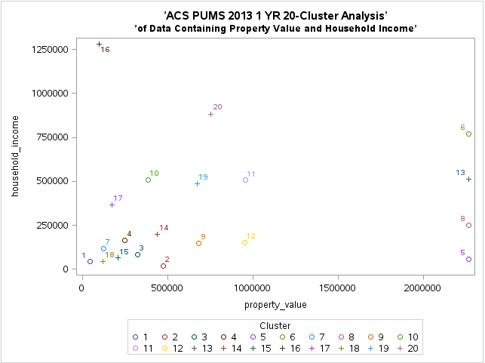
Final Project: Scatter Plot of 20 clusters
Below graph represents 20 clusters which are formed on the basis of property value and household income variables of housing data set.

Slide 9
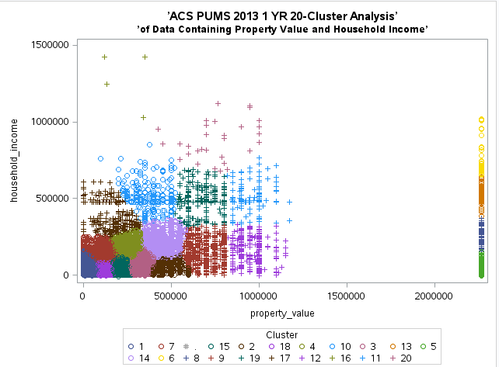
Final Project: Scatter Plot of 20 clusters
Below graph represents 20 clusters after completion of FASTCLUS proc.
Note : Color and sign of clusters changes after completion of proc and it’s different from initial cluster seeds as shown in previous slide but cluster positions are same.

Slide 10
Final Project: Characterization of variables
Each cluster is characterized on TAXP, VALP, HNCP, MV, WIF, WORKSTAT and SMX variables of source data set to understand the behavior of cluster.
TAXP is useful to group households into high to low classes based on their tax amount which further can be used in deciding tax increase schemes according to tax value ranges.
HINCP is useful to get the idea of current household income as it plays major role in deciding tax increase depending on it’s high to low brackets.
VALP is used to understand the asset value on which householders are paying taxes.
MV helps to understand since when owner is paying property tax so it can be deciding factor while doing tax increase.
WIF is used get the idea total workers in family which can directly impact tax increase.
WORKSTAT gives the status of workers in family which can also contribute in deciding tax increment.
SMX is useful to understand the what kind of second mortgages householders have recently which depicts the stability of households to decide tax increase.
Characterization Sheet –

Slide 11
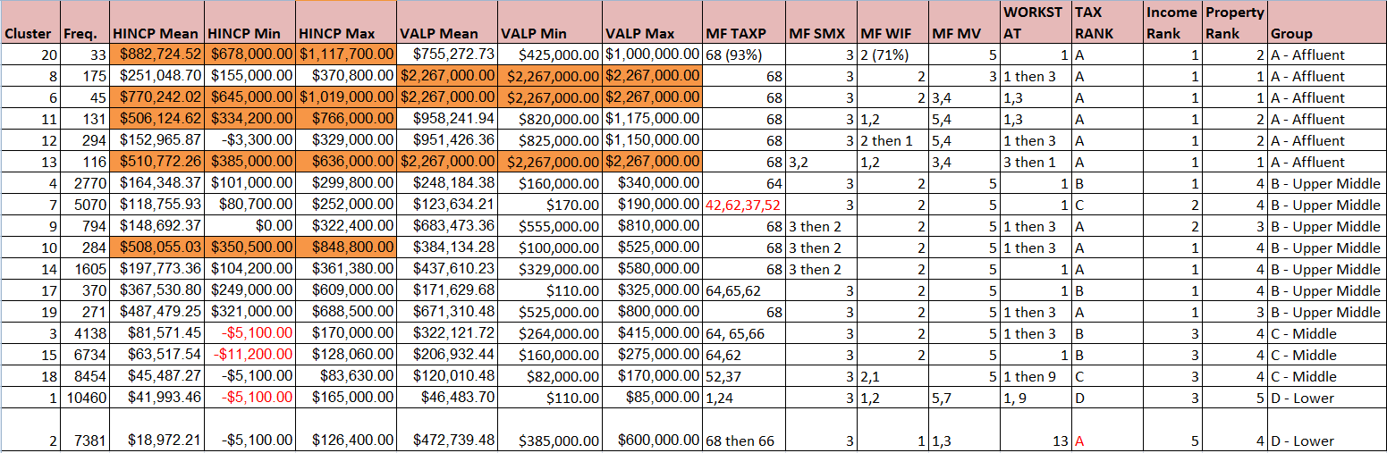
Final Project: Characterization of variables
Orange colored values are high ranged values out of which 6, 13 are outliers and red colored texts are negative values.

Slide 12
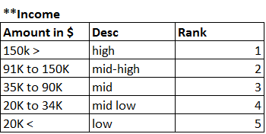
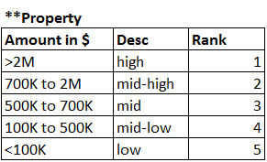
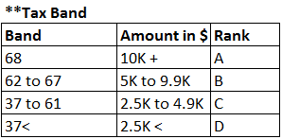
Final Project: Characterization of variables
Ranking of variable values is done on the basis of below ranges. (These ranges are decided looking at overall data set values i.e considering minimum, maximum and average values)

Slide 13
Final Project: Cluster Analysis & Profiling
Clusters are grouped on the basis of their similar characteristics and divided it into 4 groups as follows –
Group A –Affluent Class (Cluster : 20,8,6,11,12,13)
Mid-High or high property value
High income
2 workers in family
Highest tax payer i.e 10K $+
Both husband and wife are employed
Group B –Upper-middle Class (Cluster : 4,7,9,10,14,17,19)
Mid or mid-low property value
Mid-high or High income
2 workers in family
Pays tax more than 5K $
Owning house for more than 10 years
Both husband and wife are employed
Home equity loans as second mortgage

Slide 14
Final Project: Cluster Analysis & Profiling
Group C –Middle Class (Cluster : 3,15,18)
Mid-low property value
Average or medium income
2 workers in family and also includes cases where only husband is working
Pays tax in between $2.5K to $4.9K
Group D –Lower Class (Cluster : 1,2)
Low or mid-low property value
Medium or below average income
No tax or less than 3K $
Non-working, female household

Slide 15
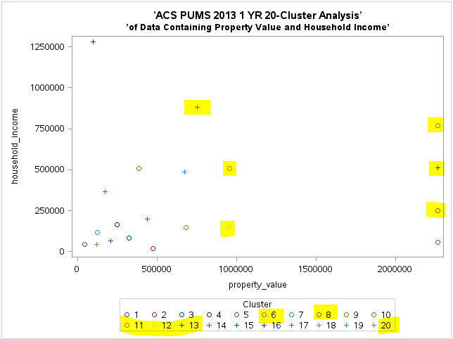
Final Project: Groups on scatter plot
Group A - Affluent

Slide 16
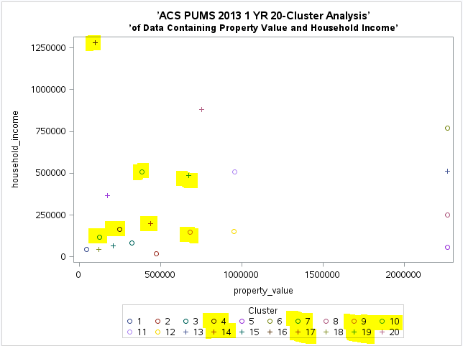
Final Project: Groups on scatter plot
Group B – Upper middle

Slide 17
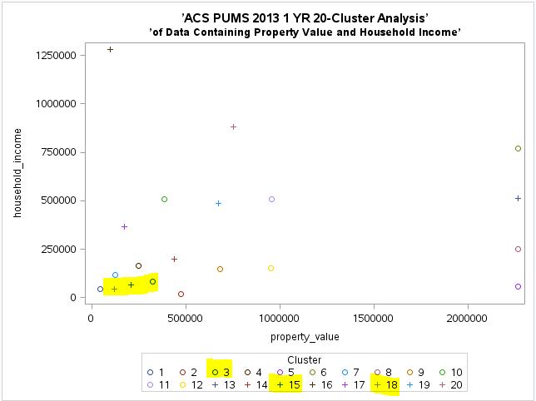
Final Project: Groups on scatter plot
Group C - Middle

Slide 18
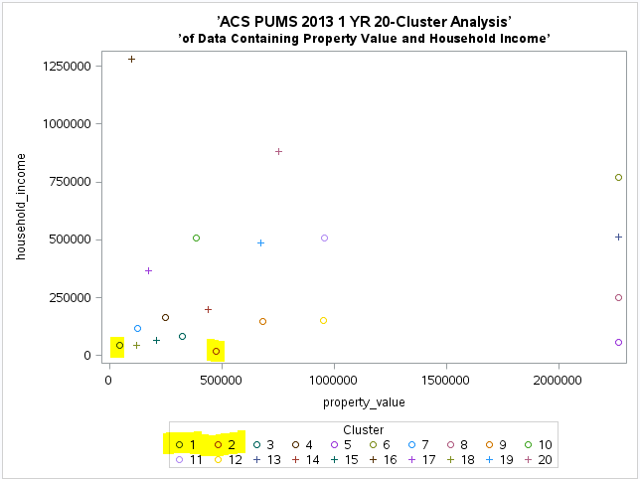
Final Project: Groups on scatter plot
Group D - Lower

Slide 19
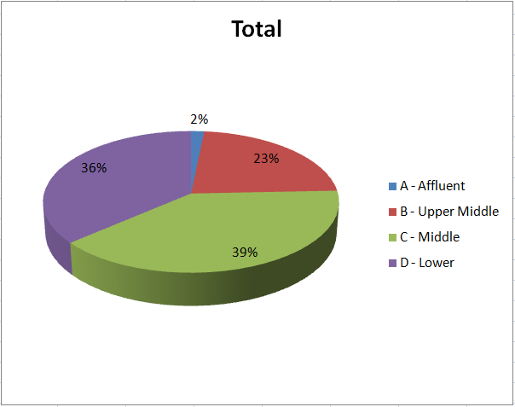
Final Project: Cluster Summary
7989 records are omitted from analysis due to missing values.
50217 records are divided into 20 clusters.
Out of 50217 , 1092 records i.e clusters 5 and 16 are ignored due to high missing values of VAPL and HINCP variables.
Maximum households are from middle class(C group) who pays taxes in between $2.5K to $9.5K. So tax strategy will be decided considering this fact.

Slide 20
Final Project: Tax Strategy
Below tax increase schemes are applied to all 4 groups based on above cluster analysis and ranking given to clusters. Households can fit into multiple schemes but it will start hierarchically from scheme 1 i.e highest tax bracket and so whichever is the highest tax bracket scheme fits to household among all is applicable to that household.
Scheme 1
30% tax increment for households who are currently paying taxes more than $10K, having property value above $2M and yearly income is more than $150K.
Scheme 2
25% tax increment for households who are currently paying taxes more than $5K, having property value above $700K and yearly income is more than $150K.
Scheme 3
20% tax increment for households who are currently paying taxes more than $5K, having property value less than $700K and yearly income is more than $150K.

Slide 21
Final Project: Tax Strategy
Scheme 4
15% tax increment for households who are currently paying taxes in between $2.5K to 5K, having yearly income more than $90K and workers in family are more than 1 except which falls in non-working categories (Workstat : 15,9,12).
Scheme 5
10% tax increment for households who are currently paying taxes in between $1K to 2.499K, having yearly income more than $70K and workers in family are more than 1 except which falls in non-working categories (Workstat : 15,9,12).
Rest all are exempted from tax increase.

Slide 22
Final Project: Tax Strategy Calculation
Increased tax for all groups is calculated as follows –
Get the tax group of household to which it belongs.
Find out minimum and maximum range of tax group and calculate average.
Apply tax scheme by multiplying increased percentage to above calculated average and it returns increased tax amount.
For e.g if household's tax group is 62 which has min value $5K and max value $5499 then it is paying average tax $5249.50 and if it's falling under 20% tax increase scheme then incremented tax for that household is 5249.50*0.20 = $1049.90.

Slide 23
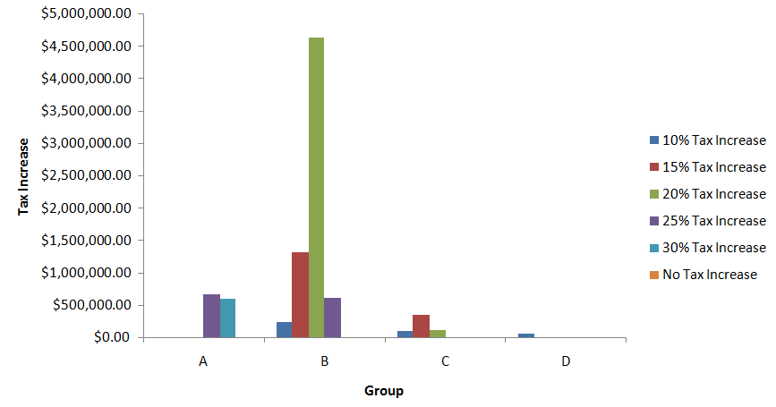
Final Project: Tax Strategy Findings
Maximum tax increase benefit can be obtained from group B i.e upper middle class where as group D i.e lower class has lowest tax increase. Group A i.e affluent class mostly falls in 30% or 25% tax increment scheme.

Slide 24
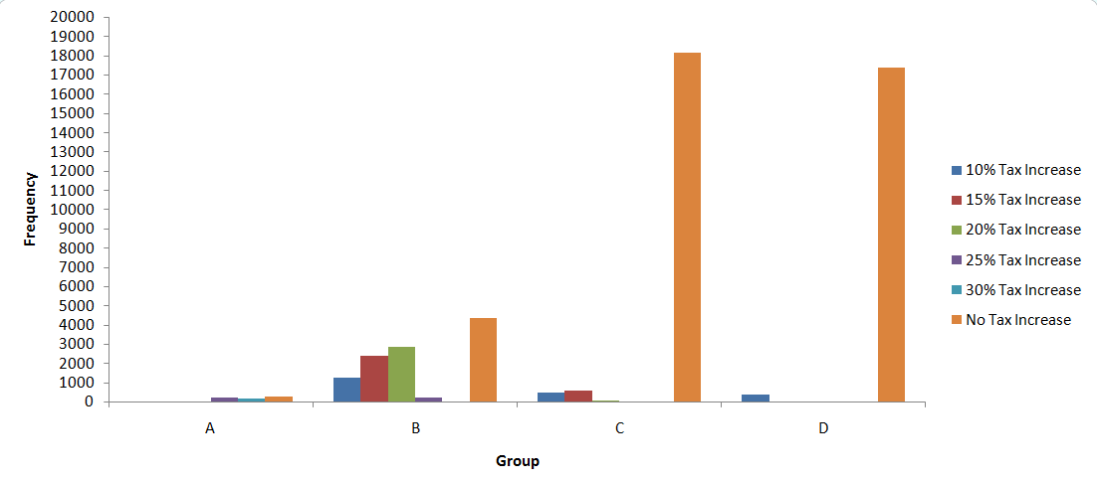
Final Project: Tax Strategy Findings
Group B class has majority of households falling in10% to 25% tax increment schemes and around $6M can be obtained from it whereas very less i.e around $67K can be obtained from Group D. Only group A falls in 30% tax increment scheme.

Slide 25
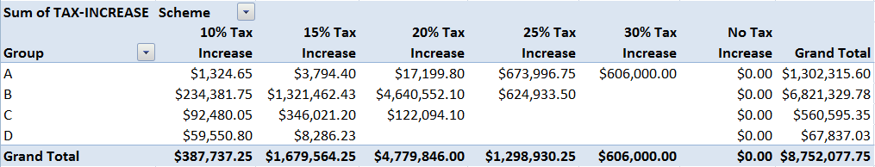
Final Project: Tax Strategy Summary
Total anticipated tax increment is around $8.5M.
Maximum returns can get from 20% tax increase scheme and around $4.5M can be anticipated from upper middle class i.e Group B.
Only group A i.e affluent class falls in 30% tax increment scheme.
Group D i.e lower class’ majority of amount is from 10% tax increment scheme.
Group C i.e middle class’ majority of amount is from 15% tax increment scheme.

Slide 26
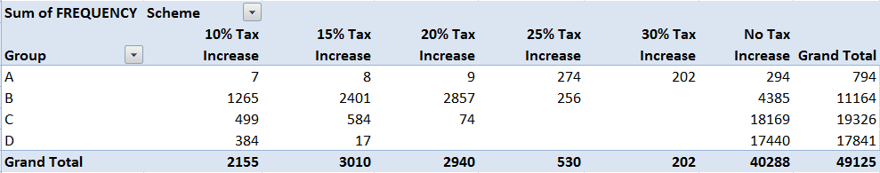
Final Project: Tax Strategy Summary
40288 households out of 49125 are exempted from tax increase.
Maximum households which are falling under no tax increase are from group C and D i.e middle and lower classes.
20% increased tax payers are majorly from Group B i.e upper middle.
476 households out of 794 from group A i.e affluent class falls in 25% and 30% tax increment schemes.
All above points support previous slide’s analysis.

Slide 27
Final Project: Conclusion
Total anticipated tax increase is $8,752,077.75.
Highest tax payers and very high income householders are in group A so they fall in maximum i.e 30% tax increment scheme. Total returns of group A can go up to $1,302,315.60.
Low tax payers having low household incomes are exempted from tax increase and these are majorly from middle and lower classes.
For Group C, maximum returns are anticipated from 15% tax increase scheme; total anticipated returns from Group C is $560,595.35.
98% of households from Group D are exempted from tax increase.
Most stable group is B as maximum anticipated returns for upper middle class is $6,821,329.78.
Around 82% of households cannot go under tax increase scheme so it is the next focus area to look after on their existing tax strategy and how it's working out currently.

