Slide 1
529 Data Analytics
March 22, 2016
Analysis of bike sharing data
Sonali Nimbalkar

Slide 2
Table of Content
Business Scenario and Objective
Data Selection
Data Flow
Exploratory Data Analysis Results
Basic statistics for variables
Histogram & probability plot
Association between response vs predictors and among predictors
Regression Modeling Results
Modeling strategy
Temperature vs Bike rental count using proc REG
Season vs Bike rental count using proc GLM
Weather vs Bike rental count using proc GLM
Wind speed vs Bike rental count using proc REG
Holiday vs Bike rental count using proc GLM
Interaction of season, temp and weather vs bike rental count using proc GLM
Summary
Conclusions

Slide 3
Business Scenario and Objective
Business Scenario –
Bike sharing systems are new generation of traditional bike rentals where whole process from membership, rental and return back has become automatic. Through these systems, user is able to easily rent a bike from a particular position and return back at another position. Today, there exists great interest in these systems due to their important role in traffic, environmental and health issues. Opposed to other transport services such as bus or subway, the duration of travel, departure and arrival position is explicitly recorded in these systems. This feature turns bike sharing system into a virtual sensor network that can be used for sensing mobility in the city. Hence, it is expected that most of important events, environmental issues in the city could be detected via monitoring these data.
Objective -
Predication of bike rental count based on the environmental and seasonal changes so it will help to understand what all environmental factors like temperature, humidity, wind speed and weather change are affecting increase or decrease in bike rental count.
The secondary objective is to perform analysis of seasonal changes which will not only help to understand the impact on bike renting but also it will give an idea of how weather, temperature, wind speed are co-related with season and contribute in fluctuations in bike rental count.

Slide 4
Selected Data Understanding of data set
Bike sharing data is gathered from UCI link -
https://archive.ics.uci.edu/ml/datasets/Bike+Sharing+Dataset
Folder & File name: Bike-Sharing-Dataset.zip : hr.csv, day.csv
Hour row count : 17379, day row count: 732.
day.csv is used for analysis which is aggregated data set of hr.csv.
The data set is related to the two-year historical log corresponding to years 2011 and 2012 from Capital Bike share system, Washington D.C., USA which is publicly available in http://capitalbikeshare.com/system-data. The data set is aggregated on day level and it includes environmental factors like humidity, temperature, wind speed, season, weather status and apart from these, it also has holiday, working day flags.

Slide 5
Selected Data Understanding of variables
Data set has 16 variables out of which 8 variables are considered for analysis.
season : season (1:springer, 2:summer, 3:fall, 4:winter)
yr : year (0: 2011, 1:2012)
holiday : whether day is holiday or not
weathersit : 1: Clear, Few clouds, Partly cloudy, Partly cloudy
2: Mist + Cloudy, Mist + Broken clouds, Mist + Few clouds, Mist
3: Light Snow, Light Rain + Thunderstorm + Scattered clouds, Light Rain + Scattered clouds
4: Heavy Rain + Ice Pallets + Thunderstorm + Mist, Snow + Fog
temp : Normalized temperature in Celsius. Range between 0 and 1
hum: Normalized humidity. Range between 0 and 1
windspeed: Normalized wind speed. Range between 0 and 1
cnt: count of total rental bikes including both casual and registered
Two sample sets are created based on each year.

Slide 6
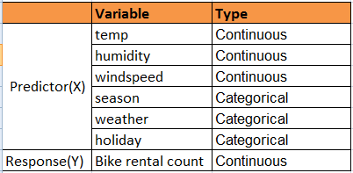
Selected Data Understanding of variables
Below X and Y variables are used for modeling.

Slide 7
Data Flow
<>
Data Sourcing
Data Integration
Presentation Layer
Data Import
(Excel to SAS table)
SAS
Bike Sharing Data (year 2011, 2012)
CSV File
Histogram
Probability Plot
QQ Plot
SGSCATTER plot
Regression Result
Diagnostic plot
Freq plot
Vbox plot
GLM Result
Data Processing
Data Transformation Activity
Program files
Sample files
Output files
Excel
SAS
PPT

Slide 8
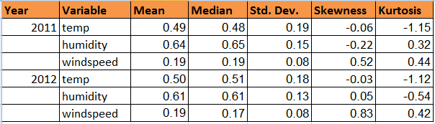
Exploratory Data Analysis Basic statistics for continuous variables
As per given data set, all 3 variables have normalized value in between 0 to 1 range.
Mean and median of below variables are close to each other which indicates normal distribution of data.
Skewness and Kurtosis values are near to 0 for numeric values of all sample sets except temperature. Also, standard deviation is very close to 0 i.e values are clustered around the mean. Hence, data is normally distributed.

Slide 9
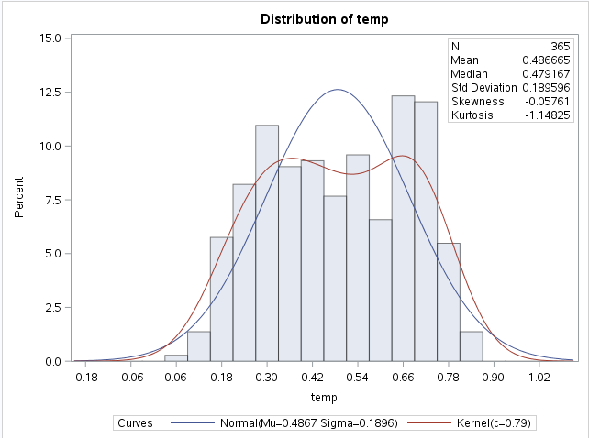
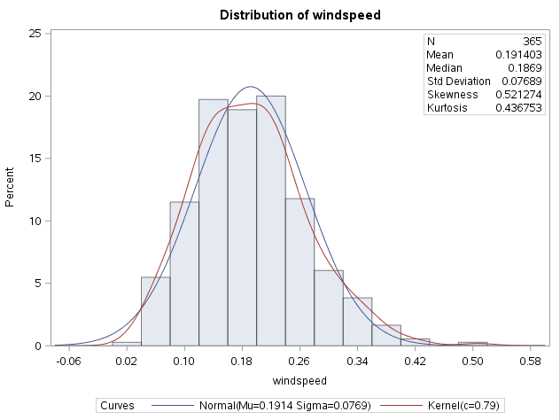
Exploratory Data Analysis Histogram for continuous variables
Temperature is little bit left skewed at 0.66-0.78 and it’s showing platykurtic distribution. But wind speed is showing quite normal distribution as kurtosis is near to 0.
Note : Statistical values for all sample sets are provided on slide 7

Slide 10
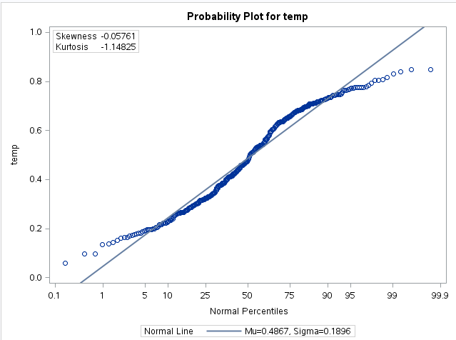
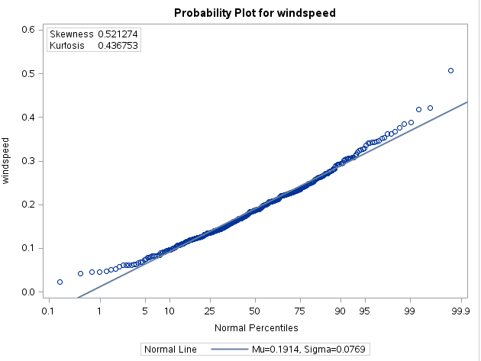
Exploratory Data Analysis Probability Plot for continuous variables
Temperature is showing light tailed distribution but mostly all points are hovering around reference line whereas wind speed has normally distributed values.
Note : Statistical values for all sample sets are provided on slide 7

Slide 11



Exploratory Data Analysis Basic statistics for categorical variables
Mean of bike rental count is high in clear or partly cloudy weather(1) whereas it’s very low in light rain or snow(3). Also, mean of bike rental count is comparatively high on non-holidays(0) than holidays(1) so maximum bikes are rented on working days.
Fall(3) season has highest mean of bike rental count whereas spring(1) has lowest mean.
Note : Number of obs is equal to number of days so total is always 365 days and mean depicts average of bike rental count.

Slide 12
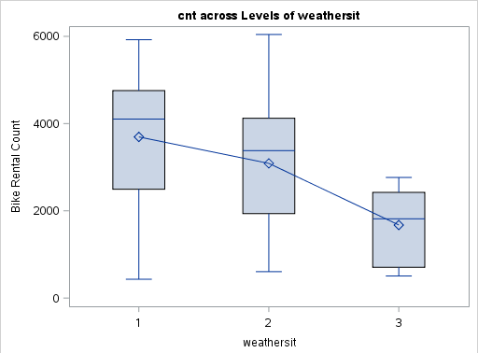
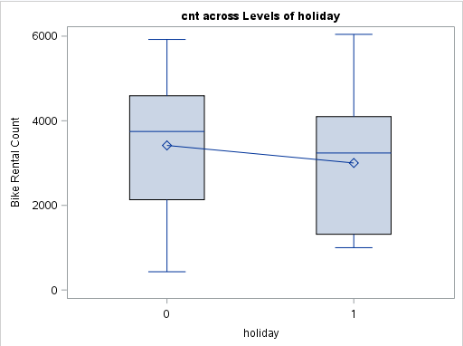
Exploratory Data Analysis Association between response and predictors
Average bike rental count is above 4000 in clear or partly cloudy weather(group 1) whereas it’s below 2000 in light rain or thunderstorm or snow(group 3).
Bike rental count is comparatively high on non-holidays but no much significant difference in means of both groups so it might not have strong influence on variation in bike rental count.
Weather vs bike rental count
Holiday vs bike rental count
0= Non-holiday,1=Holiday

Slide 13
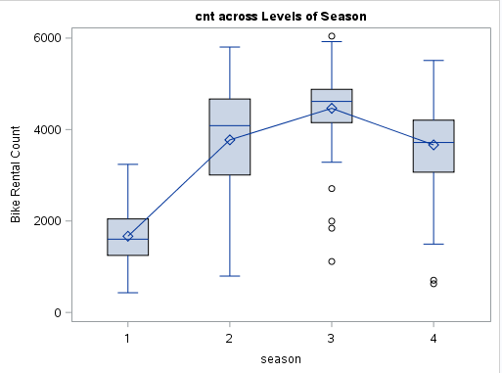
Exploratory Data Analysis Association between response and predictors
Fall season(group 3) has high bike rental count i.e above 4000 whereas spring(group 1) has very low bike rental count.
Overall there is statistically significant difference in means of each group of season and weather so both factors have good association with bike rental count.
Season vs bike rental count

Slide 14
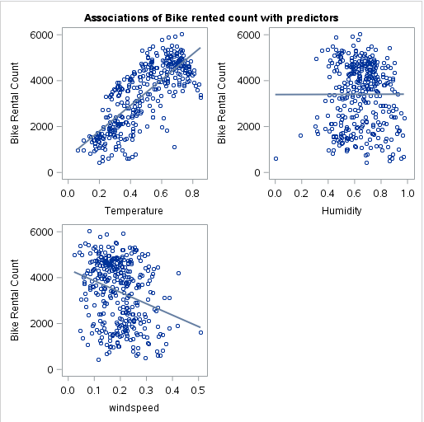
Exploratory Data Analysis Association between response and predictors
It shows that temperature has linear relationship with bike rental count whereas wind speed and humidity are not showing association with rental count.

Slide 15
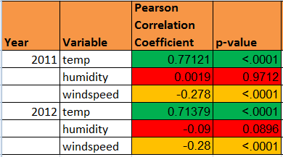
Exploratory Data Analysis Association between response and predictors
Pearson correlation coefficient for temperature is near to 0.7 which shows strong positive linear relationship with bike rental count. Also, respective p-value is <0.05 which rejects null hypothesis i.e slope is not horizontal.
Wind speed shows little bit negative association with rental count i.e bike rental count is high with low wind speed and vice versa but still there is no much significance.
Humidity has no association with bike rental count.

Slide 16
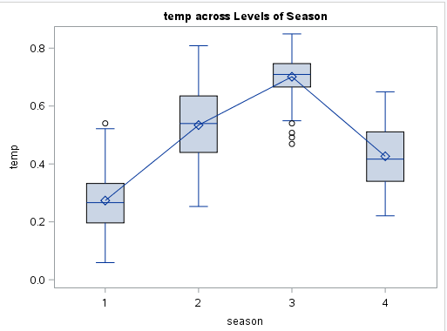
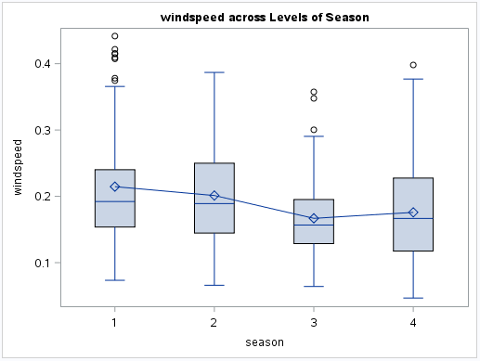
Exploratory Data Analysis Association among predictors
Season has association with temperature; temperature is high in fall and very low in Spring. Summer has moderate temperature.
Wind speed is low in Fall as compared to other seasons whereas it’s bit high in spring i.e around January to march.
This association among predictors is further used to find better fit for model considering effect of each factor on the other.(Model with interaction)
Season vs temperature
Season vs wind speed
16

Slide 17
Regression Modeling Modeling Strategy
From previous exploratory analysis, it’s clear that temperature, season and weather have good association with bike rental. Also, wind speed and holiday flag are showing some association with bike rental count so the strength of association is validated further using modeling techniques.
Prediction of bike rental count and impact of these variables/factors on bike rental count i.e how much influence these factors have individually/together in the variation of bike rental count is checked using below models.
Temperature vs Bike rental count using proc REG
Wind speed vs Bike rental count using proc REG
Season vs Bike rental count using proc GLM
Weather vs Bike rental count using proc GLM
Holiday vs Bike rental count using proc GLM
Impact of interaction of variables on bike rental count using proc GLM:n-way ANOVA i.e 2 or more significantly associated factors are considered together to find out the best model fit.

Slide 18
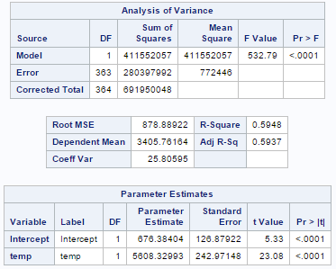
Regression Modeling 1. temperature vs bike rental count
F-value(532.79) of model is high and corresponding p-value is less than 0.05 which depicts that over all model is significant and good amount of variability is explained by model. p-value of slope is <0.05 which rejects null hypothesis i.e slope is not horizontal and it’s value is non-zero hence temperature is statistically significant in predicting bike rental count i.e if temp increases by 1 unit, bike rental count increases on an average by β₁₌5608.32 value. Also, intercept value is non-zero.
59% of variation(R-square=0.59) in bike rental count is explained by temperature in below regression model.
Reg equation to predict bike rental count:
Ybike_rental_count = 676.38 + 5608.32 * Xtemperature
18

Slide 19
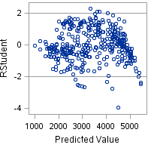
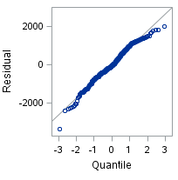
Regression Modeling 1. temperature vs bike rental count - validation of regression model using diagnostic plot
Below 2 graphs indicates that this regression model is better fit as residuals are normally distributed for temperature.
Residuals are estimates of error term. It’s showing random pattern of residuals above and below 0 which states that error terms have equal variances.
QQ plot is showing normal distribution of residuals as all points are around ref. line.
19

Slide 20
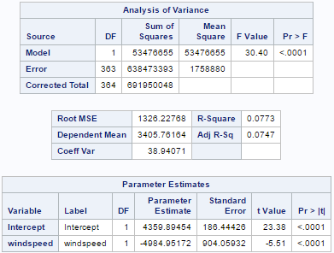
Regression Modeling 2. wind speed vs bike rental count
F-value(30.40) of model is good enough and corresponding p-value is less than 0.05 which depicts that over all model is significant. p-value of slope is <0.05 which rejects null hypothesis i.e slope is not horizontal and it’s value is negative hence there is negative correlation between wind speed and bike rental count i.e if wind speed increases by 1 unit, bike rental count decreases on an average by β₁₌-4984.95 value. Also, intercept value is non-zero.
7% of variation in bike rental count is explained by wind speed in below model which depicts that wind speed has no much influence on variability in bike rental count.
20

Slide 21
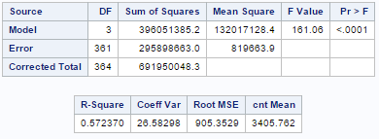
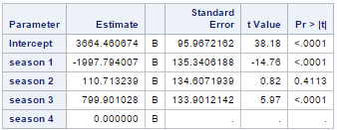
Regression Modeling 3. season vs bike rental count
F-value(161.06) of model is high and corresponding p-value is <0.05 which rejects the null hypothesis i.e mean of at least one season group is significantly differs than others which depicts that over all model is significant. p-value of 2 groups is <0.05 i.e mean for spring, fall groups significantly differs from mean of winter(season 4) which is reference group. In below model, intercept is mean of reference group i.e winter and estimate values of other groups are difference in the mean of that group and reference group. Fall(season 3) has high mean difference(β₃₌799.90) which shows that max. bikes are rented in fall but spring(season 1) has negative difference(β₁₌-1997.79) hence less bikes are rented in spring than other seasons. Mean of summer(season 2) is not significantly different from winter but it may differ with respect to other seasons.
57% of variation(R-square=0.57) in bike rental count is explained by season.
Avg. bike rental count for all seasons:
Yfall_mean_count = 3664.46+799.90=4464.36
Yspring_mean_count = 3664.46+(-1997.79) =1666.67
Ysummer_mean_count = 3664.46+110.71=3775.17
Ywinter_mean_count = 3664.46+0=3664.46
21

Slide 22
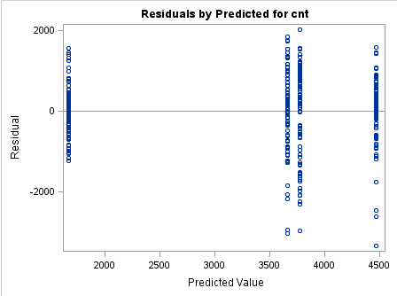
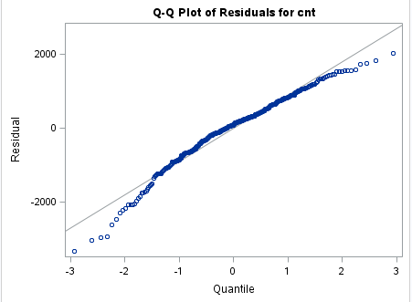

Regression Modeling 3. season vs bike rental count - validation of model using diagnostic plot and Levene’s test
But model didn’t fail to reject null hypothesis in HOVTEST/Levene’s test of variance equality i.e variances are not equally distributed as p-value is less than 0.005
Residuals are estimates of error term. It’s showing random pattern of residuals above and below 0 which states that error terms have equal variances.
QQ plot is showing normal distribution of residuals as all points are around ref. line.
22

Slide 23
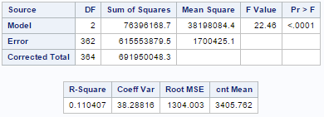
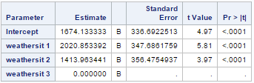

Regression Modeling 4. weathersit vs bike rental count & validation of model using Levene’s test
F-value(22.46) of model is good and corresponding p-value is less than 0.05 which rejects the null hypothesis i.e mean of at least one weather group is significantly differs than others which depicts that over all model is significant. p-value of 2 groups is <0.05 i.e mean for weather 1 and 2 significantly differs from mean of weather 3 which is reference group. In below model, intercept is mean of reference group i.e weather 3 and estimate values of other groups are difference in the mean of that group and reference group. Also, clear/partly cloudy weather(weathersit 1) has high estimate value(β₁₌2020.85 ) compared to misty/broken cloudy weather(weathersit 2) which shows that max. bikes are rented in clear weather where as rainy weather(weathersit 3) has low count(mean=1674.13)
11% of variation(R-square=0.11) in rental count is explained in below regression model showing less influence. Model failed to reject null hypothesis in Levene’s test of variance equality(p-value is >0.05) i.e variances are equally distributed.
23

Slide 24
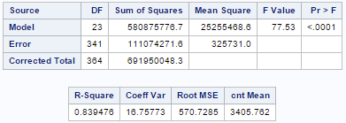
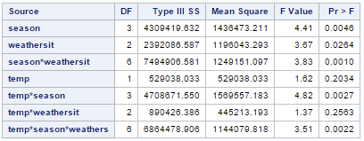
Regression Modeling 6. n-way ANCOVA with interaction
Overall season and temp factors have good influence on bike rental count as they explains 57% and 59% of variability resp. whereas weather explains bit low i.e 11% of variability in bike rental count.
From exploratory analysis, it’s clear that season has association with temperature and weather. So further, combined impact of season*temp*weather is checked and it shows 83%variability in rental count i.e these factors together have more influence on rental count and main effects in model are better explained by these factors i.e for every season, change in weather and temp have significant effect on change in rental count. Also, over all p-value and interaction term p-value is <0.05 which depicts that this model with interaction is statistically more significant.
24

Slide 25
Summary
Bike rental count is high(above 4K) when weather is clear /partly cloudy whereas it’s very low i.e below 2K in light rain/snow/thunderstorm.
Fall season has high bike rental count i.e avg. 4464.36 whereas Spring has very low bike rental count as Fall is less windy and has high temperature compared to other seasons(refer slide:15) and temperature has strong positive linear relationship with rental count (coefficient: 0.7) i.e count of bike rented at low temp is minimum, and high at moderate temp. Also, wind speed has weak negative correlation with rental count(coefficient : -0.2) i.e bikes are rented more in low wind.
Temperature, season, and weather individually have 59%,57% and 11% influence on variation in bike rental count resp.(as per 2011 data). Clear/partly cloudy weather has high estimate value(2020.85) compared to light rainy/snowy weather which shows that max. bikes are rented in clear weather.
Overall interaction of season*temp*weather shows 83% of variability in rental count i.e these variables together shows more influence on bike rental count change. It means for any season, if temperature fluctuates due to change in weather condition then accordingly bike rental count will change and that variation in count is more influenced by combined effect of these 3 factors rather than individual effect as these factors are correlated to each other.
25

Slide 26
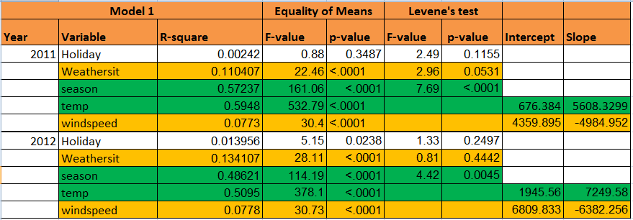
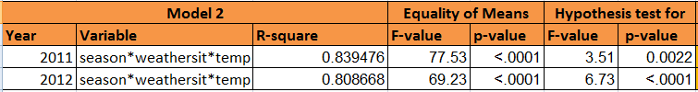
Summary
Weather and wind speed individually explains bit low variability in bike rental count. Holiday is not a significant predictor as p-value of model is >0.05 and also R-square value is 0.
But season, temperature and weather together have good influence on rental count.
26

Slide 27
Conclusion
Overall Fall has high bike rental count as people might prefer commuting via bikes due to suitable environmental conditions. Also, count in summer is good due to it’s moderate temperature.
But spring is comparatively windy and it has very low temperature due to thunderstorms/rain/snow which affects bike rental count as it’s hard to drive in such conditions.
This analysis can be further used to sense mobility in the city by predicting bike rental count against environmental changes.
27

