Slide 1

MSPM’S Deogiri Institute of Engineering and Management Studies, Aurangabad Department of Computer Science and Engineering Subject :Theory Of Computation Topic : DFA starts with string’aa’ Submitted by Sonali Nare(36139) Aditya Thombre(36140) Under the Guidance of Prof. Sarika Chavan Asst.Prof.Department of CSE TY-2 (Deogiri Institute Engineering and Management Studies) 2019-2020

Slide 2
Problem Statement
Write a program to build DFA that starts with ‘aa’ from input (a ,b).
Example –
I/P aabab
O/P YES
I/P ababa
O/P NO

Slide 3
Deterministic Finite Automaton (DFA)
In DFA, for each input symbol, one can determine the state to which the machine will move. Hence, it is called Deterministic Automaton. As it has a finite number of states, the machine is called Deterministic Finite Automaton.
Formal Definition of a DFA
A DFA can be represented by a 5-tuple (Q, ∑, δ, q₀, F) where − Q is a finite set of states. ∑ is a finite set of symbols called the alphabet. δ is the transition function where δ: Q × ∑ → Q q₀ is the initial state from where any input is processed (q₀ ∈ Q). F is a set of final state/states of Q (F ⊆ Q).

Slide 4
Graphical Representation of a DFA
A DFA is represented by digraphs called state diagram. The vertices represent the states. The arcs labelled with an input alphabet show the transitions. The initial state is denoted by an empty single incoming arc. The final state is indicated by double circles.

Slide 5
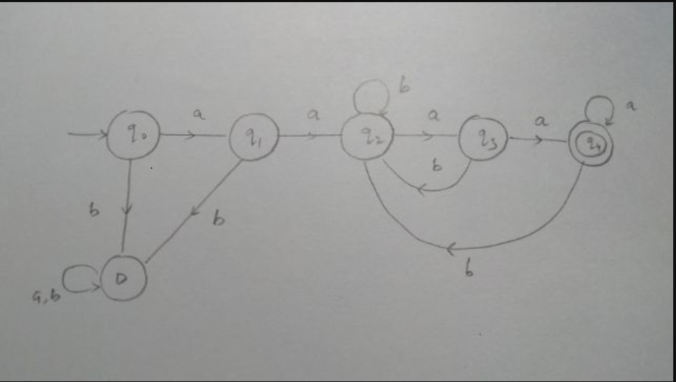

Slide 6
#include <stdio.h>
#include <string.h>
int dfa = 0;
int count=0;
void start(char c){
if (c == 'a') {
dfa = 1;
count++;}
else if (c == 'b') {
dfa = 3; }
else {
dfa = -1;}}
void state1(char c){
if (c == 'a') {
printf("q1->");
dfa = 2;
count++;}
else if (c == 'b') {
printf("q4->");
dfa = 4;}
else {
dfa = -1;}}
void state2(char c){
if (c == 'b') {
printf("q3->");
dfa = 3; }
else if (c == 'a') {
printf("q1->");
dfa = 1;}
else {
dfa = -1;}}
void state3(char c){
if (c == 'b') {
printf("q3->");
dfa = 3; }
else if (c == 'a') {
printf("q4");
dfa = 4;}
else {
dfa = -1;}}
void state4(char c){
dfa = -1;}
nt isAccepted(char str[]){
int i, len = strlen(str);
for (i = 0; i < len; i++) {
if (dfa == 0)
start(str[i]);
else if (dfa == 1)
state1(str[i]);
else if (dfa == 2)
state2(str[i]);
else if (dfa == 3)
state3(str[i]);
else if (dfa == 4)
state4(str[i]);
else
return 0; }
if (count==2)
return 1;
else
return 0;}
void main(){
char str[10];
clrscr();
printf("enter string");
gets(str);
if (isAccepted(str))
printf("ACCEPTED");
else
printf("NOT ACCEPTED");
getch();}

Slide 7

Output

Slide 8
Application
In almost all compliers DFA understanding is required.
It is used in language processing system.
Text processors also apply the DFA basic.
It in applied is speech processing system.

Slide 9
Conclusion
Else, We have implemented DFA starting with string ‘aa’ using c programming language.

Slide 10
THANK YOU !!

