Slide 1
AWS VPC
This document and all its contents contain information from Cybage Software Private Limited which may be privileged, confidential, or otherwise protected from disclosure. The information is intended to be for the addressee(s) only. Any unauthorized disclosure, copy, distribution, or use of the contents of this message is strictly prohibited.

Slide 2
VPC characteristics
What is VPC?
VPC elements
VPC security
Default vpc and default subnet
Non default subnet

Slide 3
CIDR block
10.0.0.0/24
32-24=8
2^8=256 ip addresses
When you create a VPC, we recommend that you specify a CIDR block (of /16 or smaller) from the private IPv4 address ranges :
10.0.0.0 - 10.255.255.255 (10/8 prefix)
172.16.0.0 - 172.31.255.255 (172.16/12 prefix)
192.168.0.0 - 192.168.255.255 (192.168/16 prefix)
You can create a VPC with a publicly routable CIDR block that falls outside of the private IPv4 address ranges specified in RFC 1918; however, for the purposes of this documentation, we refer to private IP addresses as the IPv4 addresses that are within the CIDR range of your VPC.

Slide 4
IP addressing
Private ipv4 addresses
Public ipv4 addresses
Ipv6 addresses
Modifying subnet’s public ip address

Slide 5
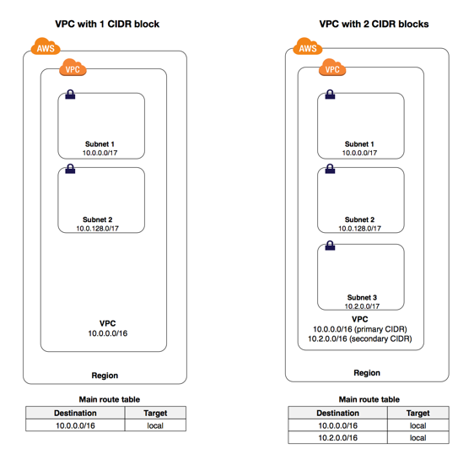
ROUTING

Slide 6
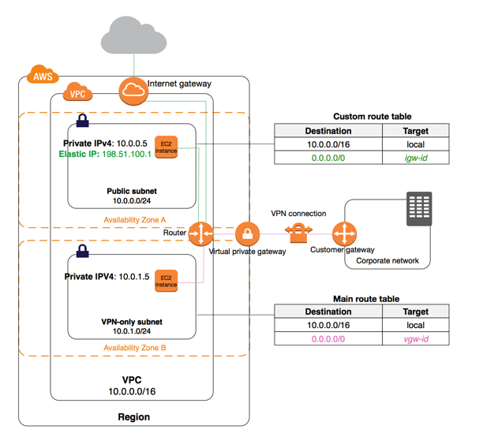

Slide 7
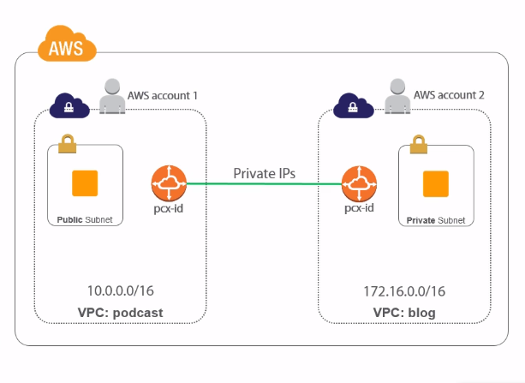
VPC PEERING

Slide 8
VPC benefits
Ability to launch instances
Custom cidr
Custom routes between subnets
Configure internet gateway for internet access to resources
Connection to outside corporate network using vpn
Layered security

Slide 10
Thank You!

