Slide 1
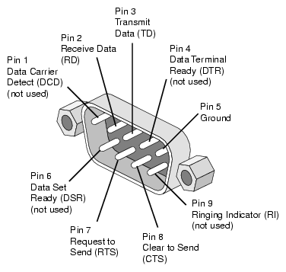
EECS 373
Design of Microprocessor-Based Systems
Prabal Dutta
University of Michigan
Serial buses
Some material from: Brehob, Le, Ramadas, Tikhonov & Mahal

Slide 2
This Week: Serial interfaces
traps &
exceptions
C
Assembly
Machine Code
EECS 370
CPU
Software
Hardware
ldr (read)
str (write)
ISA
SVC#
fault
INT#
interrupts
System Buses
AHB/APB
Interrupts
GPIO/INT
Timers
USART
DAC/ADC
Internal &
External
Memory
Internal
External
Input
I2C
SPI
ADC
DAC
EMC
Output
Capture
UART
Interrupt
Compare

Slide 3
Outline
Introduction to Serial Buses
UART
SPI
I2C

Slide 4
Serial bus interface motivations
Motivation
  Connect different systems together
    Two embedded systems
    A desktop and an embedded system
  Connect different chips together in the same embedded system
    MCU to peripheral
    MCU to MCU
  Without using a lot of I/O lines
    I/O lines require I/O pads which cost $$$ and size
    I/O lines require PCB area which costs $$$ and size
  Often at relatively low data rates
  But sometimes at higher data rates
So, what are our options?
  Universal Synchronous/Asynchronous Receiver Transmitter
  Also known as USART (pronounced: “you-zart”)

Slide 5
Serial bus design space
Number of wires required?
Asynchronous or synchronous?
How fast can it transfer data?
Can it support more than two endpoints?
Can it support more than one master (i.e. txn initiator)?
How do we support flow control?
How does it handle errors/noise?

Slide 6
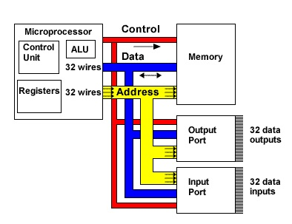
Fun with buses
A multidrop bus (MDB) is a computer bus in which all components are connected to the same set of electrical wires. (from Wikipedia)
  In the general case, a bus may have more than one device capable of driving it.
    That is, it may be a “multi-master” bus as discussed earlier.
Notes:
Figure from http://tek-electronics.blogspot.com/

Slide 7
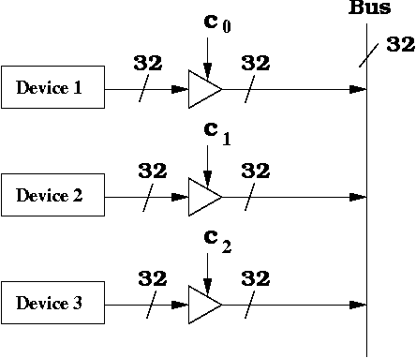
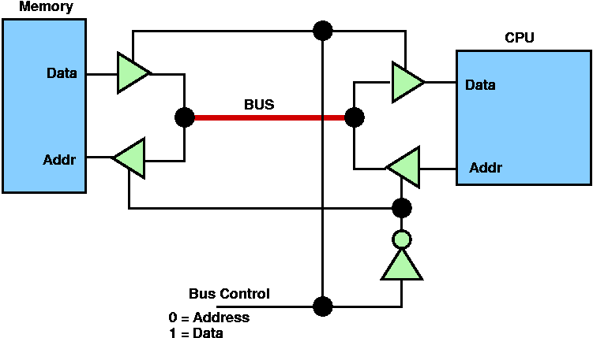
How can we handle multiple (potential) bus drivers?
(1/3)
Tri-state devices, just have
one device drive at a time.
Everyone can read though
  Pros:
    Very common, fairly fast, pin-
    efficient.
  Cons:
    Tri-state devices can be slow.
      Especially drive-to-tristate?
    Need to be sure two folks not driving at the same time
      Let out the magic smoke.
  Most common solution (at least historically)
    Ethernet, PCI, etc.
Notes:
Image from http://www.cs.umd.edu/class/sum2003/cmsc311/Notes/CompOrg/tristate.html

Slide 8
How can we handle multiple (potential) bus drivers?
(2/3)
MUX
  Just have each device generate its data, and have a MUX select.
    That’s a LOT of pins.
      Consider a 32-bit bus with 6 potential drivers.
        Draw the figure.
        How many pins needed for the MUX?
  Not generally realistic for an “on-PCB” design as we’ll need an extra device (or a lot of pins on one device)
    But reasonable on-chip
      In fact AHB, APB do this.

Slide 9
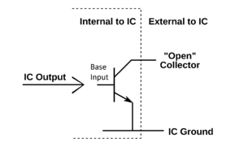
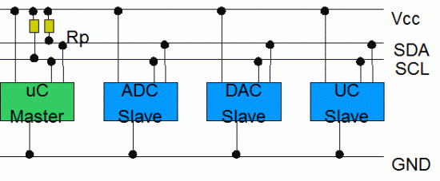
How can we handle multiple (potential) bus drivers?
(3/3)
“pull-up” aka “open collector” aka “wired OR”
  Wire is pulled high by a resistor
  If any device pulls the wire low, it goes low.
Pros:
  If two devices both drive the bus, it still works!
Cons:
  Rise-time is very slow.
  Constant power drain.
Used in I2C, CAN

Slide 10
Outline
Introduction to Serial Buses
UART
SPI
I2C

Slide 11
UART
Universal Asynchronous Receiver/Transmitter
Hardware that translates between parallel and serial forms
Commonly used in conjunction with communication standards such as EIA, RS-232, RS-422 or RS-485
The universal designation indicates that the data format and transmission speeds are configurable and that the actual electric signaling levels and methods (such as differential signaling etc.) typically are handled by a special driver circuit external to the UART.
Most of the UART stuff (including images) Taken from Wikipedia!

Slide 12

Protocol
Each character is sent as
  a logic low start bit
  a configurable number of data bits (usually 7 or 8, sometimes 5)
  an optional parity bit
  one or more logic high stop bits
  with a particular bit timing (“baud”)
Examples
  “9600-N-8-1” → <baudrate><parity><databits><stopbits>
  “9600-8-N-1” → <baudrate><databits><parity><stopbits>

Slide 13
Variations and fun times
UART is actually a generic term that includes a large number of different devices/standards.
  RS-232 is a standard that specifies
    “electrical characteristics and timing of signals, the meaning of signals, and the physical size and pin out of connectors.

Slide 14
Signals (only most common)
The RXD signal of a UART is the signal receiving the data. This will be an input and is usually connected to the TXD line of the downstream device.
The TXD signal of a UART is the signal transmitting the data. This will be an output and is usually connected to the RXD line of the downstream device.
The RTS# (Ready to Send) signal of a UART is used to indicate to the downstream device that the device is ready to receive data. This will be an output and is usually connected to the CTS# line of the downstream device.
The CTS# (Clear to Send) signal of a UART is used by the downstream device to identify that it is OK to transmit data to the upsteam device. This will be an input and is usually connected to the RTS# line of the upstream device.

Slide 15
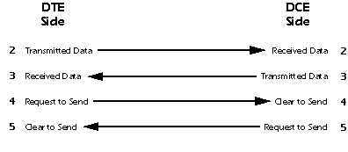
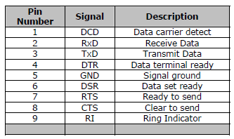
DB9 stuff
DTE vs DCE
Pinout of a DCE?
Common ground?
Noise effects?
Wiring a DTE device to a DCE device for communication is easy.
The pins are a one-to-one connection, meaning all wires go from pin x to pin x.
A straight through cable is commonly used for this application.
In contrast, wiring two DTE devices together requires crossing the transmit and receive wires.
This cable is known as a null modem or crossover cable.

Slide 16
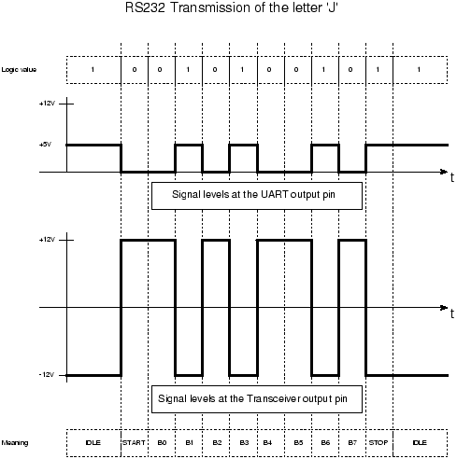
RS-232 transmission example

Slide 17
Discussion Questions
How fast can we run a UART?
What are the limitations?
Why do we need start/stop bits?
How many data bits can be sent?
  9600-8-N-1 is ok. Is 9600-8192-N-1 ok too?

Slide 18
Outline
Introduction to Serial Buses
UART
SPI
I2C

Slide 19
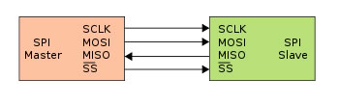
Introduction
What is it?
Basic Serial Peripheral Interface (SPI)‏
Capabilities
Protocol
Pro / Cons and Competitor
Uses
Conclusion
Serial Peripheral Interface
http://upload.wikimedia.org/wikipedia/commons/thumb/e/ed/
SPI_single_slave.svg/350px-SPI_single_slave.svg.png

Slide 20
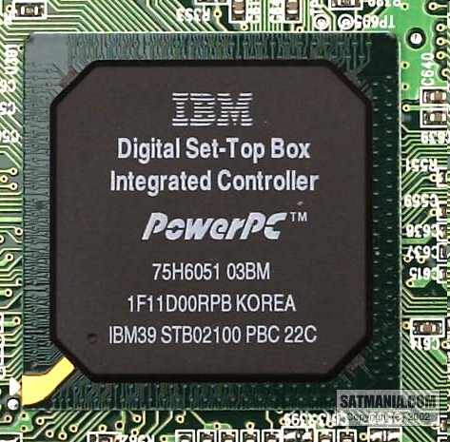
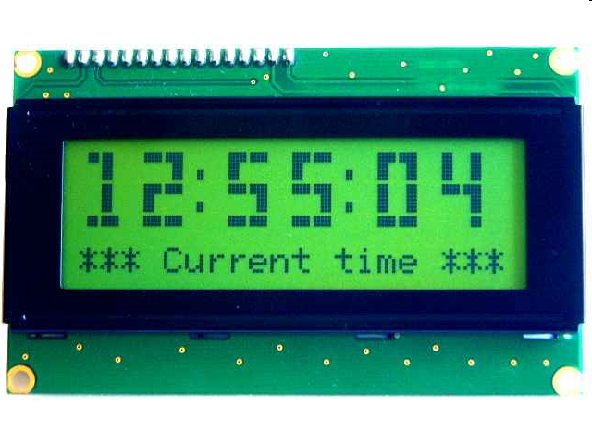
What is SPI?
Serial Bus protocol
Fast, Easy to use, Simple
Everyone supports it

Slide 21
SPI Basics
A communication protocol using 4 wires
  Also known as a 4 wire bus
Used to communicate across small distances
Multiple Slaves, Single Master
Synchronized

Slide 22
Capabilities of SPI
Always Full Duplex
  Communicating in two directions at the same time
  Transmission need not be meaningful
Multiple Mbps transmission speed
Transfers data in 4 to 16 bit characters
Multiple slaves
  Daisy-chaining possible

Slide 23
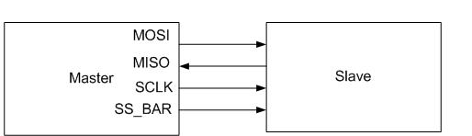
Protocol
Wires:
  Master Out Slave In (MOSI)‏
  Master In Slave Out (MISO)‏
  System Clock (SCLK)‏
  Slave Select 1…N
Master Set Slave Select low
Master Generates Clock
Shift registers shift in and out data

Slide 24
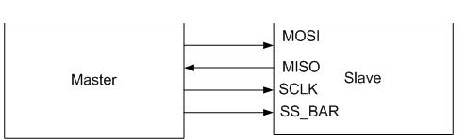
Wires in Detail
MOSI – Carries data out of Master to Slave
MISO – Carries data from Slave to Master
  Both signals happen for every transmission
SS_BAR – Unique line to select a slave
SCLK – Master produced clock to synchronize data transfer

Slide 25
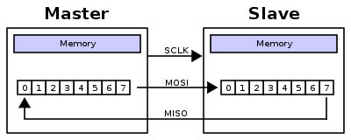
Shifting Protocol
Master shifts out data to Slave, and shift in data from Slave
http://upload.wikimedia.org/wikipedia/commons/thumb/b/bb/SPI_8-bit_circular_transfer.svg/400px-SPI_8-bit_circular_transfer.svg.png

Slide 26
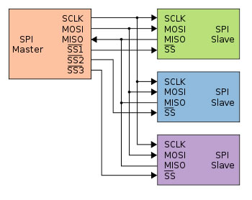
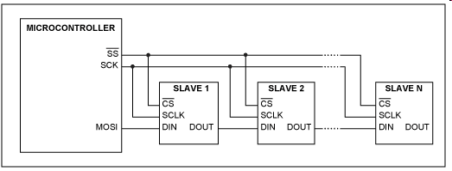
Diagram
Some wires have been renamed
Master and multiple daisy-chained slaves
http://www.maxim-ic.com/appnotes.cfm/an_pk/3947
Master and multiple independent slaves
http://upload.wikimedia.org/wikipedia/commons/thumb/f/fc/SPI_three_slaves.svg/350px-SPI_three_slaves.svg.png

Slide 27
Clock Phase (Advanced)‏
Two phases and two polarities of clock
Four modes
Master and selected slave must be in same mode
Master must change polarity and phase to communicate with slaves of different numbers

Slide 28
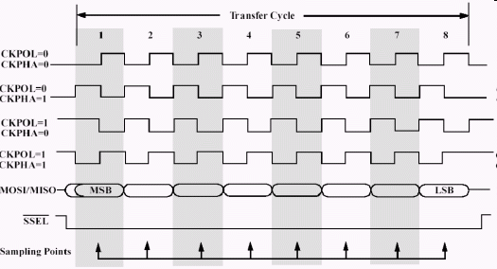
Timing Diagram
Timing Diagram – Showing Clock polarities and phases
http://www.maxim-ic.com.cn/images/appnotes/3078/3078Fig02.gif

Slide 29
Pros and Cons
Pros:
Fast and easy
  Fast for point-to-point connections
  Easily allows streaming/Constant data inflow
  No addressing/Simple to implement
Everyone supports it
Cons:
SS makes multiple slaves very complicated
No acknowledgement ability
No inherent arbitration
No flow control

Slide 30
Uses
Some Serial Encoders/Decoders, Converters, Serial LCDs, Sensors, etc.
Pre-SPI serial devices

Slide 31
Summary
SPI – 4 wire serial bus protocol
  MOSI MISO SS SCLK wires
Full duplex
Multiple slaves, One master
Best for point-to-point streaming data
Easily Supported

Slide 32
Outline
Introduction to Serial Buses
UART
SPI
I2C

Slide 33
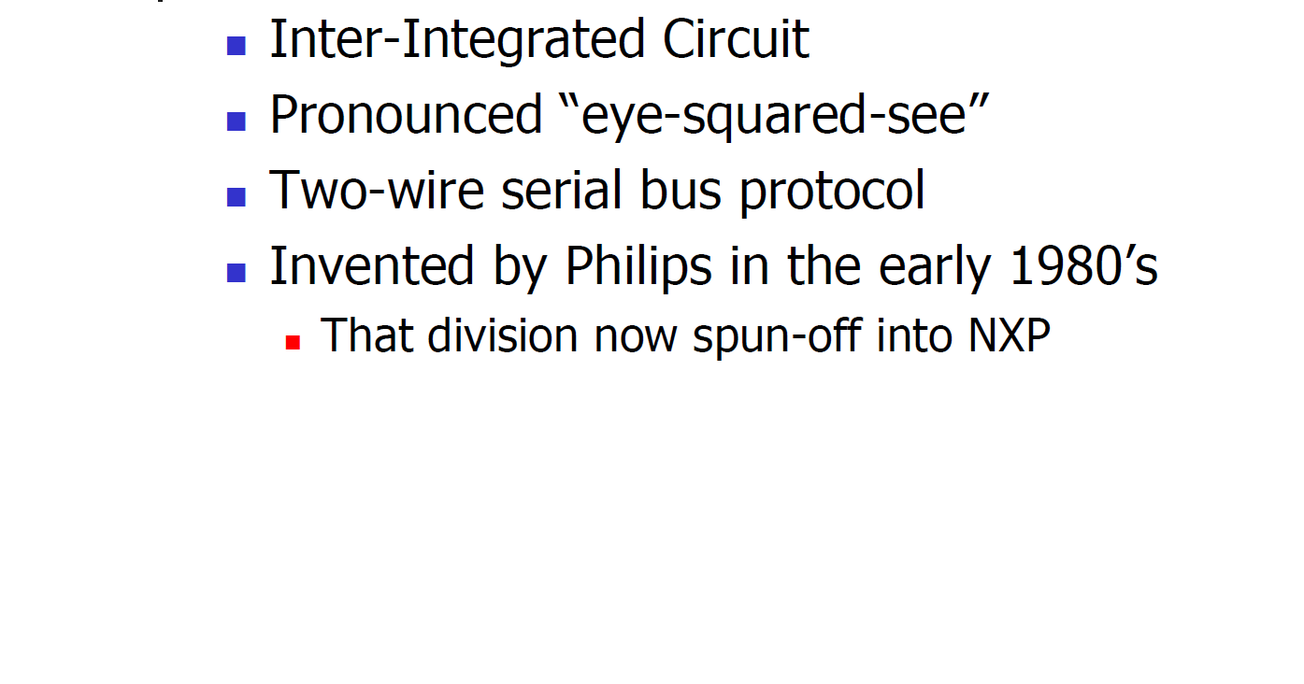
What is I²C (or I2C)?

Slide 34
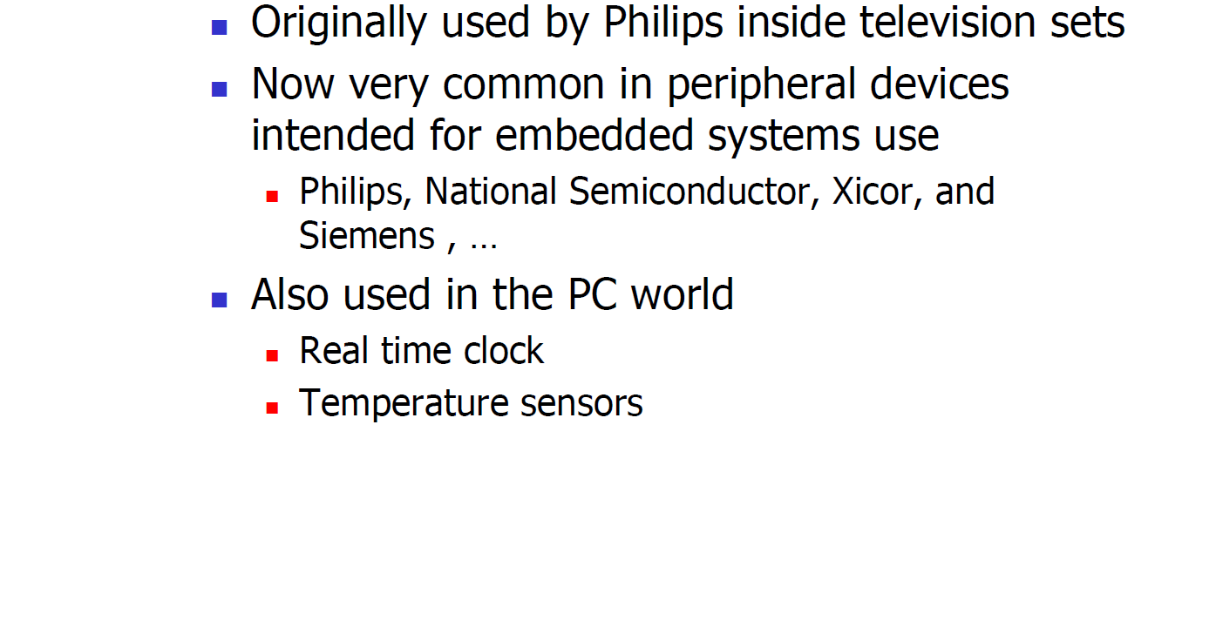
Where is it Used?

Slide 35
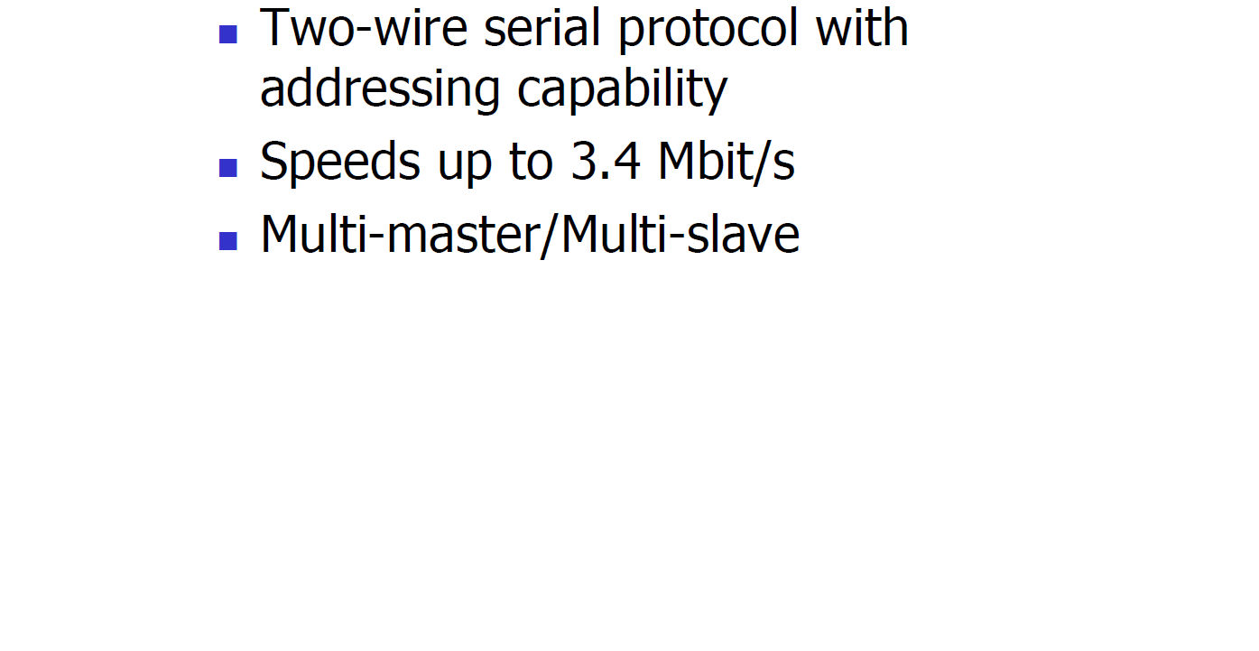
Basic Description

Slide 36
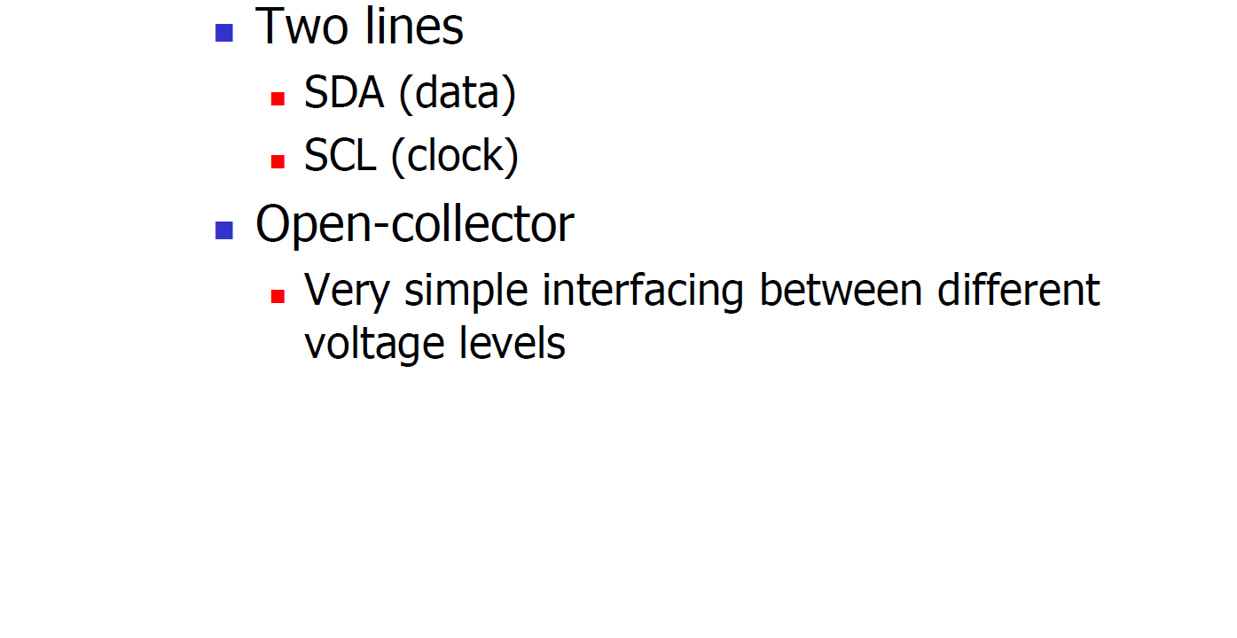
Electrical Wiring

Slide 37
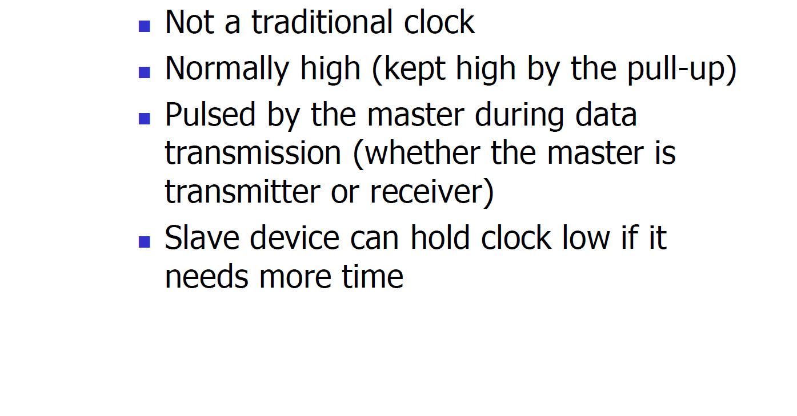
Clock

Slide 38
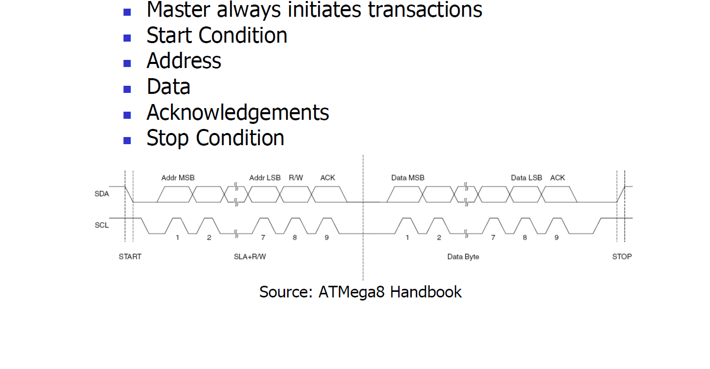
A Basic I2C Transaction

Slide 39
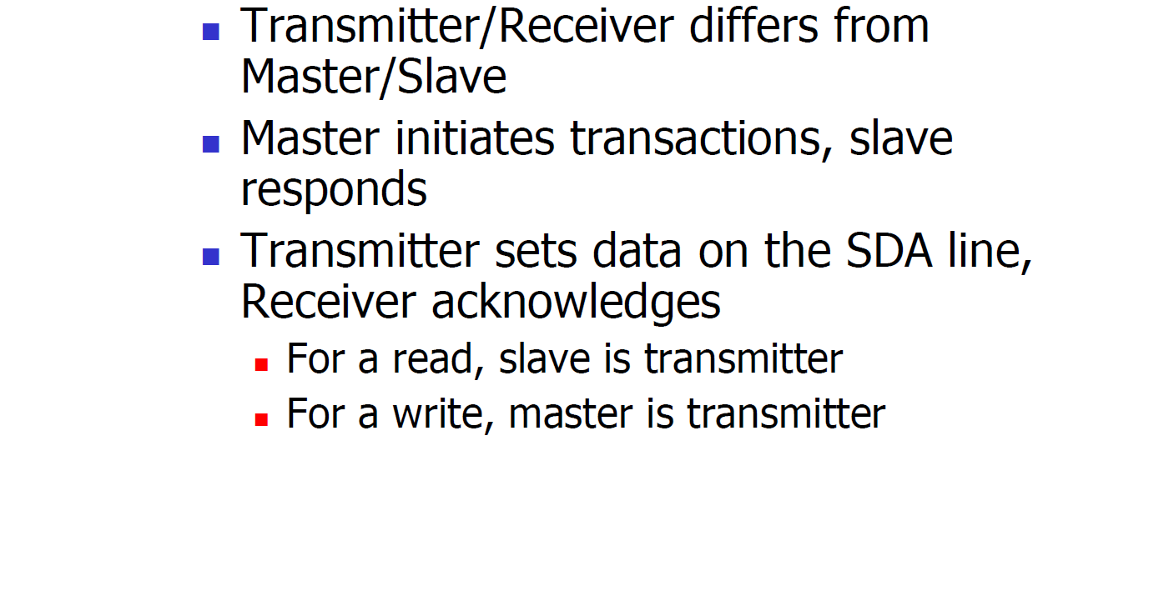
A Basic I2C Transaction

Slide 40
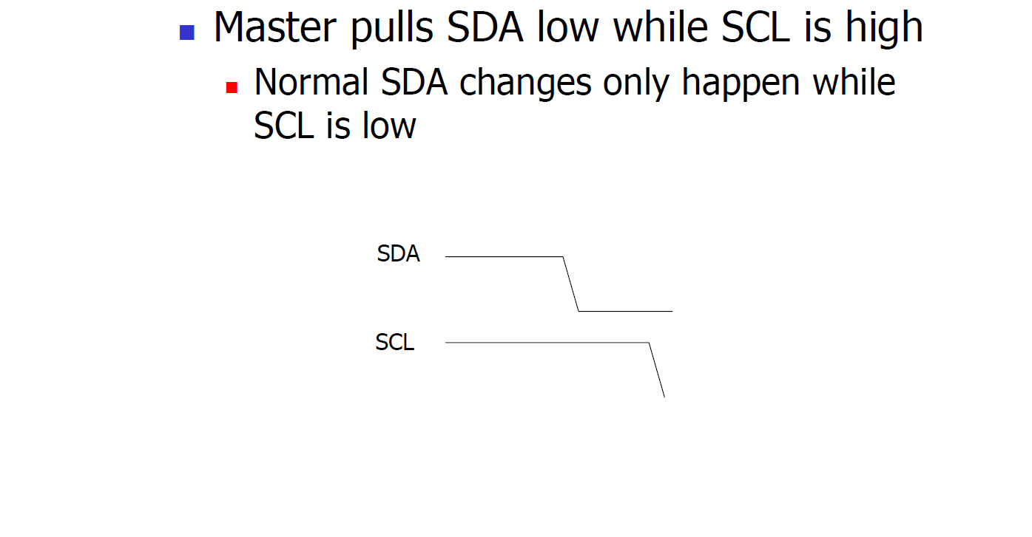
Start Condition

Slide 41
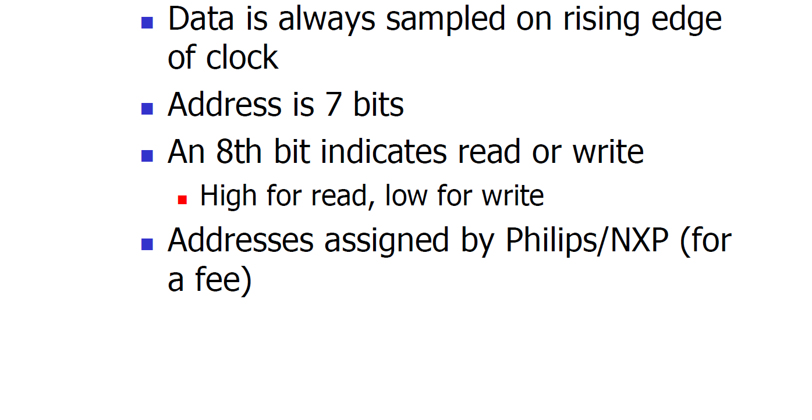
Address Transmission

Slide 42
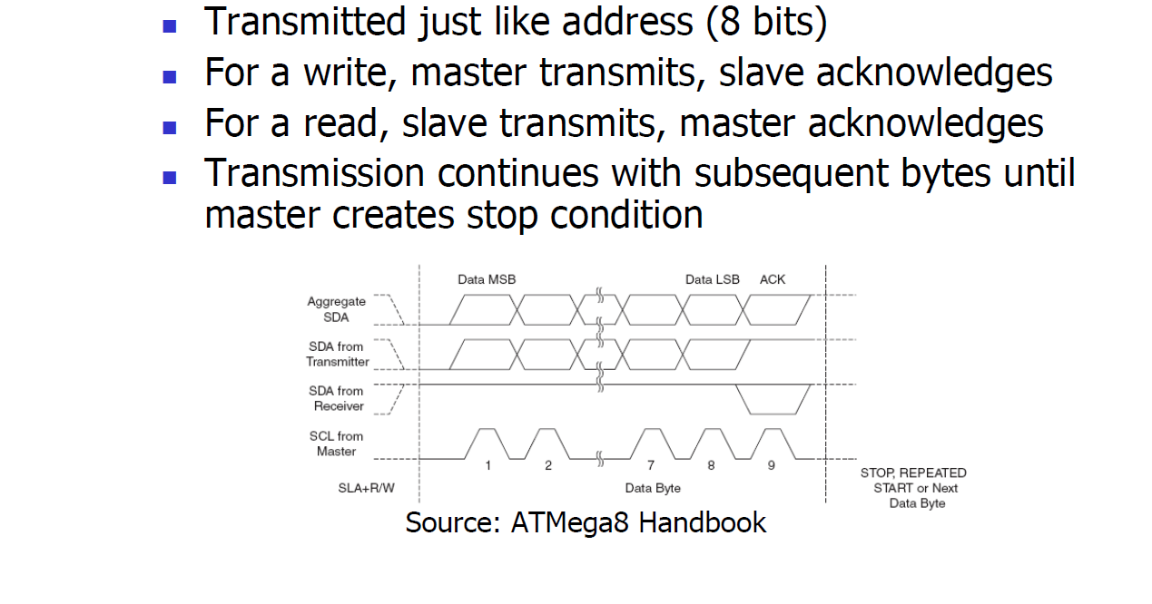
Data transmission

Slide 43
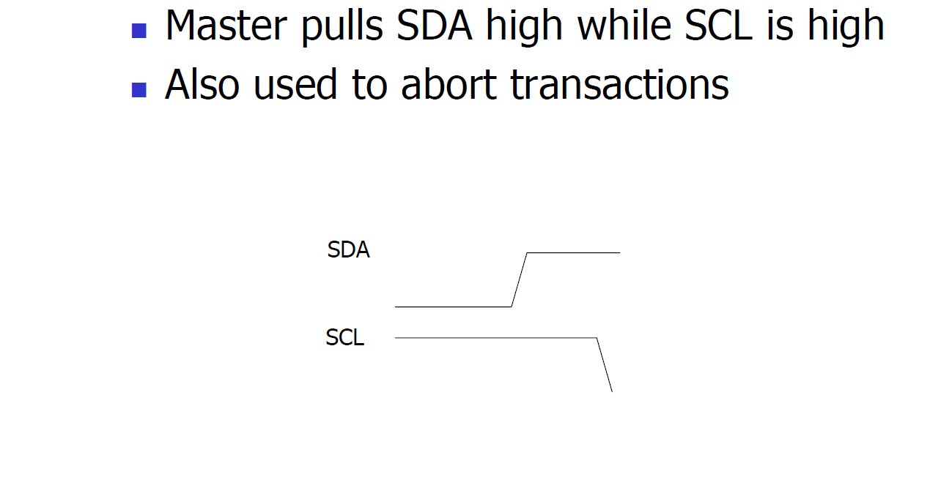
Stop Condition

Slide 44
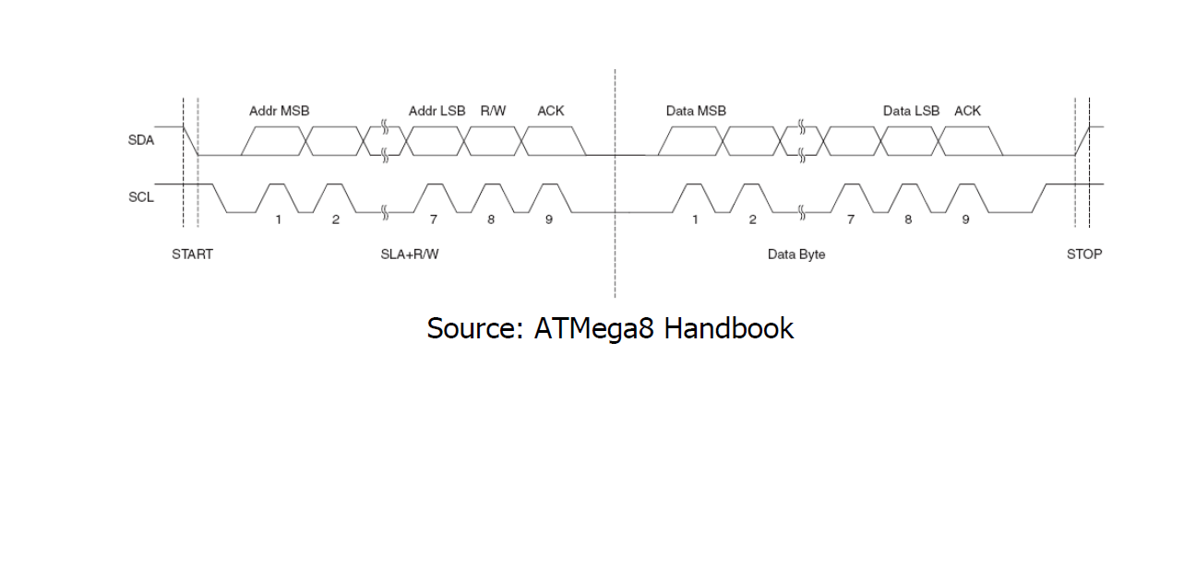
Another look at I2C

Slide 45
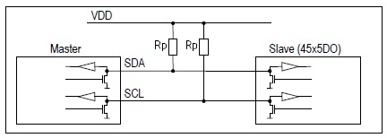
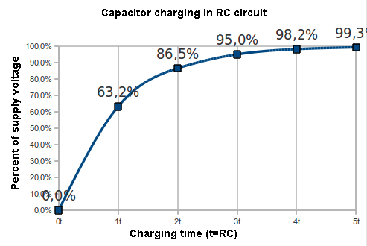
Exercise: How fast can I2C run?
How fast can you run it?
Assumptions
  0’s are driven
  1’s are “pulled up”
Some working figures
  R_{p} = 10 kΩ
  C_{cap} = 100 pF
  V_{DD} = 5 V
  V_{in_high} = 3.5 V
Recall for RC circuit
  V_{cap}(t) = V_{DD}(1-e^{-t/τ})
  Where τ = RC

Slide 46
Exercise: Bus bit rate vs Useful data rate
An I2C “transactions” involves the following bits
  <S><A6:A0><R/W><A><D7:D0><A><F>
Which of these actually carries useful data?
  <S><A6:A0><R/W><A><D7:D0><A><F>
So, if a bus runs at 400 kHz
  What is the clock period?
  What is the data throughput (i.e. data-bits/second)?
  What is the bus “efficiency”?

