Slide 1
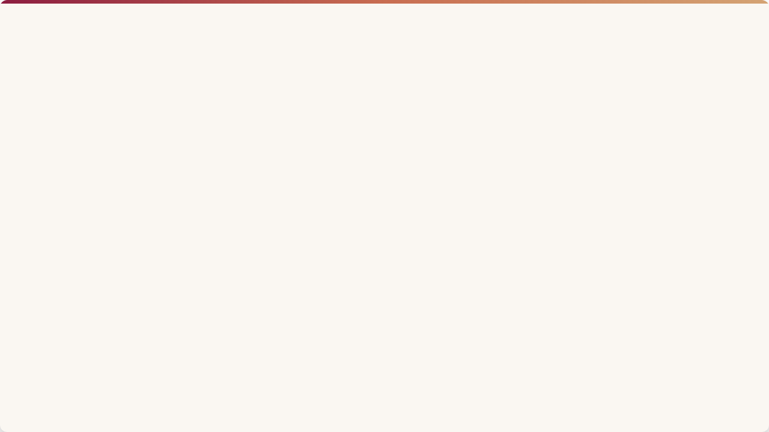

FROM CONTENT PRESENCE TO PLATFORM ADVANTAGE
MARS Cosmetics already has an active multi-platform presence.
INSTAGRAM
BUILD BRAND MEMORY
YOUTUBE
BUILD BEAUTY AUTHORITY
THE OPPORTUNITY:
Give each platform a distinct strategic role.
FACEBOOK
DRIVE CONSIDERATION
One brand. Four distinct platform advantages.
LINKEDIN
BUILD CREDIBILITY
Prepared by Sonali
MBA | Fortune Institute of International Business, New Delhi

Slide 2
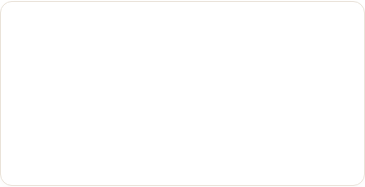
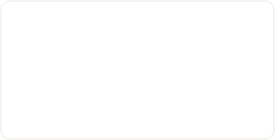

MAKE MARS MORE DISTINCTIVE ON INSTAGRAM
01 | Distinctive Brand Codes
02 | MARS-Owned Content Experiences
03 | Unlock Portfolio-Led Content
Create consistent visual, verbal and storytelling cues that make MARS recognisable before the logo appears.
Use the breadth of the MARS portfolio to create solution-led and cross-product discovery.
Develop original, repeatable content territories that MARS can own rather than simply participate in trends.
BUSINESS IMPACT:
Brand recall | Differentiation | Cross-product discovery

Slide 3
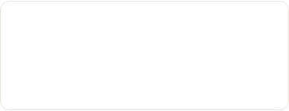
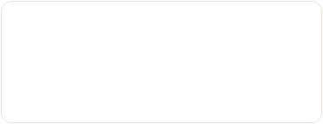
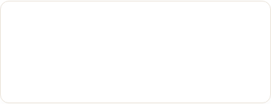
OWN BEAUTY SEARCH
01 | Search-Led Beauty Content
02 | Evergreen Content Library
03 | Strengthen Signature Formats
Build around high-intent beauty questions and problems.
Create tutorials, comparisons and how-to content with long-term discovery value.
Develop existing formats into recognisable MARS YouTube properties.
BUSINESS IMPACT:
Evergreen discovery | Beauty authority | Longer content shelf life

Slide 4
MAKE FACEBOOK THE BEAUTY DECISION HUB
01 | Product & Shade Guidance
02 | Consumer Decision Content
03 | Everyday Beauty Utility
Help consumers evaluate products, shades and use cases.
Use comparisons, FAQs and real consumer questions to support consideration.
Build practical content around routines, occasions and real-life beauty needs.
BUSINESS IMPACT:
Consideration | Product confidence | Purchase intent

Slide 5
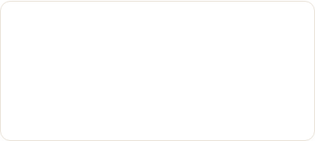
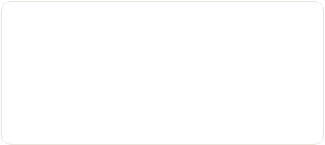

TURN BRAND ACTIVITY INTO BRAND CREDIBILITY
01 | Show the Thinking Behind MARS
02 | Build the People Story
03 | Extend Campaigns into Case Studies
Campaign insights, creative decisions and marketing learnings.
Employee journeys, culture and teams behind the brand.
Challenge → Insight → Idea → Execution → Learning
BUSINESS IMPACT:
Employer brand | Industry authority | Corporate credibility

Slide 6
ONE BRAND. FOUR DISTINCT PLATFORM ROLES.
Platform | Role | Core Focus
Instagram | BUILD BRAND MEMORY | Culture • Creators • Distinctiveness
YouTube | BUILD BEAUTY AUTHORITY | Search • Education • Expertise
Facebook | DRIVE CONSIDERATION | Utility • Decisions • Community
LinkedIn | BUILD CREDIBILITY | People • Thinking • Industry
STRATEGIC SHIFT
FROM CONTENT DISTRIBUTION → TO PLATFORM-LED BRAND BUILDING

