Slide 1

Movie Industry Trend
EDA

Slide 2
Problem Statement
In a world... where movies made an estimated $41.7 billion in 2018, the film industry is more popular than ever. Find out the movie industry trends based below points.
Highest Revenue of movie with respect to genre
Popular subject
Rating and meta score of movies based on subject
Directors and revenue

Slide 3
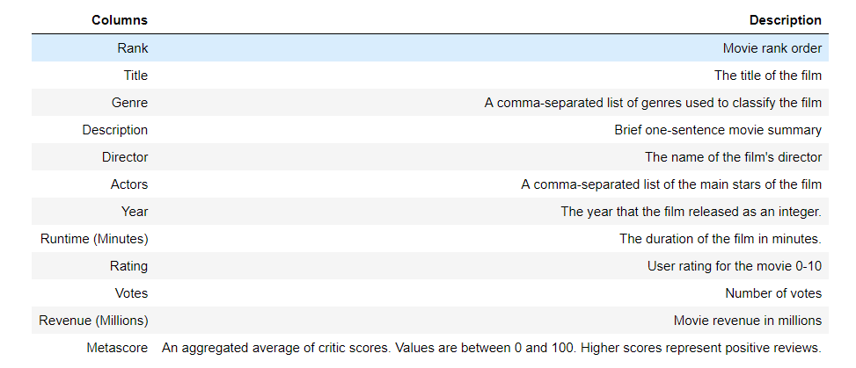
DATA IN DEPTH
The data dictionary describing the different columns in the dataset.

Slide 4
DATA IN DEPT (…)
There are a total of 1000 samples (rows) and 12 columns in the data frame.
There are 4 columns with a numeric data type , 3 columns with float data type and 5 columns with an object data type.
There are 128 missing values in the Revenue data and 64 missing values in Meta score data. Missing value in % are Revenue - 13% (High) , Meta score - (6%)
Filled missing values in columns:
Revenue – by Median Revenue
Meta score – Dropped rows with missing values.
After cleaning: 936 rows and 12 columns
There is no incorrect datatypes.
The relationship of Genre, Director, Runtime of movies against Revenue, Rating and Meta score could provide significant insights.

Slide 5
WHAT DID I DO ?
Examined the dataset
Cleaned up the dataset
Came up with several questions to find out the relationship of Genre, Director and Runtime of movies against Revenue, Rating and Meta score.
Explored the dataset based on the questions using descriptive statistics and visualization.
Drew conclusions from the exploration.
Found out actionable insights from conclusion.

Slide 6
WHAT DID I DO ? (Explore data)
Explored the impact of Director on a movie’s Revenue, Rating and Meta score.
Analyzed movie’s Revenue, Rating and Meta score against these categories.
Explored the effect of Genre count on a movie’s Revenue, Rating and Meta score.
Explored the effect of Genre combination on a movie’s Revenue, Rating and Meta score.
Analyzed the growth of movie industry over the 10 year period in terms of Revenue and Rating.
Explored the correlation between Revenue, Rating and Meta score.

Slide 7
EXPLORATION AND CONCLUSION

Slide 8
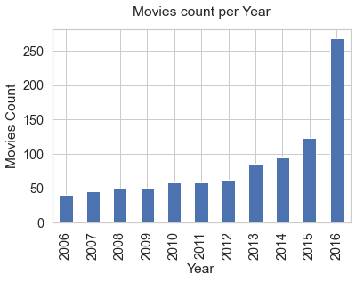
INDUSTRY GROWTH Y-ON-Y V/s MOVIE COUNT
Growing with respect to number of movies released.

Slide 9
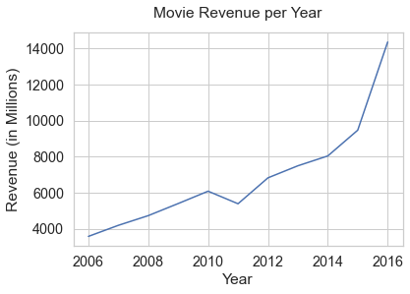
INDUSTRY GROWTH Y-ON-Y V/s TOTAL REVENUE
Growing in terms of Total Revenue per year

Slide 10
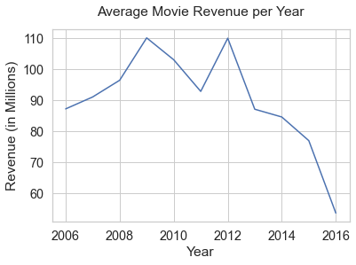
INDUSTRY GROWTH Y-ON-Y V/S AVERAGE REVENUE
Trend decreased year by year.
Competition is increased and more movies are released per year
Total revenue gets distributed among many movies.

Slide 11
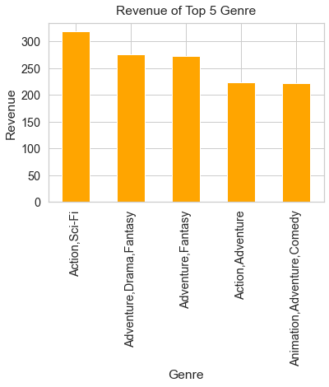
GENRE COMBINATION vs REVENUE
Following 5 genre has earned highest revenue
Action, Sci-Fi
Adventure, Drama, Fantasy
Adventure, Fantasy
Action, Adventure
Animation, Adventure, Comedy
Adventure features more in the top 5

Slide 12
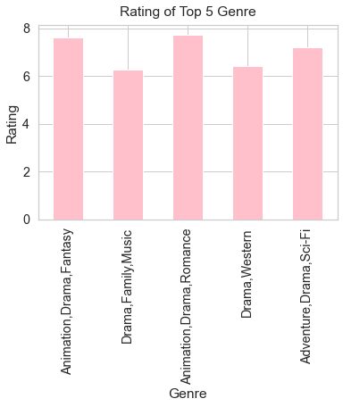
GENRE COMBINATION VS RATING
Following 5 genre has highest average rating
Animation, Drama, Fantasy
Drama, Family, Music
Animation, Drama, Romance
Drama, Western
Adventure, Drama, Sci-Fi
Drama is the most popular

Slide 13
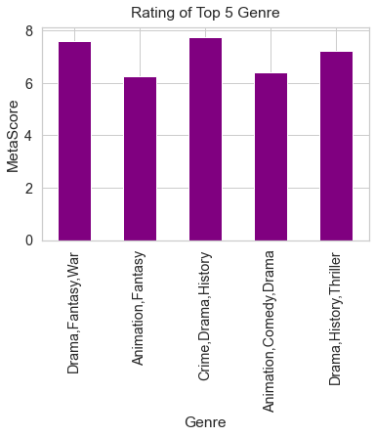
GENRE COMBINATION VS METASCORE
Following 5 genre and average met score
Drama, Fantasy, War
Animation, Fantasy
Crime, Drama, History
Animation, Comedy, Drama
Drama, History, Thriller
Drama is the most popular among critics

Slide 14
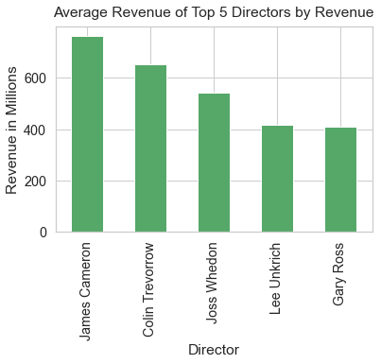
Director vs REVENUE
Following 5 Directors has earned highest revenue
James Cameron
Colin Trevorrow
Joss Whedon
Lee Unkrich
Gary Ross
James Cameron created Action, Adventure, Fantasy subject movie and has highest revenue

Slide 15
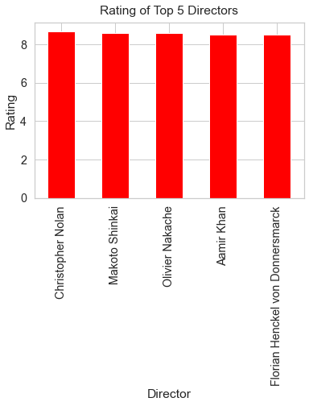
Director VS RATING
Following 5 Directors has highest average rating
Christopher Nolan
Makoto Shinkai
Olivier Nakache
Aamir Khan
Florian Henckel von Donnersmarck
Christopher Nolan created almost all types of movies like Action, adventures ,Sci-Fi, drama etc

Slide 16
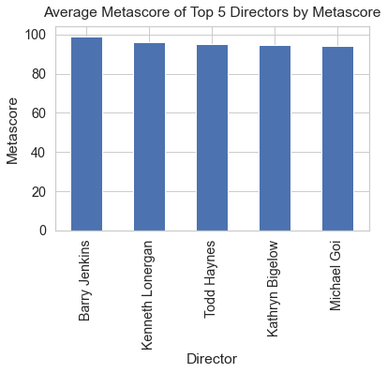
Director VS METASCORE
Following 5 Directors and average met score
Barry Jenkins
Kenneth Lonergan
Todd Haynes
Kathryn Bigelow
Michael Goi
Barry Jenkins has created Drama movie and has highest meta score

Slide 17
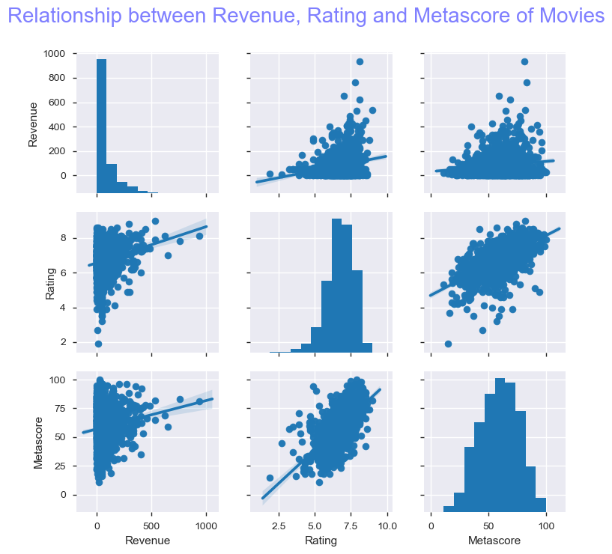
CORRELATION: REVENUE, RATING AND METASCORE
Rating and Meta score have strong correlation.
As the Rating increases, the Revenue also tend to increase
As the Meta score increases, the Revenue also tend to increase.
The users and Critics tend to agree with each other.

Slide 18
ACTIONABLE INSIGHTS

Slide 19
This is based on the conclusions drawn from the EDA done
Produce multiple movies with best features - The movie industry is growing very fast. More movies are released year on year and the competition is very high and the revenue is distributed among many movies. It would not be a good idea to wait for that ONE BIG MOVIE like Avatar (by James Cameron) that brings highest Revenue, Rating and Meta score. So, produce more movies using the best features (explained below) for reaping the maximum benefits.
Produce movies with 3 Genre combination - Include a mix of Drama, Animation, Adventure, Sci-Fi, Fantasy. The movies should relate to audience with real life incidents, should move them to the edge of the seats and should enhance their imagination.
Produce movies that will satisfy both People and Critics - These movies will earn higher Revenue more often than not

Slide 20
THANKS
sonali_s_s@rediffmail.com

